Slide 1
KIARA
DYNAMIC FAST BUFFERS

Slide 2
Introduction
Uncompleted C & C++ API for communication
Based on IDL parsing
Both User & Server must know data structure
Uses external modules (DFC, Boost, LLVM, etc.) as helpers

Slide 3
Internal Structure
Common: Interfaces for common use, like “Types.h” (definitions used by Boost)
Compiler: Files required for parser
Components: Useful files used in message sending
Core: Generic “.hpp” and “.cpp” files used by Kiara (Exception, GCObject, etc.)
IDL: Parser for IDL data (lexical and syntactic analyzer)
LLVM: LLVM files
Utils: Other files for paths and URL's support
Kiara code: C++ & C files that contain main Kiara code

Slide 4
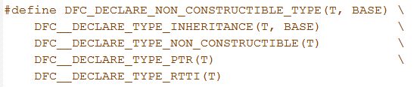
External modules (I)
DFC (Dmitri's Foundation Classes)
  Object Factory used for creating Typecode classes
  Generates the code of the classes
  Uses C++ macros
  Avoids unnecessary coding on user's side

Slide 5
External modules (II)
BOOST
  Allows internal errors and instantiation control
  Provides support for tasks such as multithreading and unit testings among others
LLVM
  Designed for compile-time, link-time and run-time
  Runtime codegeneration

Slide 6
Generating Typecode (I)
Kiara uses a Typecode for type definition
Maps abstract IDL types to the native data structures
Uses hierarchical namespaces
Provides support for declaration of:
  Primitive types
  Structures
  Functions
  Arrays
  Forward structures
  Pointers

Slide 7
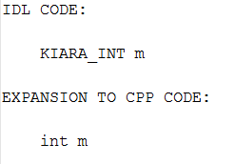
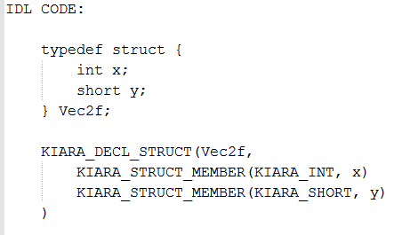
Generating Typecode (II)
Use of hierarchical C++ macros
Simple for primitive types
May be complex for non trivial data

Slide 8
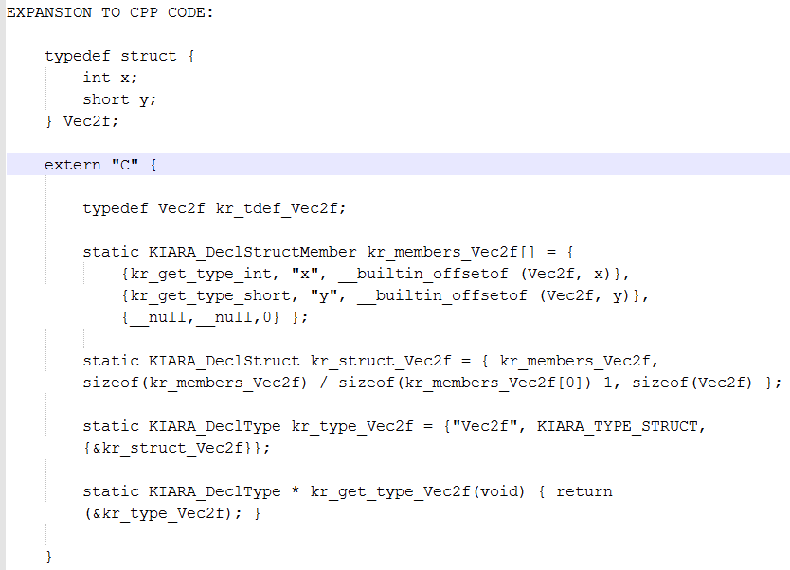
Generating Typecode (III)

Slide 9
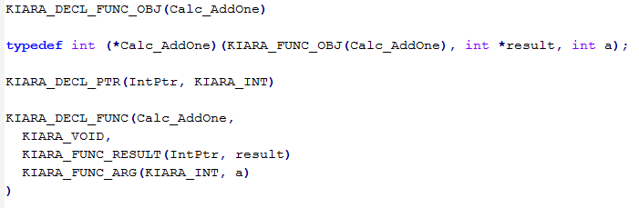
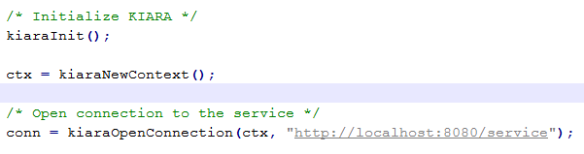
Example: RPC declaration and use (I)
IDL definition
Main code
  Kiara initialization and connection opening (at this point, Typecode classes are created)

Slide 10
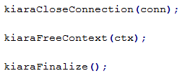
Example: RPC declaration and use (II)
Converting IDL data to native data
Calling remote procedure
Closing connection and finalizing Kiara

Slide 11
Dynamic Fast Buffers
C++ library
Main objective: Serialize the data defined by user
Based on:
  TypeCode definition
  Generation of Bytecode for a given TypeCode
  Automatic serialization of data
Three API's provided:
  Creation of data structures (simple types, structures, unions and functions). Typecode generation
  Bytecode generation
  Data serialization

Slide 12
Features
Simple Typecode
Data type independent serialization
Won't use C++ macros
Simple user API
Integrated with eProsima Fast Buffers
Could be integrated with Dmitri code

Slide 13
Prototype
Pros:
  Simple structure
  No need for macros
  Small amount of information in Typecode
  Doesn't use LLVM or other external modules (except Fast Buffers library)
  User doesn't need to know Bytecode structure neither

Slide 14
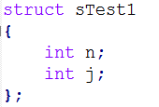
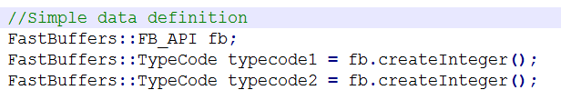
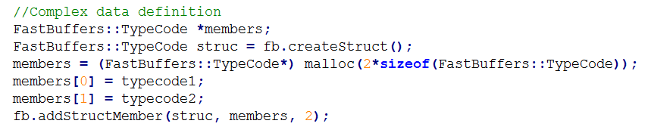
Overall sample (I)
Previous data definition:
Typecode generation:
  Simple data types
  Complex data types

Slide 15
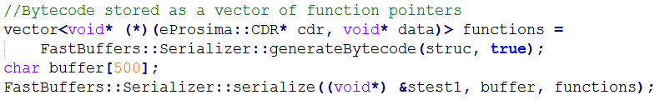
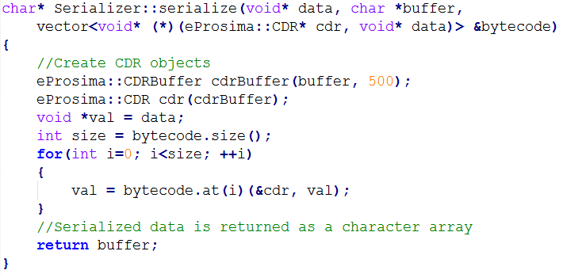
Overall sample (II)
Serialization using eProsima Fast Buffers:

Slide 16
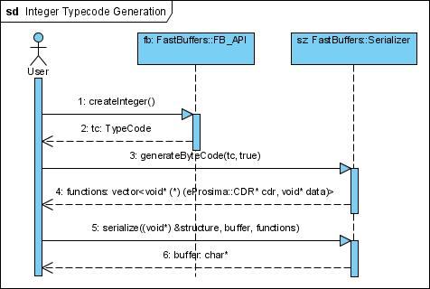
Simple sequence diagram
Diagram without low level details

Slide 17
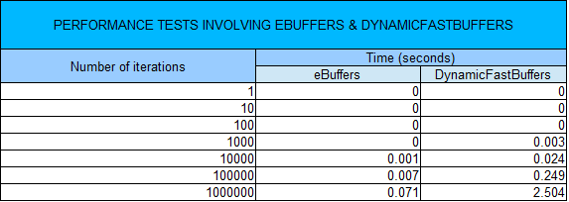
Performance tests

Slide 18
Thank you

