Slide 1

















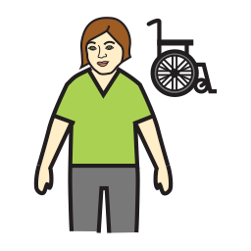
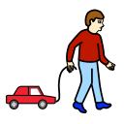







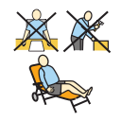














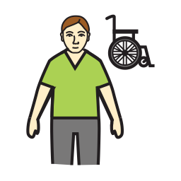
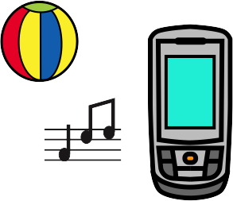






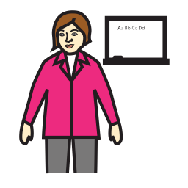














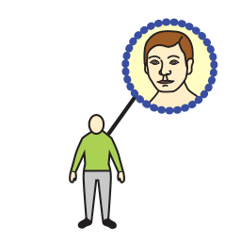
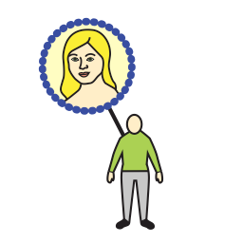






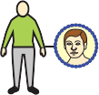
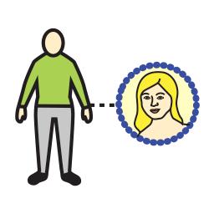















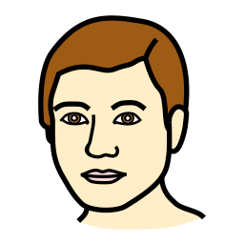





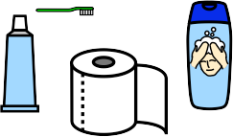









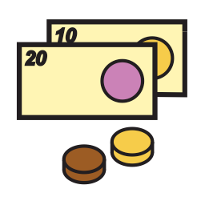








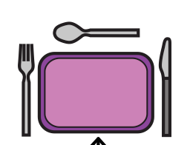
















Yes | like | hello | I want to talk to you | I’m fine | Ok | I love you | Happy birthday | I’m not so good | I don’t know
My name | I | my | I want | go outside | to call someone | to cook | want | help | get
I live in | you | mine | something else | watch | holiday | my turn | do | look | give
My birthday | it | friend | listen to music | swim | go home | go | stop | come | know
I live with | class | support staff | leisure | finished | wrong | right | wet | dry | clean
pets | Ed staff | family | TV/DVD | all | different | same | big | fast | slow
college | Dad | Mum | photo | more | idea | opposite | little | soft | easy
My age | brother | sister | phone | morning AM | afternoon PM | evening | day | night | tonight
stuff | Granddad | Grandma | music | Yesterday | today | tomorrow | month | Tuesday T | Wed W
thing | woman | man | time | again | later | now | special day | Friday F | Saturday S
bag | tablet | furniture | toiletries | food | drink | breakfast | jam | lunch | meal
battery | camera | things that help | money | weather | hot drink | cereal | butter | sandwich | pasta
fire | charger | kitchen | transport | animals | cold drink | toast | beans | soup | Chinese food
book | clothes | body parts | nature | garden | straw | egg | cooked breakfast | cheese | stew
PM

Slide 2





































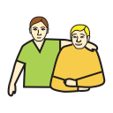





















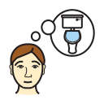

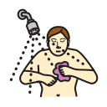











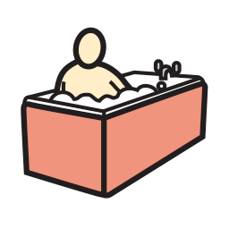
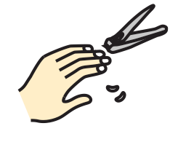

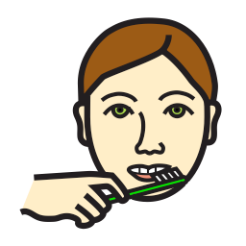






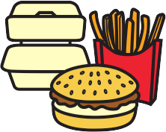































goodbye | cool | wow! ! | lucky | leave me alone | no way | shut up | no symbol | don’t like | No
think | wait | listen | have | Are you ignoring me? | Question ? | Can I see that? | What’s next? | When | Don’t
say | put | make | eat | What’s dinner | what | What doing? | Where | What do you think? | Please
take | tell | ask | drink | Do you have? | How are you? | who | why | which | Thank you
dirty | colour | feelings | afraid | safe | up | down | in | out | Your name?
shape | hungry | happy | sad | sick | here | there | on | off | You live?
hard | thirsty | tired | hot | cold | and & | the | under | over | Your Birthday?
Monday M | place | shop | outside | school | toilet | I need help | I’m ill | shower | U live with
Thursday Th | cinema | town | my place | pool | shave | meds | change | do hair | Your pet?
Sunday Su | library | pub | doctors | home | bath | do nails | pain | clean teeth | college
roast | meat | fish | veg | salad | fruit | fast food | snack | pudding | Your age?
pie | ham | bacon | potato | tomato | banana | chips | crisps | cake | salt/pepper
curry | chicken | broccoli | carrot | cucumber | orange | pizza | chocolate | cream | sauce
lasagna | sausage | onion | peas | lettuce | apple | burger | sweet | ice cream | gravy
ask

