Slide 1

























Top page
Yes
Yes
No
Hello
I want to talk to you.
Chatting
Questions
I
People
Personal Care
Little Words
My Day
Action words
go
want
Describing
Things
Time
Places
Leisure
Delete Word

Slide 2


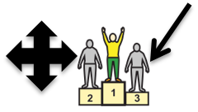

















chatting
Yes
Yes
No
Top Page
Template
About Me
WML
I can’t find what I want to say.
bye
I’m fine
ok
I’m not so good
please
thank you
sorry
excuse me
maybe
really
I don’t know
My stories
I love you
but
Ouch
so
Delete Word

Slide 3















About me
Yes
Yes
No
Top Page
Name
I live in
Birthday
age
I live with
pet
School/college
email
work
Communication aid
music
film
hobby
TV
disability
mobile
Tell me about you.

Slide 4





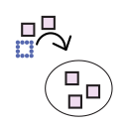










Food chat
Yes
Yes
No
Top Page
I like it
It’s gross
It’s spicy
Cut up food
Can I have some more?
Can I have a drink?
wipe my face
please
thank you
What’s for dinner?
What have you been doing?
I’ve had enough
eat
drink
It’s too hot
It’s too cold
full
empty
Clear

Slide 5



About you
Yes
Yes
No
Top Page
What’s your name?
Where do you live?
When’s your Birthday?
How old are you?
Who do you live with?
Do you have a pet?
Tell me about your day?
What’s your email?
Where do you work?
What’s your mobile number?
What music do you like?
What films do you like?
What’s your hobby?
What TV do you like?
Do you have a disability?

Slide 6







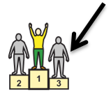












case
Yes
Yes
No
Top Page
cool
Are you ignoring me?
leave me alone
lucky
chill out
go away
looser
wow
minga
Your doing my head in.
whatever
no way
shut up
Were you put on this earth to annoy me?
don’t
not
well

Slide 7

Case
Yes
Yes
No
Top Page
My stories
C
C

Slide 8









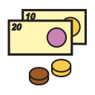



breakfast!
Yes
Yes
No
Top Page
Questions
why
when
what
who
where
which
how
Can I see that?
How much?
How are you?
What have you been doing?
What do you think?
What’s next?
What’s that?
Clear

Slide 9


















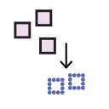




Breakfast!
Yes
Yes
No
Top Page
breakfast
lunch
meals
meat and fish
I’m hungry
vegetables
fruit
drinks
fast food
I’m thirsty
snacks/pudding
Sauces/ingredients
salad
cooking words
some
with
and
Food chat
Favorite food

Slide 10














breakfast
Yes
Yes
No
Top Page
breakfast
cereal
porridge
bran
toast
butter
croissant
jam
muesli
boiled egg
fried egg
scrambled egg
bagel
Full english
beans
fruit
pancakes
Clear

Slide 11
Blue
Yes
Yes
No
Red
breakfast
cereal
porridge
bran

Slide 12
Red
Yes
Yes
No
Blue
breakfast
cereal
porridge
bran

