Slide 1

Fake People
Did you know:
Project Real was created by young people, teachers, university academics and influencers

Slide 2
Aims
Consider how to spot who might be a 'fake person’ online
Consider who you should trust on social media for different types of information
Understand what social blade and other tools you can use to verify who people online are

Slide 3
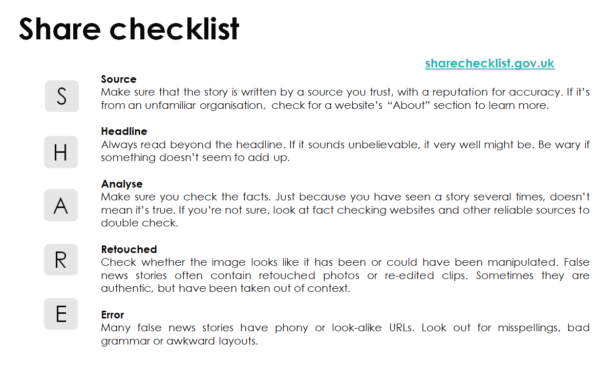
Notes:
Please remind students of the SHARE guidelines

Slide 4
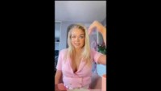
Spotting Fake People Online
Notes:
https://www.youtube.com/watch?v=poKhvyt1MXE

Slide 5
STarter- discussion
What might you do to check who might be a ‘fake person’ on social media?
Did the video raise anything you had not thought of before?
Notes:
You can host this as a class discussion or ask students to discuss this in pairs or small groups

Slide 6
1. What you might do to check who might be a ‘fake person’ on social media?
Check their followers/following numbers (high numbers may suggest they are real, but not if they have high numbers of followers but low following numbers)
Check number of posts (extremely high numbers may suggest a bot, especially if they do not interact with other people’s posts)
Check their biography (people who are not real may not have a biography or it might have mistakes in it)
Check their username (the REAL … or the FAMOUS… are likely to be fake)
Use social blade or a general search engine to see if the profile appears to be real

Slide 7
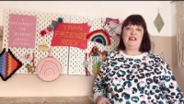
An influencer perspective
Notes:
https://www.youtube.com/watch?v=HaDuNUWlPNM

Slide 8

Main Activity
Now in pairs/small groups it is up to you to decide whether you could trust the profiles of different social media influencers which will be shown on the next slides.
Remember the SHARE guidelines!
Notes:
Paired or small group discussion
Each slide has a profile and a question to answer
Give students a few minutes to discuss each profile, then move onto the following slide where we give the potential answers

Slide 9
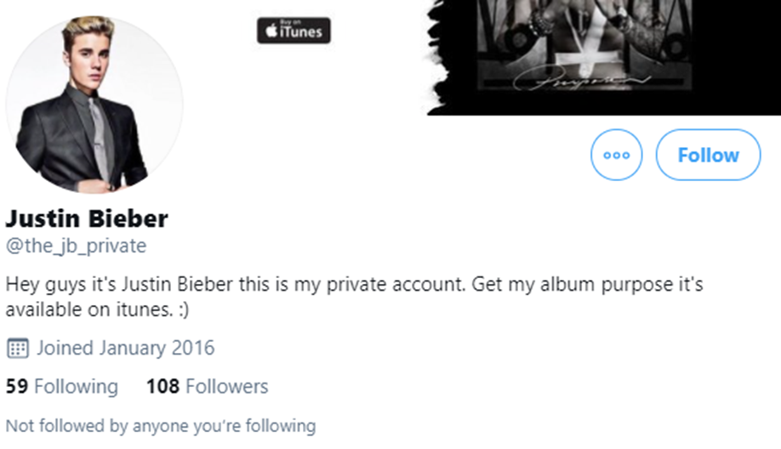
Could you trust this profile?

Slide 10
Could you trust this profile?
This is a fake account
Low followers and following (Analyse)
Errors in the bio (Errors)

Slide 11
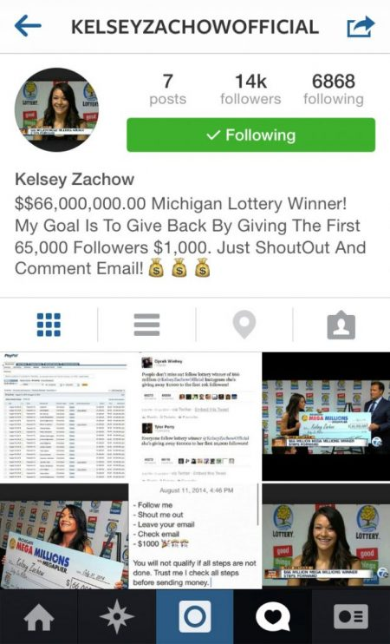
Could you trust this profile?

Slide 12
Could you trust this profile?
This is a fake account
She did win the jackpot (so the photos are real) but never intended to give away her money
If something seems too good to be true online, it probably is (Analyse)
There are errors in grammar (Error)
Notes:
This is a fake account
If something seems to good to be true online it probably is
There are also errors in grammar
She did win the jackpot (so the photos are real) but never intended to give away her money

Slide 13
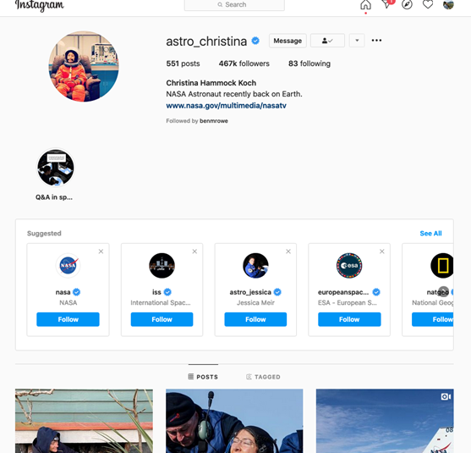
Could you trust this profile in general?
How about to provide information on?:
1. Covid-19 Vaccine
2. Space
3. Fashion and beauty
4. Photography

Slide 14
This is a real account from a female astronaut (you can find her on a search engine)
This profile has a lot of followers, but the owner has posted quite a few times and are following accounts
She has a blue tick and so may be trustworthy
Could probably trust them to give information on space but maybe not on other topics

Slide 15
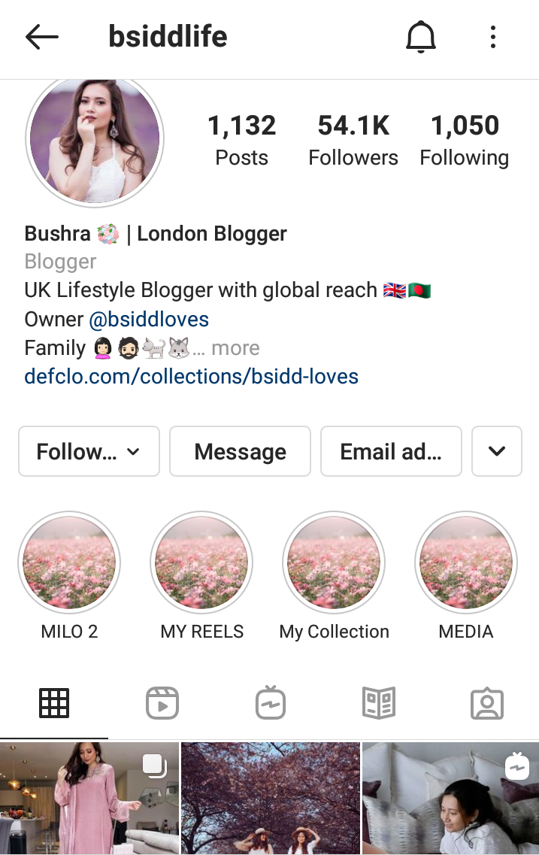
Could you trust this profile in general?
How about to provide information on?:
1. Covid-19 Vaccine
2. Space
3. Fashion and beauty
4. Photography
Notes:
This seems like an active profile (this is one of our influencers in case the students do not recognise her!)
Good number of followers, and following
But no blue tick?
Could probably trust her to give advice on fashion/beauty and photography, but not on Covid-19 or space

Slide 16
You already know Bushra as she has been on our videos, you can probably trust her!
Good number of followers, and following
She engages with other people’s posts
But no blue tick?
Could probably trust her to give advice on fashion/beauty and photography, but not on Covid-19 or space
Let’s check social blade to be sure!

Slide 17
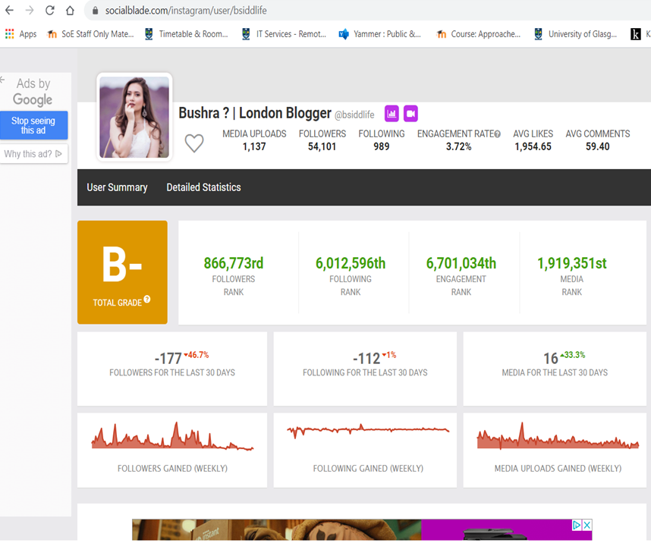
Bushra has a B grade, which suggests that this is possibly a real/trustworthy profile
She has a lot of followers
She is engaging with her followers
Notes:
Running Bushra through social blade suggests that she is probably trustworthy, she has a B grade and is recognised

Slide 18
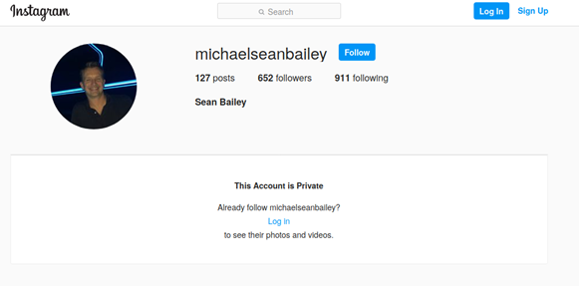
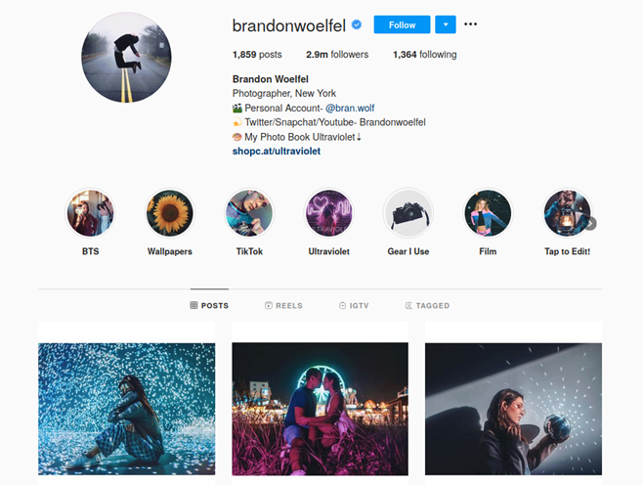
Which of these accounts looks trustworthy in general?

Slide 19
Who should I ask about how to become a film director? Why?

Slide 20
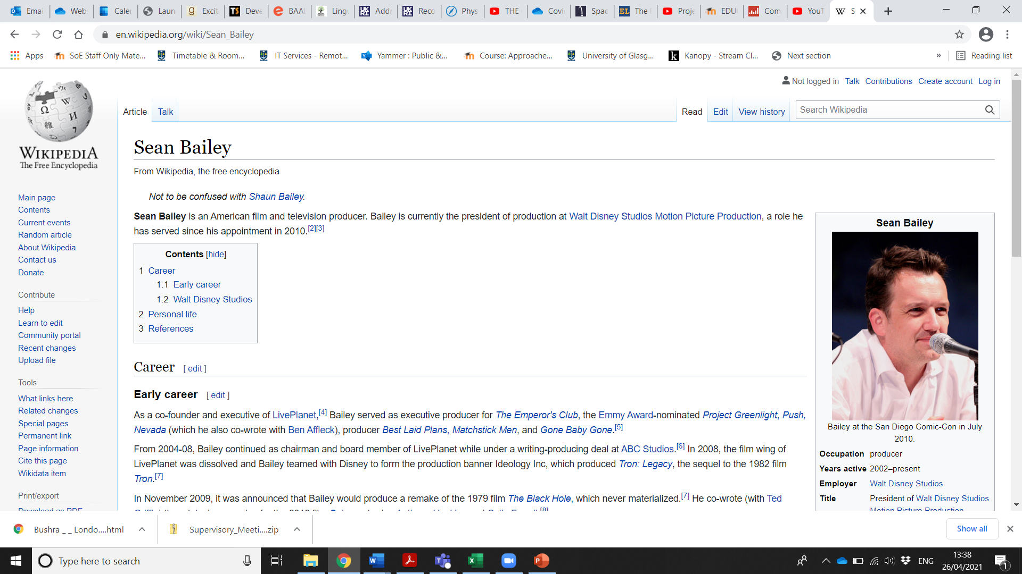
If you go beyond the Headline and search for Sean Bailey, you will find he is President of Walt Disney Studios Films
He would know about being a film director
Notes:
Michael Bailey is president of Disney Studios
You could have a discussion here on how trustworthy Wikipedia is as a source! But you may not want to get sidetracked…

Slide 21
Who could I trust to give advice on what camera I should buy? Why?
Notes:
Probably Brandon as he is a photographer

Slide 22
Stop and Think
Even if you trust the source, and believe that they are not a ‘Fake Person’, can you trust the information they share?
Why might Brandon recommend a specific camera?
What might you need to think about before you believe a news story you see on social media?
Notes:
This could be a quick discussion in pairs
Brandon may be being paid to promote a certain camera

Slide 23
Closing Activity
Answer the following questions with:
‘Yes’ or ‘No’
Notes:
The following are Yes or No questions
You can play the game ‘Corners’ and ask pupils to move to different corners of the room to give their answers
You could also ask them to vote by using thumbs up or thumbs down

Slide 24

QUESTION: You should believe all social media posts online from anybody

Slide 25
You should believe all social media posts online from anybody
No!
Some people might not be who they say they are
Trying to sell you something
Trying to get you to believe something
Trying to access information about you

Slide 26
QUESTION: You can trust an account with a blue tick more than an account without one

Slide 27
YOU CAN TRUST AN ACCOUNT WITH A BLUE TICK MORE THAN AN ACCOUNT WITHOUT ONE
Yes
But a blue tick does not necessarily mean they can be trusted
Use the SHARE guideline to check them and any information they have shared

Slide 28
QUESTION: Celebrities and influencers are always a reliable source of information

Slide 29
CELEBRITIES AND INFLUENCERS ARE ALWAYS A RELIABLE SOURCE OF INFORMATION
No!
People might be impersonating them
They can have their accounts hacked
They may have contracts to sell things to people

Slide 30
QUESTION: It is always easy to spot fake social media accounts

Slide 31
IT IS ALWAYS EASY TO SPOT FAKE SOCIAL MEDIA ACCOUNTS
No!
People might be impersonating others and can copy their pictures and layout on Instagram
Some fake profiles look very realistic

Slide 32
QUESTION: If you trust the person sharing the information on social media, you can definitely believe any article they share

Slide 33
IF YOU TRUST THE PERSON SHARING THE INFORMATION ON SOCIAL MEDIA, YOU CAN DEFINITELY BELIEVE ANY INFORMATION THEY SHARE
No!
They can have been tricked by Fake News too
Always use the SHARE guidelines

Slide 34
Exit Pass
What is one way to detect a 'fake person' online?
Notes:
Some schools use ‘exit passes’ where students need to do something to leave the room
If you choose to do this, you can ask pupils to write their answer on a post it note and leave it on the door
Otherwise you could ask them to share their idea with the class

Slide 35
Summary
Today you have learned:
What social blade is
How to spot who might be a 'fake person’ online
Who you should trust on social media for different types of information

Slide 36
Links to our learning
Notes:
You can complete this slide to show how this lesson might fit in with other content the students are learning.

Slide 37
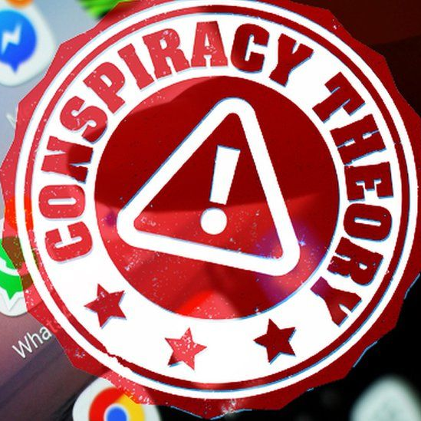
Next week…
FAKE STORIES
A session looking at conspiracy theories

