Slide 1

TEACHING YOUNGER YEARS

Slide 2
Aims
Summarise Project Real
Revise how to spot fake news, photos, people and videos online
Create a resource to teach younger people about what you have learnt from Project Real

Slide 3
Starter - Revision
On your own or in small groups, make notes (or create a mind map) of what you have learned from Project Real.
Notes:
We recommend getting students into small groups and supplying pens and large paper.

Slide 4

Summary of the project
In this programme you have learned about:
Fake news Fake people Fake photos Fake stories Fake videos

Slide 5
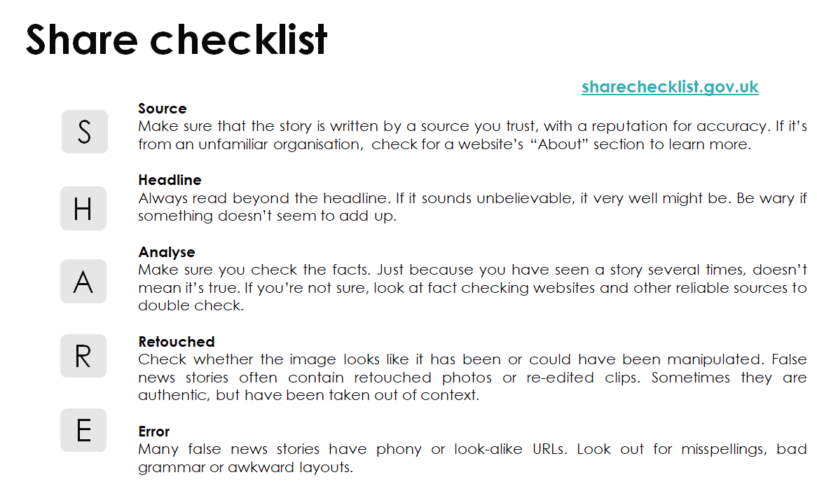

Slide 6

Main Activity
Project Real was created by young people, teachers, academics and influencers
Now it is your turn to design an activity to teach younger people about fake news
Notes:
It may be necessary to check what resources are available beforehand as to whether students are given the option to create something digitally.

Slide 7
Main Activity
You can cover one topic in detail, a few topics, or all topics more broadly, or even a new topic related to fake news
It is up to you what you decide to create. It could be: a poster, a PowerPoint, a game, a song, a lesson or anything else creative.
Think about what you want people to learn from your session and what would make it fun
Notes:
It may be necessary to check what resources are available beforehand as to whether students are given the option to create something digitally.

Slide 8
Closing Activity
Quiz: Test your knowledge!
Notes:
This assessment is

Slide 9
1) What does 'S' stand for in the SHARE Guidelines? (1 mark)
A) Secret
B) Source
C) System
D) Setting

Slide 10
2) Name 2 things you could do to check if a video is real or fake. (2 marks)

Slide 11
3) What does 'A' stand for in the SHARE Guidelines? (1 mark)
A) Address
B) Accept
C) Assess
D) Analyse

Slide 12
4) Write down one positive and one negative of editing photos. (2 marks)

Slide 13
5) What does 'R' stand for in the SHARE Guidelines? (1 mark)
A) Reedited
B) Resourced
C) Retouched
D) Replaced

Slide 14
6) Name the 2 key ingredients of a conspiracy theory. (2 marks)

Slide 15
7) What does 'H' stand for in the SHARE Guidelines? (1 mark)
A) Headline
B) Hoax
C) History
D) Header

Slide 16
8) Name 2 things you could do to check if a profile is real or fake. (2 marks)

Slide 17
9) What does 'E' stand for in the SHARE Guidelines? (1 mark)
A) Error
B) Edited
C) Erased
D) Exited

Slide 18
10) Give one reason why someone might believe a conspiracy theory? (1 mark)

Slide 19
11) Write down one positive and one negative of editing videos. (2 marks)

Slide 20
12) Name 2 things you could do to check if a photo is real or fake. (2 marks)

Slide 21
How did you do?

Slide 22
1) What does 'S' stand for in the SHARE Guidelines (1 mark)
A) Secret
B) Source
C) System
D) Setting

Slide 23
2) Name 2 things you could do to check if a video is real or fake. (2 marks)
Check who released the video
Check if it from a spoof or trustworthy website
Check if it was released by the person in it
Check whether it is really believable/realistic e.g., would the Queen release a video like that?
Check whether the context of the video add up to real life e.g., was Tom Cruise in America when this was filmed?
Check to see whether the video looks real (note: they are getting better and better so it is important not to always rely on this) e.g., do the head movements match the rest of the body?
Check to see if there any mistakes in the video, e.g., in the movements, accent, etc.?

Slide 24
3) What does 'A' stand for in the SHARE Guidelines (1 mark)
A) Address
B) Accept
C) Assess
D) Analyse

Slide 25
4) Write down one positive and one negative of editing photos. (2 marks)
Positives: Makes the photos look better, get rid of blur, keeps the focus on the subject of the photo, if you e.g. get rid of a spot, you might feel better about sharing the photo, if it is a group shot you can make sure everyone is looking at the camera
Negatives: can make people feel bad about their own bodies, can make people feel disappointed when they go to a place and it does not look like it does in pictures, can be used to deceive people in online shopping, can be used to make fake news stories seem more real, can make people feel bad about their lifestyle

Slide 26
5) What does 'R' stand for in the SHARE Guidelines (1 mark)
A) Reedited
B) Resourced
C) Retouched
D) Replaced

Slide 27
6) Name the 2 key ingredients of a conspiracy theory. (2 marks)
1. You're trying to explain an event or topic, which often is a large significant event
2. Where something is happening in secret, there is some kind of hidden element to it that has been hidden by a powerful force or by a powerful group

Slide 28
7) What does 'H' stand for in the SHARE Guidelines (1 mark)
A) Headline
B) Hoax
C) History
D) Header

Slide 29
8) Name 2 things you could do to check if a profile is real or fake. (2 marks)
Check their followers/following numbers (high numbers may suggest they are real, but not if they have high numbers of followers but low following numbers)
Check number of posts (extremely high numbers may suggest a bot, especially if they do not interact with other people’s posts)
Check their biography (people who are not real may not have a biography or it might have mistakes in it)
Check their user name (the REAL … or the FAMOUS… are likely to be fake)
Use social blade or a general search engine to see if the profile appears to be real

Slide 30
9) What does 'E' stand for in the SHARE Guidelines (1 mark)
A) Error
B) Edited
C) Erased
D) Exited

Slide 31
10) Give one reason why someone might believe a conspiracy theory? (1 mark)
Believing in it may reduce anxiety around the situation or event
Blaming the situation or event on hidden sources may make people feel that they have come up with a solution to complex problems
Believing in conspiracy theories may be a way of someone trying to understand a chaotic event
People believe in conspiracy theories as a way to understand the world

Slide 32
11) Write down one positive and one negative of editing videos. (2 marks)
Positives: Humour, entertainment, financial reasons e.g., don't actually have to pay Tom Cruise to come to a studio, education, e.g., learn from about paintings from Picasso himself, training videos are more interesting than manuals, dubbing films from another language
Negatives: Can be done without people's permission, can be used in a harmful way, can make people believe things that are not true, might lead people to distrust others

Slide 33
12) Name 2 things you could do to check if a photo is real or fake. (2 marks)
Check to see if the background is blurred, e.g., have people been blurred out?
Check if it is from a spoof or trustworthy website
See who posted it, e.g., are they trustworthy, do they want to portray a certain image?
Check whether it is really believable/realistic, e.g., would that area realistically be empty?
Zoom in to see if the pixels look right
Check for any mistakes e.g., no shadow, looks strange
Do a reverse image search

Slide 34
Summary
Today you have:
Summarised Project Real
Revised how to spot fake news, photos, people and videos online
Created a resource to teach younger students about what you have learnt from Project Real

Slide 35
Exit Pass
What is the most important thing you have learned in Project Real which you think other people should know about?
Notes:
Some schools use ‘exit passes’ where students need to do something to leave the room
If you choose to do this, you can ask pupils to write their answer on a post it note and leave it on the door
Otherwise you could ask them to share their idea with the class

Slide 36
We hope you enjoyed the programme!

