Slide 1


Short Tandem Repeats
By Pascal Luc
April 2026

Slide 2


Introduction
Goal of this project is to retrace and comprehend the application of STR-Analysis to identify and verify genome mutations which can lead to unregulated cell division
In-Going Scenario: Given a sequencing sample from a Patient with suspected cancer, we need to investigate, whether there is an effective variant, which is related to the patients symptom.

Slide 3

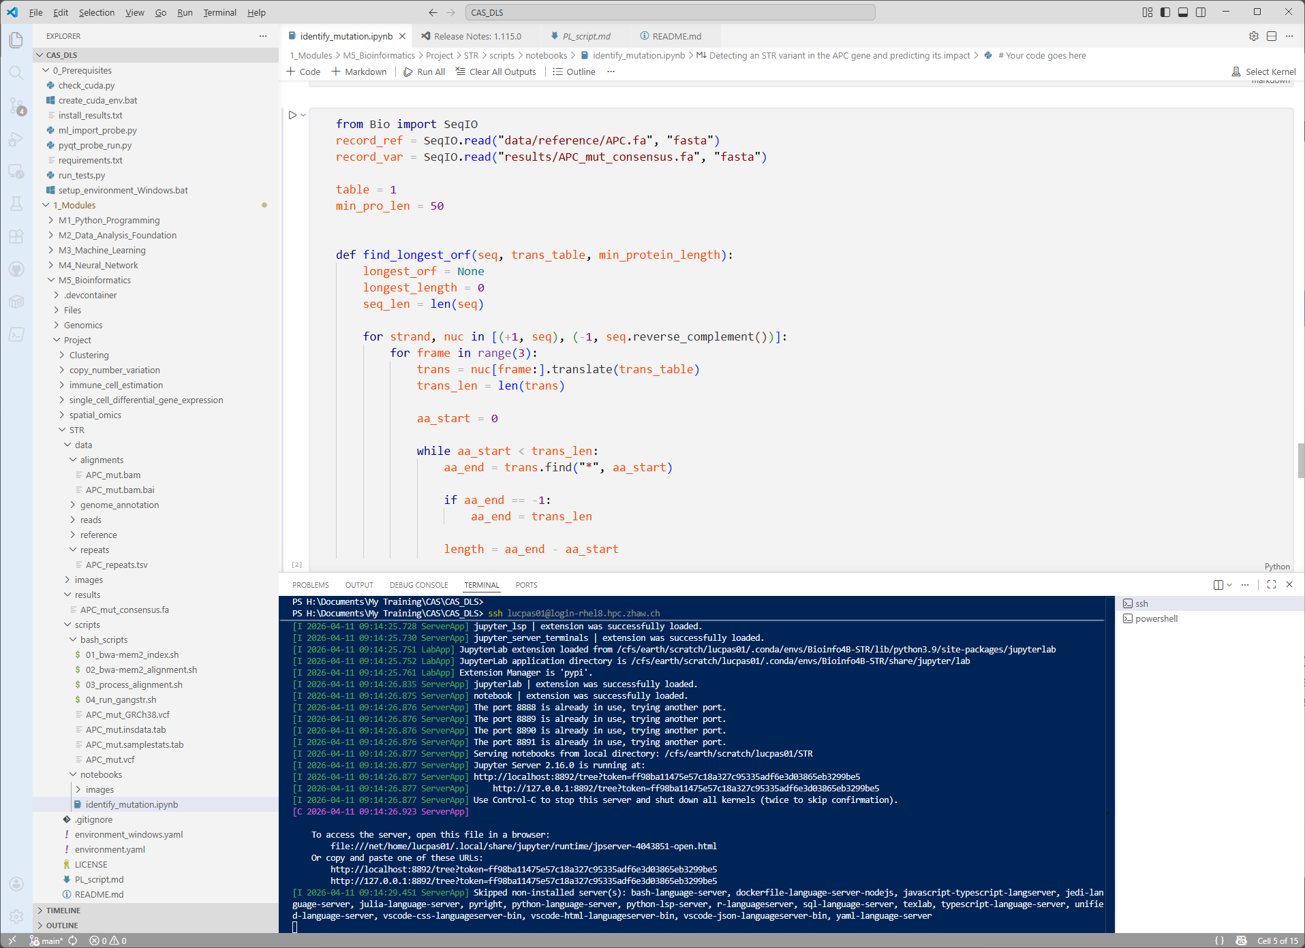


Setup
Home
Windows
Visual Studio Code
SSH
Jupyter notebook
FileZilla
SFTP
ZHAW
Earth Cluster
Linux “Rocky 8”
Conda 4.12
- python=3.9
- gangstr
- bwa-mem2
- samtools
- cyvcf2
- biopython
- notebook
- cnvkit
VPN
CHR5 Genome Reference (FA, FAI)
Sample Short Reads (FASTQC)
APC Repeats (TSV)

Slide 4

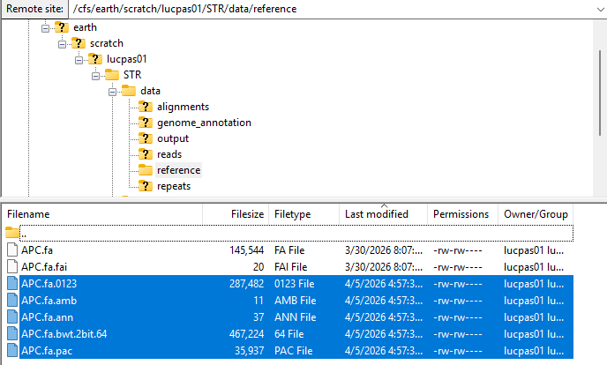
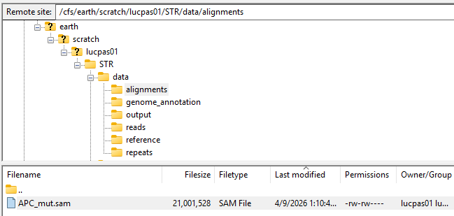
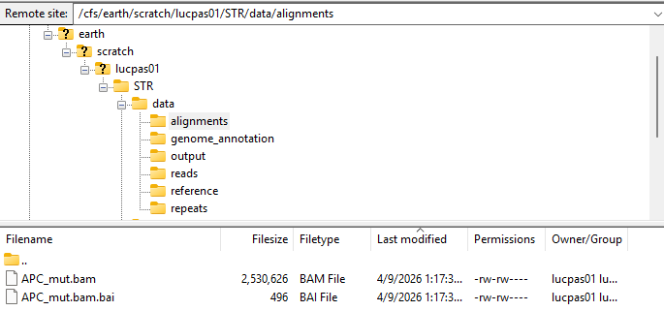
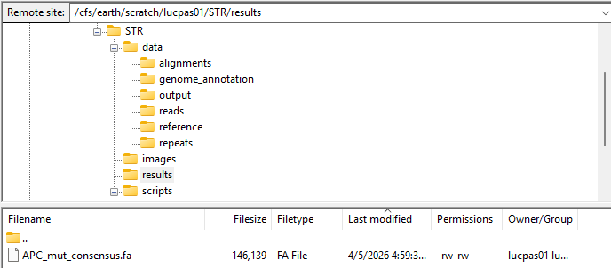
Alignment
01.
Index CHR5 Reference for Sample alignment
TOOL: BWA-MEM2
02.
Alignment of our Sample to the indexed reference genome
TOOL: BWA-MEM2
03.
Convert the raw Alignment File SAM into compressed BAM Format
Sort and Index the sequences
Tool: samtools
Using the parameter –l 60 provide us a very high consensus quality
(Error probability = 0.0001%)

Slide 5


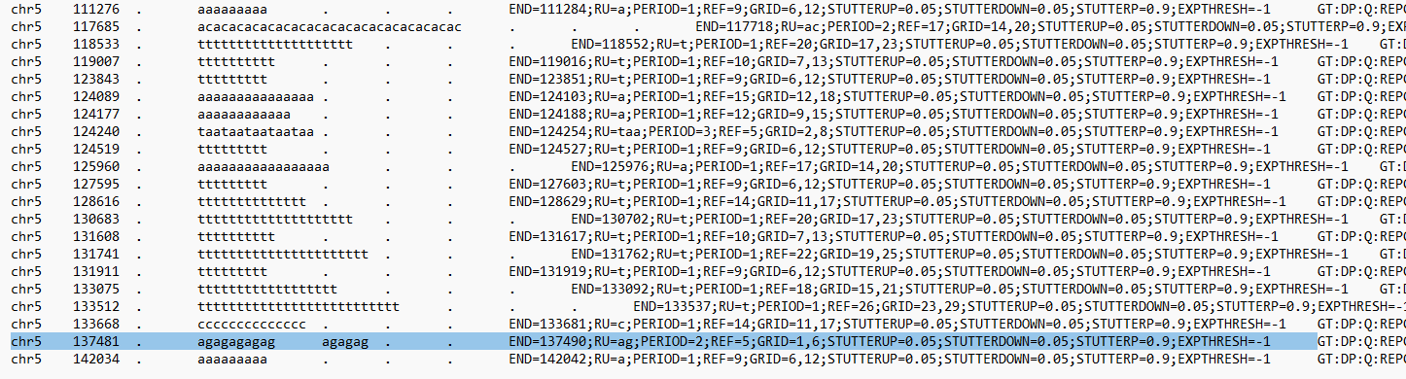

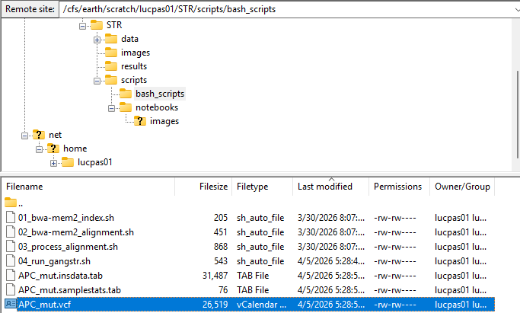
STR Analysis
GangSTR --bam "../../data/alignments/APC_mut.bam" --ref "../../data/reference/APC.fa" --regions "../../data/repeats/APC_repeats.tsv" --out "APC_mut"
BAM
Compressed Sequencing Alignment Map
Source: Our Sample from the short reads
REF
APC Reference Data
Source: Human Genome Project (APC Gene)
REGIONS
Coordinates of Repeat Sites
Source: STR Genotype Database
OUT
Custom prefix for the outputs

Slide 6
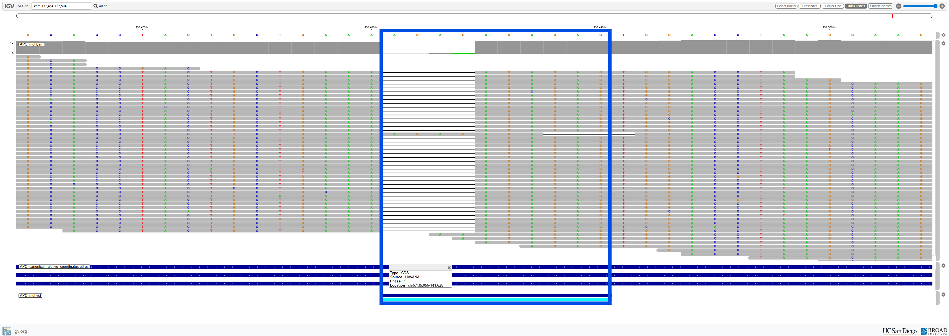
Visualization
143,6k bp

Slide 7
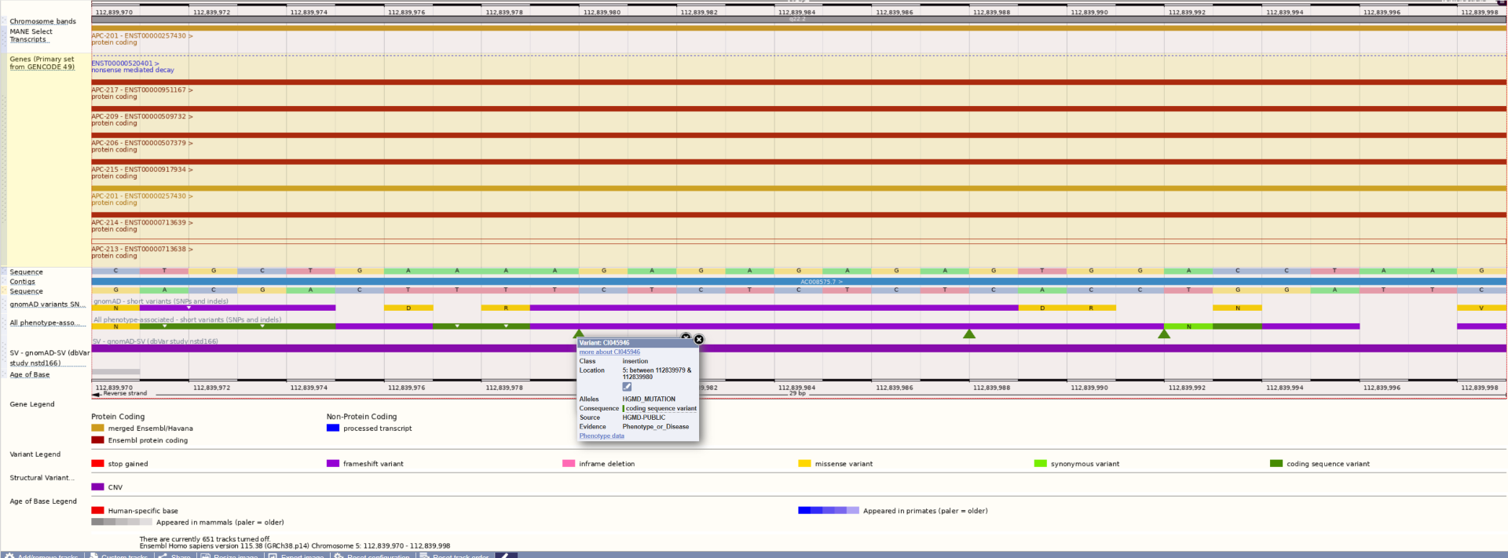

STR variant's impact
01.
Clean (delete other variants) & Convert APC Gene Coordinates
TOOL: Editor
02.
Upload Variant to VEP
TOOL: www.ensembl.org

Slide 8
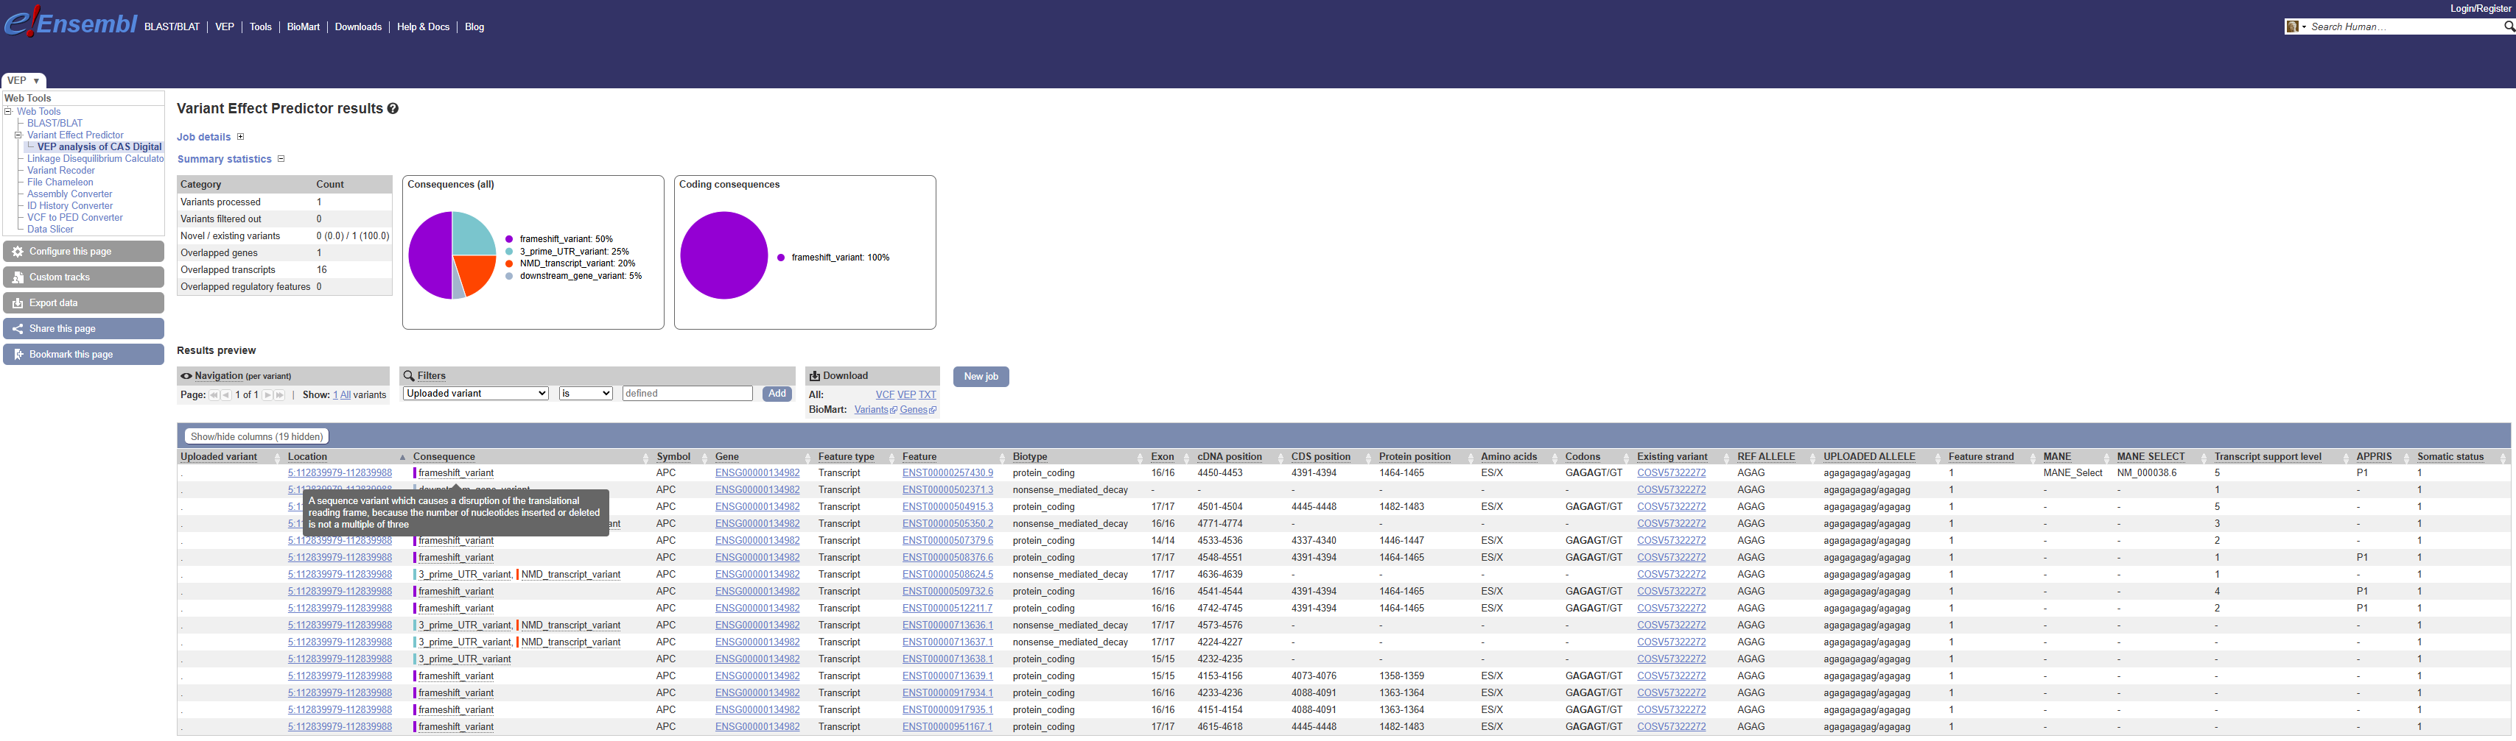
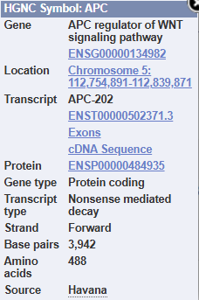

Slide 9


Discussion
Frame-shift
Longest ORF
Reference APC Length: 2194 amino acids
VS
Longest ORF
Sample Variant
Length: 1381 amino acids
3 UTR_prime
NMD
Downstream Gene

Slide 10
Conclusion
Mutation on the Coding Site of the APC gene (Exon 16)
-> Gene is expressed during transcription
Mutation is a deletion -> Frame-Shift
NMD, Shorten Protein, Misfolded Protein
Missing / Non-functional Marker (+ Toxic Build Up)
APC is a cell growth regulating gene (in binding to beta-catenin, to mark a cell for destruction)
-> Studies: ~80–90% of colon cancers involve APC mutations
Proof of possible malignant mutation is found in our sample

Slide 11
THANK YOU
Questions?

