Slide 1

Simulation OF Phase 3 - Clinical Trials Pascal Luc
April 2026

Slide 2

Agenda
Introduction
Problem Analysis
System Boundaries
Deep Dive

Slide 3
Phases of Clinical Trial
Preclinical Research
Phase 0/I
Phase II
Phase III
Post-clinical Monitoring
Drug Discovery
Questions:
Toxicity
Side effects
Pharmacokinetics Initial effectiveness
Laboratory research
In vitro
Animals
Continuously
Safety and Dosage
Micro-dosing
Questions:
Behavior in humans
Pharmacokinetics
Side effects
10-100 healthy Participants
Duration:
Months – 1 year
Effectiveness
Questions:
Does it actually work?
Optimal dose
Short-term side effects
100-300 Participants with the disease
Duration:
1year – 3years
Large-Scale Testing
Market Approval
Questions:
How it compares against: Placebo /
Existing treatments
1000-3000 Participants with disease
Duration:
Multiple Years
Long-term safety after approval
Questions:
Detect rare side effects
Monitor real-world effectiveness
Thousands to millions of patients
Duration:
years – 10 years

Slide 4
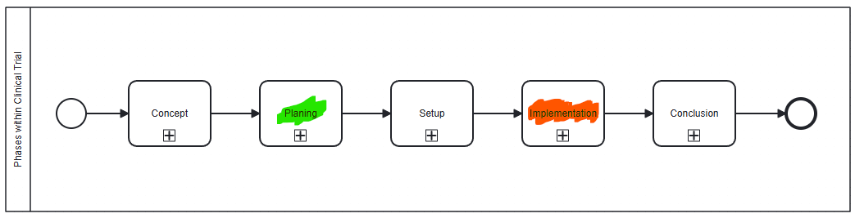
Why Simulate Clinical Trials?
Complex
Many parties involved
Strictly regulated in Switzerland
Large Number of options
Many Uncertainties
Consent of Patients
Trial Site Participation
Staffing
Effectiveness of Drug / Device
Long Running
Multi Year Project
Benefits: Accurate Sample Size determination, resource estimation, avoid unexpected prolongation

Slide 5
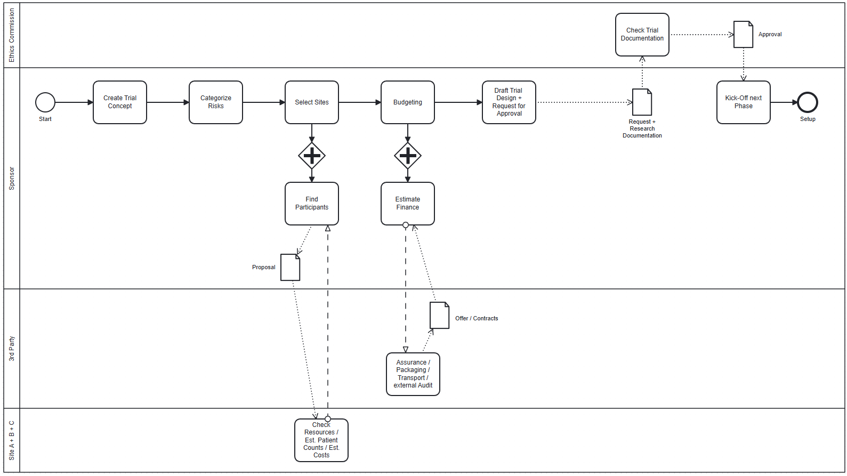
Planning Phase (Who is involved?)

Slide 6
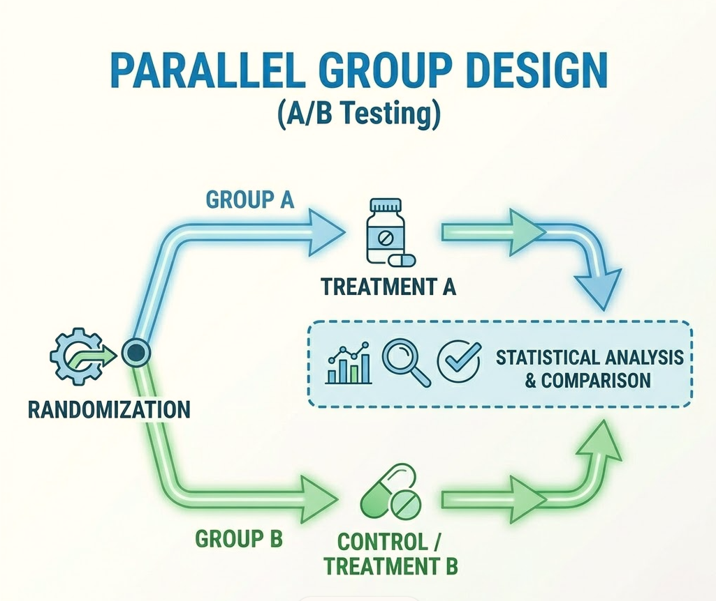
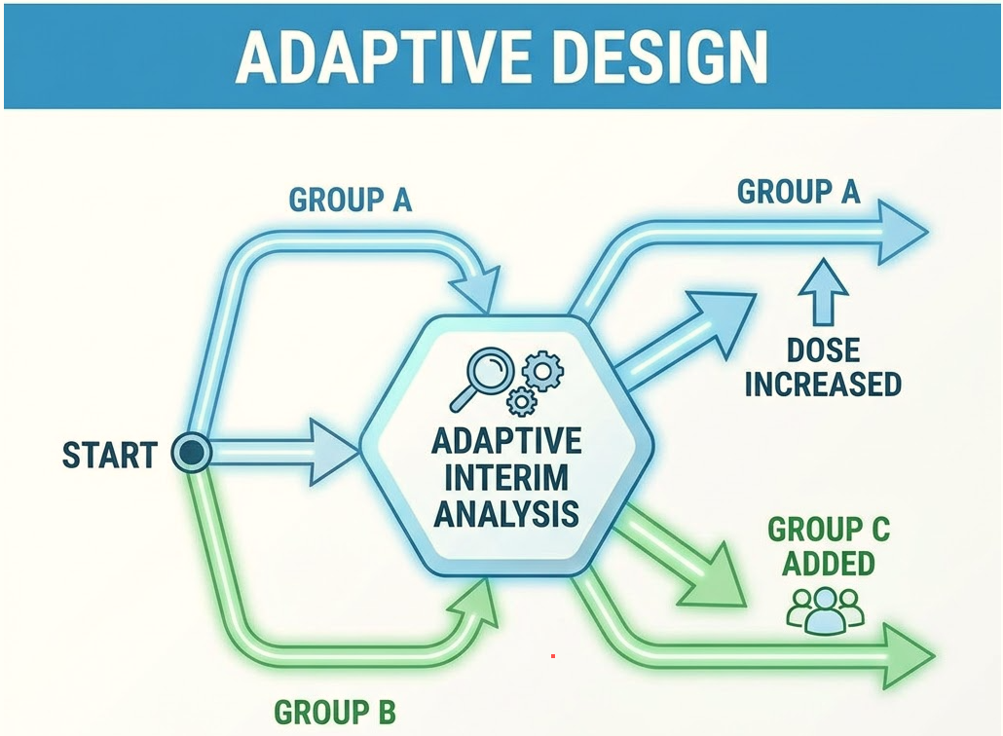
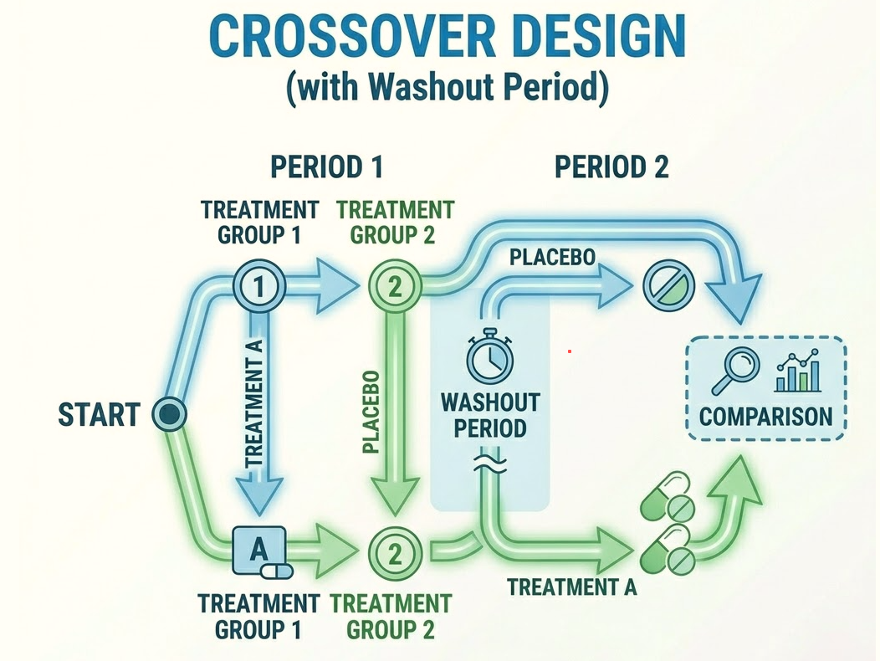
Designs of a Multicentric Trial
For Drug with New Substances (CAT C KLIN-V)

Slide 7
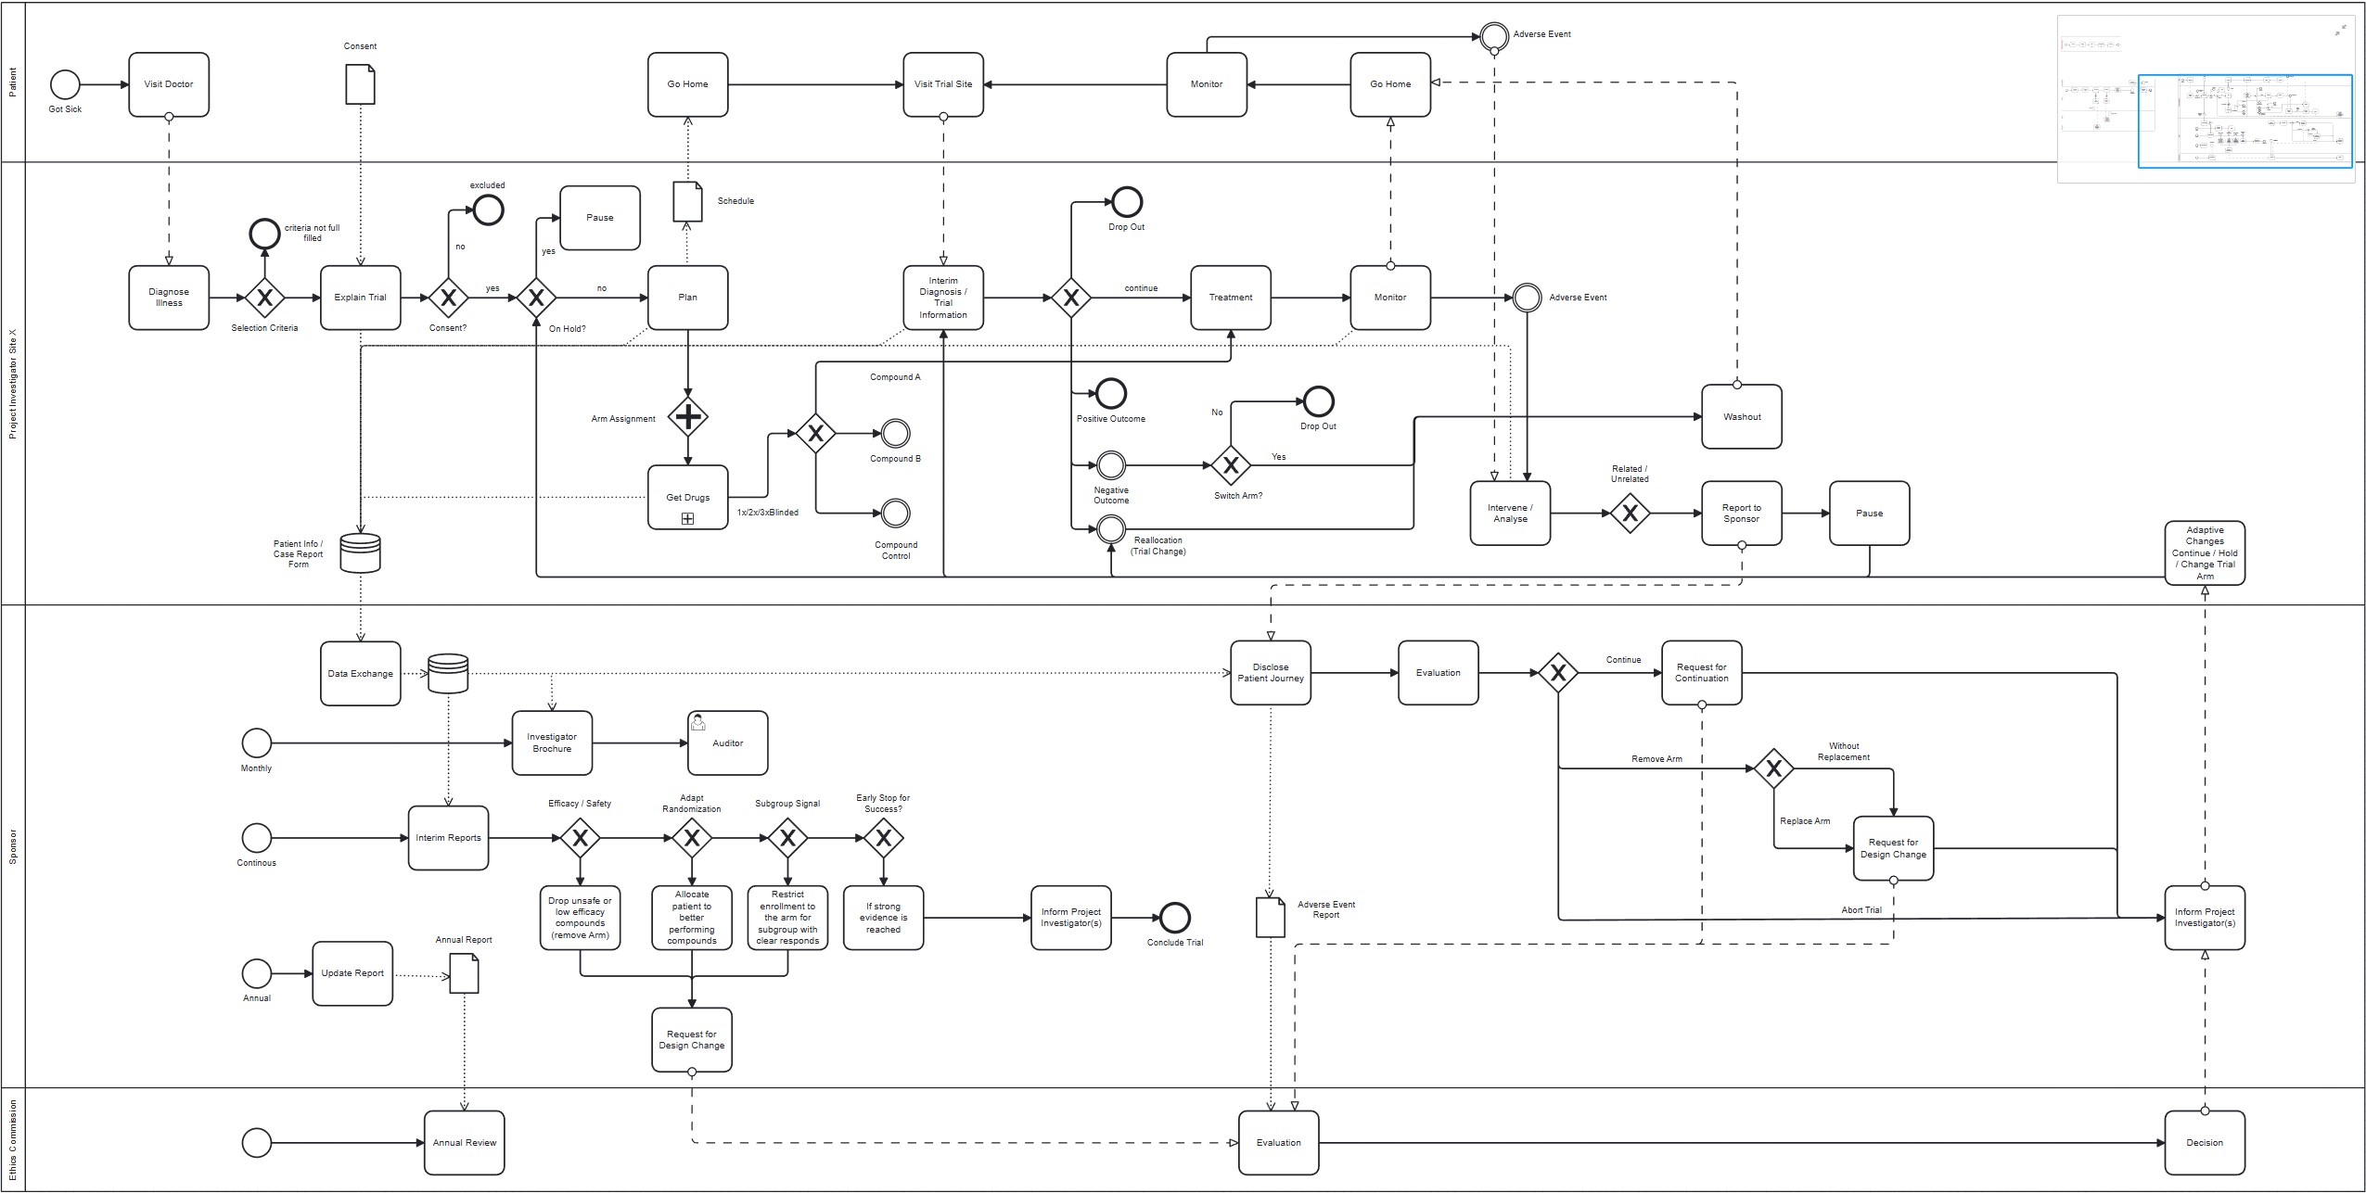
Slide Templates
Implementation Phase

Slide 8

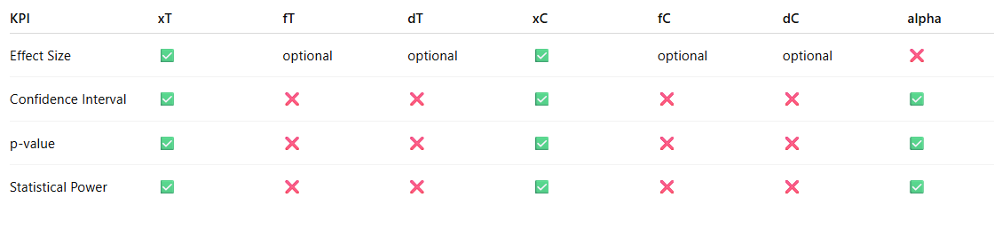
Objectives
Assessing total runtime of a trial design
Assessing impact of delays on runtime
Assessing impact of trial changes on runtime
Determining the utilization levels of individual system components
Assessing number trial changes
Determining when to stop a trial arm
Determining when to stop the clinical trial
KeyPerformanceIndicators
Run Time
Total Run Time (Days)
Trial Arm Run Time (Days)
Delays (Days)
Ressource Utilization
Staff_Utilization / Site
# Patient / Site
# Patient_non_consenting / Site
# Visits / Patient
# Treatment / Patient
Trial Design
# Patient / Compound
# (xT, xC) Positive Outcomes / Compound
# (fT, fC) Negative Outcomes / Compound
# (dT,dC) Drop-Outs / Compound
# Trial Change due to outcome
# Trial Change due to adverse event

Slide 9

Trial (-arm) stop / Regulatory requirements:
Variables & Parameters
Example P-Value:
KPI Threshholds (depend on # compounds):
Significance: P-Value: <0.01, Z-Score >2.58
Confidence Intervall: >99%
Effect Size: +10%
Statistical Power: >90%
Patient rate (suitable additional candidates during trial): RateTable
Additional Trial Arm added per year (simulate discovery of new compound): 1
Trial Arm switch trial arm stop: 50%
Trial Arm switch low efficacy: 10%
Wash-out duration (Patient need to wait until effect of previous Compound is washed out, before enrolling to new trial arm): 15 days
Adverse Events as a percentage of all visits with treatments: 5%
Patient drop-out rate: 10%
Parameters set from previous experience:

Slide 10

Stochastic elements
Number of treatment until outcome is decided: 5-10
Related events (short trial pause, 15-45 days): 25% of adverse events
Severe unexpected events: 25% of related events
Subsequent impact 50/50:
additional trial pause of 60-180 days
trial design change + additional trial pause of 15-180 days
Compound with success rate:
last one: above threshhold
other below in a percentage range (according to phase 2 results)
Placebo:10% / Control: according to existing rate

Slide 11

Challenges / Discussions / Questions

Slide 12

Thank you

