Slide 1



Nextflow
9 March, 2026

Slide 2

What is a pipeline?
Big data ~200GB for human
48 hours +

Slide 3
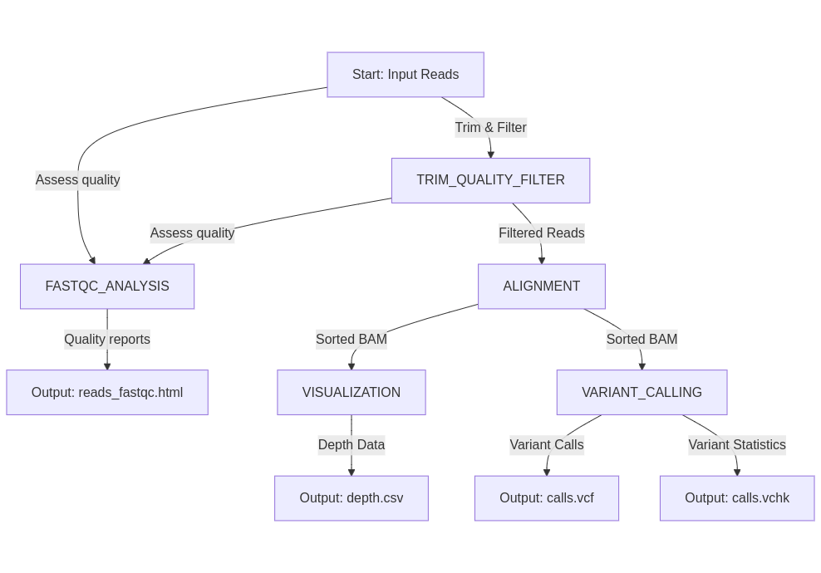
Pipelines
Main challenges:
Data size and processing time
Reproducibility
Asynchronous and parallel tasks

Slide 4





Pipeline tools
Fast setup for small pipelines
Reproducible, parallel pipelines for large data

Slide 5
Nextflow key features - processes
process TRIM_QUALITY_FILTER {
input:
path reads
output:
path "reads_filtered.fastq", emit: filtered_reads
path "reads_trimmed.fastq", emit: trimmed_reads
script:
"""
fastx_trimmer -f 20 -l 240 -i ${reads} -o reads_trimmed.fastq
fastq_quality_filter -q 30 -p 95 -i reads_trimmed.fastq -o reads_filtered.fastq
"""
}

Slide 6
What is an Environment?
How to install it?
Different installation instructions for different OS
Repeat the process for each tool
How to share your code?
What if tool updates?
What if you need same tool but different versions?
- cyvcf2
- figtree
- samtools
- phylip
- numpy
- pandas
- seaborn
- biopython
- notebook
- fastx_toolkit
- fastqc
- bcftools

Slide 7


Environment management
Install software without conflicts
Keep different versions of the same tool for different projects
Ensure reproducibility over time

Slide 8
Conda
environment.yml
Works on Windows, macOS, Linux.
Has its own repository of software
name: bio_pipeline
channels:
- bioconda
- conda-forge
- defaults
dependencies:
- cyvcf2=0.30.16
- figtree=1.4.4
- samtools=1.15
- phylip=3.697
- numpy=1.21
- pandas=1.3
...
conda env create -f environment.yml
conda create -n my_env python=3.8
conda activate my_env
conda install samtools=1.15
conda deactivate

Slide 9
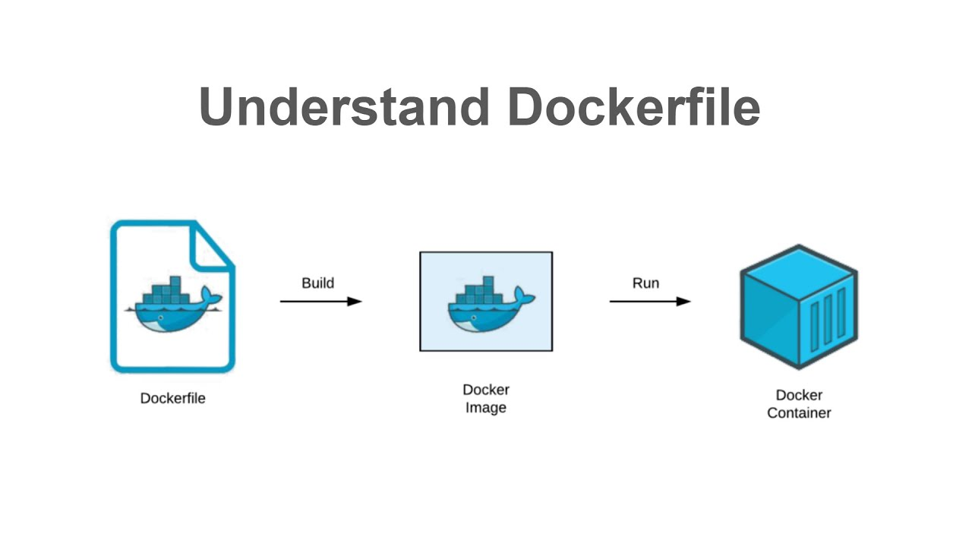
Docker
Operating system
All the software you need
All the dependencies
Build
Run

Slide 10
Nextflow key features - processes
process TRIM_QUALITY_FILTER {
conda: “Env_Genomics.yml”
container: "ghcr.io/kondratievaolesya/bio_env:2"
input:
path reads
output:
path "reads_filtered.fastq", emit: filtered_reads
path "reads_trimmed.fastq", emit: trimmed_reads
script:
"""
fastx_trimmer -f 20 -l 240 -i ${reads} -o reads_trimmed.fastq
fastq_quality_filter -q 30 -p 95 -i reads_trimmed.fastq -o reads_filtered.fastq
"""
}

Slide 11
Nextflow key features - channels
Channel.fromPath("input/*.fastq")
[ “reads1.fastq”, “reads2.fastq”...]
process ALIGNMENT {
input:
path reads
output:
path "sorted.bam” ,emit: bam
...
}
ALIGNMENT ALIGNMENT
ALIGNMENT.out.bam ALIGNMENT.out.bam
process VISUALIZATION {
input:
path sorted_bam
...
}
process VARIANT_CALLING {
input:
path sorted_bam
...
}

Slide 12
Nextflow key features - workflows
workflow {
fastq_channel = Channel.fromPath("input/*.fastq") // Initial channel with FASTQ files
ALIGNMENT(fastq_channel) // First process
VISUALIZATION(ALIGNMENT.out.sorted_bam) // Second process
VARIANT_CALLING(ALIGNMENT.out.sorted_bam) // Third process
}

Slide 13
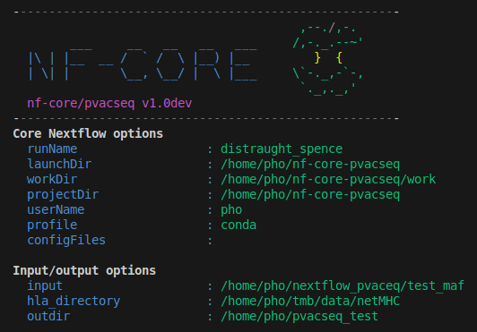
nf-core templates
Standardized templates: for creating new modules and pipelines.
Code guidelines: testing setup and input validation.
Helpful features: reference genome loading, MultiQC for reporting.

Slide 14



More links

