Slide 1
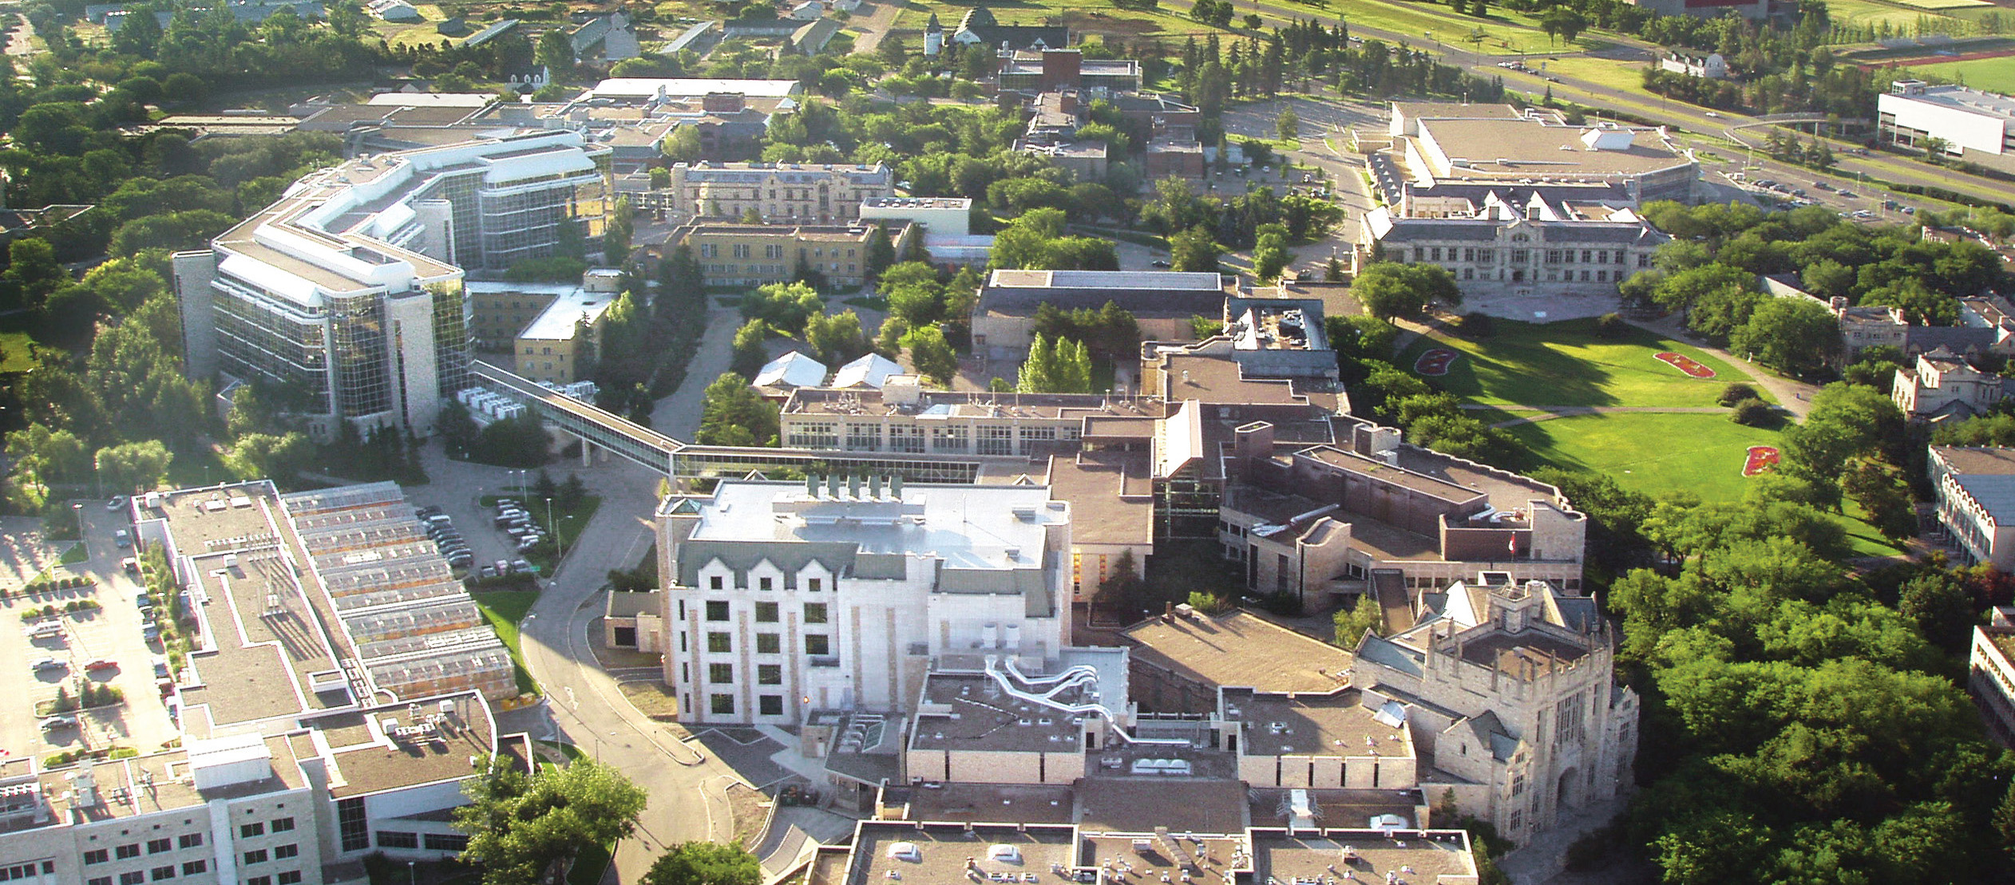


TITLE
Presenter name; credentials; date
www.usask.ca

Slide 2
Model Implementation
Drivers interact within a realistic GIS environment
Drive between random cities
Use decision-making process to find truck stops
Truck stops may or may not have enough space for drivers to park
Key components
  Trucker behaviour
  Trucker routing
  GIS data

Slide 3
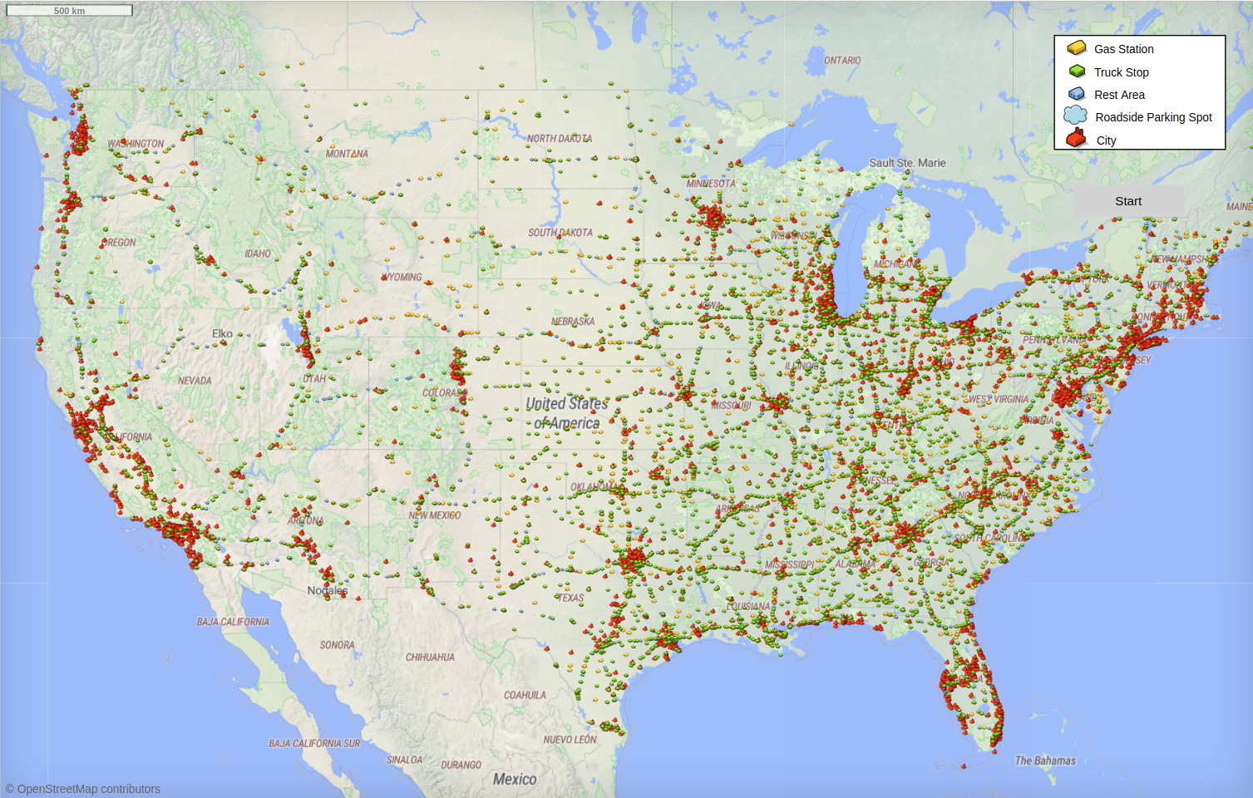

Slide 4
Trucker Behaviour
Assign a destination
  Shipper, receiver, or home
Each time we start driving:
  Select where to stop
    Direct to destination? Stop at a truck stop? Which stop?
  Select what to do at the stop
    Sleep for the night? Refuel and keep driving?
Networks
  Truckers at the same location temporarily enter a shared network

Slide 5
Trucker Routing
How to handle the large number of cities?
Gravity Model
  Borrowed from gravitational simulations
  Cities are “planets”, with population size as “mass”
  Select random cities weighted by population and distance
    “Gravitational force”
Quadtree data structure
  (Slightly customized for our use case)
  Allows efficient implementation of the above
  Automatically group “galaxies” together as a unit

Slide 6
GIS Data
We want our model to have a very rich dataset
  Realistic conditions
  Compelling to outside stakeholders
  Easy to compare against real-world data
Model runs in GIS environment representing the entire contiguous USA
  Trucks should drive along realistic routes and stop in realistic places
What data do we need?
  Cities
  Highways
  Locations where truckers stop

Slide 7
Cities Data
USA census data is readily available with populations for major cities
Accessed through the internet

Slide 8
Highways Data
OpenStreetMap has free and open-source maps of public roads across the world
Integrated with AnyLogic
  By default, will search for map data online
  Download the data for improved performance
Agents navigate along roads with no special programming necessary

Slide 9
Truck Stop Data
This part was more tricky...
Types of truck stop:
  Truck Stop
    Full amenities including food, fuel, and overnight parking spaces
  Gas Station
    Food and fuel available, but no overnight parking spaces
  Rest Area
    Overnight parking available, but no food or fuel
    Usually government-operated, such as a state “welcome centre”

Slide 10
Truck Stop Data (2)
Truck Stops
  Allstays PDF dataset
  Used Python script to extract data from PDF file
Gas Station
  Allstays again
  Only stops with <5 parking spaces
Rest Area
  Interstaterestareas.com custom Google Maps file
  Downloaded as .kml and extracted location data
  No parking data – determined randomly
Working on acquiring even more data

Slide 11

Communication Across Domains
So far, mostly worked as a team of two
  Michael – health science and trucking
  Eric – scientific computing
Health and computing are different languages
How do we communicate?

Slide 12
Boundary Object
Boundary objects are objects which are both plastic enough to adapt to local needs and constraints of the several parties employing them, yet robust enough to maintain a common identity across sites.
Star and Griesemer, 1989
Boundary objects allow communication across domains
  They provide a common language

Slide 13
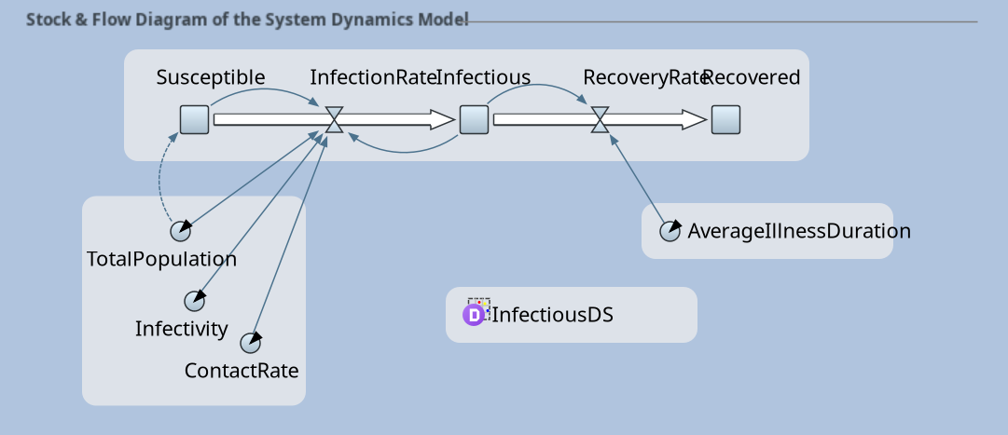
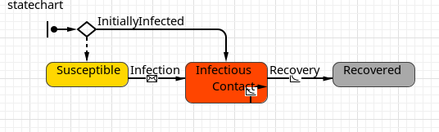
Diagrams
Diagrams are frequently used as boundary objects in modelling
  Stock and flow diagrams in SD models
  State charts in ABM models
  etc.
Many of these are built in to AnyLogic already

Slide 14
Critical Components
Communicate critical processes that drive model behaviour through boundary objects
Critical processes in trucker model:
  How do truckers decide where to stop?
  How are truckers assigned their destinations?
These are mostly decision processes.

Slide 15
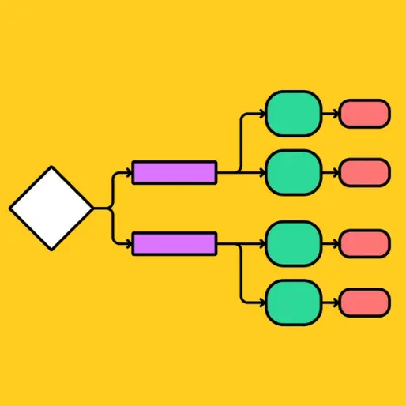
Flow Charts
Flow charts are useful boundary objects for representing a decision process
Trucker’s perspective:
  Does the flow chart match my personal experience?
Programmer’s perspective:
  Is the flow chart complete enough to implement in code?

Slide 16
Building Flow Charts
Build in collaborative sessions
Build alongside the code
  Code will reveal special cases
Our favourite tool is draw.io
  Integrated with Google Drive
  Simultaneous viewing / editing
  app.diagrams.net

Slide 17
Flow Chart Example
...

