Slide 1
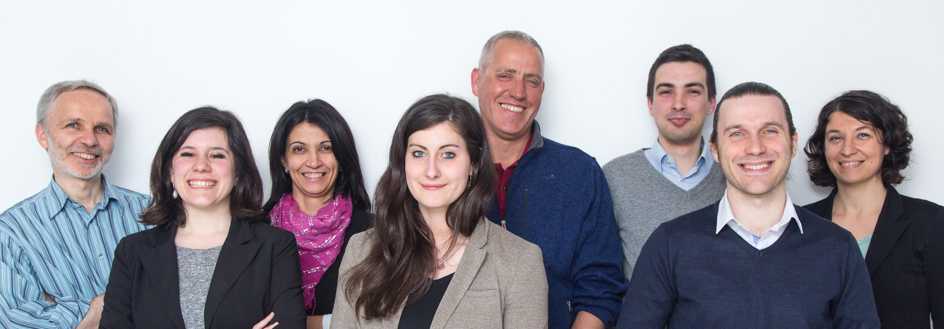


Slide 2
Quantide is an
independent
data science company
based in Milan, Italy

Slide 3

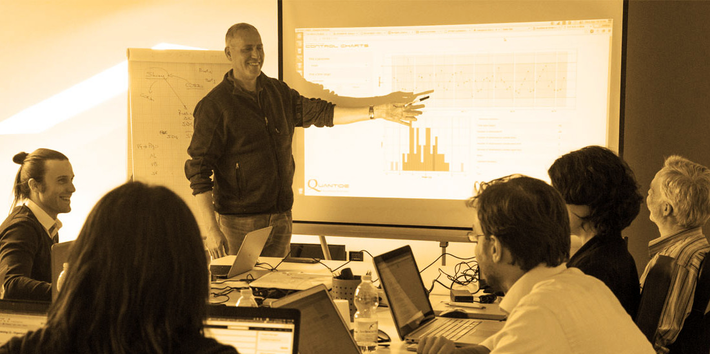
We offer
R Consulting
R Training

Slide 4
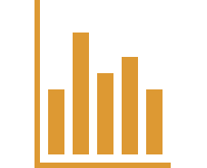
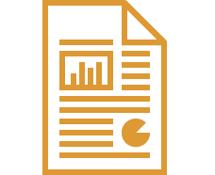
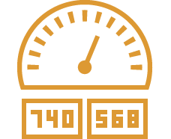
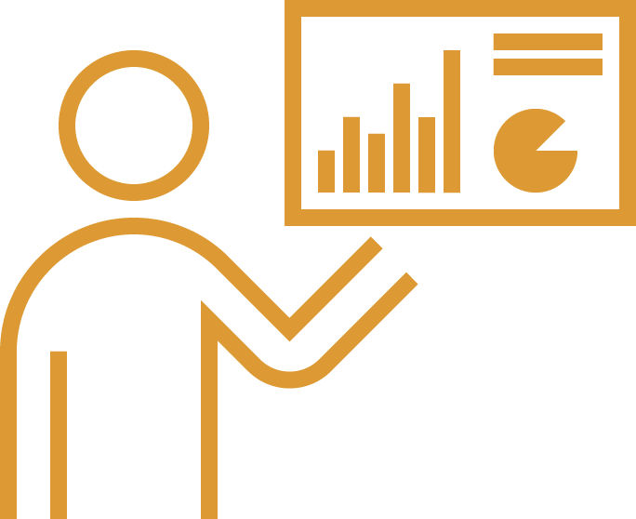
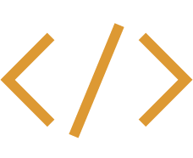

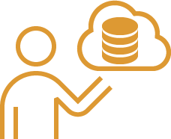
R consulting
Data analysis
Reporting
Dashboard
Training
Advanced Development
Advanced Analytics
IT for Data Analysis

Slide 5
R consulting
Fully automated reporting
Scheduling
PDF or Html output
Shiny application for interactive data visualization
Reporting &
Dashboard

Slide 6
R consulting
Development of efficient data analysis software
Optimization of existing software
Update of existing routines to the newest version of R
Organization of R code into structured and documented packages
Advanced development

Slide 7
R consulting
Cloud custom Unix servers set up with:
R and R-studio server
Distributed computing environment with R on top of Hadoop and Spark
Shiny server
IT for Data Analysis

Slide 8
R consulting
Operational risk management Churn modeling Quality statistics Pharma process development Insurance pricing Customer profiling Sales forecast ...
Advanced analytics

Slide 9



R training
R for Beginners
Data Manipulation with R
Data Visualization with R
Statistical Models with R
R Courses
Data Mining with R
R for Developers

Slide 10
Quantide is founder and supporter of
MilanoR
the largest R user community in Italy

Slide 11
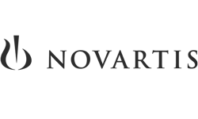

















Our clients

Slide 12
www.quantide.com
info@quantide.com

