Slide 1
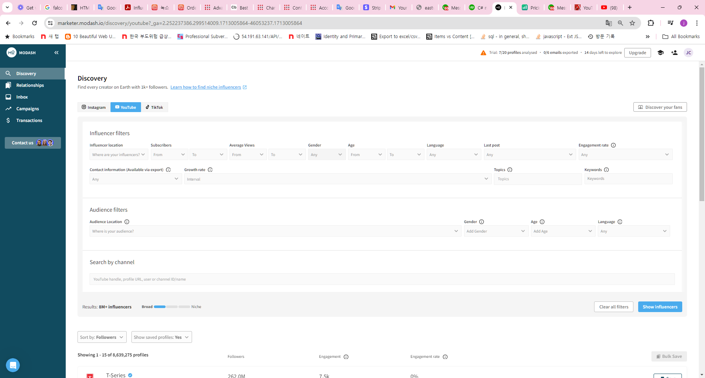
List Page - Search

Slide 2
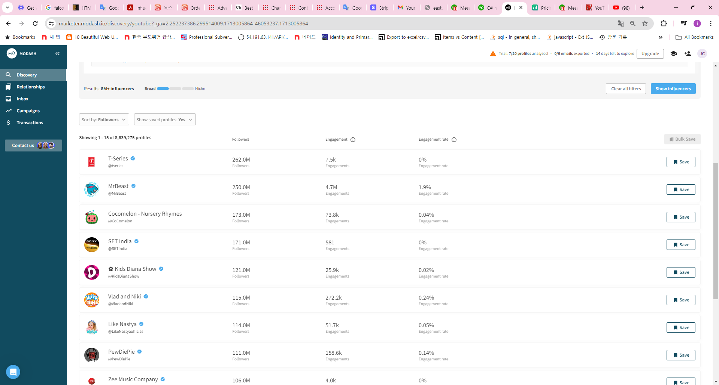
List Page – data
Bellow down show paging bar

Slide 4
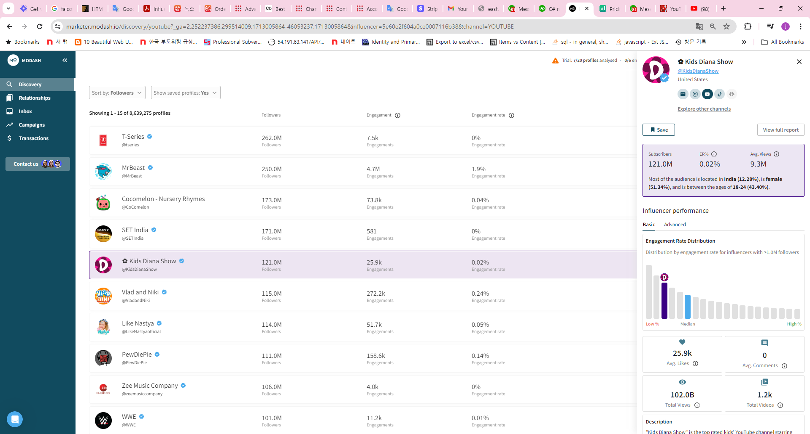
Row click.- right bar detail

Slide 5
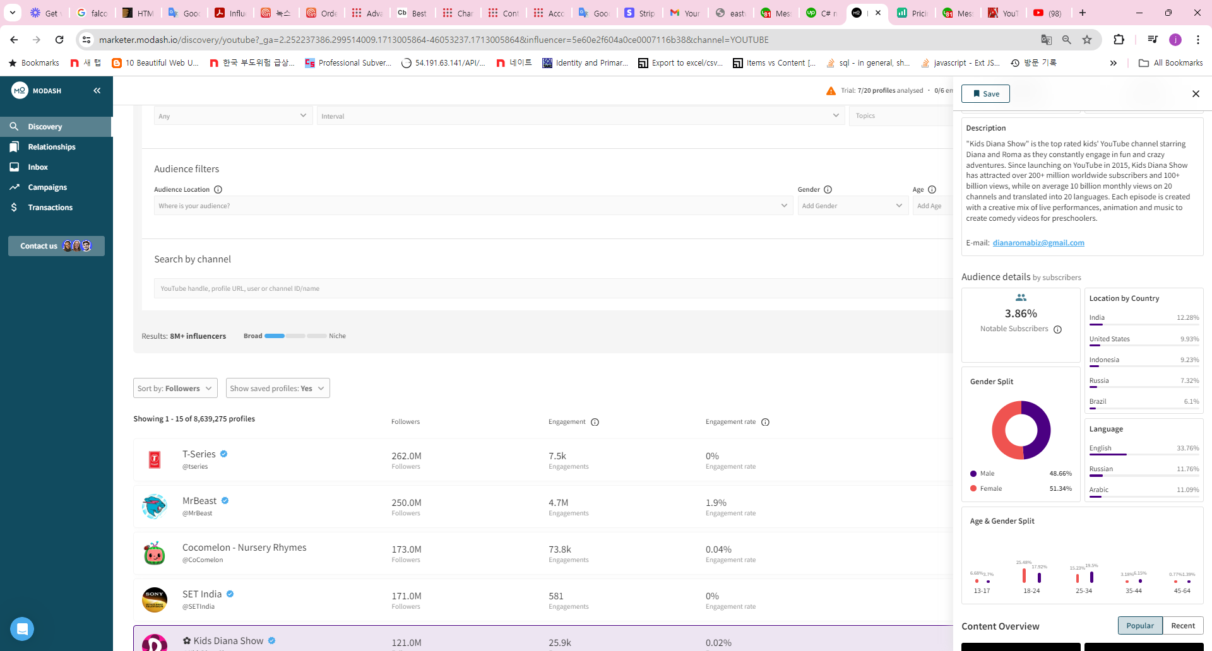
Row click.- right bar detail

Slide 6
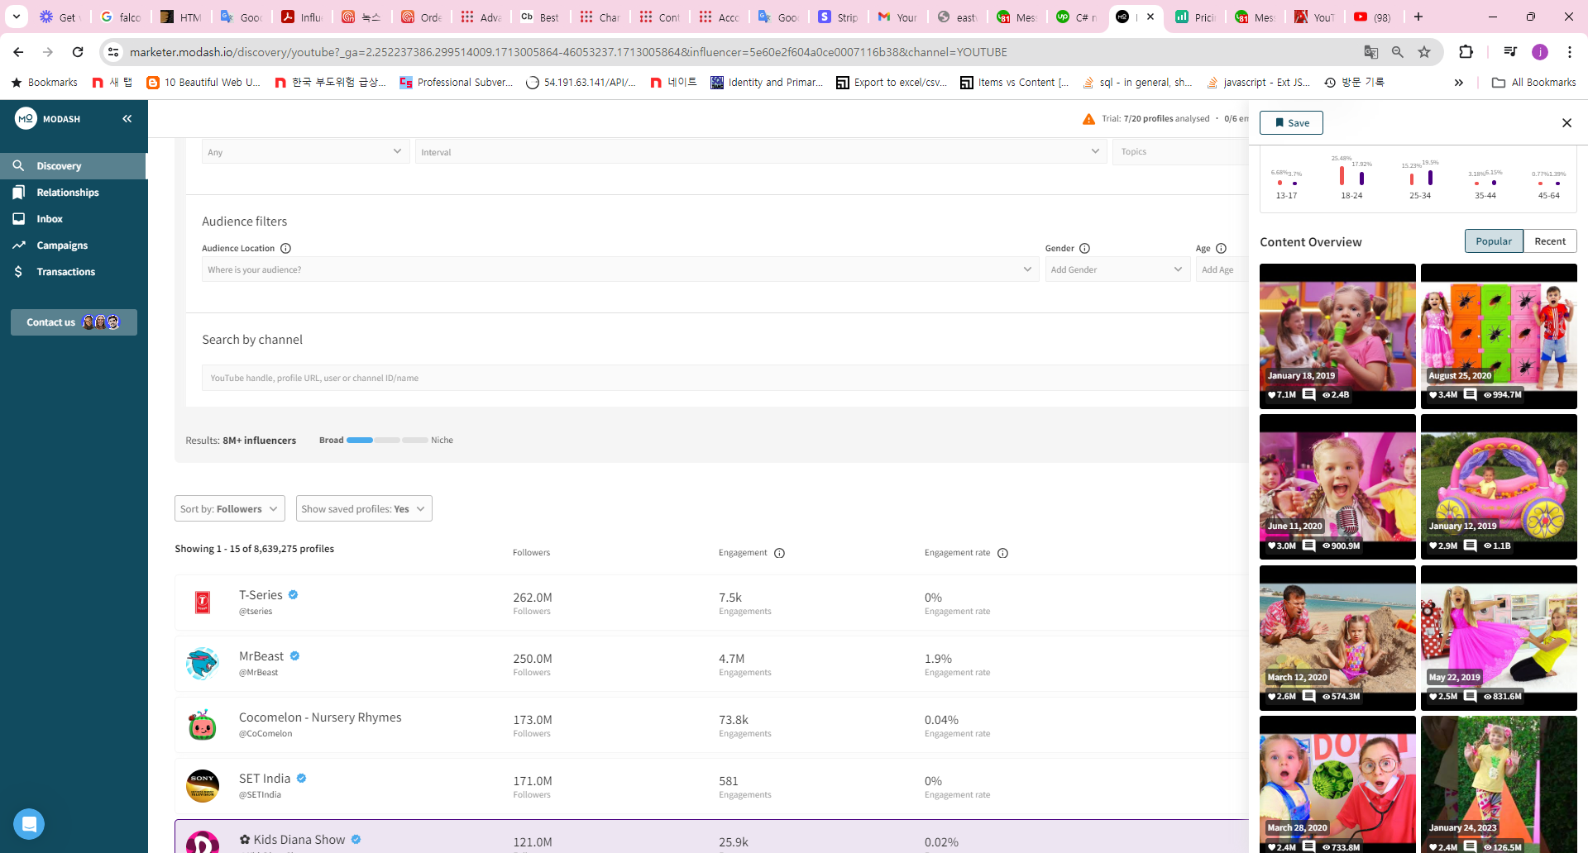
Row click.- right bar detail

Slide 7
Row click.- right bar detail

Slide 8
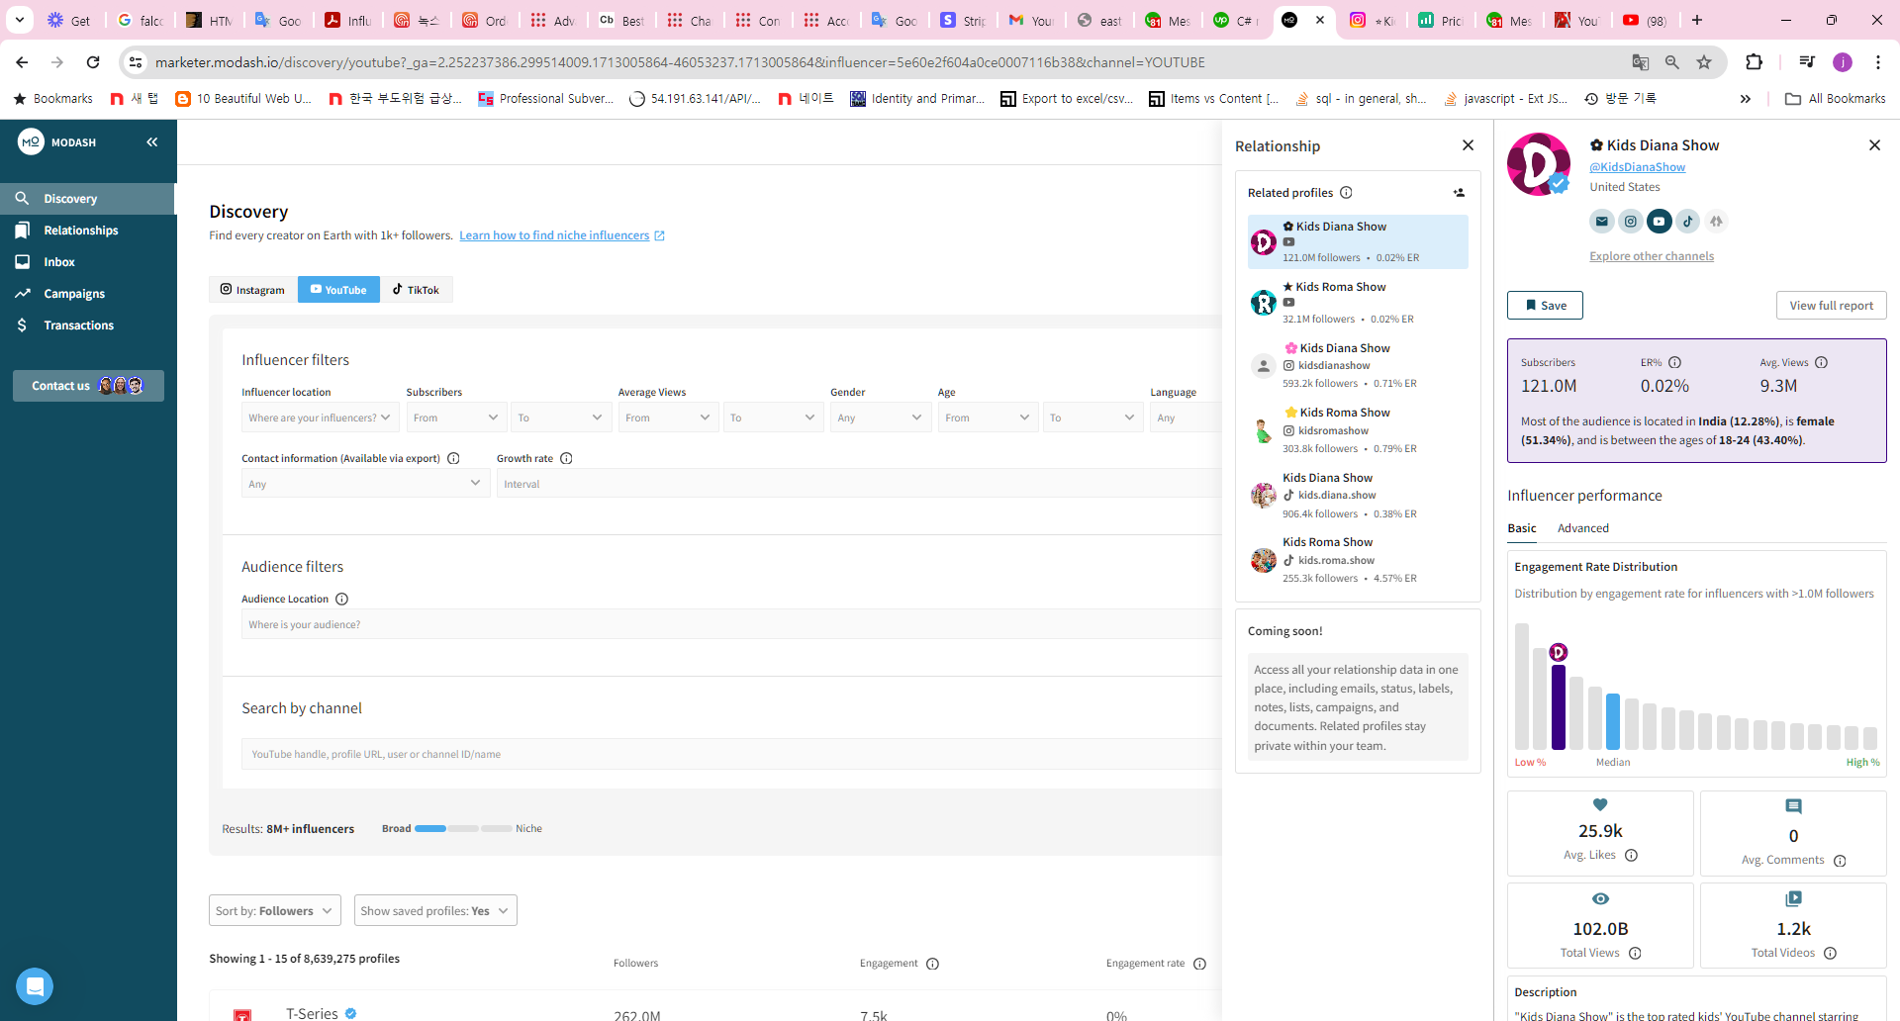
right-bar – explore other channels click
Showing right bar

