Slide 1


Slide 2
Test Driven Development
Ryan Kotzen
TDD Dojo

Slide 3
Prerequisites
Laptop with the following:
Node.js the 6.10.2+ LTS version is fine.
Your favourite text editor/IDE, such as:
Webstorm
VS Code
Atom
Brackets
Sublime
Notepad++
A basic understanding of JavaScript.
A basic understanding of unit and integration testing.
Knowing Mocha and Chai will be useful but is not necessarily required before hand.

Slide 4
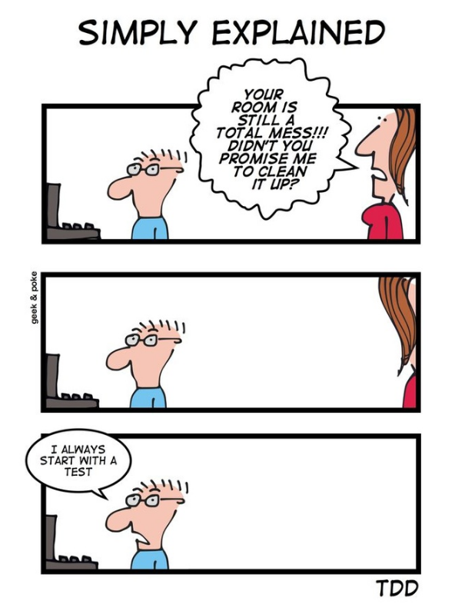

Slide 5
Why TDD?
Tests cover actual expectations
Tests don’t check that the code does what it already does
Leads to testable code
No struggle to figure out how to test something because of how it was built
Smaller units
Each component is tested and therefore written in smaller parts

Slide 6
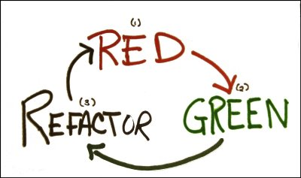
Three Laws of TDD
You must write a failing test before you write any production code.
You must not write more of a test than is sufficient to fail, or fail to compile.
You must not write more production code than is sufficient to make the currently failing test pass.

Slide 7
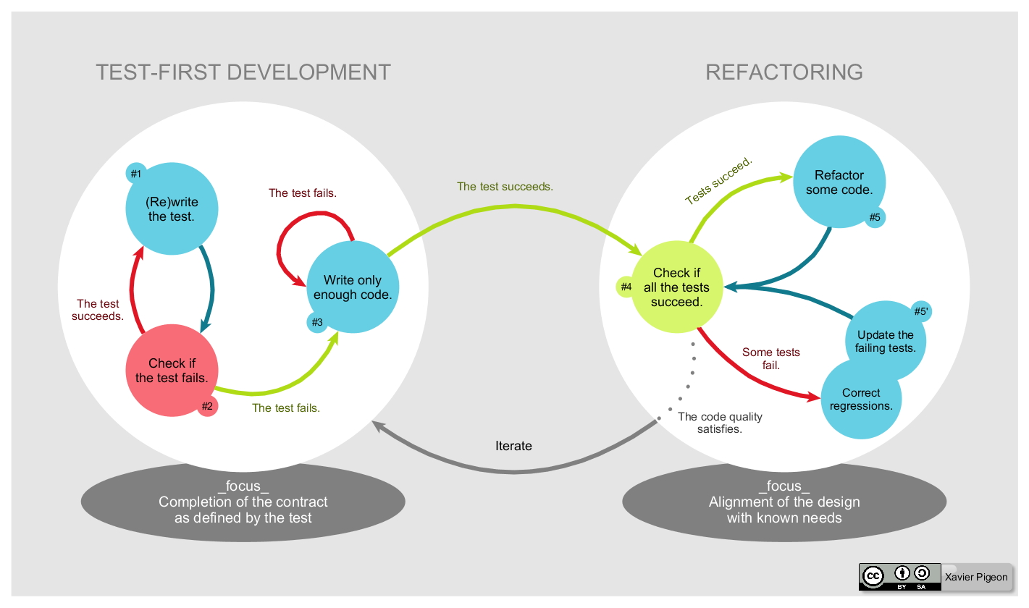

Slide 8
Don’t TDD your GUI
Complexity – the number of possible user interactions from different application states, grows exponentially as the GUI functionality increases.
Verification – as the complexity increases it becomes harder to create automated test scripts that cover a sufficient number of cases.
Change – GUIs change very often during development, so test script maintenance becomes a burden.

Slide 9
Test Double
Test Double is the generic term for any kind of pretend object used in place of a real object for testing purposes. The name comes from the notion of a Stunt Double in movies.
Dummy objects are passed around but never actually used. Usually they are just used to fill parameter lists.
Fake objects actually have working implementations, but usually take some shortcut which makes them not suitable for production (an in memory database is a good example).
Stubs provide canned answers to calls made during the test, usually not responding at all to anything outside what's programmed in for the test.
Spies are stubs that also record some information based on how they were called. One form of this might be an email service that records how many messages it was sent.
Mocks are what we are talking about here: objects pre-programmed with expectations which form a specification of the calls they are expected to receive.

Slide 10
Dummies
Objects passed around but never actually used (used to fill parameter lists), “empty” implementation
public class FooDummy : Foo
{
public String bar() { return null; }
}
public class FooCollectionTest
{
[Test]
public void it_should_maintain_a_count()
{
FooCollection sut = new FooCollection();
sut.Add(new FooDummy());
sut.Add(new FooDummy());
Assert.AreEqual(2, sut.Count());
}
}

Slide 11
Fakes
Actual working implementation, but have some shortcut which means they unsuitable for production
class InMemoryUserRepository : UserRepository
{
private UserCollection users = new UserCollection();
public bool Add(User user)
{
return this.users.Add(user);
}
public bool Delete(User user)
{
return this.Delete(user.GetIdentifier());
}
}

Slide 12
Stubs
Implementation of interface, but with canned responses
class FooStub : Foo
{
public String Bar()
{
return "baz";
}
}
public class FooCollectionTest
{
[Test]
public void it_should_return_joined_bars()
{
FooCollection sut = new FooCollection();
sut.Add(new FooStub());
sut.Add(new FooStub());
Assert.AreEqual("bazbaz", sut.Joined());
}
}

Slide 13
Mocks
Different to others which assert on state, mocks assert on behaviour. Mocks say “I expect you to do xyz”
// returning different values on each invocation
var mock = new Mock<IFoo>();
var calls = 0;
mock.Setup(foo => foo.GetCountThing())
.Returns(() => calls)
.Callback(() => calls++);
// returns 0 on first invocation, 1 on the next, and so on
Console.WriteLine(mock.Object.GetCountThing());
Notes:
The distinction here is the call to verify. Without it, then the test double is just a stub (even though we using a Mocking framework to create it)
Stubs assert state (what is the result), mocks assert behaviour (set up expectations, how was the result achieved)
Some say the difference is that mocks can fail a test, but stubs cannot i.e. mocks run asserts, stubs do not

Slide 14
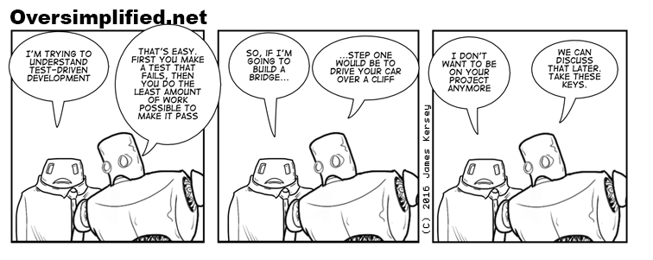
Practical Time!

Slide 15
References
https://martinfowler.com/articles/mocksArentStubs.html
http://www.velocitypartners.net/blog/2016/10/26/experience-shifting-traditional-development-tdd/
http://blog.cleancoder.com/uncle-bob/2014/12/17/TheCyclesOfTDD.html
https://zeroturnaround.com/rebellabs/if-and-when-you-should-use-test-driven-development/

Slide 16
Further Reading
http://www.amazon.com/Test-Driven-Development-By-Example/dp/0321146530
http://www.amazon.com/The-Art-Unit-Testing-Examples/dp/1933988274

