Slide 1
Enhancement to eXpOS Operating System and eXpFS File System
- Kruthika Suresh Ved
Sikha V Manoj
Sonia V Mathew
Guided by: Dr.K.Muralikrishnan

Slide 2
File System Calls
Create
Delete
Open
Close
Read
Write
Seek

Slide 3
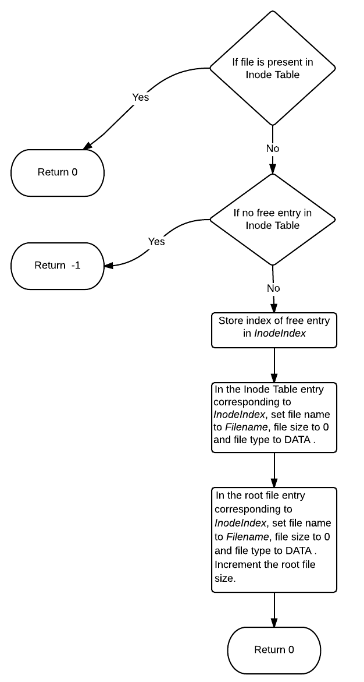
Create System Call

Slide 4
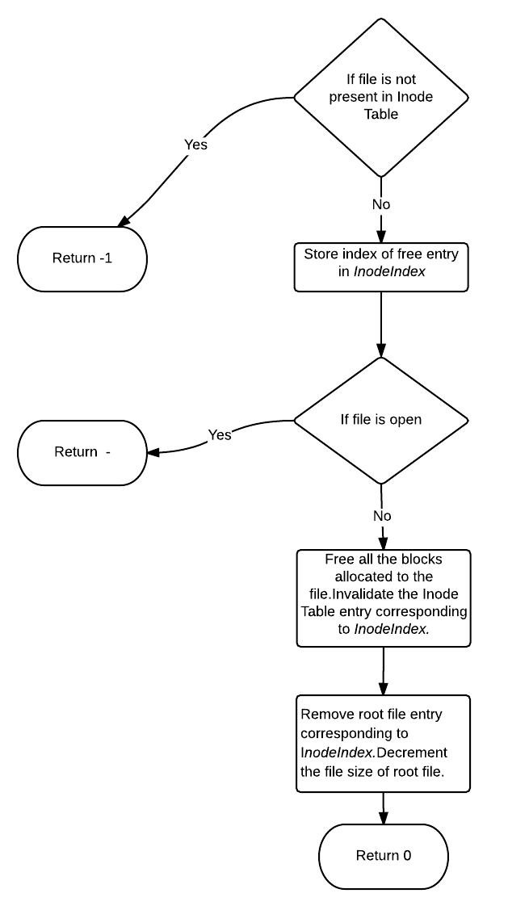
Delete System Call

Slide 5
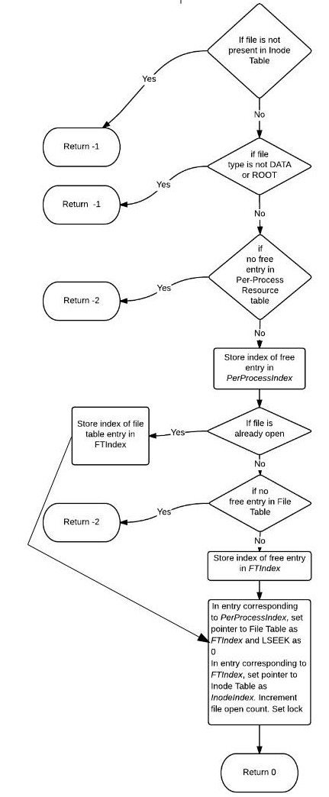
Open System Call

Slide 6
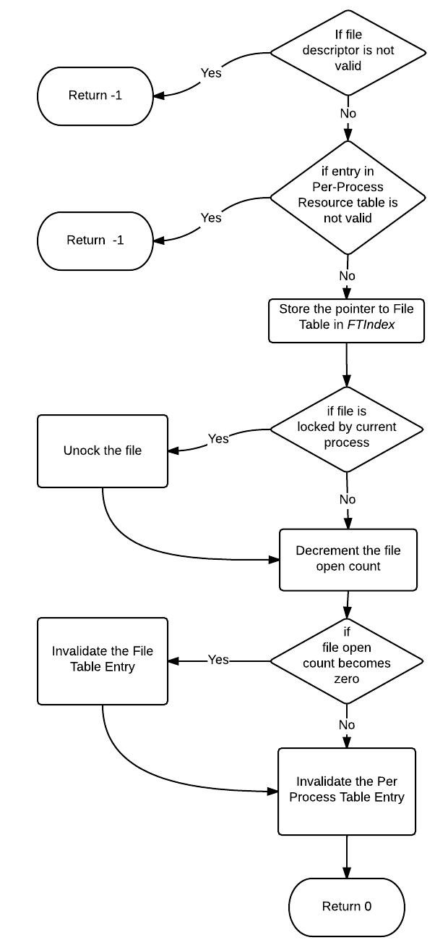
Close System Call

Slide 7
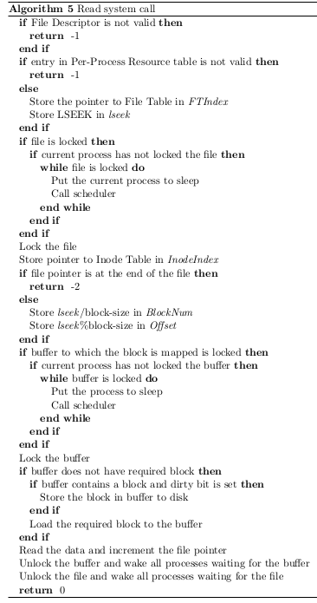

Slide 8
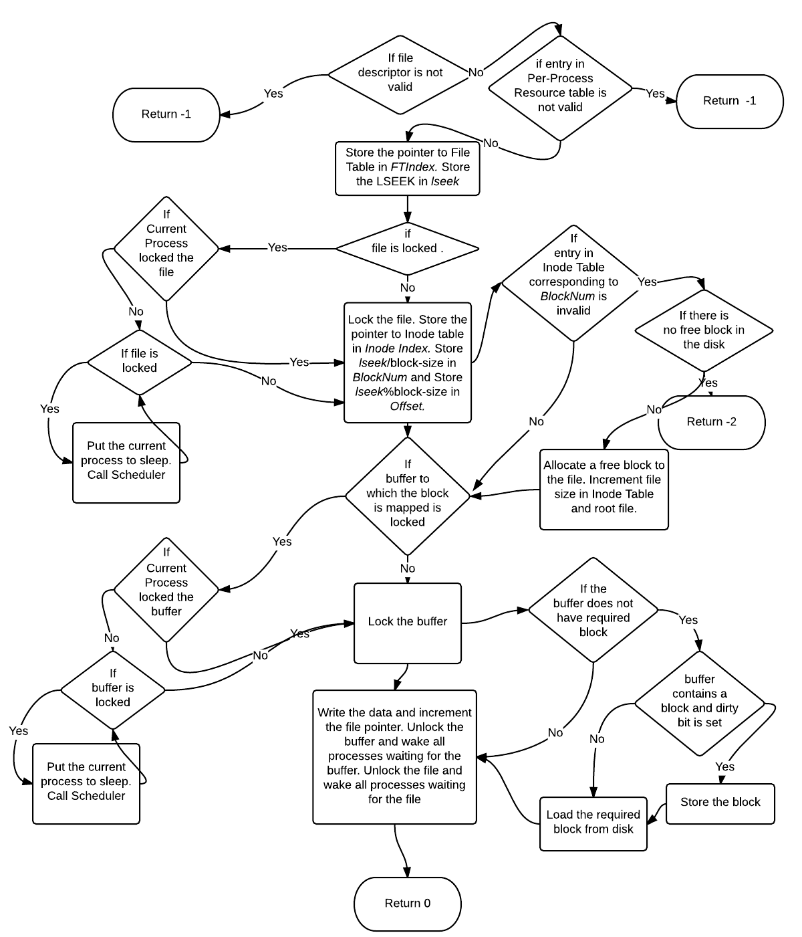
Write System Call

Slide 9
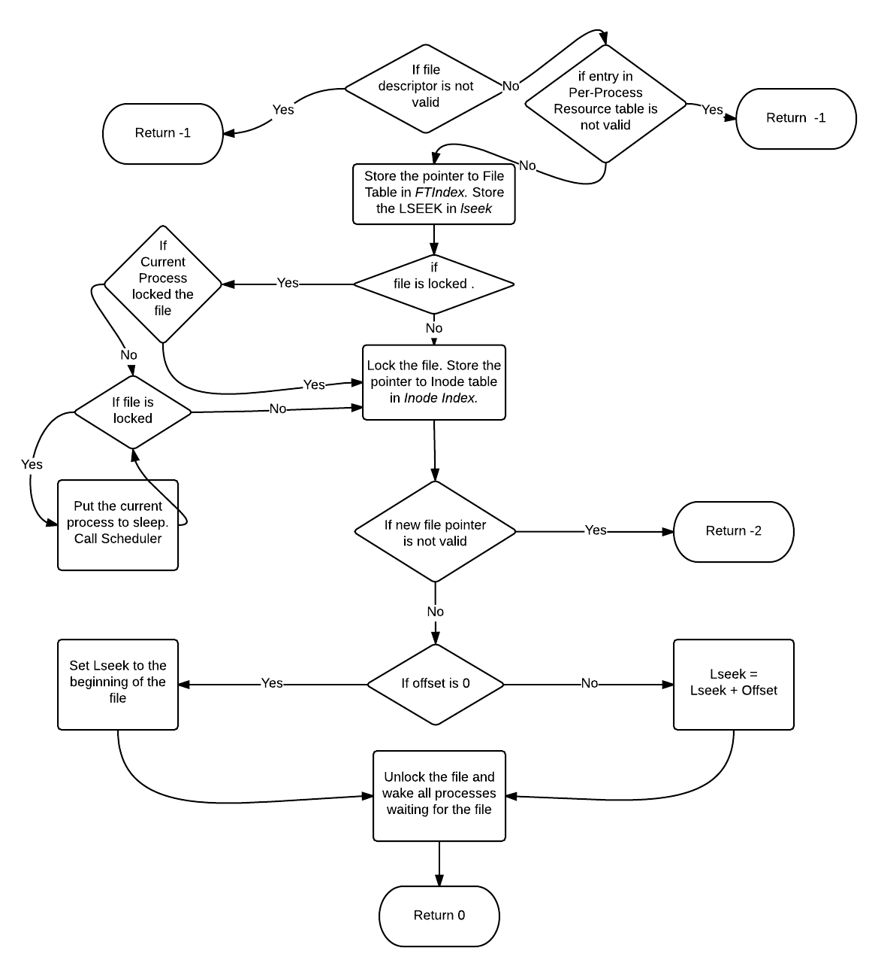
Seek System Call

Slide 10
Process System Calls
Fork
Exec
Exit
GetPid
GetPPid
Shutdown

Slide 11
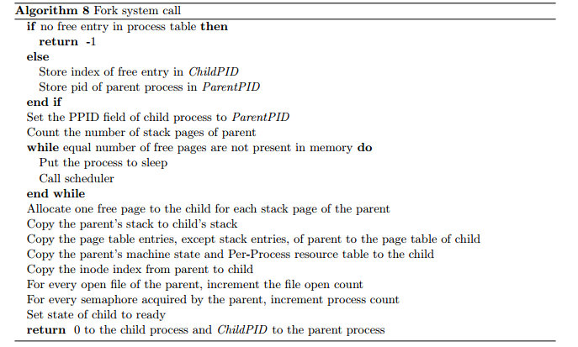

Slide 12
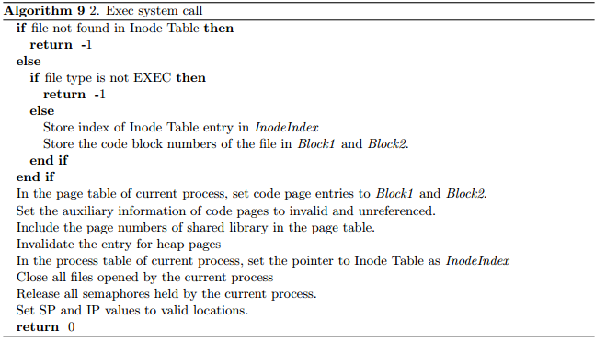

Slide 13
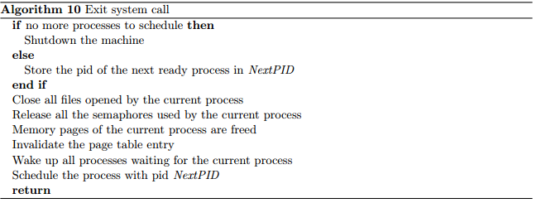

Slide 14

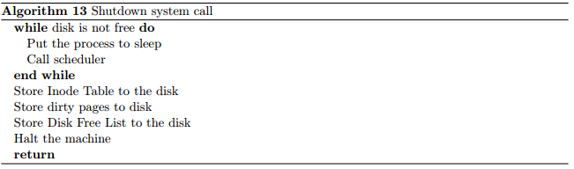

Slide 15
System calls for access control and synchronization
Wait
Signal
Flock
FunLock
Semget
Semrelease
SemLock
SemUnLock

