Slide 1
ALGORITHMS
File System Calls
Process System Calls
System Calls for synchronization and access control
Hardware Interrupts and Exception Handlers
Miscellaneous

Slide 2
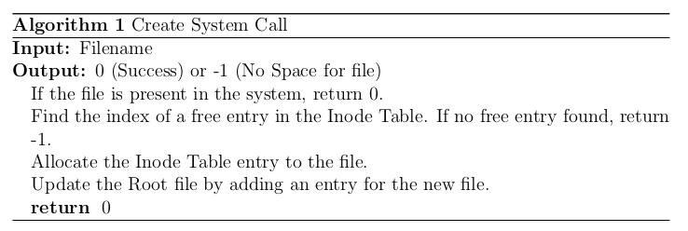
Create System Call
The Create operation creates an empty file.
If a root entry for the file already exists, then the system call returns 0 (success).
It creates a root entry for the file name, sets the file type to DATA and file size to 0.
Note that the file name must be a character string and must not be named “root”.

Slide 3
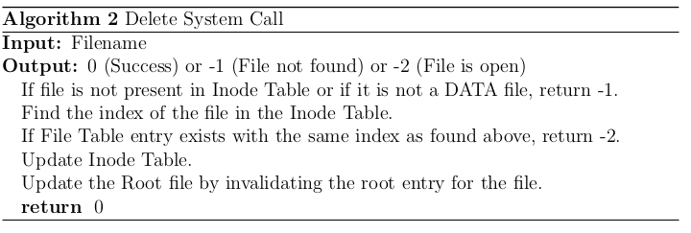
Delete System Call
Delete removes the file from the file system and removes its root entry.
A file that is currently opened by any application cannot be deleted.
Root file and Executable files also cannot be deleted.

Slide 4
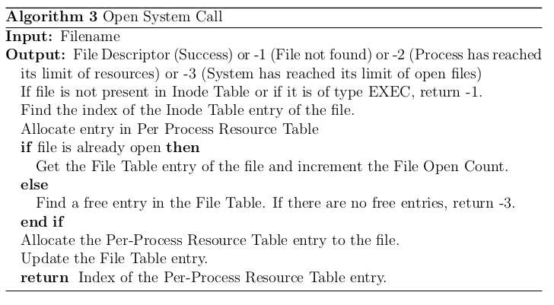
Open System Call
Only data and root files can be opened.
The file descriptor must be passed as argument to other file system calls, to identify the open instance of the file.
An application can open the same file several times and each time, a different descriptor will be returned by the Open operation.
The Open system call sets the file pointer to 0 (beginning of the file).

Slide 5
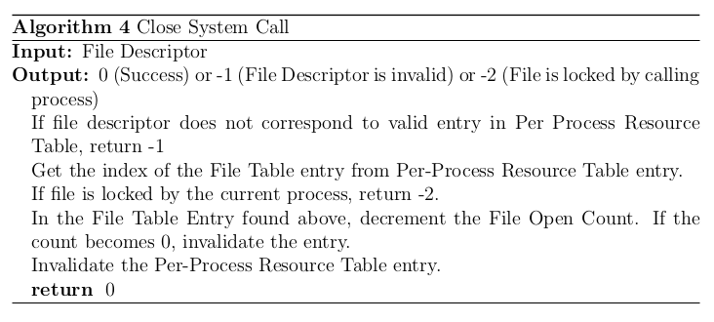
Close System Call
The file descriptor ceases to be valid once the close system call is invoked.
Close system call fails if file was locked by the process which invoked the system call.

Slide 6
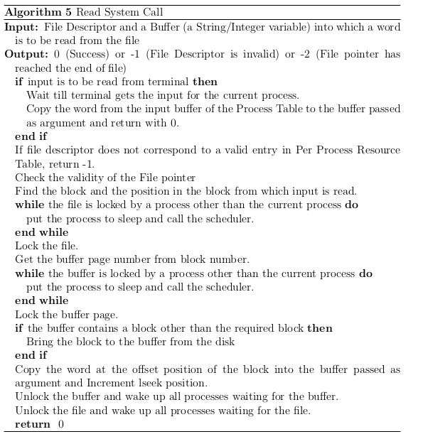
Read System Call
The Read operation reads one word from the position pointed by the file pointer and stores it into the buffer.
After each read operation, the file pointer advances to the next word in the file.

Slide 7
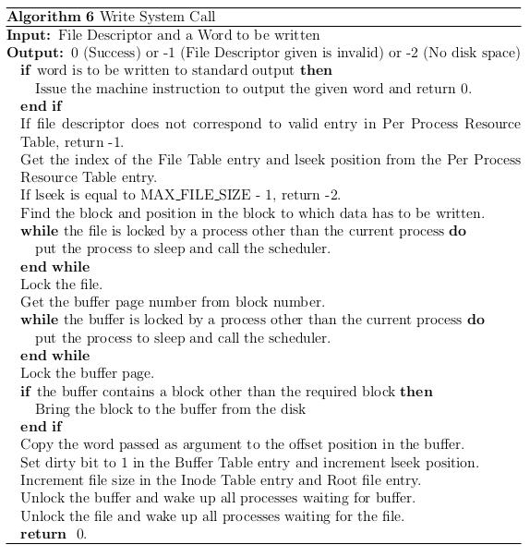
Write System Call
The Write operation writes the word stored in the buffer to the position pointed by the file pointer of the file.
After each Write operation, the file pointer advances to the next word in the file.

Slide 8
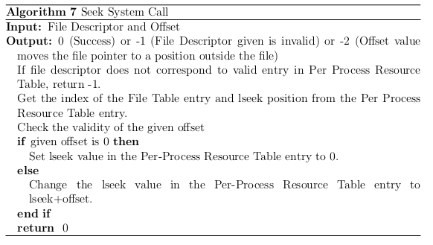
Seek System Call
The Seek operation allows the application program to change the value of the file pointer so that subsequent Read/Write is performed from a new position in the file.
The new value of the file pointer is determined by adding the offset to the current value. (A negative Offset will move the pointer backwards).
An Offset of 0 will reset the pointer to the beginning of the file.

Slide 9
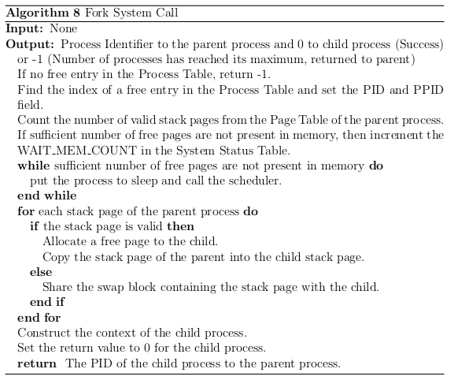
Fork System Call
Replicates the process invoking the system call.
The heap, code and library regions of the parent are shared by the child.
A new stack is allocated to the child and the parent's stack is copied into the child's stack.
When a process executes the Fork system call, the child process shares with the parent all the file and semaphore descriptors previously acquired by the parent.

Slide 10
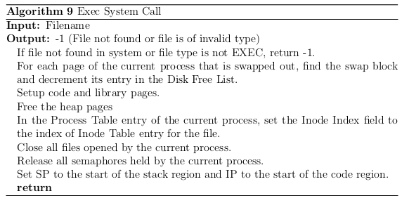
Exec System Call
Exec destroys the present process and loads the executable file given as input into a new memory address space.
The newly created process will inherit the PID of the calling process.

Slide 11
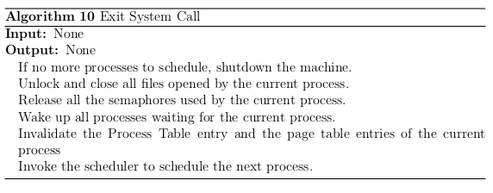
Exit System Call
Exit system call terminates the execution of the process which invoked it and destroys its memory address space.
The calling application ceases to exist after the system call and hence the system call never returns.

Slide 12
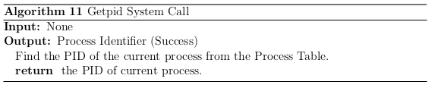
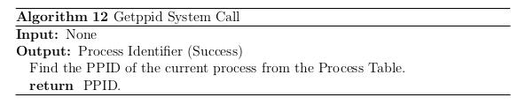
Getpid
Getppid
Returns the process identifier of the invoking process.
The system call does not fail.
Returns to the calling process the value of the process identifier of its parent.
The system call does not fail.

Slide 13
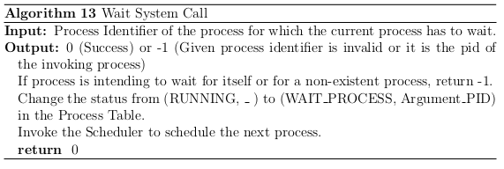
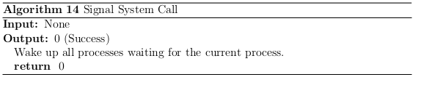
Wait Signal
The current process is blocked till the process with PID given as argument executes a Signal system call or exits.
The system call will fail if a process attempts to wait for itself.
All processes waiting for the signaling process are resumed.
The system call does not fail.

Slide 14
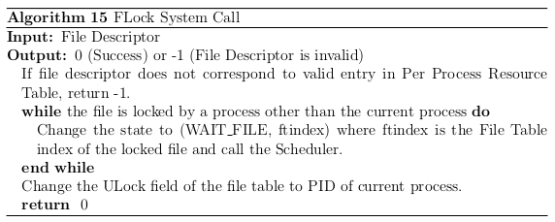
FLock System Call
To lock a file so that other applications running concurrently are not permitted to read/write the file till the calling process unlocks it.
If the file is already locked by some other process, the Read/Write system call waits for the file to be unlocked, locks it, and returns to the calling process.

Slide 15
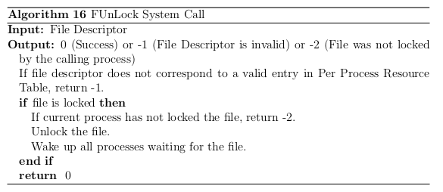
FUnlock System Call
FUnLock operation allows an application program to unlock a file which the application had locked earlier.

Slide 16
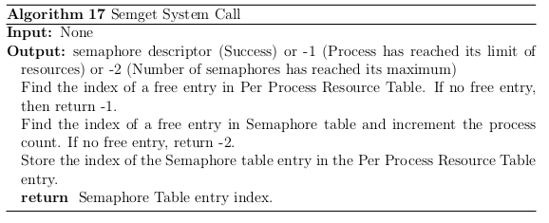
Semget System Call
This system call is used to obtain a binary semaphore.
The calling process can share the semaphore with its child processes using the fork system call

Slide 17
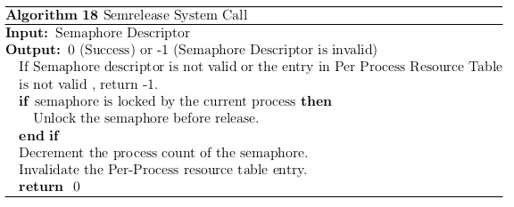
Semrelease System Call
This system call is used to release a semaphore descriptor held by the process.

Slide 18
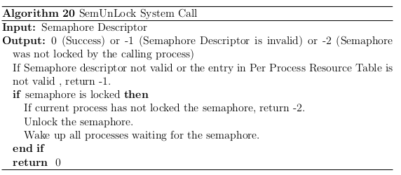
SemLock System Call
This system call is used to lock the semaphore.
If the semaphore is already locked by some other process, then the calling process goes to sleep and wakes up only when the semaphore is unlocked.
Otherwise, it locks the semaphore and continues execution.

Slide 19
SemUnLock System Call
This system call is used to unlock a semaphore that was previously locked by the calling process.
It wakes up all the processes which went to sleep trying to lock the semaphore while the semaphore was locked by the calling process.

Slide 20
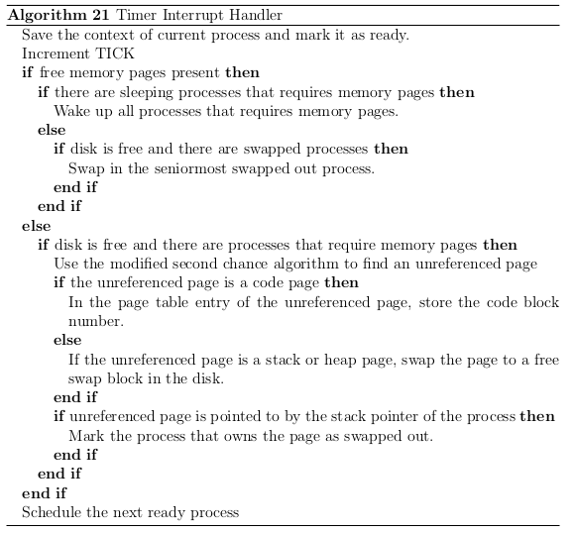
Timer Interrupt Handler
The Timer Interrupt routine handler implements a co-operative multitasking round robin scheduler.
The timer interrupt routine schedules the next ready process for execution.
It swaps in (or out) processes from (or to) the disk.
If unused memory pages are present in the system, it wakes up those processes which were blocked due to lack of memory.

Slide 21
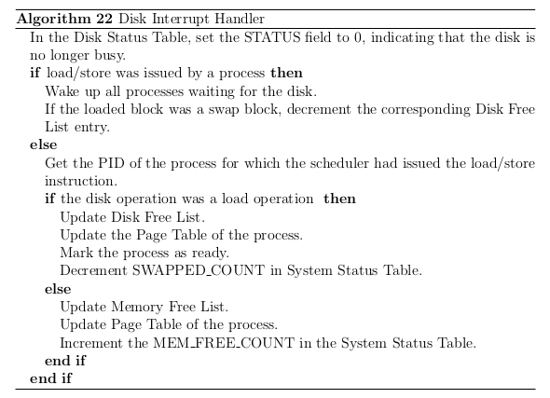
Disk Interrupt Handler
Hardware sends an interrupt on completion of a load/store operation.
This interrupt is handled by the Disk Interrupt Handler.

Slide 22
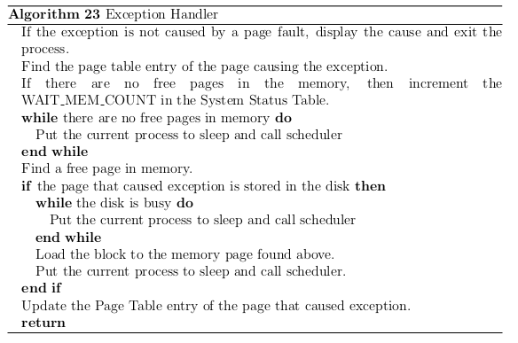
Exception Handler
When a page fault exception occurs, the exception handler routine checks if the page resides in the disk.
If it does, it is loaded to the memory and the page table is updated.
Otherwise, a new page is allocated to the process by the exception handler.

Slide 23
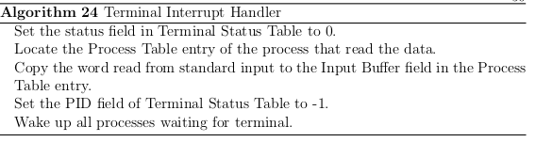
Terminal Interrupt Handler
Once input data is read, the terminal device sends a hardware interrupt, which is handled by the terminal handler.
The terminal handler is responsible for waking up processes that are blocked for input console.

Slide 24
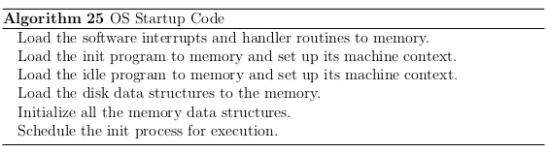
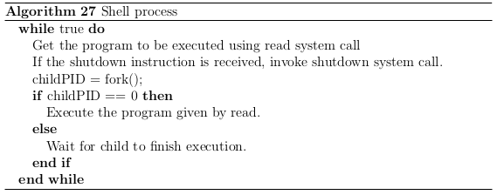
OS Startup Code
Shell Process

Slide 25
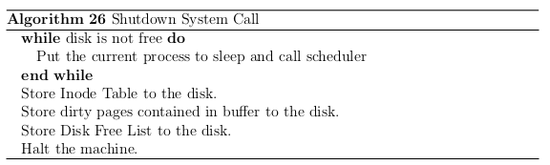

Shutdown System Call
Idle Process

Slide 26
Work Done
The existing OS data structures were redesigned to incorporate the changes done.
New data structures like Buffer Table, Disk Status Table, Semaphore Table, System Status Table etc were designed.
System calls were redesigned to incorporate asynchronous operations, buffer cache and co-operative time sharing scheduling.
Executable file format was designed.
Algorithms for system calls and other interrupt handlers were designed.
Webpage for Project eXpOS was created.
http://exposnitc.github.io/

Slide 27
Future Work
Building a Roadmap for guidance.
Implementing and testing the algorithms designed
Adding more features like file permissions and Super-User previleges.
Adding Multi-Threading feature.
Adding a Directory structure in eXpFS.

Slide 28
References
Shamil C. M., Sreeraj S, and Vivek Anand T.Kallampally, ”XOS - An Experimental Operating System”, http://xosnitc.github.io/
Saman Hadiani, Niklas Dahlbck, and Uwe Assmann, ”Nachos Beginner’s Guide”, http://www.ida.liu.se/TDDB63/material/begguide/
George Fankhauser, Christian Conrad, Eckart Zitzler, Bernhard Plattner, ”Topsy - A Teachable Operating System”, Version 1.1, http://www.tik.ee.ethz.ch/topsy/Book/Topsy1.1.pdf
Maurice J. Bach, ”The Design of Unix Operating System”
Thomas W. Doeppner, ”Operating Systems in Depth”, Wiley, 2011.

