Slide 1

Do you want to brew a coffee?
XR CONTINUUM PRESENTS
Notes:
COLD OPEN. Lights low if you can. One speaker, standing, no reading. Click, then wait a full two seconds before speaking.
"Do you want to brew a coffee?"
[Pause. Let them answer in their heads.]

Slide 2
A double shot flat white.
18 g
COFFEE IN
25–30 s
EXTRACTION
65 °C
MILK
Notes:
"A double shot flat white."
[Slower now, almost fond.] "Eighteen grams of coffee. Twenty-five to thirty seconds. Milk at sixty-five degrees."
[It should sound simple. That's the trap.]

Slide 3
But do you know how?
Notes:
[Beat. Then quietly:] "But do you know how?"
[Hold eye contact with the panel. Count three.]

Slide 4
Nobody does, the first time.
Every barista learned on a live machine, in the middle of a rush, one wasted shot at a time.
Notes:
"Nobody does, the first time. Every barista you've ever met learned on a live machine, in the middle of a rush, one wasted shot at a time. Beans in the bin. A queue at the counter. Someone senior sighing over their shoulder."

Slide 5
This isn't a game.
It's the morning before your first shift.
Notes:
"So we built something. This isn't a game. It's the morning before your first shift: the café is empty, the machine is warm, and every mistake is free."
[Click to the title. Lights up.]

Slide 6


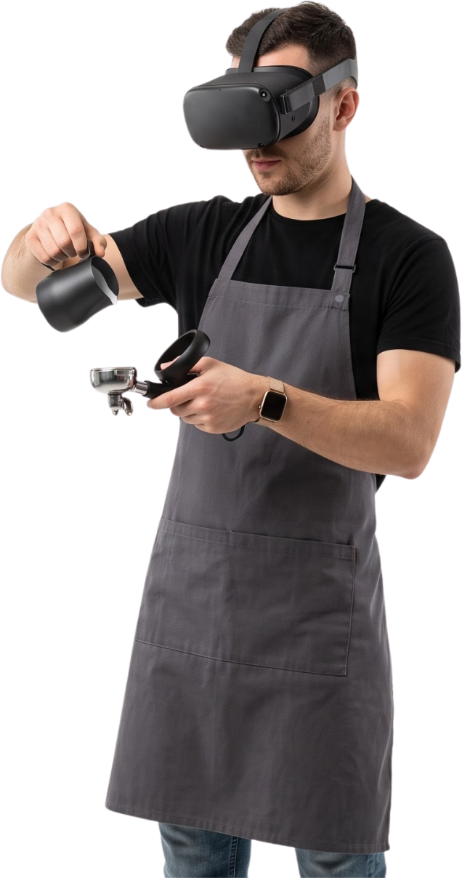

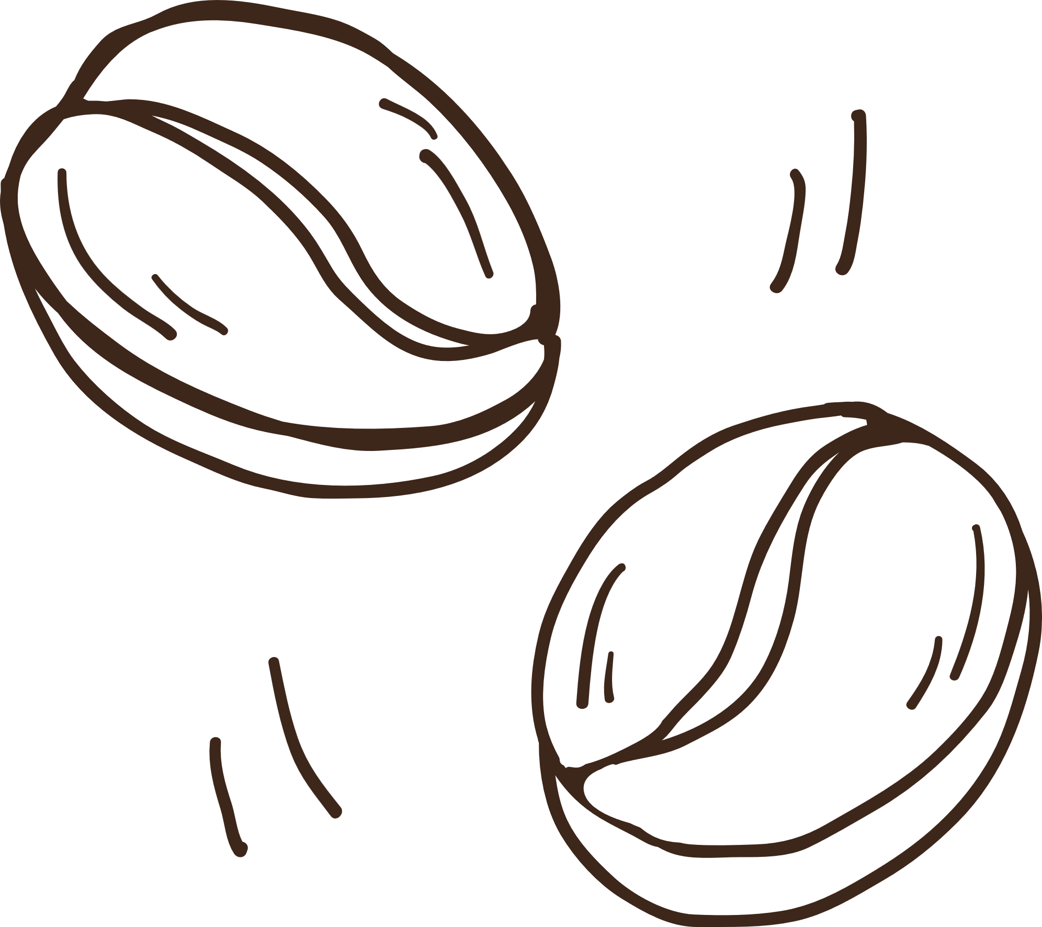
INTE 42312 · VIRTUAL & AUGMENTED REALITY
Barista Calibration Trainer
Dialling in a commercial espresso machine in VR
TEAM XR CONTINUUM
<Member 1> · <Member 2> · <Member 3> · <Member 4>
Notes:
Segment 1, lights up. "This is the Barista Calibration Trainer, by XR Continuum, for INTE 42312." Introduce every member by name, then go straight to the contribution slide: the brief requires the declaration and timeline first, so the cold open must stay under a minute.

Slide 7

02 · INDIVIDUAL CONTRIBUTION
Who built what, and who defends it
MEMBER A
MEMBER B
MEMBER C
MEMBER D
<name>
<name>
<name>
<name>
XR rig & build
Dose & tamp
Brew & model
Milk, flow & audio
Device tracking origin, seated eye height
Snap turn, no locomotion
Keyboard & mouse fallback
Windows build pipeline
Grinder dosing & grind dial
Upright tamper grip
Spring tamp: force and level
Portafilter sockets
Group-head bayonet lock
Live extraction model
Pressure gauge, timer, yield
Steam to 65 °C and pour
ShiftFlow, ticket, result dial
Spatial audio
Welcome & credits boards
KEY FILES
KEY FILES
KEY FILES
KEY FILES
CafeSceneBuilder (rig), DesktopRigDriver, input actions
GrinderStation, GrindDial, Tamper, TamperPress, TamperGrabTransformer
GroupHead, ExtractionModel, MachineGauge
SteamWand, MilkPour, ShiftFlow, OrderTicket, ResultDial, AudioKit
Each member operates and explains their own part live in the demo.
XR Continuum · Barista Calibration Trainer
07
Notes:
Segment 2, presented FIRST. Each person names their part and files. The panel may question anyone on their own part, so only claim what you can explain. With three members, merge B and C.

Slide 8

03 · PROJECT MANAGEMENT
Plan vs. what actually happened
Planned
Actual (drag to match)
TASK
MON 5 OCT
TUE 6 OCT
WED 7 OCT
THU 8 OCT
FRI 9 OCT
SAT 10 OCT
Rig, packages, grey-box café
Dose & tamp
Lock, extraction model, gauge
Steam, pour, flow, audio
UX, physics & text polish
Windows build, cross-testing, credits
Rehearse, submit & present
DEVIATIONS & WHY
<e.g. Unity 6 + XR packages took most of day 1 · text and physics feel needed an extra polish pass after the first simulator tests · the exe showed an old scene until the build menu regenerated it>
XR Continuum · Barista Calibration Trainer
08
Notes:
Segment 3, straight after the declaration. Dark bars = plan, caramel = actual. Drag the caramel bars to reality and give one reason per slip; honesty about deviations is what is marked.

Slide 9

04 · PROBLEM STATEMENT
Baristas learn on the live machine
New café staff learn espresso on the café's only machine, often during service.
Every practice shot uses about 18 g of specialty coffee and every practice latte uses milk. Dialling in a grinder takes many shots.
The group head is blocked, customers wait, and a shift lead has to stand beside the trainee.
18 g
of coffee binned on every practice shot
1
group head tied up while a trainee practises
3
people affected: trainee, shift lead, owner
XR Continuum · Barista Calibration Trainer
09
Notes:
Segment 4: the specific problem, who it affects and why it matters. Keep it concrete: beans, milk, a blocked machine, a supervisor's time.

Slide 10
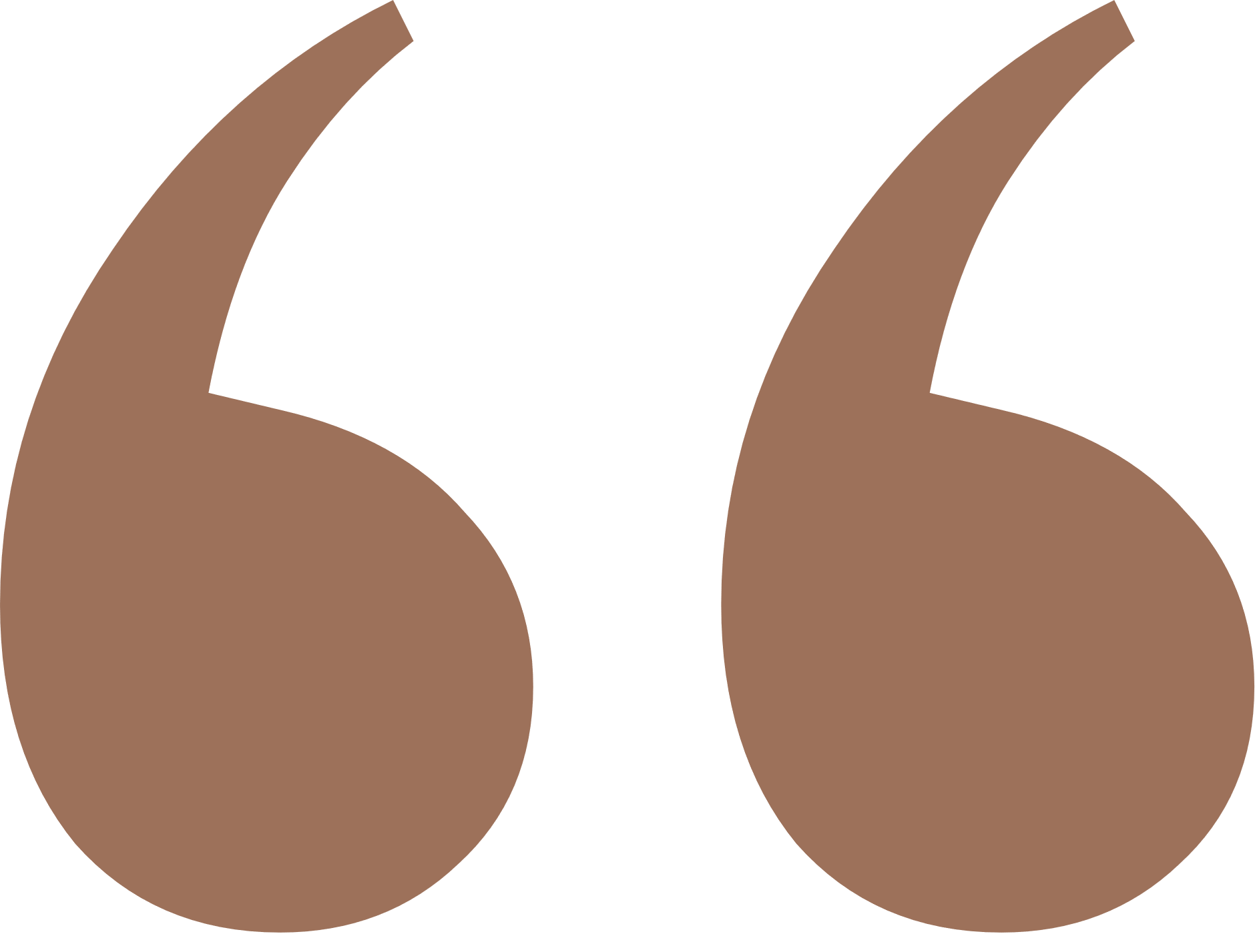
05 · VISION STATEMENT
A new barista sits down, reads one order ticket and pulls a correctly calibrated flat white, without anyone showing them how and without wasting a single real bean.
What success looks like for the trainee
XR Continuum · Barista Calibration Trainer
10
Notes:
Segment 5: read it once, slowly. Every later slide traces back to: unaided, calibrated, no waste.

Slide 11

06 · OBJECTIVES
Three measurable objectives
01
Unaided, end to end
A first-time user completes the order, ticket to verdict, with no help in under 6 minutes.
02
Understands calibration
Explains a sour or bitter shot from the result dial and reaches Balanced within 3 attempts.
03
Milk on temperature
Steamed milk finishes between 63 and 67 °C on at least one attempt.
XR Continuum · Barista Calibration Trainer
11
Notes:
Segment 6: up to three, each measurable. Results come back on the conclusion slide.

Slide 12

07 · THEORETICAL GROUNDING
Module theory, applied to real decisions
01
02
03
Presence
Cybersickness
Vergence-accommodation
One coherent café, no menus floating in a void. Instructions on a paper ticket, the gauge on the machine, sounds from their source.
Seated and stationary, so no vection. The only rotation is an instant 45° snap turn; smooth move and teleport are off.
Reading panels sit 0.75–1 m away. Tools are within arm's reach but only glanced at, not read.
04
05
06
D.I.C.E.
Embodied learning
Spatial audio
Practising on the real machine is Counterproductive (blocks service) and Expensive (beans and milk).
Dose, grind, tamp force and level come from the hands, not a menu, so practice transfers to the real task.
Every sound is a 3D source at its object: VR's default, the reverse of the mono AR convention.
XR Continuum · Barista Calibration Trainer
12
Notes:
Segment 7: for each concept say the decision it caused. The criterion is application, not recital.

Slide 13


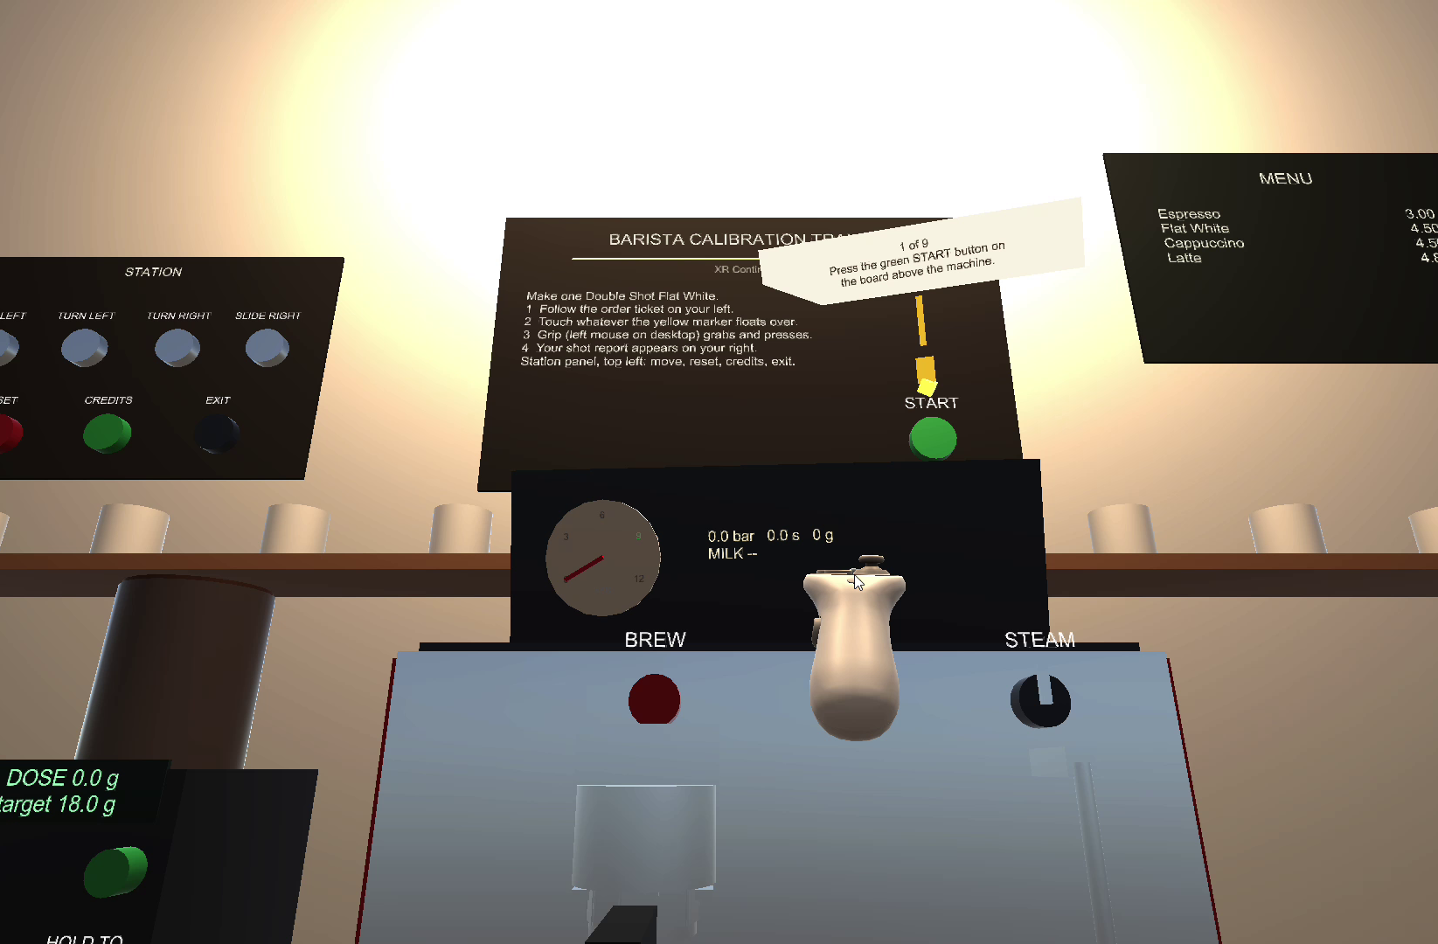
08 · PROPOSED SOLUTION
One shift, one café, one flat white
THE BRIEF
You're the new barista. An order ticket asks for a flat white.
THE WORK
Unlock, dose, tamp, lock in, pull the shot, steam milk to 65 °C, pour.
THE VERDICT
A result dial grades the shot Sour, Balanced, Bitter or Channeled and says what to change.
THE TWIST
The grinder starts coarse on purpose, so shot one runs sour. You calibrate, like a real barista every morning.
Seated start in the exported build: welcome board, station panel, menu, machine.
XR Continuum · Barista Calibration Trainer
13
Notes:
Segment 8: one story, not a feature list. Emphasise the calibration loop: first shot sour by design.

Slide 14
08 · CONCEPT: THE SHIFT
A clear beginning, middle and end
Briefing
Welcome board, START
Detach
Free the portafilter
Dose
Hold to grind, ~18 g
Tamp
Level press, force shown
Lock
Bayonet into group head
Pull another shot
grind setting is kept
Result
Verdict + what to change
Pour
Tilt pitcher over cup
Steam
Stop at 65 °C
Brew
Live gauge, time, yield
Clear start
Real conclusion
The welcome board and order ticket explain the goal in seconds; a glowing marker points at the next thing to touch.
The result dial resolves the order and says how to improve. Reset, Exit and Credits stay on the station panel.
XR Continuum · Barista Calibration Trainer
14
Notes:
Still segment 8. Walk the loop: clear start, clear end, retry keeps the grind setting.

Slide 15
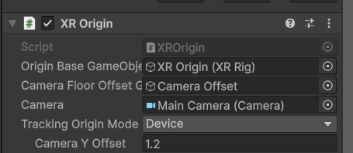

09 · BRIDGE DECISION 1
Tracking origin: Device, seated
The task is a fixed reach envelope in front of a seated person.
Device origin places the counter relative to where the headset starts.
A 1.2 m Camera Y Offset gives the same seated eye height in the simulator and on a headset.
NOT CHOSEN
Floor-referenced
Virtual floor = real floor, ideal for standing and room-scale. A seated user would end up with their eyes at counter height.
OUR CHOICE
Device-referenced
Origin = where the headset started, ideal for a seated workstation.
Consistent 1.2 m eye height over a 0.84 m counter.
Works at a desk with the simulator and in a seated headset.
XR Origin on the rig: Tracking Origin Mode Device, Camera Y Offset 1.2
XR Continuum · Barista Calibration Trainer
15
Notes:
Bridge decision 1. Likely question: what if the user stands? The counter stays relative to the start pose; the experience is designed and labelled as seated.

Slide 16
09 · BRIDGE DECISION 2
Why VR, not AR: D.I.C.E.
D
PARTLY
I
PARTLY
C
MAIN REASON
E
MAIN REASON
Dangerous
Hot steam and a 9-bar group head, but a minor factor here.
Impossible
A real machine can't show live pressure or extraction. VR can.
Counterproductive
Practice blocks the only group head and delays customers.
Expensive
About 18 g of beans, plus milk, wasted on every practice shot.
What replacing the world gives us that adding to it cannot
AR still needs the real machine, beans, milk and service floor. VR removes all four.
We can show hidden state (live pressure, extraction time) and repeat a shot instantly.
We keep the café's sound but remove its rush, so the trainee can focus.
XR Continuum · Barista Calibration Trainer
16
Notes:
Bridge decision 2. Lead with C and E; admit D and I only partly apply. That honesty earns rationale marks.

Slide 17


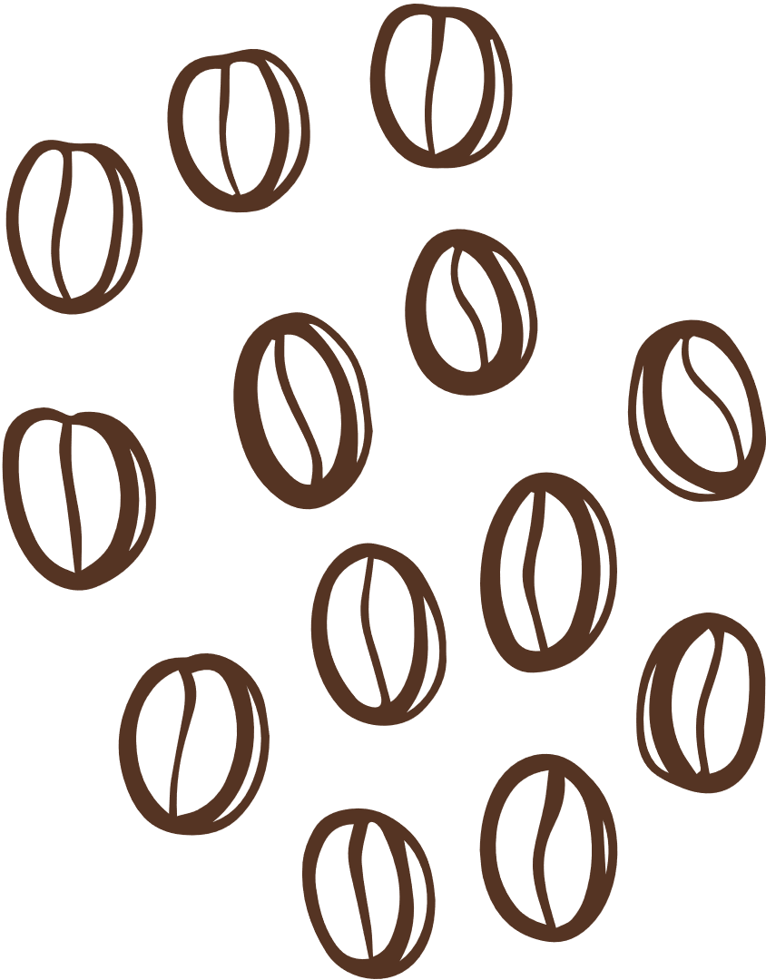
09 · DESIGN RATIONALE
Comfort, interaction, UI and audio
Locomotion & comfort
Interaction
No movement provider: seated, everything within reach
45° snap turn only: instant, so no vection
No smooth move or teleport: the task never needs travel
XRI grab interactables with velocity tracking, so tools feel weighty
Sockets hold the portafilter (fork, mat) and the pitcher (steam rest)
Dials and lock are hand-position drags; all input via named XRI actions
Spatial UI
Audio
Ticket, gauge, thermometer and result dial are objects in the café: no HUD
Reading panels at 0.75–1 m to limit vergence-accommodation strain
A glowing marker hovers over the next step
Every sound is a 3D source at its object, logarithmic roll-off
Grinder, pump, steam hiss (pitch falls as milk heats), pour, knock, chimes
All synthesised in code: nothing to license
XR Continuum · Barista Calibration Trainer
17
Notes:
Segment 9: each decision with its reason. Name the comfort defaults: seated, snap turn, no artificial motion.

Slide 18
10 · SYSTEM ARCHITECTURE
From XR Origin to game logic
XR Grab Interactable
portafilter, tamper, pitcher, cup
Stations
Grinder, TamperPress, GroupHead, SteamWand, MilkPour
XR ORIGIN · DEVICE, SEATED
Main Camera
Tracked Pose Driver
Complete(step)
XR Simple Interactable
buttons, dials, portafilter lock
ShiftFlow
step machine: Briefing → Result
Left / Right controller
Near-Far Interactor
Snap Turn Provider
45°, the only locomotion
ToolSocket
grinder fork, tamp mat, steam rest
ExtractionModel
advanced feature
Named XRI input actions
Physics helpers
ToolSettle, TamperGrabTransformer
World-space outputs
OrderTicket, HintMarker, MachineGauge, ResultDial, AudioKit
DesktopRigDriver
adds keyboard & mouse bindings
XR Continuum · Barista Calibration Trainer
18
Notes:
Segment 10. Hands are interactors, tools are interactables, sockets are interactors that hold tools. Stations report to ShiftFlow; ExtractionModel drives the gauge and verdict. The whole scene is generated by Barista > Build Cafe Scene (CafeSceneBuilder.cs).

Slide 19
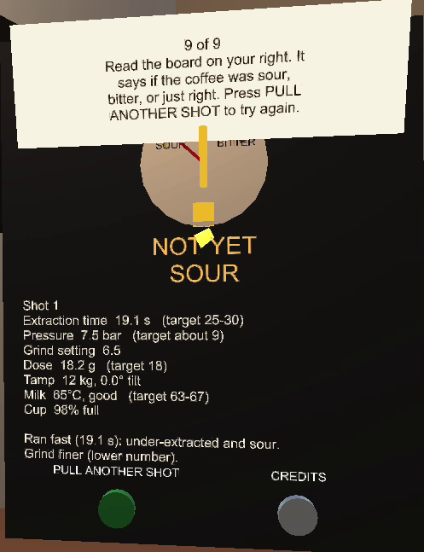
10 · ADVANCED FEATURE
Live extraction model
SHOT TIME
t = 27.5 s · e^(−0.22 (grind − 5)) · (1 + 0.015 (tamp − 15)) · (dose ⁄ 18)^1.6
× 0.8 if tamp < 5 kg · × 0.75 if tilt > 5° (channeling)
PRESSURE
p = 9 bar · √(t ⁄ 27.5), clamped to 2.5–11 bar
Sour
< 25 s
Balanced
25–30 s
Bitter
> 30 s
Channeled
tilt > 5°
Turns what the hands did into a shot the trainee can read.
Drives the live gauge, timer and yield, then the verdict dial.
Deterministic, so fully testable in the XR Device Simulator.
A teaching model with the right direction of effect, not fluid physics.
Shot 1, recorded run: 19.1 s at grind 6.5, so Sour
XR Continuum · Barista Calibration Trainer
19
Notes:
Advanced feature. It closes the loop between hand technique and outcome. The recorded run matches the model: starting grind 6.5 gave 19.1 s, so Sour, and the board says grind finer. Be explicit that it is a teaching model, not physics.

Slide 20
10 · HANDLING & PHYSICS
Weight without chaos
01
02
03
Plausible weight
Nothing clips through
Settling & the tamper
Velocity-tracked grabs: heavier tools lag the hand
Velocity changes capped, smoothing on
Physics at 90 Hz, solver iterations 12 / 4
Grabbed tools stay physical, so the counter and machine block them
Push-out capped at 0.25 m/s, so contact never flings a tool
Collisions ignored only where parts must nest
Released tools rest upright, or return home
Tamper held vertical: 30% wrist follow, max 12°
Tamp resistance is visual, a force readout and haptics
90 Hz
physics step
12 / 4
solver iterations
0.25 m/s
push-out cap
12°
max tamper wrist tilt
XR Continuum · Barista Calibration Trainer
20
Notes:
Maps to the 13-mark technical criterion. Be honest: controllers can't push back, so resistance is simulated with visuals, a force number and haptics.

Slide 21
10 · AI-TOOL DISCLOSURE
How we used AI, and how much
TOOL | USED FOR | HOW MUCH | DEFENDED BY
Cursor (AI agent) | Drafting the scene builder and C# scripts from our design; debugging physics, text shader and build; first draft of slides and viva notes | <High: ~X% of code> | Each member, own part
<Other, if any> | <e.g. explaining XRI concepts, checking references> | <Low / Medium> | <name>
Team, no AI | Concept, D.I.C.E. case, objectives, design choices, testing, tuning, verifying each fix | n/a | All
Responsible use
We specified what to build, reviewed every change, tested it in the simulator and the exported exe, and rejected fixes that didn't work, such as kinematic grabs that let tools pass through. Every member can explain their part live.
XR Continuum · Barista Calibration Trainer
21
Notes:
Fill in the amounts honestly. Disclosure is not the safeguard; understanding is. Expect 'why velocity tracking and not kinematic?' and answer it yourselves.

Slide 22
11 · TESTING & EVALUATION
Walkthrough tests by a non-builder
<Who tested whose part · number of full runs · average time per shift>
# | CHECK | EXPECTED | RESULT
01 | Launch | Ticket readable, goal clear in 5 s | ☐ Pass ☐ Fail
02 | Start | START moves to 'unlock' | ☐ Pass ☐ Fail
03 | Detach | Handle swing frees portafilter | ☐ Pass ☐ Fail
04 | Dose gating | No grind unless in the fork | ☐ Pass ☐ Fail
05 | Dose | Counts to ~18 g; under 8 g refused | ☐ Pass ☐ Fail
06 | Tamp | Force rises, haptics, lift completes | ☐ Pass ☐ Fail
07 | Tilt | Tilted tamp gives Channeled | ☐ Pass ☐ Fail
08 | Lock | Brew refused until locked | ☐ Pass ☐ Fail
# | CHECK | EXPECTED | RESULT
09 | Brew | Needle ~9 bar; time & yield count | ☐ Pass ☐ Fail
10 | Grind effect | Finer grind, longer shot | ☐ Pass ☐ Fail
11 | Steam | Heats only in milk; chime at 65 °C | ☐ Pass ☐ Fail
12 | Pour | Tilt fills cup; verdict appears | ☐ Pass ☐ Fail
13 | Retry | Restarts at unlock, grind kept | ☐ Pass ☐ Fail
14 | Audio | Each sound from its source | ☐ Pass ☐ Fail
15 | Physics | No floating or falling through | ☐ Pass ☐ Fail
16 | Exported build | Exe runs; shift done with mouse | ☐ Pass ☐ Fail
XR Continuum · Barista Calibration Trainer
22
Notes:
Tick results from real runs and add anything that failed and was fixed. Objectives 1-3 are measured here: time to finish, attempts to Balanced, final milk temperature.

Slide 23
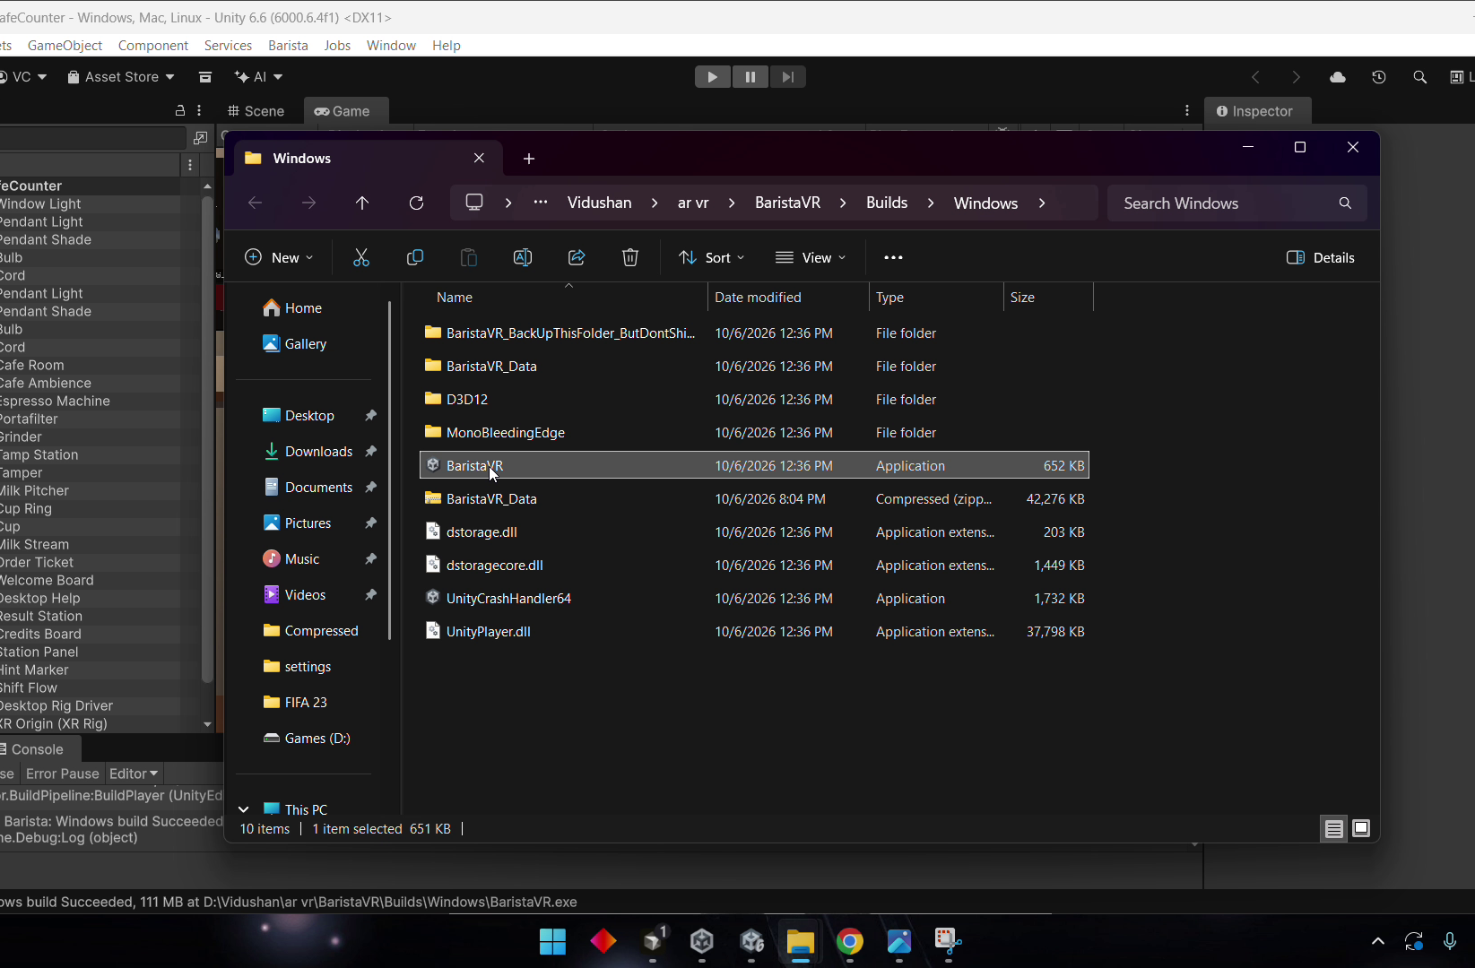
11 · EXPORTED-BUILD CHECK
Runs outside Unity, no headset
HOW IT'S BUILT
Barista ▸ Build Windows Player regenerates and saves the scene, then builds the exe.
HOW IT'S DRIVEN
Keyboard and mouse bindings on the same XRI actions; the simulator isn't in a build.
WHAT WE SAW
Recorded run: launch to verdict in about 1.5 min. Shot 1 at 19.1 s → Sour; milk 65 °C.
FOUND & FIXED
The exe once showed an old scene, so the build now rebuilds the scene first.
Launching Builds/Windows/BaristaVR.exe after a successful build
XR Continuum · Barista Calibration Trainer
23
Notes:
Named requirement in the brief. State exactly what you did: launched the exe without a headset and completed a shift with keyboard and mouse (see the recording).

Slide 24
12 · CHALLENGES & SOLUTIONS
What went wrong, and how we fixed it
Unreadable floating text
Labels blended into the café and showed through the hands.
FIX
Custom WorldText shader with a hard edge, plus backdrop plates.
Exe showed an old scene
The build used the last saved scene, not the generated one.
FIX
The build menu now regenerates and saves the scene first.
Buttons pressed by accident
Counter buttons sat in the working area.
FIX
Moved to a back-wall station panel; Reset and Exit need two presses.
Floaty, jumpy tools
Cups and pitchers had no weight and flew off.
FIX
Capped velocity tracking, smoothing, 90 Hz physics, settle on release.
Tools passed through things
Kinematic grabs ignored the counter and machine.
FIX
Physical grabs with capped push-out; ignores only where parts nest.
Wobbly, sideways tamper
It tilted in the hand and lay flat when tamping.
FIX
Custom grab transformer: upright grip, limited wrist follow.
XR Continuum · Barista Calibration Trainer
24
Notes:
Pick two or three you can explain best and go deep on why the fix works.

Slide 25
13 · LIMITATIONS & CONSTRAINTS
What the simulator could not tell us
COULD NOT VERIFY | PUBLISHED GUIDANCE OR SAFE DEFAULT USED INSTEAD
Comfort | Seated, stationary, snap turn only, no artificial motion (Meta comfort guidance; LaViola, 2000)
Scale & reach | 0.84 m counter, tools 0.4–0.7 m away, real dimensions (58 mm basket, 350 ml pitcher)
Presence | One coherent café, spatial audio, diegetic UI (Slater & Wilbur, 1997)
Text legibility | Panels at 0.75–1 m, 1.2–2.4 cm letters, high-contrast backdrops
Haptics & force | Haptics sent through XRI but not felt in the simulator; controllers can't push back
Binaural audio | Unity 3D panning; an HRTF spatializer is future work
Out of scope: multiplayer, latte art, customer AI, real fluid simulation.
Headset check: <tested on a real headset? yes or no, and what you found>
XR Continuum · Barista Calibration Trainer
25
Notes:
The brief rewards stating what you could NOT verify and the guidance used instead. Don't overclaim.

Slide 26
14 · CONCLUSION & REFLECTION
Did we solve the problem?
01
Unaided, under 6 min
<met / not met · average time>
<Member 1>
<One-minute reflection: what I built, what was hard, what I'd do differently>
<Member 2>
<One-minute reflection: what I built, what was hard, what I'd do differently>
02
Balanced within 3 attempts
<met / not met · attempts>
03
Milk at 63–67 °C
<met · 65 °C in the recorded run>
WHAT WE LEARNED
<e.g. physical feel needs tuning, not just correct code; designing for a headset we couldn't always test meant leaning on published guidance>
<Member 3>
<One-minute reflection: what I built, what was hard, what I'd do differently>
<Member 4>
<One-minute reflection: what I built, what was hard, what I'd do differently>
XR Continuum · Barista Calibration Trainer
26
Notes:
Answer the title with test numbers, then each member gives a short personal reflection (individual marks).

Slide 27
15 · REFERENCES & CREDITS
References
GUIDANCE & THEORY
ASSETS & TOOLS (ALSO CREDITED IN THE BUILD)
Unity Technologies. XR Interaction Toolkit 3.6 manual. docs.unity3d.com
Meta. VR best practices: locomotion, user comfort, interaction. developers.meta.com/horizon
LaViola, J. J. (2000). A discussion of cybersickness in virtual environments. ACM SIGCHI Bulletin, 32(1).
Hoffman, D. M., Girshick, A. R., Akeley, K., & Banks, M. S. (2008). Vergence-accommodation conflicts hinder visual performance and cause visual fatigue. Journal of Vision, 8(3).
Slater, M., & Wilbur, S. (1997). A framework for immersive virtual environments (FIVE). Presence, 6(6).
Specialty Coffee Association. Espresso brewing guidance (dose, yield, time).
XR Origin & XR Device Simulator: XR Interaction Toolkit 3.6.1 Starter Assets, Unity Companion License.
Unity OpenXR Plugin, Input System, Universal Render Pipeline: Unity Technologies.
Café models built by the team from Unity primitives; audio synthesised in code (AudioKit.cs).
Build font: Unity LegacyRuntime (Arial). Slide font: Google Sans (SIL Open Font License).
Slide template: “Coffee” free presentation template by EaTemp.
Barista illustration: <source and licence>.
AI tools: Cursor (see AI-tool disclosure).
XR Continuum · Barista Calibration Trainer
27
Notes:
Shown, not narrated. Fill in the barista illustration source before submitting.

Slide 28
So.
Would you like to brew a coffee?
Pull up a chair.
Notes:
THE CALLBACK. Same speaker as the cold open. "So." [Beat.] "Would you like to brew a coffee?" [Turn to the machine or headset.] "Pull up a chair."
Then straight into the live demo.

Slide 29
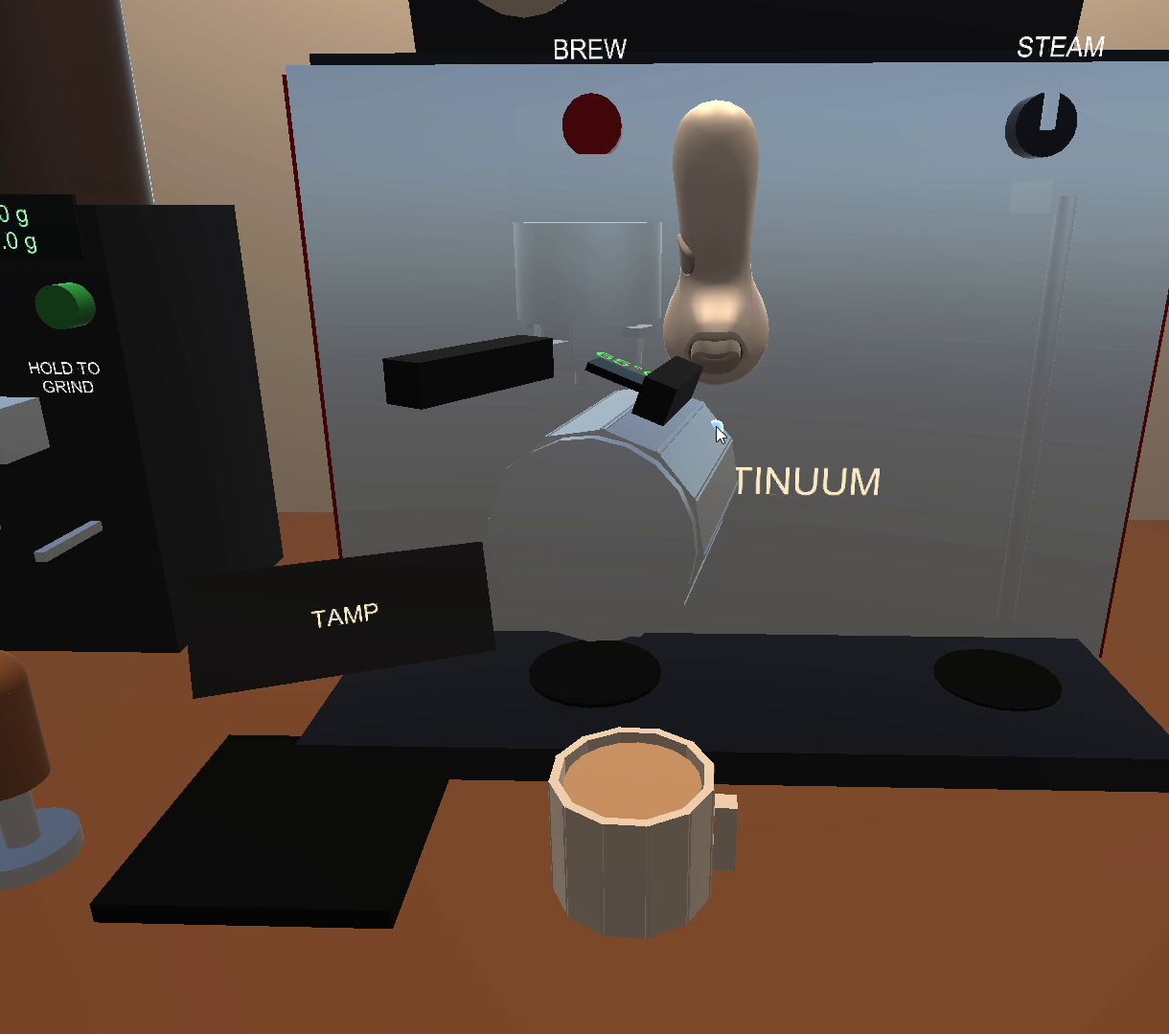
16 · LIVE DEMONSTRATION
Live demo
Up to 10 minutes, including questions
Seated start, snap turn, no movement provider
A
Dose and tamp; tilt once to show channeling
B
Lock in, pull the shot, narrate gauge and model
C
Steam to 65 °C, pour, read the dial, pull another shot
D
Launch the exe and complete one action with the mouse
A
XR Continuum · Barista Calibration Trainer
29
Notes:
Run live from START to the result dial without help, then each member operates their own part. Have the exe and the Editor both ready.

Slide 30


Thank you.
Questions?
TEAM XR CONTINUUM
Barista Calibration Trainer · INTE 42312
<Member 1> · <Member 2> · <Member 3> · <Member 4>
Notes:
Close and invite questions; keep the build running.

