Slide 1
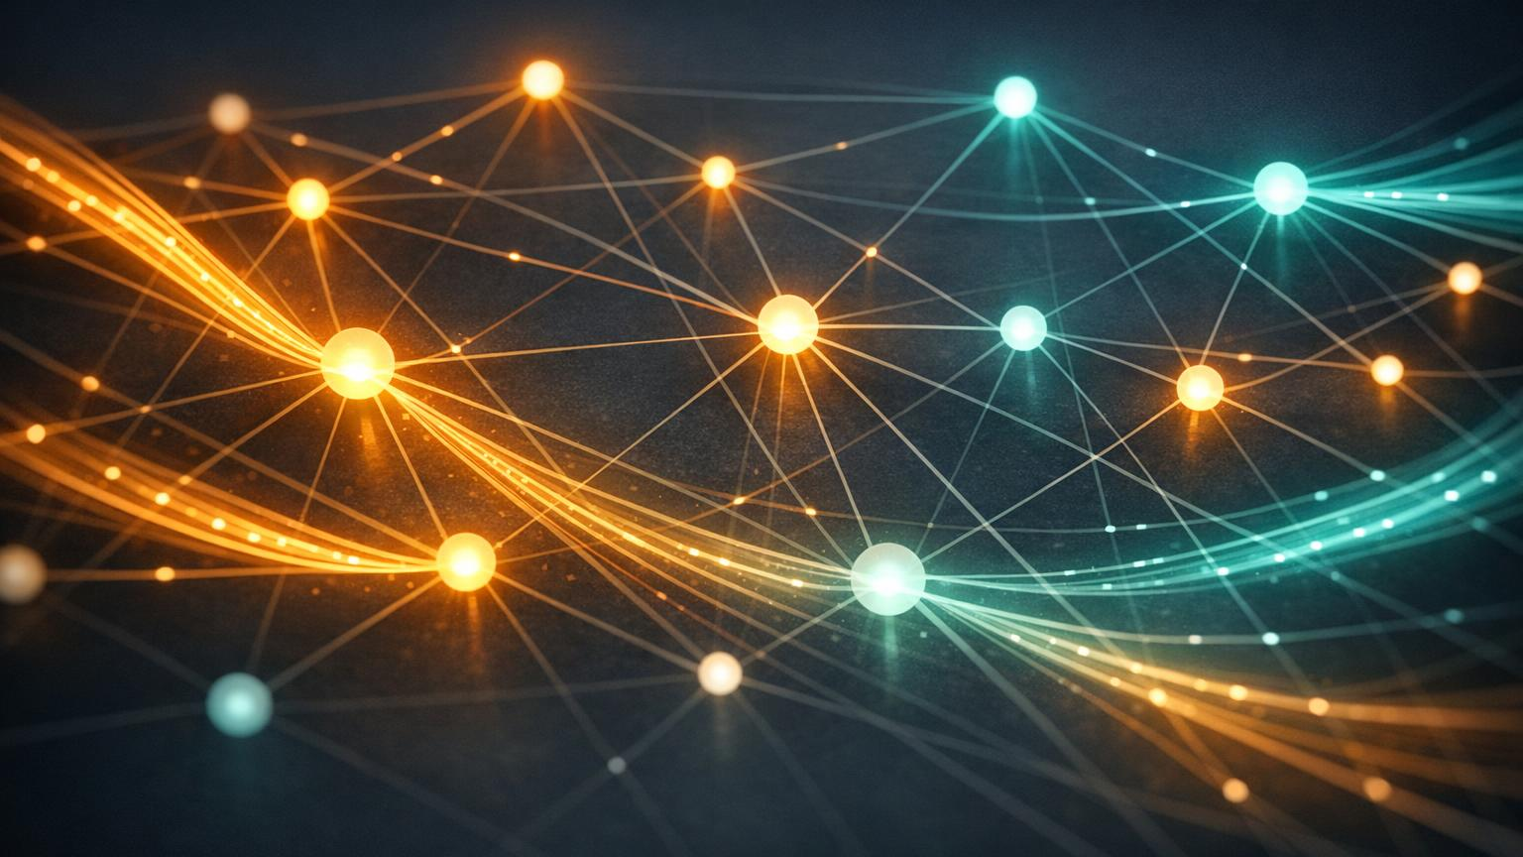
INTERN ONBOARDING · AI ENGINEERING
Building with AI
LLMs · LangChain · Vector Databases
A beginner-friendly guide to how modern AI applications are built — from raw language models to retrieval-powered assistants.
Engineering Onboarding Series | June 2026

Slide 2
WHAT WE'LL COVER
Your learning roadmap
1
Large Language Models
2
Working with LLMs
3
LangChain
What they are and how they predict text
Prompting, strengths, and real limitations
The framework that orchestrates everything
4
Embeddings
5
Vector Databases
6
RAG, End-to-End
Turning text into meaning-rich numbers
Storing and searching by similarity
Combining it all into a smart assistant
LLMs · LangChain · Vector DBs
2

Slide 3
FOUNDATIONS
What is a Large Language Model?
Trained on huge text
In one sentence
1
Books, code, and websites — billions of examples of human language.
An LLM is a program trained on enormous amounts of text that learns to predict the next word — and by doing that incredibly well, it can write, summarize, answer, and reason.
Predicts, doesn't "know"
2
It generates the most likely next token, one piece at a time.
General-purpose
3
One model handles many tasks with no task-specific programming.
LLMs · LangChain · Vector DBs
3

Slide 4
UNDER THE HOOD
How does an LLM generate text?
→
→
STEP 1
STEP 2
STEP 3
Tokenize
Predict
Generate
Your text is split into small chunks called tokens (words or word-pieces).
A neural network (the transformer) scores which token is most likely to come next.
It picks a token, adds it to the text, and repeats — building the answer word by word.
Where does the skill come from? Pre-training teaches general language from raw text; fine-tuning then shapes the model to be helpful and follow instructions.
LLMs · LangChain · Vector DBs
4

Slide 5
WORKING WITH LLMS
Prompting well — and knowing the limits
Good prompting habits
Limitations to remember
Be specific
Tell the model exactly what you want and the format.
Give context
Include the relevant facts it needs to answer.
Show examples
A sample of input and ideal output guides the style.
Set a role
"You are a helpful tutor…" steers tone and depth.
Hallucinations
It can state wrong things very confidently.
Knowledge cutoff
It doesn't know events after its training date.
Limited context window
It can only "see" so much text at once.
No access to your data
Out of the box, it can't read your files or live systems.
LLMs · LangChain · Vector DBs
5

Slide 6
ORCHESTRATION
What is LangChain?
LangChain is a framework that connects an LLM to everything around it — your data, external tools, memory, and multi-step logic — so you can build real applications, not just one-off chats.
Why it exists
1
Glue between pieces
2
Reusable components
3
Build fast
Wires models, data, and tools into one workflow.
Standard building blocks instead of custom plumbing.
Common patterns like chatbots and RAG are ready to use.
LLMs · LangChain · Vector DBs
6

Slide 7
LANGCHAIN
The core building blocks
Models
Prompts
Chains
The LLMs (and embedding models) you call.
Reusable templates that fill in variables.
Steps linked together into a pipeline.
Memory
Retrievers
Agents & Tools
Lets a conversation remember earlier turns.
Fetch relevant documents from your data.
Let the LLM decide and call external actions.
LLMs · LangChain · Vector DBs
7

Slide 8

MEANING AS NUMBERS
What are embeddings?
An embedding turns a piece of text into a list of numbers (a vector) that captures its meaning.
Similar meaning, similar vector
"dog" and "puppy" land close together; "car" is far away.
Created by a model
An embedding model reads text and outputs the numbers.
Enables search by meaning
We compare vectors to find related content — not just keywords.
Vectors that mean similar things cluster together in space.
LLMs · LangChain · Vector DBs
8

Slide 9
STORAGE & SEARCH
What is a vector database?
A vector database stores millions of embeddings and finds the closest ones to a query — fast. It's the "memory" your AI app searches through.
Similarity search
Approximate (ANN)
1
2
Returns items whose vectors are nearest to your query vector.
Smart indexing finds close matches in milliseconds at scale.
Metadata filters
Scales to millions
3
4
Combine meaning search with filters like date or category.
Built to store and serve very large collections of vectors.
LLMs · LangChain · Vector DBs
9

Slide 10
THE LANDSCAPE
Popular vector databases
Tool
Type
Best for
Pinecone
Managed cloud
Production apps with zero ops overhead
Weaviate
Open source + cloud
Built-in hybrid (keyword + vector) search
Chroma
Lightweight / local
Quick prototypes and learning projects
FAISS
Library (Meta)
Fast local search you embed in your code
pgvector
Postgres extension
Adding vectors to an existing SQL database
All do the same core job — store vectors and search by similarity. Pick based on scale, ops, and whether you want managed or self-hosted.
LLMs · LangChain · Vector DBs
10

Slide 11
THE BIG IDEA
RAG: Retrieval-Augmented Generation
Why teams use RAG
The idea in plain words
Fewer hallucinations Answers are grounded in retrieved, real content.
Before the LLM answers, we look up relevant facts from your own data and hand them to the model as context. The LLM then answers using those facts, not just its memory.
✓
Always up to date Update the data, not the model, to add new knowledge.
✓
Knows your domain Works over your docs, wikis, and private data.
✓
Can cite sources Shows where each answer came from — building trust.
✓
LLMs · LangChain · Vector DBs
11

Slide 12
END-TO-END
The RAG pipeline, step by step
PHASE 1 — INDEX YOUR DATA (done ahead of time)
→
→
→
Load
Chunk
Embed
Store
documents
into pieces
each chunk
in vector DB
PHASE 2 — ANSWER A QUESTION (at runtime)
→
→
→
→
Question
Embed
Retrieve
Augment
Generate
from user
the question
top matches
build prompt
grounded answer
LangChain wires these steps together so you don't build the plumbing by hand.
LLMs · LangChain · Vector DBs
12

Slide 13
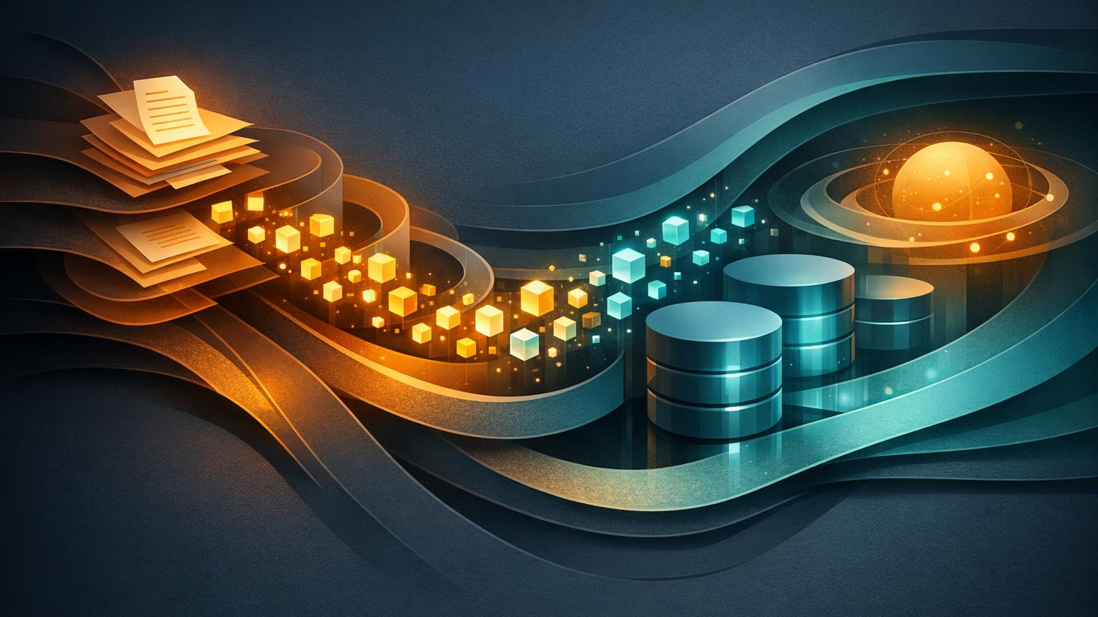
THE FULL PICTURE
How the pieces work together
User
→
LangChain
→
Vector DB
→
LLM
asks a question
orchestrates the steps
retrieves relevant context
generates the answer
The takeaway: the LLM provides language skill, the vector database provides relevant knowledge, and LangChain is the conductor connecting them into one helpful application.

Slide 14
WRAP-UP
Key takeaways & where to go next
LLMs predict text
LangChain connects
Powerful but they can be wrong and don't know your data.
It orchestrates models, data, memory, and tools.
Vectors capture meaning
RAG grounds answers
Embeddings + a vector DB enable search by similarity.
Retrieve real context, then let the LLM generate.
Your next step: build a tiny RAG app — load a few docs, embed them, store them, and ask questions. You'll learn more in an afternoon of building than a week of reading.
LLMs · LangChain · Vector DBs
14

