Slide 1

A BEGINNER'S GUIDE · 2026
VECTOR DATABASES
How AI finds things by meaning — not keywords.

Slide 2
CONCEPT 01
What Is a Vector Database?
A vector database is a specialized system that stores data as embeddings — lists of numbers that capture meaning — and retrieves results by similarity, not exact matches.
TRADITIONAL DATABASE
Find exact matches
WHERE category = 'shoes' AND price < 100
VECTOR DATABASE
It powers the AI tools you already use: chatbots that read documents, search that understands intent, and "more like this" recommendations.
Find similar meanings
Nearest neighbors to [0.12, -0.45, 0.78, …]
Vector Databases · A Beginner's Guide
02

Slide 3
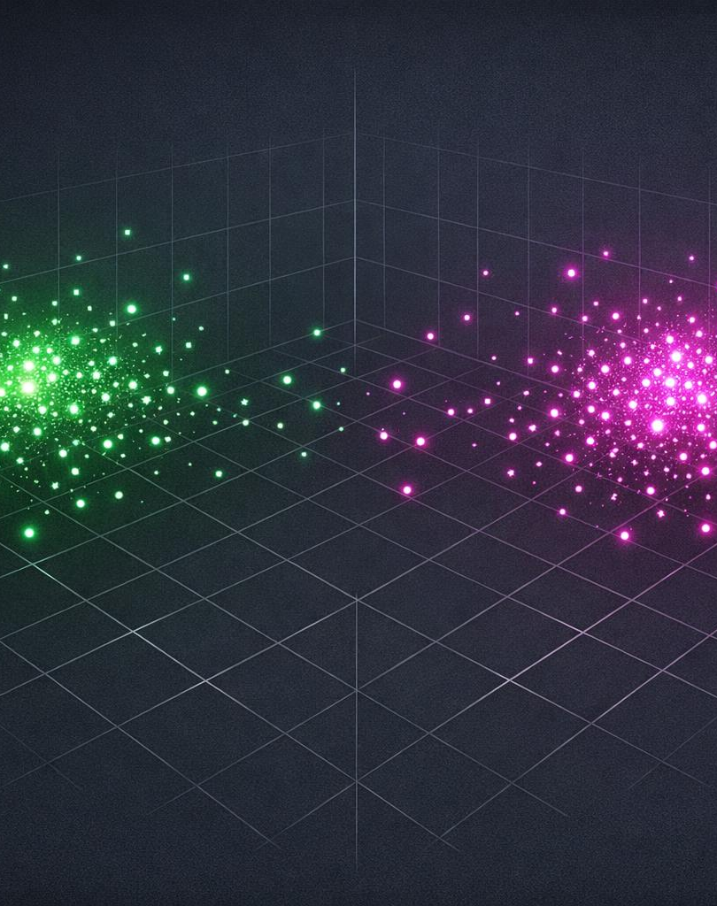
CONCEPT 02
Embeddings: Meaning as Numbers
An embedding model turns text, images, or audio into a fixed-length list of numbers. Similar items land close together in space; unrelated ones land far apart.
"king" ≈ "queen"
vectors sit close — related meaning
"king" ≠ "bicycle"
vectors sit far apart — unrelated
Typically 384–1,536 dimensions per item
Vector Databases · A Beginner's Guide
03

Slide 4
CONCEPT 03
How Vector Search Works
1
2
3
Embed the query
Measure distance
Approximate search
Your question becomes a vector using the same embedding model.
Compare with cosine similarity, Euclidean, or dot product.
ANN indexes like HNSW return top matches fast — at huge scale.
Why approximate? Checking every vector one-by-one is too slow at millions of records — ANN trades a tiny bit of accuracy for a massive speed-up.
Vector Databases · A Beginner's Guide
04

Slide 5
USE CASE 01 · THE FLAGSHIP
Retrieval-Augmented Generation (RAG)
Vector databases give large language models a searchable memory — so answers are grounded in real, current documents. Refer: https://docs.langchain.com/oss/python/langchain/rag
▸
▸
▸
▸
User question
Embed query
Vector DB finds top-K docs
LLM + retrieved context
Grounded answer
Fewer hallucinations
Always up to date
Cites its sources
Vector Databases · A Beginner's Guide
05

Slide 6
USE CASE 02
Semantic Search
Search by meaning, not spelling. Synonyms, paraphrases, and other languages all match — even with zero shared keywords.
SEARCH: "automobile"
ALSO FINDS
car
vehicle
Powers site search, help centers, document discovery, and code search.
sedan
SUV
Keyword search would miss every one of these.
Vector Databases · A Beginner's Guide
06

Slide 7
USE CASE 03
Recommendation Engines
"More like this." Items with nearby embeddings are likely relevant — so the database surfaces similar products, songs, articles, or videos instantly.
SHOPPING
STREAMING
READING
Products you may like
Songs & shows for you
Related articles
Suggest items similar to what you viewed or bought.
Match taste profiles to nearby content vectors.
Recommend stories close in meaning to the current one.
Vector Databases · A Beginner's Guide
07

Slide 8
USE CASE 04
Image & Multimodal Search
Multimodal models map text and images into the same vector space — so you can search across formats by similarity.
Text → Image
Image → Image
Describe a scene in words and retrieve matching photos.
Reverse search: find visually similar pictures.
Visual shopping
Audio & video
Snap a product and find the same or similar items.
Embed clips to search by sound or scene similarity.
Vector Databases · A Beginner's Guide
08

Slide 9
THE BIGGER PICTURE
More Places Vectors Show Up
AI chatbots & agents
Long-term agent memory
Fraud & anomaly detection
Classification & clustering
Deduplication
Question answering
POPULAR TOOLS
Pinecone
Weaviate
Milvus
Qdrant
Chroma
pgvector
Vector Databases · A Beginner's Guide
09

Slide 10
THE TAKEAWAY
Search by Meaning
Embeddings turn anything into numbers
Text, images, and audio become vectors that capture meaning.
Similarity search is the superpower
ANN indexes find nearest neighbors fast, even at massive scale.
Use cases are everywhere
RAG, semantic search, recommendations, and multimodal retrieval.
Vector Databases · A Beginner's Guide

