Slide 1

INTERN TECHNICAL TRAINING
HTTP Communication
From the Web to FastAPI
How clients and servers talk over the web — methods, status codes, REST, security, and building fast APIs in Python.

Slide 2
ROADMAP
What You'll Learn
01
HTTP Fundamentals
02
Client vs Server
Requests, responses, methods, status codes & headers
Who does what, and how the two sides talk
03
REST & Standards
04
FastAPI in Action
Design principles, HTTPS, TLS & authentication
A modern Python framework and why it's fast
HTTP Communication // Roadmap
01

Slide 3
FOUNDATIONS
What Is HTTP?
Request – Response
The language of the web
The client asks, the server answers — one round trip at a time.
HyperText Transfer Protocol is the set of rules browsers, apps, and servers use to exchange data over the web.
Stateless
Each request stands alone; the server remembers nothing between them by default.
Every page load, API call, and form submit is one or more HTTP messages travelling between a client and a server.
Human-readable
Messages are plain text: a start line, headers, then an optional body.
Built on TCP/IP
Reliable delivery underneath; HTTPS adds an encrypted TLS layer on top.
HTTP Communication // Foundations
02

Slide 4
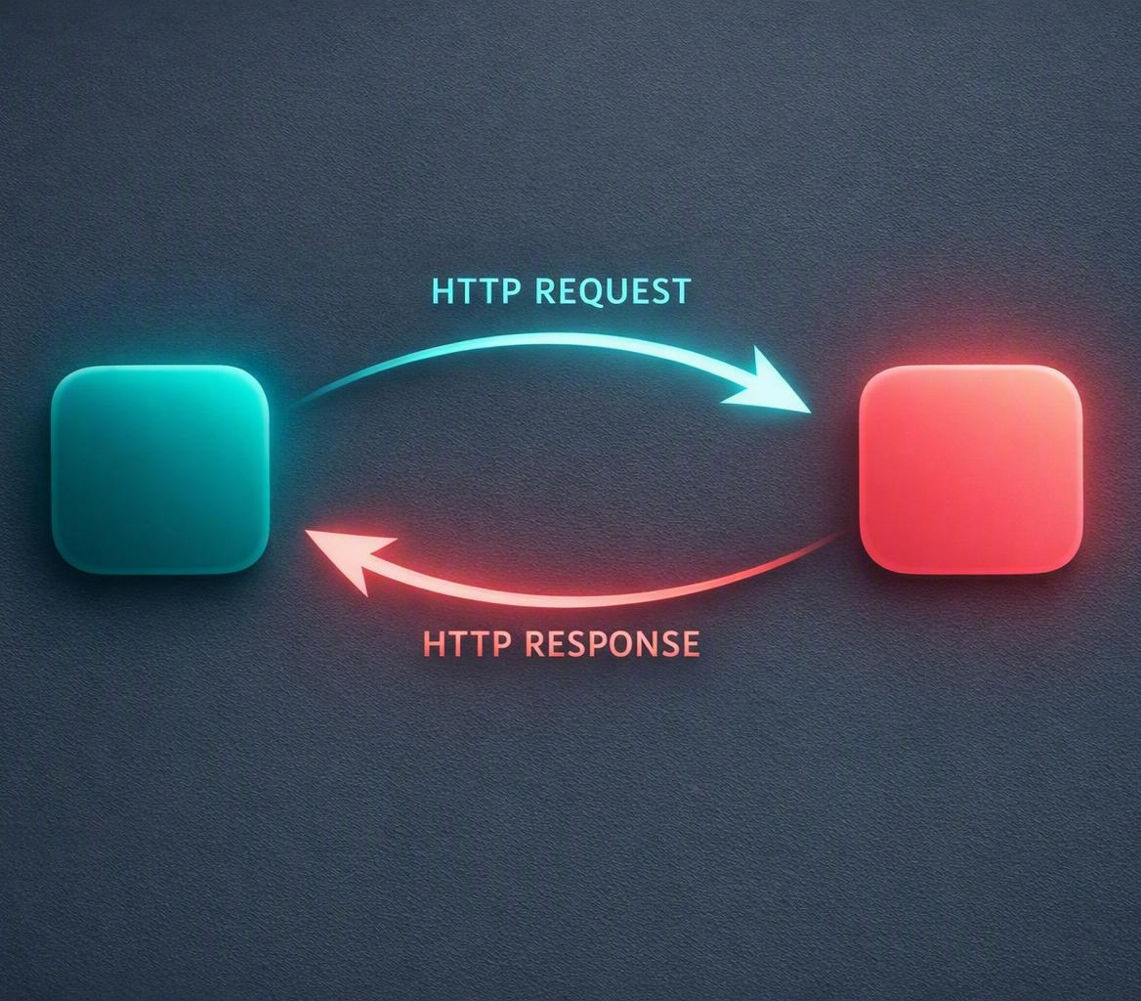
FOUNDATIONS
The Request–Response Lifecycle
1
Client sends a request
A browser or app opens a connection and sends a method + URL.
2
Server receives & processes
It routes the request, runs logic, and may query a database.
3
Server returns a response
A status code, headers, and usually a body (JSON, HTML…).
4
Client renders the result
The app displays data or reacts — then the cycle repeats.
HTTP Communication // Foundations
03

Slide 5
FOUNDATIONS
Anatomy of an HTTP Request
Method
GET /api/users/42 HTTP/1.1
Host: api.example.com
Authorization: Bearer eyJhbGci…
Accept: application/json
Content-Type: application/json
{ "active": true }
The action to perform — GET, POST, PUT, PATCH, DELETE.
Path / URL
Which resource you're targeting (e.g. /api/users/42).
Headers
Metadata: auth tokens, content type, accepted formats.
Body
Optional payload sent with POST/PUT/PATCH (often JSON).
HTTP Communication // Foundations
04

Slide 6
FOUNDATIONS
Anatomy of an HTTP Response
HTTP/1.1 200 OK
Content-Type: application/json
Content-Length: 86
Cache-Control: max-age=60
{
"id": 42,
"name": "Ada",
"active": true
}
Status line
Protocol version + status code — e.g. 200 OK or 404 Not Found.
Headers
Content type, length, caching, cookies, security policies.
Body
The actual payload: JSON, HTML, an image, or nothing at all.
HTTP Communication // Foundations
05

Slide 7
VERBS
HTTP Methods & CRUD
METHOD
CRUD
WHAT IT DOES
IDEMPOTENT
GET
Read
Retrieve a resource — never changes data.
Yes
POST
Create
Add a new resource to a collection.
No
PUT
Replace
Replace a resource entirely with new data.
Yes
PATCH
Update
Modify part of an existing resource.
No
DELETE
Delete
Remove a resource from the server.
Yes
Idempotent = repeating the same call has the same effect as making it once.
HTTP Communication // Methods
06

Slide 8
SIGNALS
Status Codes at a Glance
1xx
2xx
3xx
4xx
5xx
Informational
Success
Redirection
Client Error
Server Error
Request received, continuing.
It worked as expected.
Look elsewhere for the resource.
The request was wrong.
The server failed.
100 Continue
200 OK · 201 Created
301 Moved · 304 Not Modified
400 · 401 · 403 · 404
500 · 502 · 503
Read the first digit and you already know how the request went.
HTTP Communication // Status Codes
07

Slide 9
METADATA
HTTP Headers
Headers carry the metadata around each message — who's asking, what format, how to cache, and how to stay secure.
Request headers
Response headers
Host which domain you're calling
Content-Type format of the body
Authorization your token or credentials
Content-Length size of the payload
Accept formats the client understands
Cache-Control how long it can be cached
User-Agent the app or browser making the call
Set-Cookie state the client should keep
HTTP Communication // Headers
08

Slide 10
PART TWO
Client & Server Applications
Two sides of every web interaction — and the line that divides them.
HTTP Communication // Client & Server
09

Slide 11
ARCHITECTURE
Client Side vs Server Side
Client Side
Server Side
FRONTEND
BACKEND
Runs on the user's device (browser, mobile, app)
Runs on a remote machine you control
Builds the request and renders the response
Receives requests, applies business logic
Handles UI, interactions and presentation
Talks to databases, files and other services
Tools: HTML, CSS, JavaScript, React, mobile SDKs
Tools: Python, Node, FastAPI, Django, SQL
HTTP Communication // Client & Server
10

Slide 12
ARCHITECTURE
How the Two Sides Talk
CLIENT
SERVER
Request travels up
Server does the work
Response travels back
Method, path, headers and body leave the client.
Routing, logic, database and other services.
Status, headers and data return to be rendered.
HTTP Communication // Client & Server
11

Slide 13
DESIGN
REST: Principles of Good APIs
1
Client–Server
2
Stateless
3
Cacheable
Separate the UI from data storage and logic.
Each request carries everything needed to handle it.
Responses say whether they can be reused.
4
Uniform Interface
5
Layered System
6
Resource-Based
Consistent URLs and methods for every resource.
Proxies and gateways can sit in between, unseen.
Model things as nouns (/users/42), acted on by verbs.
HTTP Communication // REST
12

Slide 14
STANDARDS
HTTPS & Transport Security
The TLS handshake
HTTP → HTTPS
1
Hello
HTTPS is HTTP wrapped in TLS (Transport Layer Security). It encrypts every message so no one in between can read or tamper with it.
Client & server agree on a TLS version and cipher.
2
Certificate
Server proves its identity with a signed certificate.
Encryption — Data is unreadable in transit
3
Key exchange
Integrity — Tampering is detected
Both sides derive a shared secret session key.
Authentication — You reach the real server
4
Secure channel
All further HTTP traffic is now encrypted.
HTTP Communication // Security
13

Slide 15
SECURITY
Authenticating Requests
Authentication answers “who is calling?” Pick the method that matches your security needs.
API Keys
Bearer Tokens
JWT
OAuth 2.0
A single secret string sent with each request.
Short-lived tokens passed in the Authorization header.
Self-contained signed tokens carrying user claims.
Delegated access without sharing passwords.
BEST FOR
BEST FOR
BEST FOR
BEST FOR
Server-to-server
Web & mobile apps
Stateless sessions
Third-party login
SECURITY
SECURITY
SECURITY
SECURITY
Low
Medium
Med–High
High
HTTP Communication // Security
14

Slide 16

PART THREE
FastAPI: Modern Python APIs
A high-performance framework for building HTTP APIs with confidence.

Slide 17
FRAMEWORK
Why FastAPI Stands Out
FastAPI is a modern Python web framework for building APIs using standard type hints — fast to run and fast to write.
Async-first speed
Automatic docs
Type validation
Built on ASGI for high concurrency — among the fastest Python frameworks.
Interactive Swagger UI & ReDoc generated from your code, for free.
Pydantic validates and parses request data from Python type hints.
Open standards
Editor support
Easy to learn
Built on OpenAPI and JSON Schema — no proprietary lock-in.
Type hints give autocomplete and catch bugs before runtime.
Minimal boilerplate; production-ready from a few lines of code.
HTTP Communication // FastAPI
15

Slide 18
FRAMEWORK
From Code to Live API
✓
Typed & validated
from fastapi import FastAPI
app = FastAPI()
@app.get("/users/{id}")
def read_user(id: int):
return {"id": id, "active": True}
id is coerced to an int; bad input returns 422 automatically.
✓
Interactive docs
Swagger UI appears at /docs, ReDoc at /redoc — instantly.
✓
OpenAPI schema
A machine-readable contract powers clients & testing.
✓
JSON by default
Return a dict and FastAPI serializes the response for you.
HTTP Communication // FastAPI
16

Slide 19
PERFORMANCE
Built for Speed
8,500+
8,500
requests/sec — fastest by a wide margin for API workloads
Async I/O
3,100
Non-blocking concurrency handles many requests at once
2,100
Less code
FastAPI
Flask
Django
Production-ready APIs with minimal boilerplate
Representative throughput — requests/sec on a simple JSON endpoint
HTTP Communication // Performance
17

Slide 20
WRAP-UP
Key Takeaways
1
HTTP is a conversation — Every web action is a request and a matching response.
2
Methods + codes tell the story — Verbs say what you want; status codes say how it went.
3
Client and server share the work — Frontend presents; backend decides and stores.
4
Standards keep it safe — REST, HTTPS/TLS and auth make APIs reliable and secure.
5
FastAPI makes it easy & fast — Type hints, auto docs and async speed in modern Python.
Now go build something that talks to the web.

