Slide 1
Named-Entity Recognition for Patient Queries on r/AskDocs
Using a Custom NER model in spaCy
By: Rahul Mukerjee
Data Scientist | General Assembly

Slide 2
Background
People increasingly use online forums and subreddits to post their symptoms and seek advice from qualified medical professionals. This voluntary exchange between the patient and medical professionals can be made more efficient.
Extracting meaningful information from patient queries can help in better decision making for all parties the involved. This data can also be used to show the viability of the patient - caregiver exchange as a business model. Thus encouraging wider participation by other stakeholders in the healthcare domain.

Slide 3
Data Overview
Patient query data for 6 months (May - Oct 2021) was obtained from r/AskDocs for Named-Entity modeling (82k queries were extracted, cleaned for pre-processing)
All queries contain patient demographic data.
All patient queries are posted in the first person narrative.

Slide 4
What is Named-Entity Recognition (NER)?
Named-Entity Recognition is a subtask of information extraction. It seeks to locate and classify named entities mentioned in unstructured text into pre-defined categories such as person names, organizations, locations etc.
For e.g.
Ref: https://en.wikipedia.org/wiki/Named-entity_recognition

Slide 5
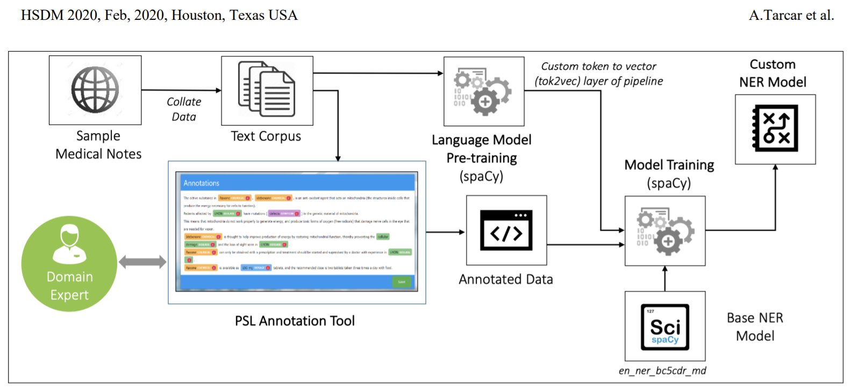

Project Pipeline
Ref: https://arxiv.org/ftp/arxiv/papers/1910/1910.11241.pdf

Slide 6
Challenges with Annotating Text
Labeling text is a time consuming process. It is also cognitively demanding to read and analyze large volumes of text.
A piece of information (for e.g. a person’s current health condition) can be described in a multitude of ways.
Understanding the context a patient is trying to present is important for proper labeling of text. So some medical domain knowledge is necessary for labeling
Use of acronyms, slang, misspellings must also be addressed.

Slide 7
The Importance of Context
A word can have different connotations depending on its context.
‘I got tested for COVID’ vs. ‘I just got my COVID vaccine’
‘I have a case of mild Asthma’ vs. ‘I was prescribed some Asthma medication’
‘I have low Vitamin D and need help’ vs. ‘I take Vitamin D supplements regularly’
Similar examples occur frequently in the text and need to be labeled correctly.
DISEASE
DRUG
DISEASE
DRUG
DISEASE
DRUG

Slide 8
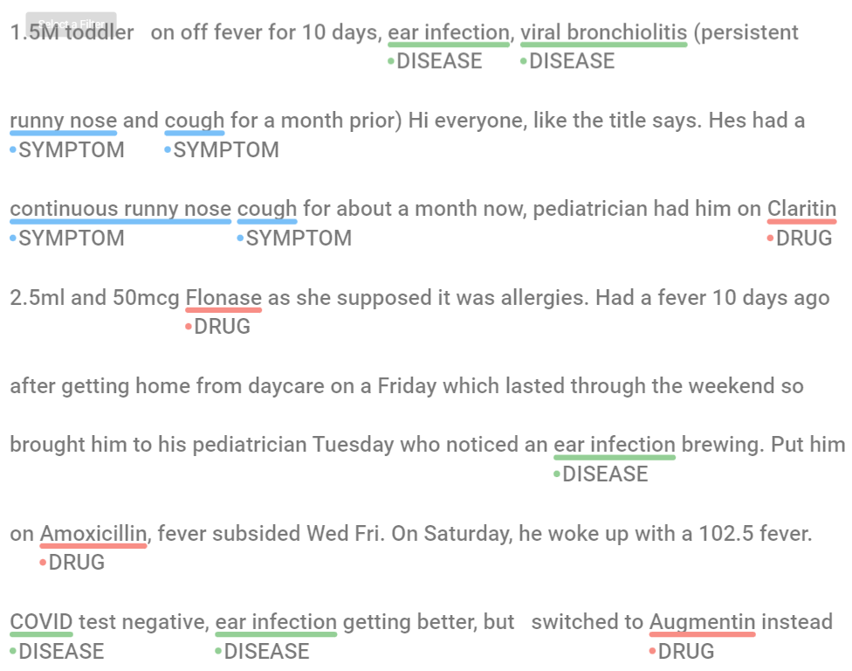
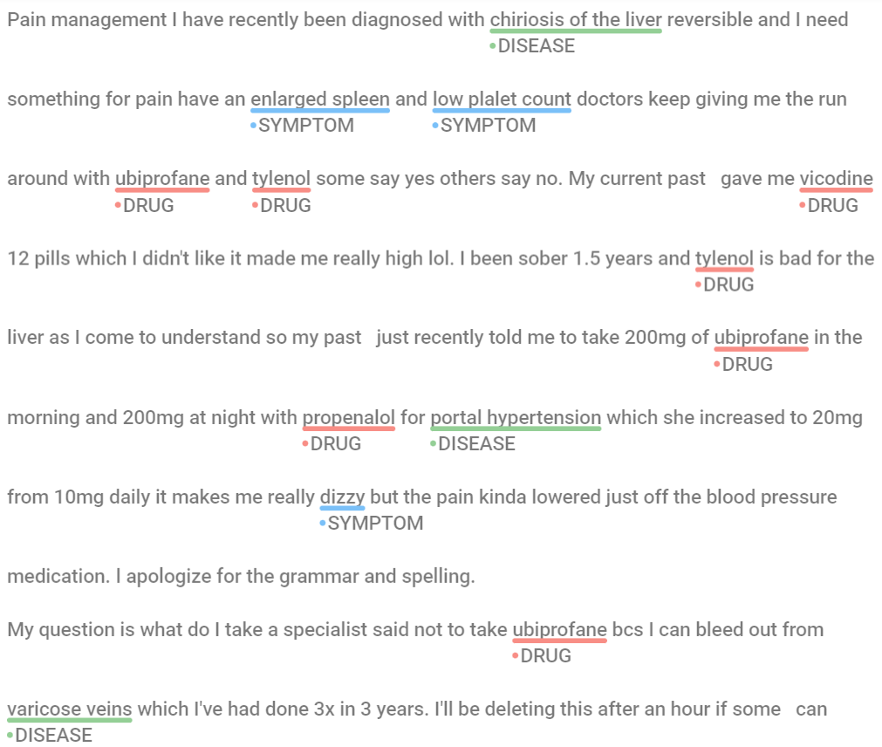
Samples where text can be labeled easily
Ex. 1
Ex. 2

Slide 9
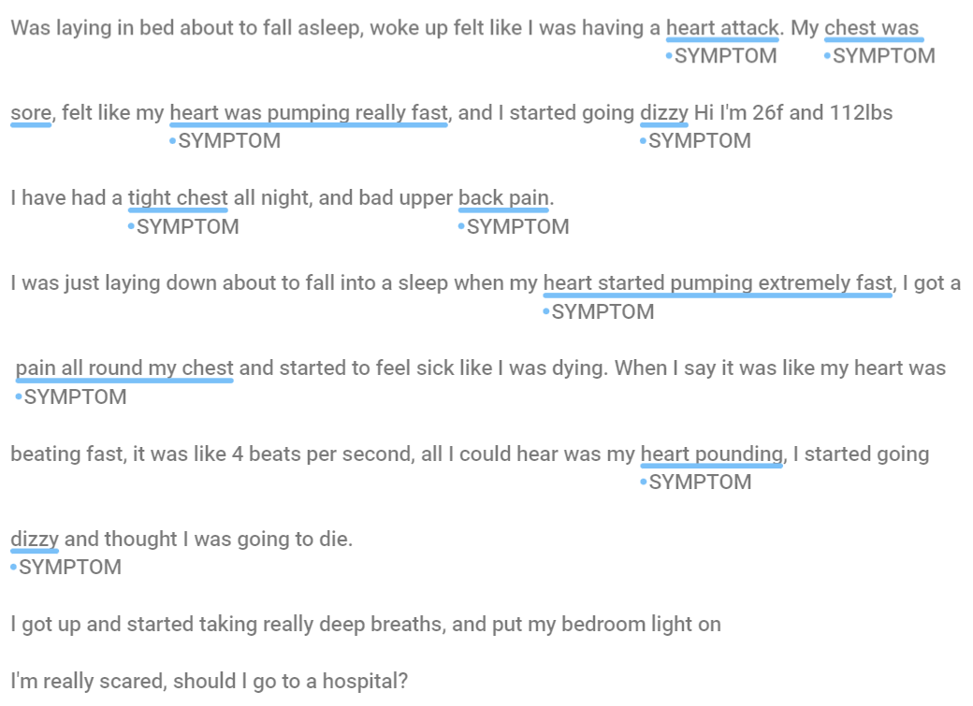
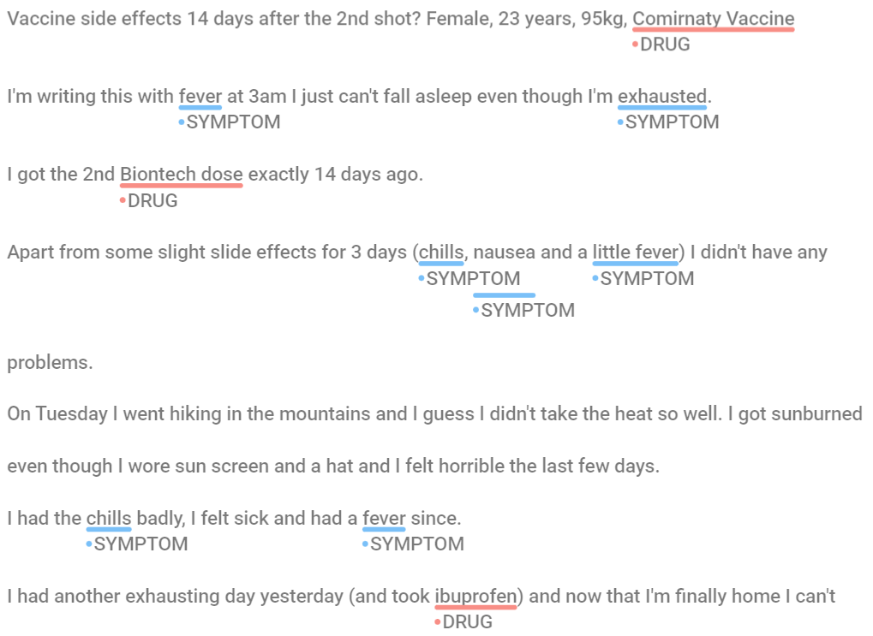
Samples where labeling was a challenge!
Ex. 1
Ex. 2
It is much easier to label medications and named diseases compared to patient symptoms. Symptoms tend to be described with more generic words and can be confusing to label.

Slide 10
Sequence of Steps for Annotating Text
Start by manually labeling a seed list of text examples
Extract the labels from Step 1 and store them as keyword patterns
Use these extracted patterns to pre-annotate the next batch of text
Import pre-annotated text into a annotation software (Doccano). Check the pre-annotations and override with manual annotation
Export annotated text for model training, evaluation
Go to Step 2 for annotating next batch of text

Slide 11
Summary of Annotated Text
Annotation done for 480 training, 240 validation posts selected randomly from the original dataset
The table below shows the number of entities annotated.
Version 1 of the annotated texts were created mostly by word matching.
Version 1 was reviewed to ensure that the labeling is appropriate for its context, as described previously. This lead to the dataset Version 2
Also notice that the entities counts are balanced.
Dataset Version | DISEASE | DRUG
Train: Ver. 1, n = 240 | 365 | 339
Train: Ver. 1, n = 480 | 712 | 659
Train: Ver. 2, n = 480 | 748 | 698
Val: Ver. 1, n = 240 | 379 | 271
Val: Ver. 2, n = 240 | 393 | 315

Slide 12
Modeling
Two approaches to modeling:
Rule-Based Model
Rule based modeling identifies exact matches in the text data and labels them. It works similar to searching for words in a text file. The model memorizes a fixed list of words and labels every occurrence it sees.
Using Machine Learning: Pre-trained and Blank models
A machine learning model tries to predict if a word or a group of words should be assigned a label based on the word’s context i.e. it’s surrounding words.
A Pre-Trained model uses an existing NER model as its starting point; On the other hand, a Blank model starts model training from scratch.

Slide 13
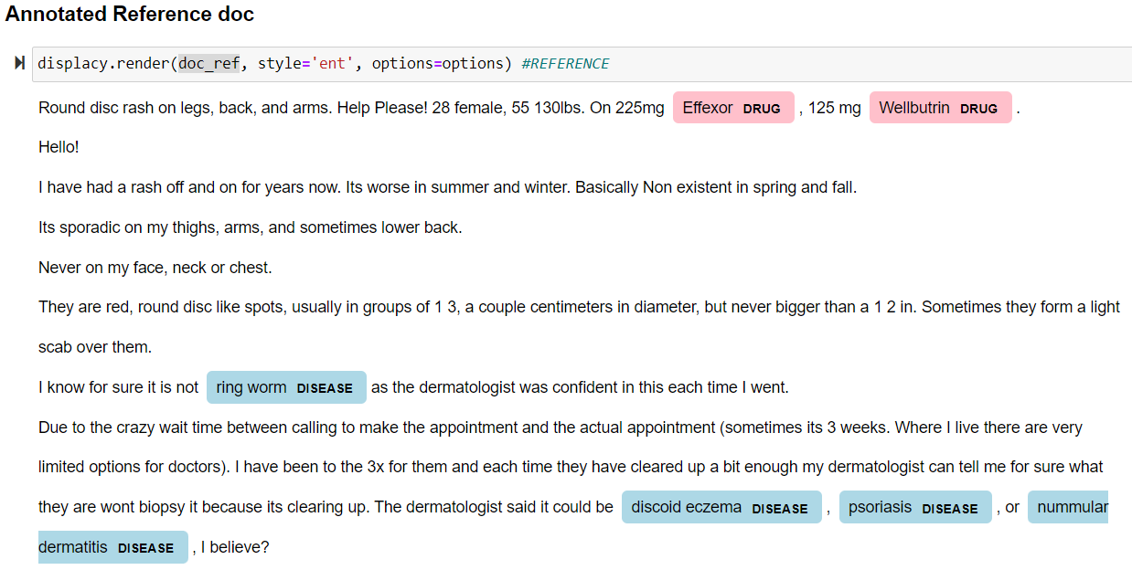
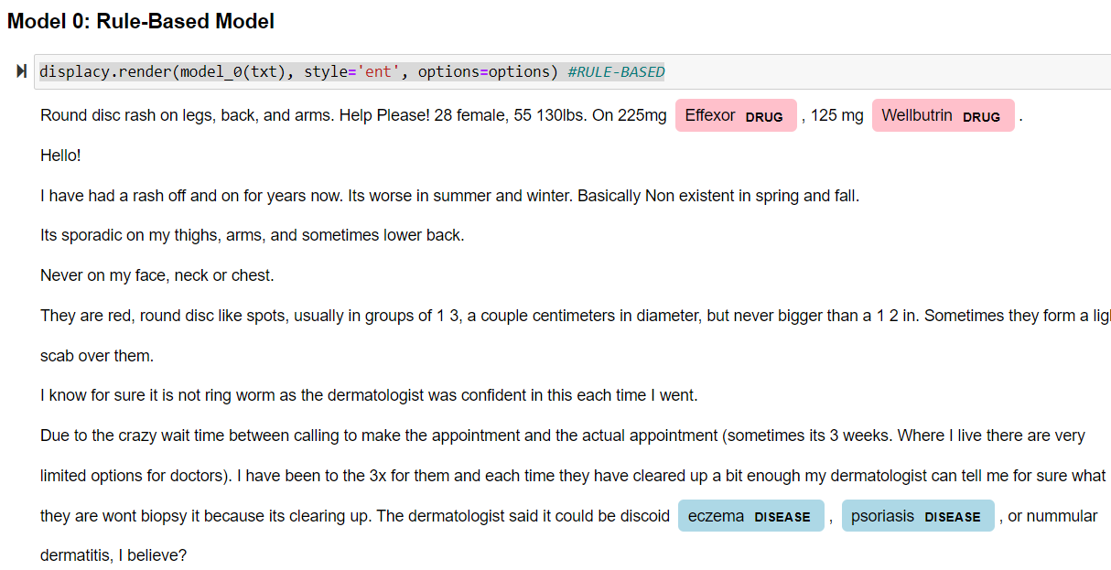
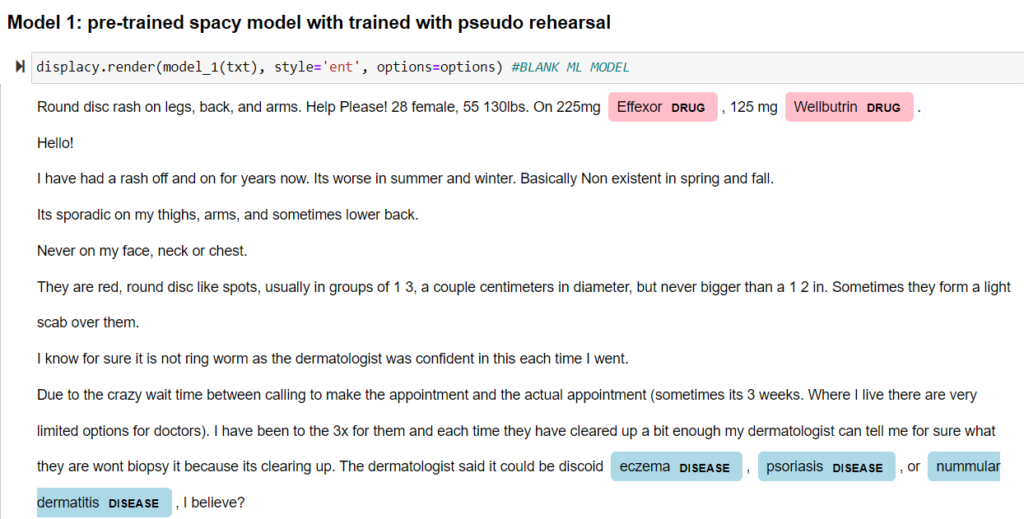
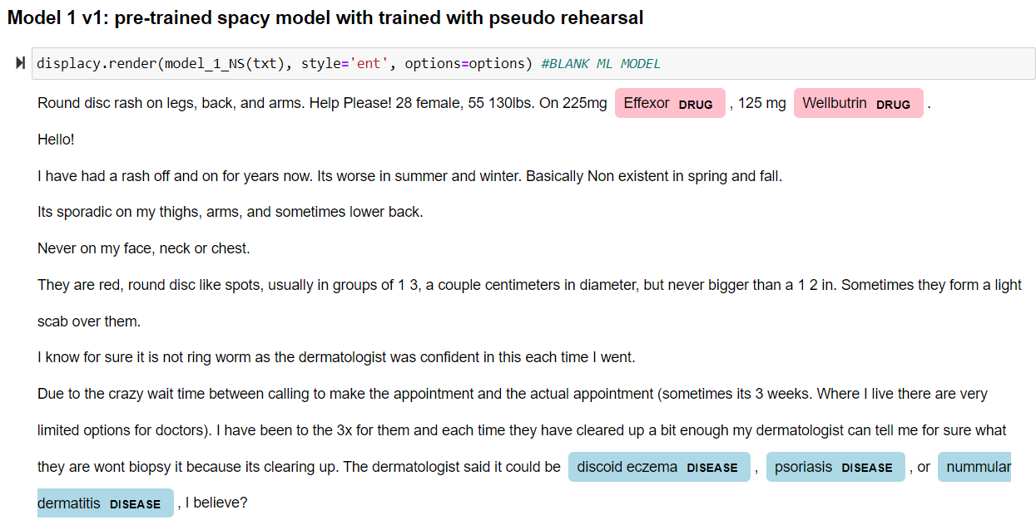
Model Predictions
Annotated Reference
Rule-Based Model
Pre-trained ML Model
Blank ML Model
Example of ML model prediction: -- ‘ring worm’ ++ ‘discoid eczema’, ‘nummular dermatitis’

Slide 14
Model Performance
Using Validation ver. 2
Training Data version | Entities | Rule-Based Model |  | Pre-trained ML Model |  | Blank ML Model
 |  | Precision | Recall | Precision | Recall | Precision | Recall
Train Ver. 1, n = 240 | DISEASE | 80.81 | 55.73 | 73.59 | 53.18 | 67.37 | 57.25
 | DRUG | 88.62 | 46.98 | 71.43 | 50.79 | 75.49 | 48.89
Train Ver. 1, n = 480 | DISEASE | 76.09 | 62.34 | 69.3 | 62.6 | 67.55 | 64.63
 | DRUG | 81.48 | 55.87 | 76.89 | 64.44 | 78.67 | 56.19
Train Ver. 2, n = 480 | DISEASE | 73.62 | 64.63 | 73.73 | 62.85 | 69.55 | 63.36
 | DRUG | 81.57 | 56.19 | 83.48 | 60.95 | 73.76 | 66.03
All values in percentages.
Precision: for e.g., Entities correctly predicted as DRUG / All entities predicted as DRUG
Recall: for e.g., Entities correctly predicted as DRUG / All entities labeled as DRUG

Slide 15
Observations from Model Training, Evaluation
Text annotation can be an iterative process. It can done efficiently if the labeling guidelines are clearly defined beforehand (this is important)
In general, more annotated data leads to better model performance. Thus, any insights from annotating a previous batch of text become very useful for annotating future batches.
The annotator must pay attention to a word’s context for labeling it correctly.
Pre-trained ML models should generally be helpful for model performance

Slide 16
Results
Potential Use cases
Custom NER models were trained in spaCy as a proof-of-concept
repo: https://github.com/ea0337ea0337/Custom_NER_AskDocs
For the limited training data, the Rule-Based model performed similar to the ML models.
Models need to perform better to be deployable in a useful way
Can help in characterizing patient queries better
Can prompt the patient towards immediate medical attention if needed.
Can be used to get broad insights into people’s health by gender / age / location etc. by extracting demographic data

Slide 17
Future Work/ Wishlist / Errors
Annotate more data for model training, validation
Add frequently occurring and easily identifiable labels such as drug dosage
Include the word doctor / Dr. / etc. which was removed (accidentally) during clean-up ¯\_(ツ)_/¯
Use domain specific pre-trained spacy models, if available
Identify similar, but large annotated datasets and use as an intermediate step in model training; fine-tune model using custom dataset
Use data augmentation to make the model more robust to misspelling etc.

Slide 18
Thank you!

Slide 19
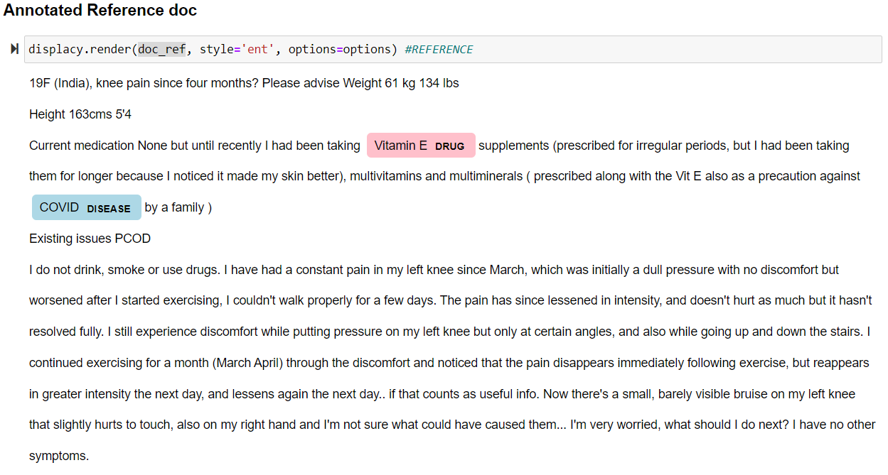
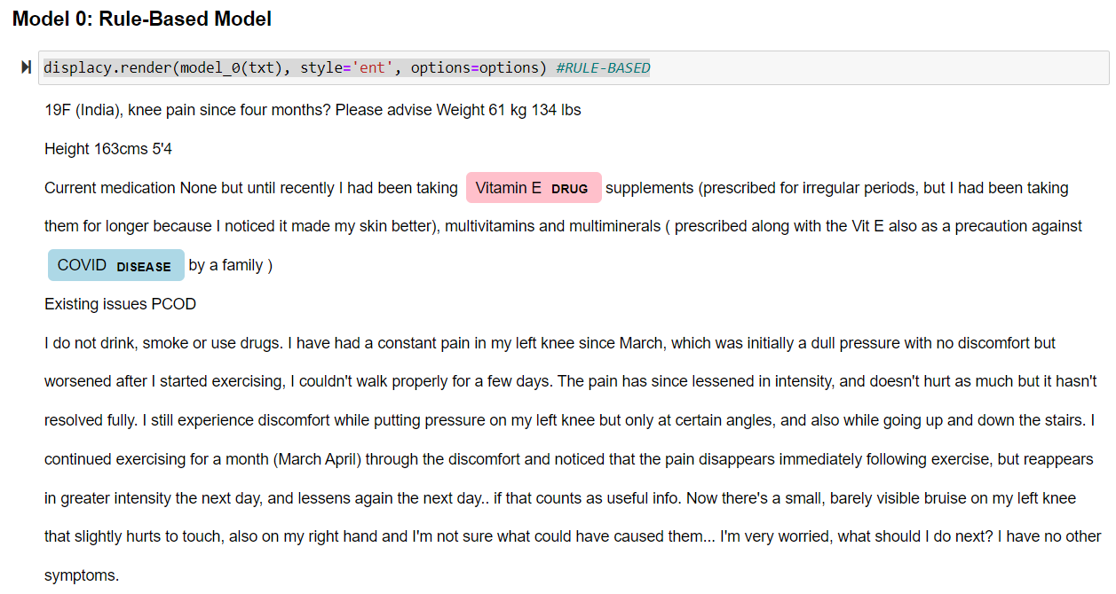
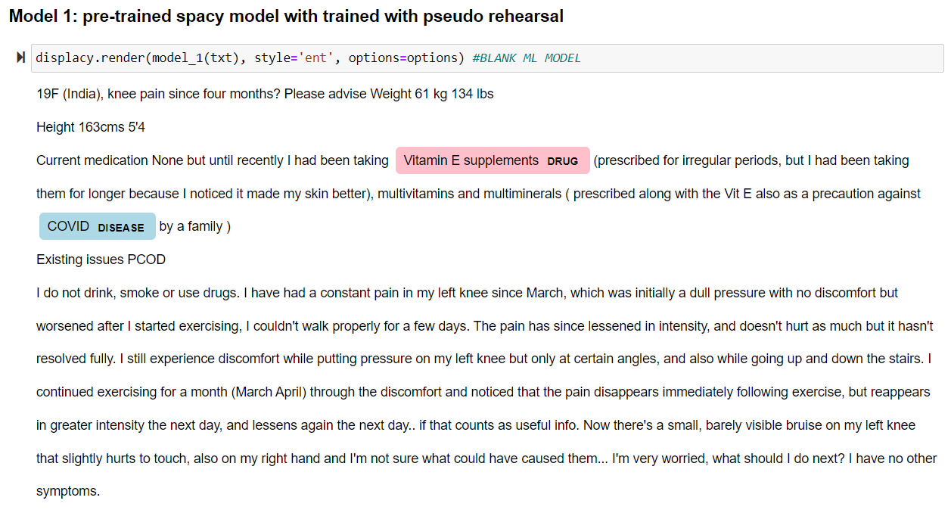
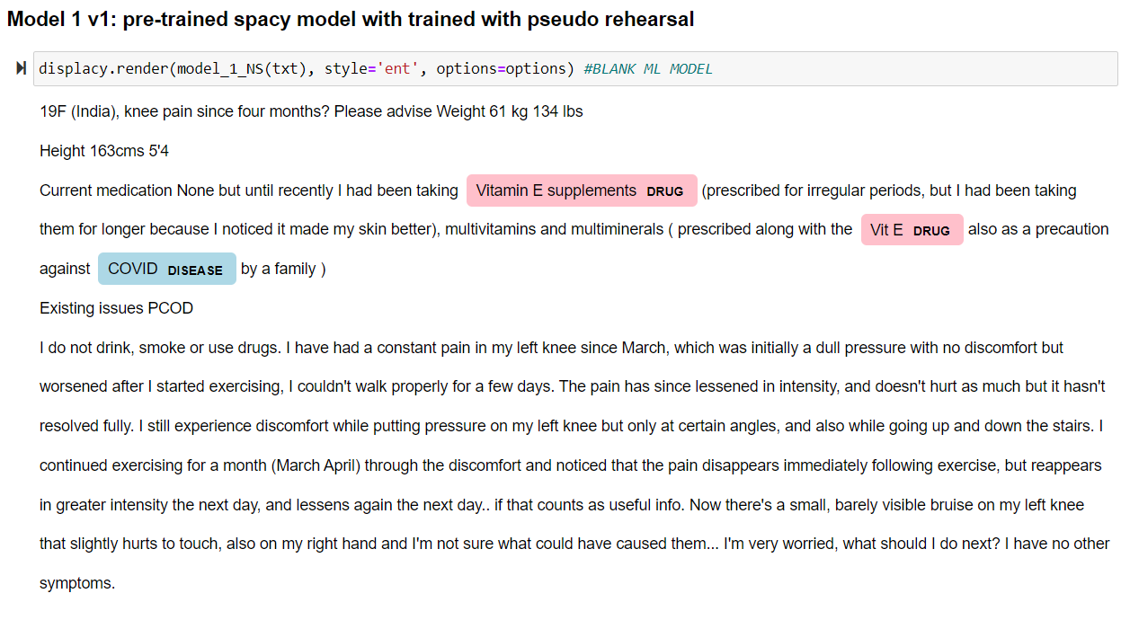
Annotated Reference
Rule-Based Model
Pre-trained ML Model
Blank ML Model
Example of how ML model generalizes: ++ ‘Vit E’

Slide 20
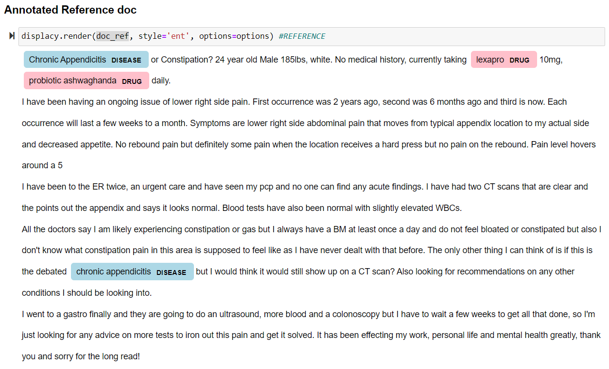
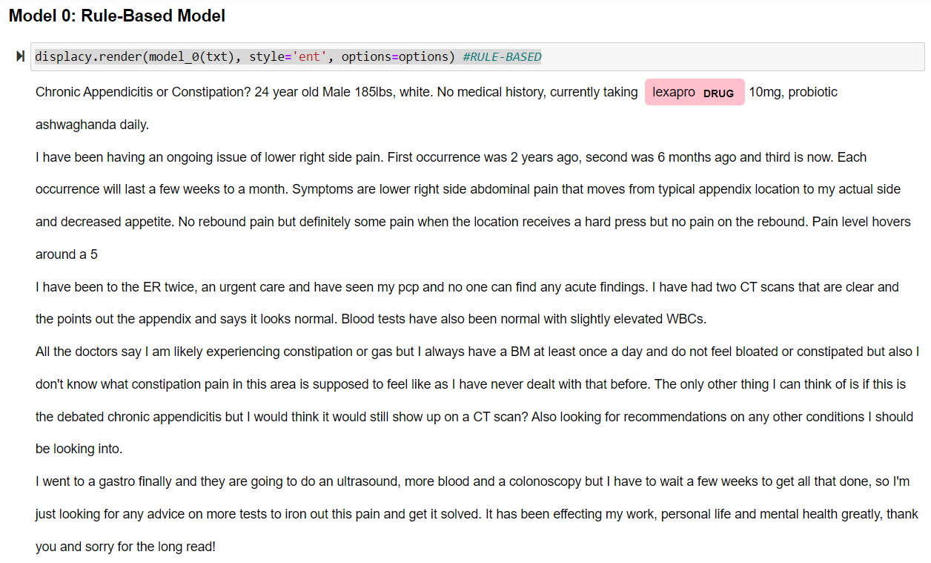
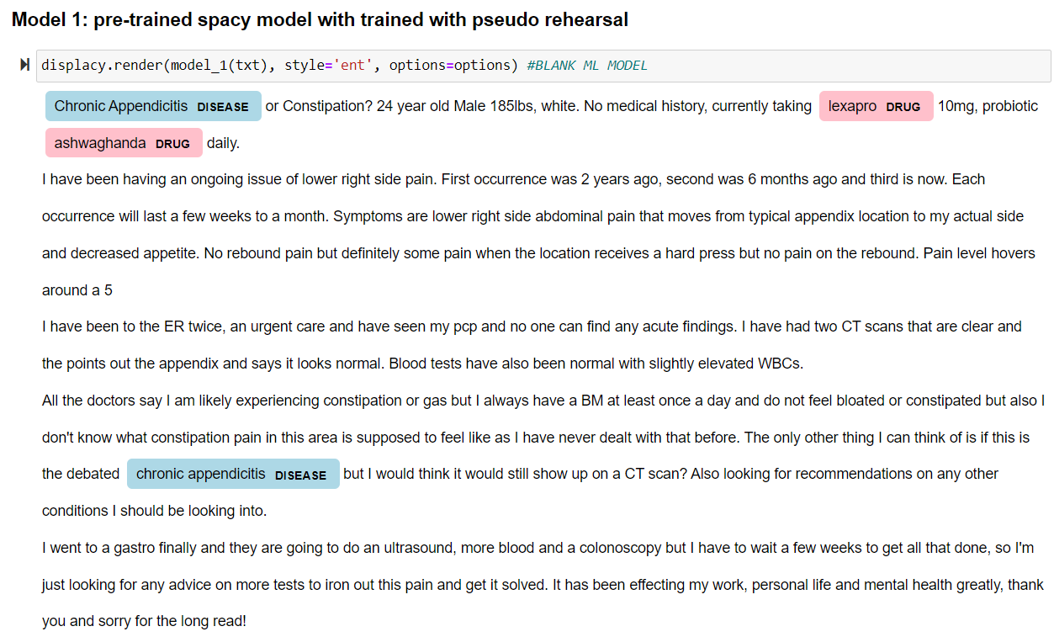
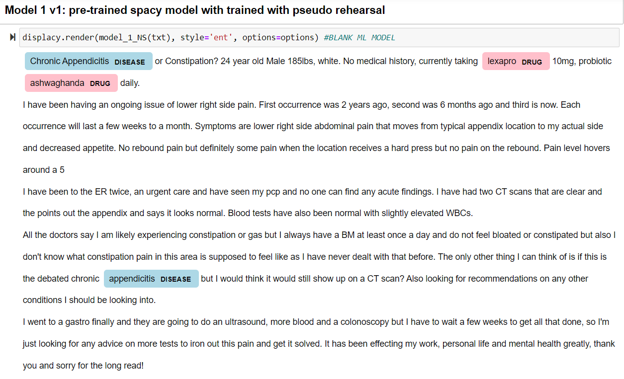
Annotated Reference
Rule-Based Model
Pre-trained ML Model
Blank ML Model
Example of how ML model generalizes: ++ ‘Chronic Appendicitis’, ‘ashwagandha’

Slide 21
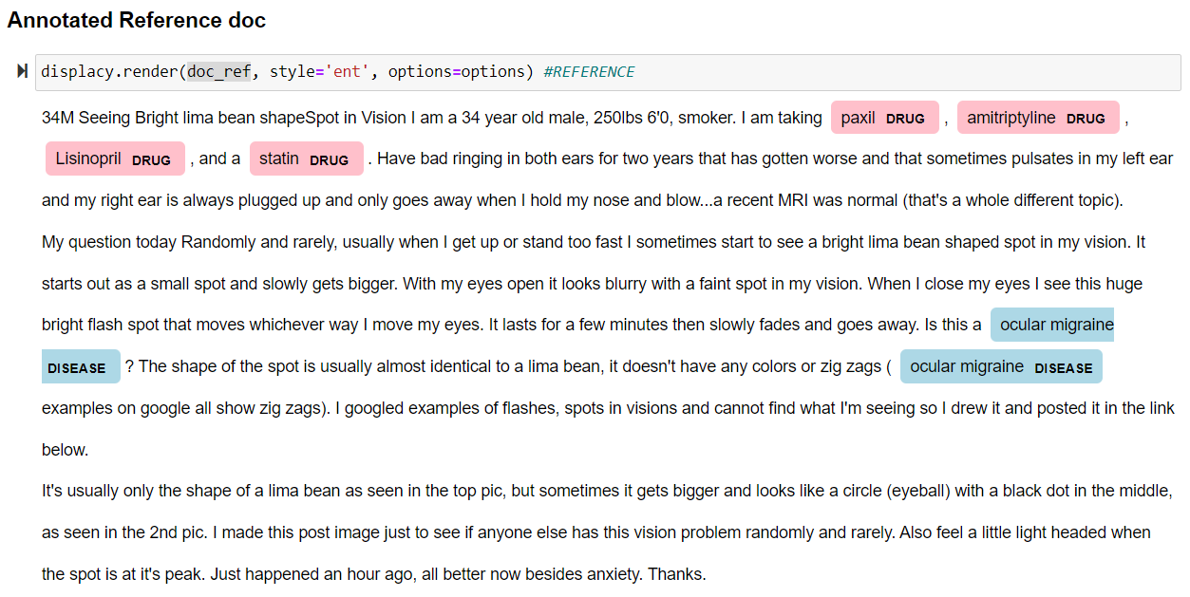
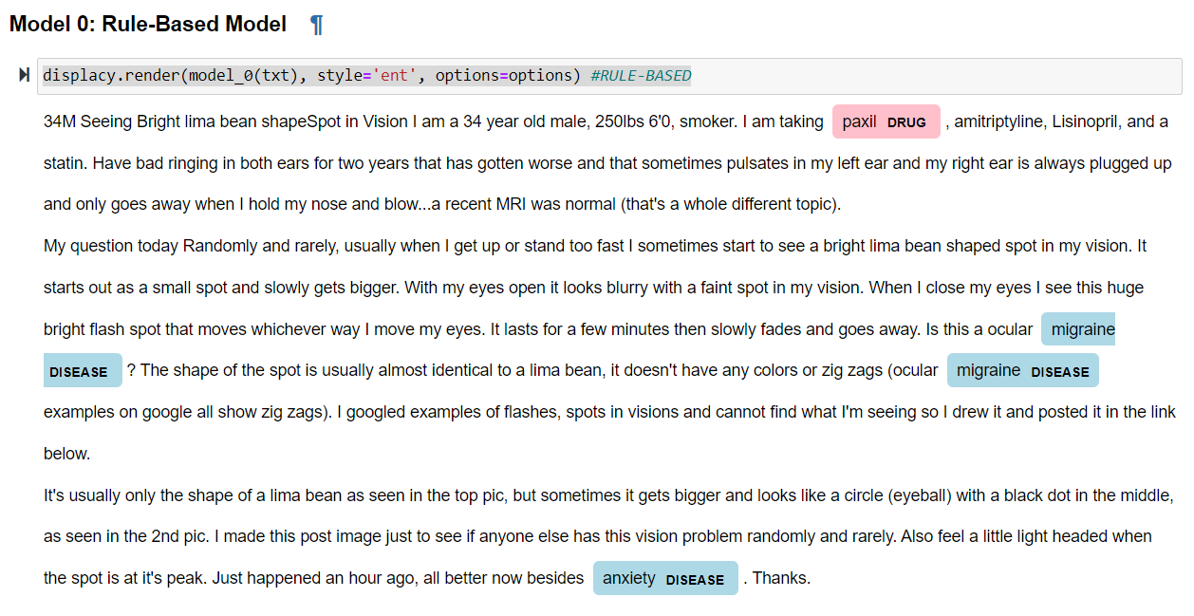
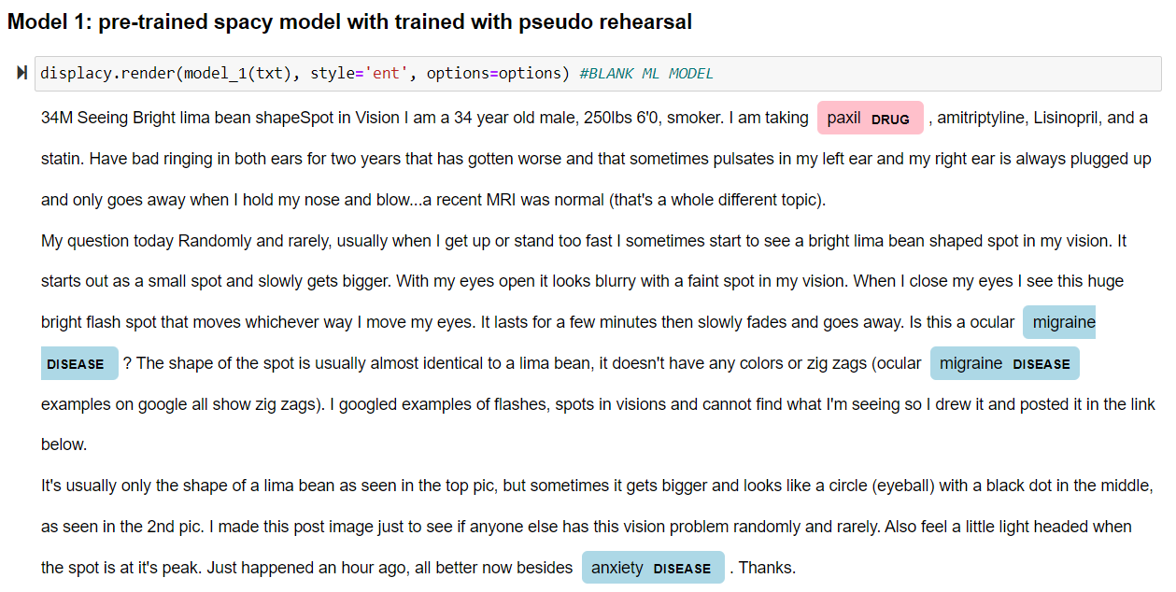
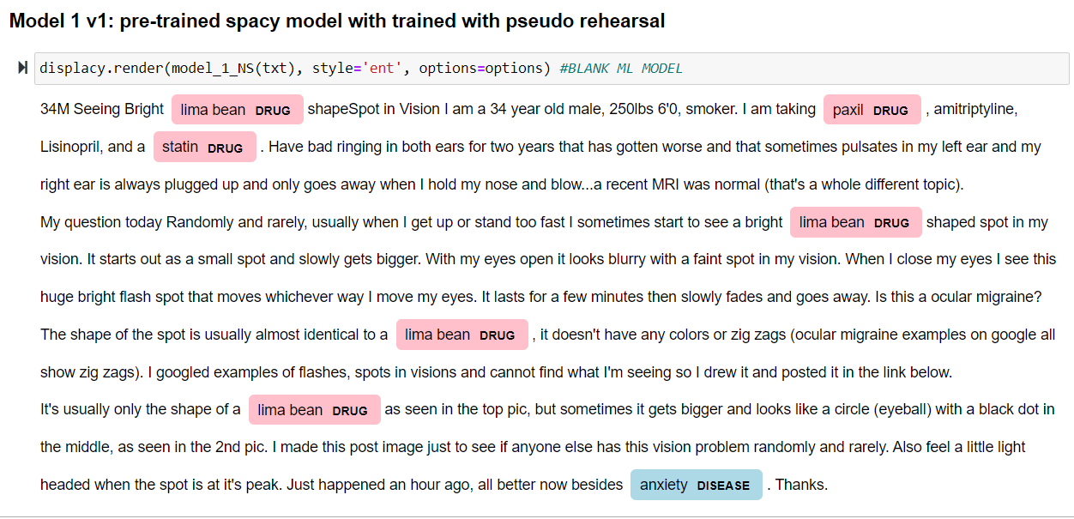
Annotated Reference
Rule-Based Model
Pre-trained ML Model
Blank ML Model
Example of how ML model fails: -- ‘amitriptyline’, ‘lisinopril’, ‘statin’, ‘lima bean’ ?? etc.

Slide 22
