Slide 1
Moving Crime Report
Workflow:
User enters new address that they are moving to
Get longitude and latitude (L&L) of new address from Google Maps API
Create new embedded google map that is 0.5 mile by 0.5 mile and centered around the new address
Use binary search to find the closest L&L to the target value
Once the closest value is found, iterate up and down in the JSON object
Create a new array containing all of the values that are within the latitude equivalent of 0.5 miles
Return all results with an L&L less than or equal to 0.5 mile away from new address L&L
Change radius of search
Display dots of incidents on map
Describe details about the crimes committed at each location
Make clickable icons for each type of crime
Percentile for crime density compared to other addresses in Minneapolis
Free
Paid

Slide 2
If there’s crime near the place you’re considering moving into, you’d probably want to know about it.
Enter New Address

Slide 3
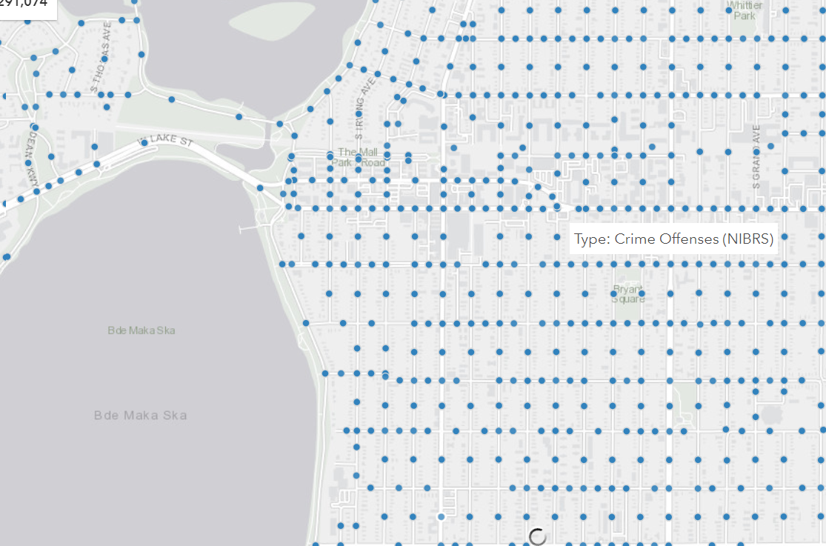
Crime results of new address

