Slide 1
Heatwave Definitions — Results, Figures & Meaning
Two definitions presented on their own — statewide Texas, 254 counties, 2015–2025
Def 01 = county-relative 85th-pctl daily-mean heat index, ≥2 consecutive days, walk-forward baseline
Def 02 = same, at the 95th percentile
Descriptive exposure classification only — not injury, worker heat dose, or official NWS advisories

Slide 2
What we are presenting
• Two heatwave definitions, each shown on its own (not compared head-to-head):
– Definition 01 — county-relative 85th-percentile daily-mean heat index, >=2 consecutive days, walk-forward baseline
– Definition 02 — same, at the 95th percentile
• Unit of analysis:
– heatwave DAY = one county on one date inside a >=2-day run
– heatwave EVENT = one uninterrupted run of heatwave days in one county; duration = its length in days
• Both are YEAR-ROUND, COUNTY-RELATIVE ('unusually hot for this county & date') = a persistent apparent-heat anomaly
• For each definition: results from the CSVs -> figures -> what they mean; then likely questions; then caveats.

Slide 3
Definition 01 — 85th percentile

Slide 4
Definition 01 — results from the data
Source: outputs/TX/def_p85_2d/ (centered 15-day window)
Statistic | Value
Total heatwave county-days (statewide, 11 yr) | 170,894
Total heatwave events | 48,323
Heatwave days per county — median (p25–p75; range) | 677 (568–775; 154–1,230)
Event duration — median / mean / max | 3 d / 3.5 d / 48 d
Events that are the minimum 2 days | 44%
Events lasting >= 5 days | 21%
Share of heatwave days in Jun–Sep | 37%
Top counties by heatwave days | La Salle 1,230; Hudspeth 1,198; Lavaca 1,122
Longest event | Presidio, Jul 5–Aug 21 2023 = 48 days (peak mean-HI 99.5°F)

Slide 5
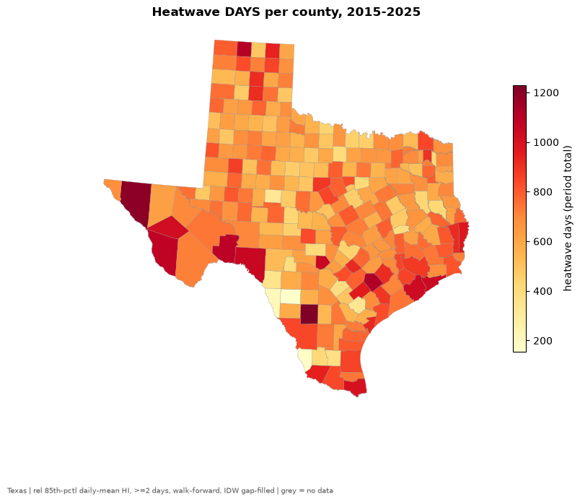
Def 01 — heatwave days per county (2015–2025)
A broad 'elevated-exposure' net: the typical county sees ~677 heatwave days over 11 years (~62/yr). Read the REGIONAL gradient, not single counties.

Slide 6
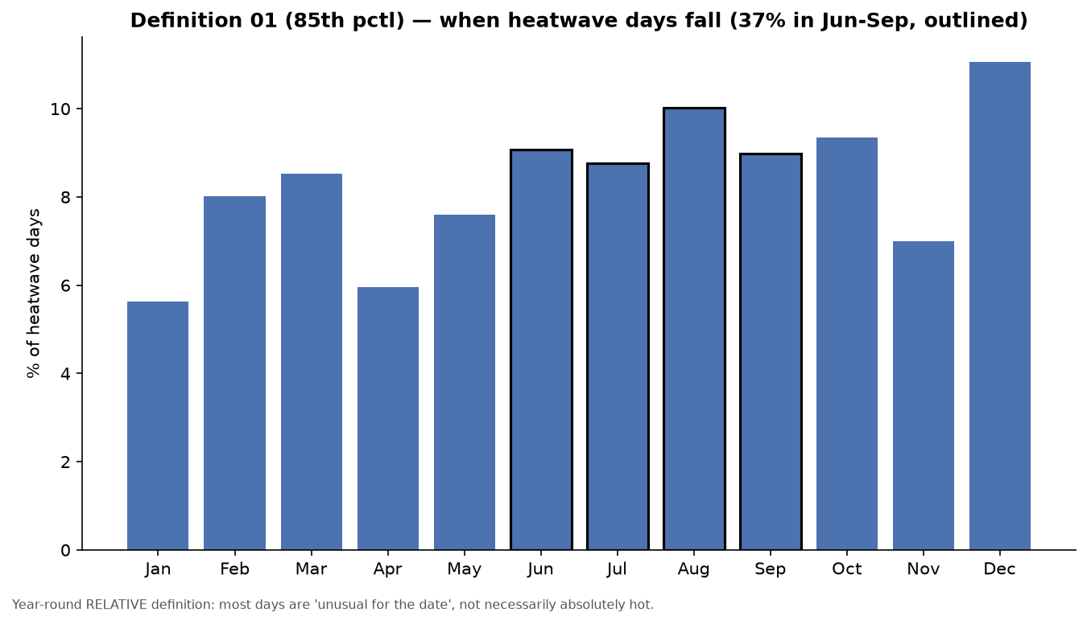
Def 01 — when heatwave days fall
Only ~37% of days are in summer (Jun–Sep, outlined). ~63% are cool-season 'unusual-for-the-date' anomalies — the signature of a year-round RELATIVE definition.

Slide 7
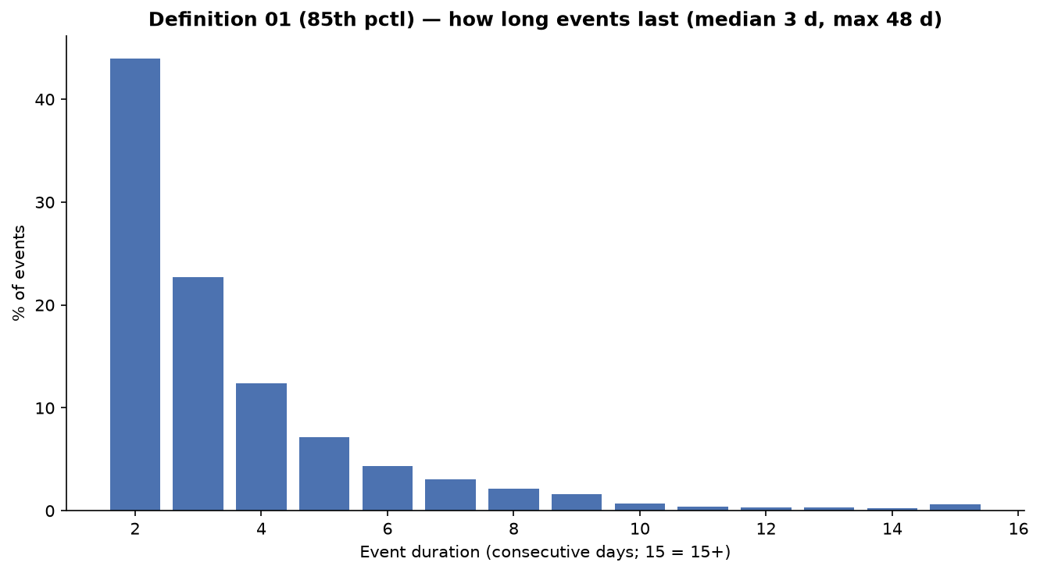
Def 01 — how long events last
Mostly short: 44% of events are the minimum 2 days (median 3). A minority are long persistent ridges (21% >=5 days; up to 48 days).

Slide 8
Definition 02 — 95th percentile

Slide 9
Definition 02 — results from the data
Source: outputs/TX/def_p95_2d/ (centered 15-day window)
Statistic | Value
Total heatwave county-days (statewide, 11 yr) | 52,786
Total heatwave events | 17,428
Heatwave days per county — median (p25–p75; range) | 196 (148–254; 18–516)
Event duration — median / mean / max | 2 d / 3.0 d / 31 d
Events that are the minimum 2 days | 53%
Events lasting >= 5 days | 14%
Share of heatwave days in Jun–Sep | 36%
Top counties by heatwave days | La Salle 516; Presidio 513; Hudspeth 508
Longest event | Kendall, Jul 2022 = 31 days (peak mean-HI 106.2°F)

Slide 10
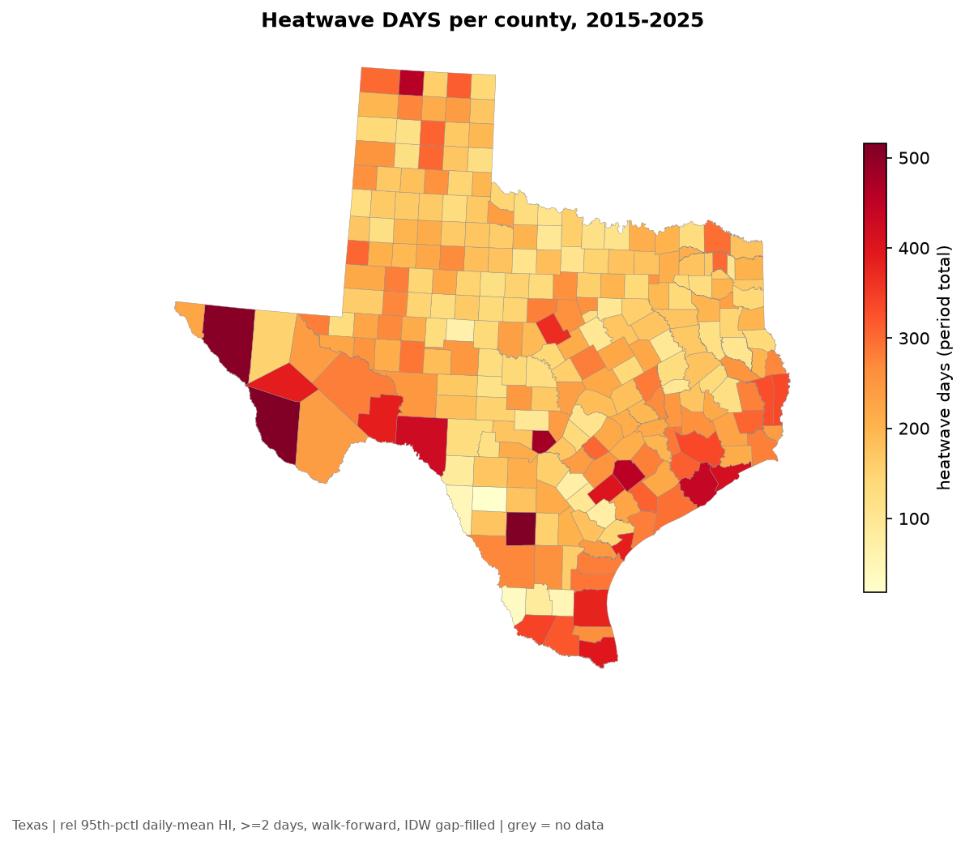
Def 02 — heatwave days per county (2015–2025)
A severe-tail screen: the typical county sees ~196 heatwave days over 11 years (~18/yr) — each county's most anomalous ~5% of days.

Slide 11
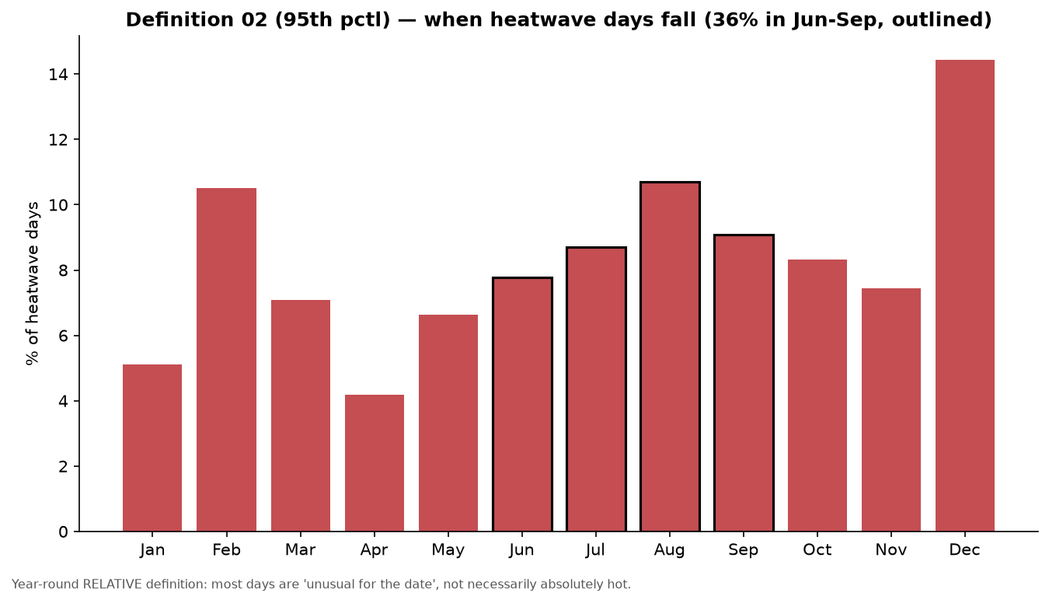
Def 02 — when heatwave days fall
~36% of days in Jun–Sep — essentially the same seasonal spread as Def 01, confirming the cool-season share is a property of the RELATIVE method, not the percentile.

Slide 12
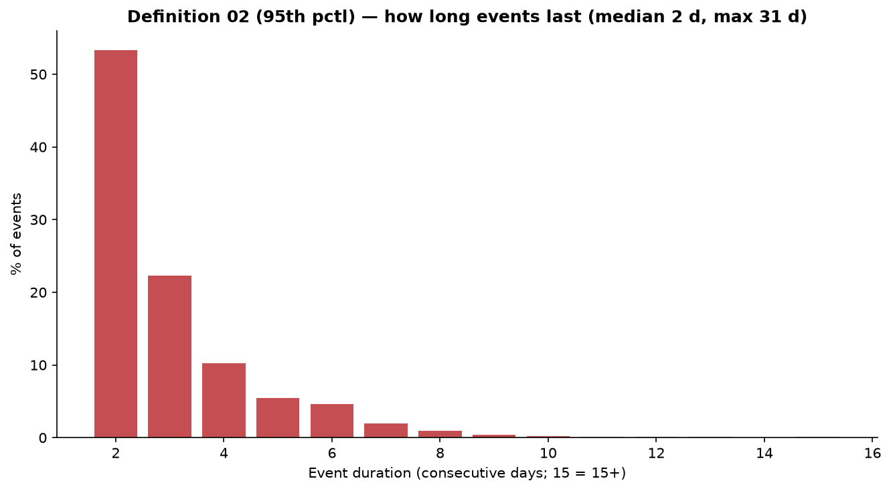
Def 02 — how long events last
Shorter & sparser than Def 01: 53% of events are exactly 2 days (median 2). Long events are rarer (14% >=5 days).

Slide 13
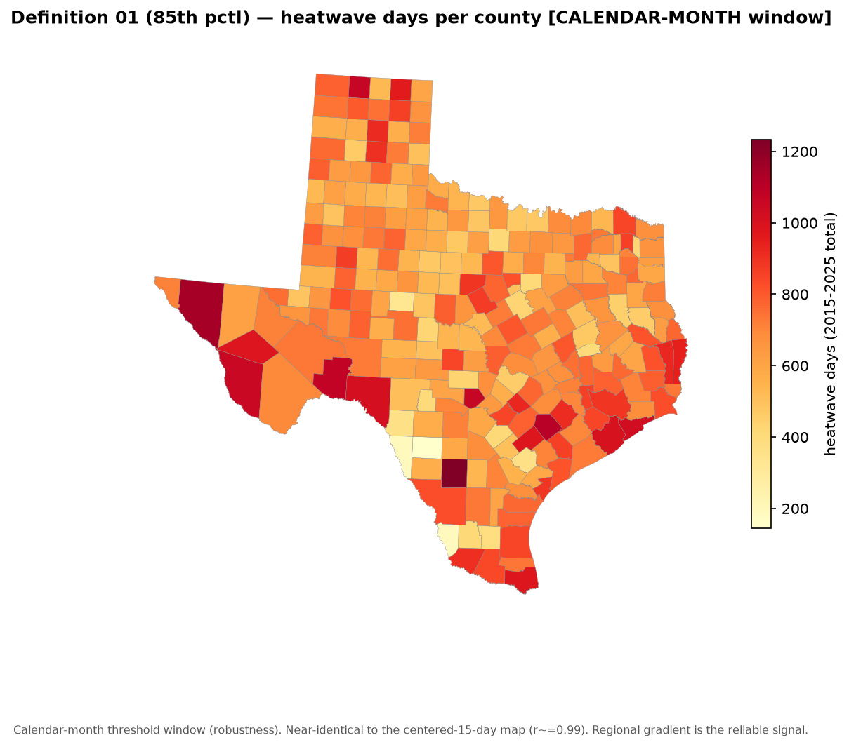
Def 01 — heatwave days per county [calendar-month window]
Robustness: the calendar-month threshold gives essentially the same map as the 15-day window (per-county r=0.994).

Slide 14
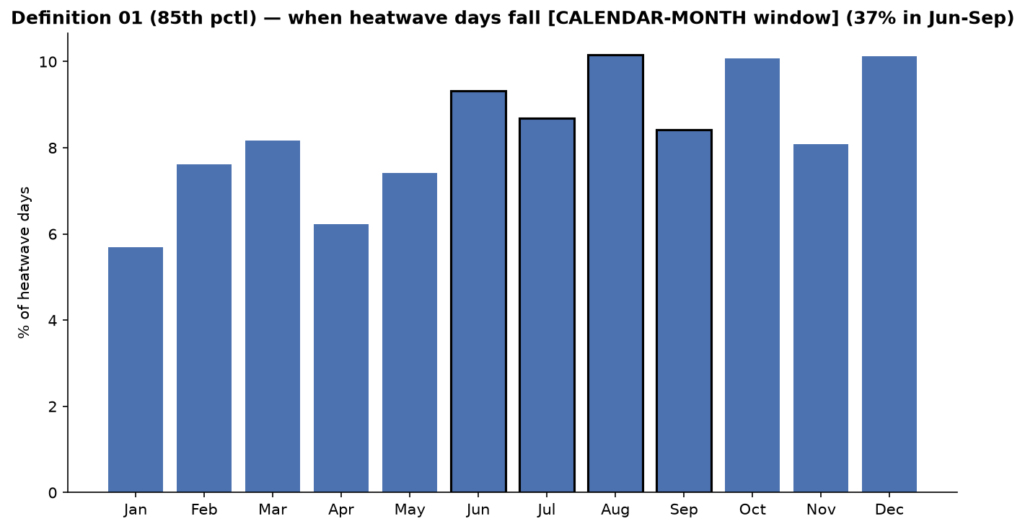
Def 01 — seasonal share [calendar-month window]
Same seasonal pattern as the 15-day window (~37% of heatwave days in Jun-Sep).

Slide 15
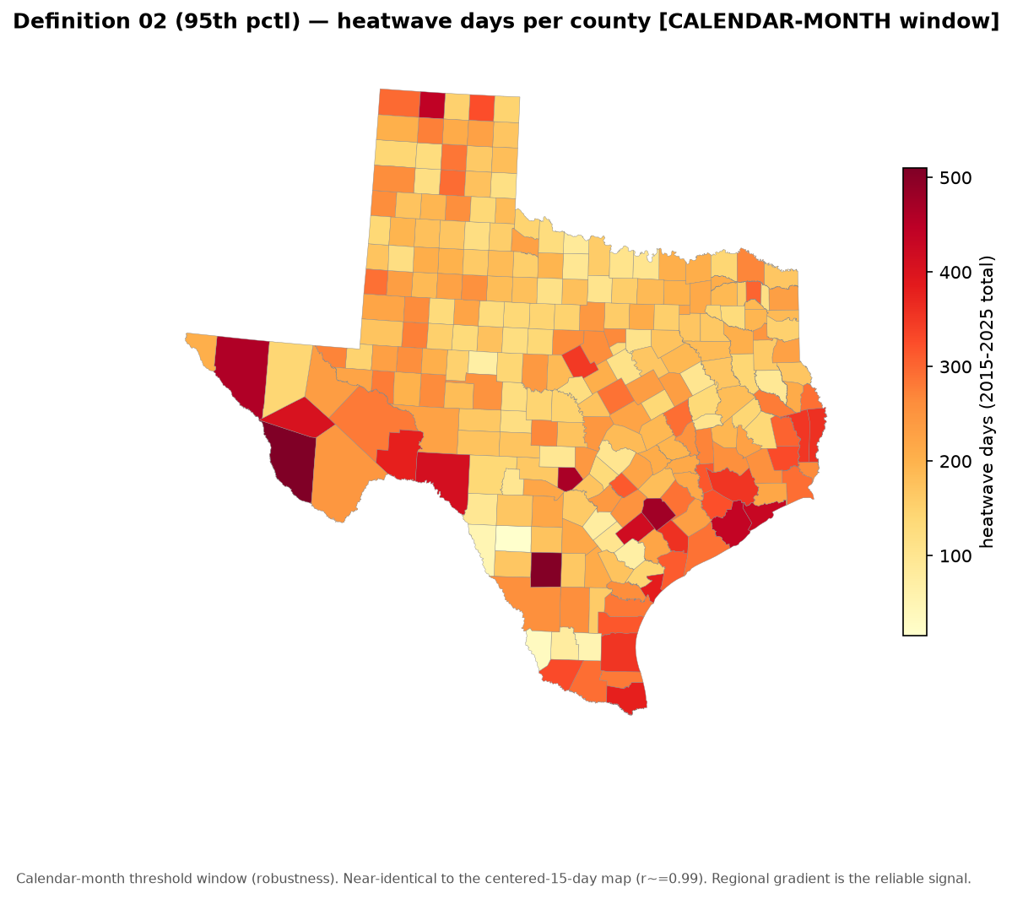
Def 02 — heatwave days per county [calendar-month window]
Robustness: near-identical to the 15-day window (per-county r=0.987).

Slide 16
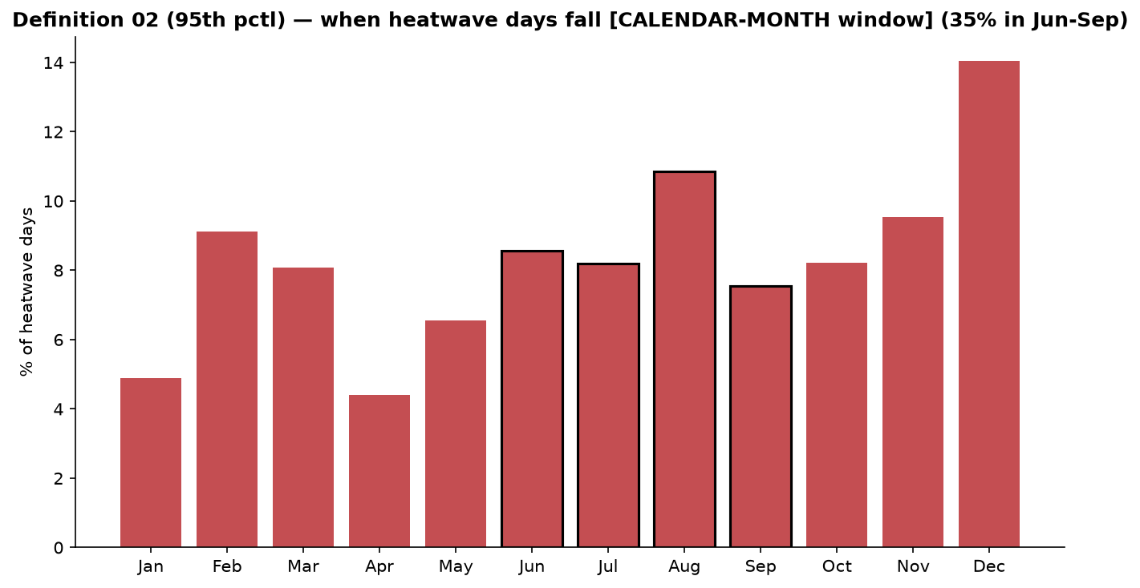
Def 02 — seasonal share [calendar-month window]
Same seasonal pattern as the 15-day window (~36% of heatwave days in Jun-Sep).

Slide 17
Both definitions were run on BOTH threshold windows
Centered 15-day (primary, shown) vs calendar-month bucket — both computed for each definition
Statistic | Value
Def 01 pooled days — 15-day / month | 170,894 / 171,115
Def 01 pooled events — 15-day / month | 48,323 / 47,470
Def 01 per-county median days — 15-day / month | 677 / 678 (r = 0.994)
Def 02 pooled days — 15-day / month | 52,786 / 53,273
Def 02 pooled events — 15-day / month | 17,428 / 17,517
Def 02 per-county median days — 15-day / month | 196 / 194 (r = 0.987)
The two windows agree to <1% and r~=0.99 per county -> the window choice is a robustness check, not a driver. Month-window CSVs: *_month.csv in each def's tables/ folder.

Slide 18
Companion outputs (definition-independent)

Slide 19
Data coverage & the NWS advisory-threshold proxy
• DATA COVERAGE / IDW imputation (same for both definitions):
– ~13% of temperature county-days are inverse-distance interpolated; 22 counties have NO native station; 93 are fully native
– => single-county map texture is noisy; the REGIONAL gradient is the trustworthy signal (see map03)
• NWS advisory-threshold PROXY (uses the daily-MAX HI vs each county's local office threshold):
– humid eastern/coastal counties accumulate many advisory-threshold days; arid far-west counties record almost none
– => a day can be a RELATIVE heatwave without reaching an ABSOLUTE advisory level (relative vs absolute heat)
– PROXY only — not an official NWS advisory (no hourly data, no duration/overnight/coverage rules)

Slide 20
Likely / scenario questions

Slide 21
Likely questions — construct & metric
Q: Only ~37% of days are in summer — how is a warm January day a 'heatwave'?
A: By design: a year-round, county-relative rule flags days unusual FOR THE DATE, not absolutely hot. ~63% are cool-season anomalies. Apply the optional mean-HI>=80°F floor (roughly halves counts) or a warm-season restriction for an absolute-heat framing.
Q: Why a daily-MEAN heat index — doesn't heat illness come from the afternoon peak?
A: The mean targets persistent day-and-night apparent heat (incl. warm nights). Trade-off: it under-weights the peak and is a DAILY PROXY, not hourly — so this is exposure CLASSIFICATION, not worker dose.
Q: Heat index is defined on hourly data — how valid is a daily proxy?
A: It's an approximate NWS proxy from GHCN-Daily temp + gridMET humidity. Regional gradient robust; single-county values & trend slopes are descriptive only.

Slide 22
Likely questions — data quality & persistence
Q: With ~13% of county-days imputed and 22 counties fully imputed, can I trust the maps?
A: Regionally yes, pixel-by-pixel no. Fully-imputed counties are interpolated, not observed — flag/exclude them for single-county claims. Statewide totals don't hinge on any one county.
Q: Is a 2-day exceedance really a 'wave', and is a 48-day event credible?
A: The >=2-day rule is a minimum-persistence filter; 44–53% of events are exactly 2 days, so 'elevated exposure' is fairer than 'wave' for much of it. Long tails are genuine persistent anomalies — lead with the median, not the max.
Q: Some adjacent counties differ sharply — is that real climate?
A: Largely no — it reflects the changing multi-station composite + IDW imputation, not micro-climate. That's why single-county rankings are presented cautiously.

Slide 23
Likely questions — thresholds, windows & claims
Q: Why 85th and 95th specifically — aren't those arbitrary?
A: Conventional relative heat thresholds (95th has published precedent), chosen to bracket a moderate and a severe cut. A fuller threshold sweep is a reasonable extension.
Q: A percentile fixes the exceedance rate — isn't the day count preordained?
A: The single-day rate is anchored (~15% / ~5%), but totals also depend on the >=2-day rule and the walk-forward baseline. The informative content is WHERE and WHEN heat clusters, not the grand total.
Q: How sensitive are results to the 15-day window vs a calendar month?
A: Not sensitive — the two windows agree at r≈0.99 per county. The consequential levers are the percentile and the floor/season choice.
Q: What can these results actually support?
A: County-level environmental apparent-heat EXPOSURE classification — not worker dose, causal injury, or official-advisory equivalence.

Slide 24
Caveats to keep on any results slide

Slide 25
Caveats
• Daily heat-index PROXY (not hourly); temperature and humidity have different spatial support.
• County temperature is a changing multi-station composite + IDW imputation -> single-county values noisy, regional gradient robust.
• Year-round RELATIVE construct = persistent apparent-heat anomaly; ~63% of days are cool-season anomalies unless the >=80°F floor is applied.
• NWS proxy is approximate and NOT an official advisory; trend slopes are descriptive only.
• Exposure classification — NOT an injury or worker-heat-dose measure.
Data: NOAA GHCN-Daily + gridMET + Census shapefile. Code (state-agnostic): github.com/eaadeniyi/gulf_heatwave

