Slide 1
TIME SERIES ANOMALY DETECTION
How Clustering Helps
Detect Anomalies in
Streaming Sensor Data
A walkthrough of the Cluster-Aware Causal Mixer
Elias Abay / CMPE 255 Short Story
01
Notes:
0:00–0:40
Introduce the Medium article and the paper it reviews. Set up the core question: how does a system recognize abnormal sensor behavior while readings are still arriving? The talk follows a water monitoring example, then covers the model and what the experiments actually measure.
Article: https://medium.com/@elias.abay_17085/how-clustering-helps-detect-anomalies-in-streaming-sensor-data-044000521b4e
Paper: https://arxiv.org/abs/2506.00188v2

Slide 2
One reading is only part of the picture
01
A pressure dip
A single observation may be unusual relative to typical readings.
02
A sustained change across sensors
An interval may look unusual because of how the readings move together.
03
Normal operating data
The model learns a reference pattern from mostly normal examples.
Blázquez-García et al. (2020), Section 2
02
Notes:
0:40–1:55
Imagine a water operator seeing a short pressure dip. Ask what other information would change their interpretation. A simultaneous flow change and a sustained pattern provide context. Explain that a multivariate time series records several sensor channels together. The survey distinguishes point outliers from unusual sequences. CCM-TAD trains its reconstruction model on predominantly normal data and uses the mismatch between an observation and its reconstruction as evidence.
Sources: https://arxiv.org/abs/2002.04236 and https://arxiv.org/abs/2506.00188v2 (Sections 1–3).

Slide 3
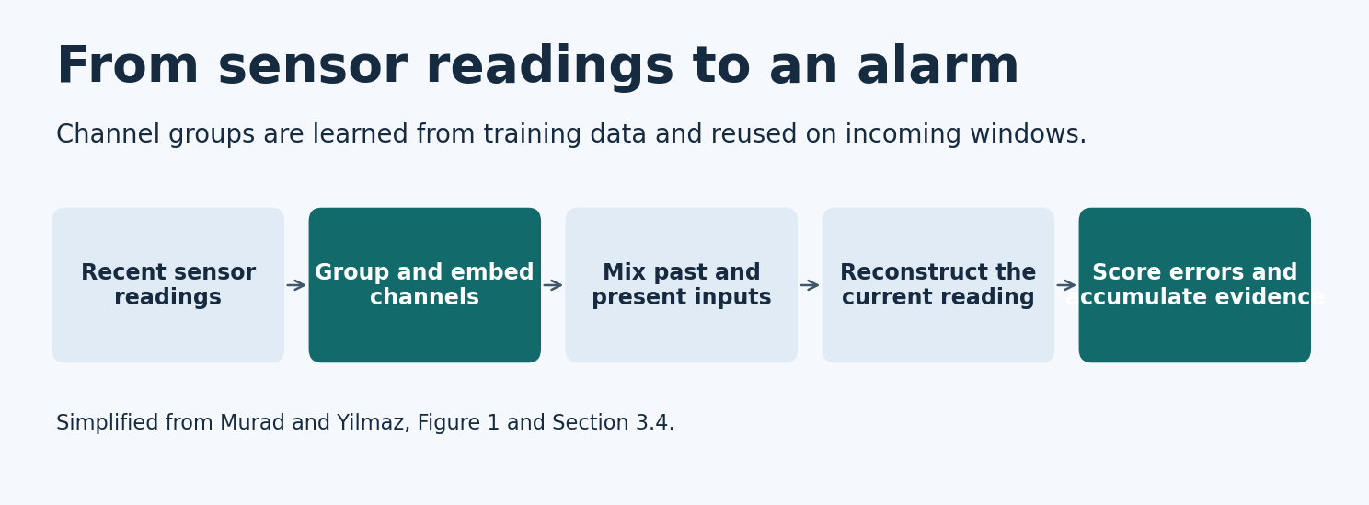
The CCM-TAD pipeline
The model reconstructs the current reading and passes its error to the scoring stage.
Adapted from Murad and Yilmaz (2026), Figure 1 and Section 3.4
03
Notes:
1:55–3:00
Walk through the figure from left to right. A sliding window ends at the current observation. The system groups channels using assignments learned during training, embeds each group, and combines the embeddings. The mixer processes those features and the reconstruction head estimates the current observation. The difference between the observed and reconstructed readings enters a separate scoring stage. Keep the architecture and scoring procedure distinct.
Source: https://arxiv.org/abs/2506.00188v2 (Sections 3.1–3.4).

Slide 4
Channel clusters and embeddings
01
Correlation profiles
Measure the strength of each channel’s relationships across the training data.
02
Spectral clustering
Build a graph from profile similarities and apply K-means in the spectral space.
03
Group-specific embeddings
Embed each group separately and combine the representations.
Murad and Yilmaz (2026), Section 3.2
04
Notes:
3:00–4:10
Explain that the objects being clustered are sensor channels. For each channel, the model looks at the magnitude of its correlations with other channels in training data. A correlation profile captures that whole pattern. Two channels can be similar because their profiles look alike across the system. The method compares profiles, uses spectral clustering, and applies K-means to the spectral representations. Each resulting group has its own embedding. The learned assignments are reused when new data arrives.
Source: https://arxiv.org/abs/2506.00188v2 (Section 3.2).

Slide 5
Temporal masking in the mixer
Past readings + current reading
The temporal mask limits the inputs available at each time position.
The embedding mixer combines features at that position.
Murad and Yilmaz (2026), Sections 3.3 and 4.2.5
05
Notes:
4:10–5:15
Use the index t to explain that a representation at time t can use observations through t. The mask restricts mixing along the time axis. Feature mixing operates at a given time position. In the paper’s gradient example, later positions inside the window have zero gradient for the causal variant at the selected output position. The example tests information flow inside the supplied window. Here causality refers to time order.
Source: https://arxiv.org/abs/2506.00188v2 (Sections 3.3 and 4.2.5, Figure 3).

Slide 6
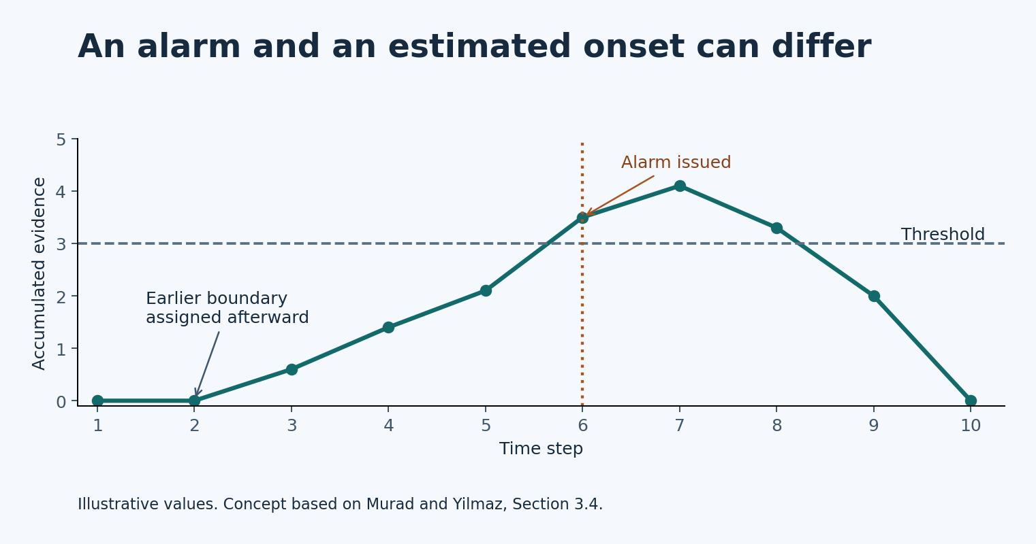
Accumulated evidence and alarm timing
Alarm time
When evidence crosses the threshold
Estimated onset
When the event likely began
Illustrative example based on Murad and Yilmaz (2026), Section 3.4
06
Notes:
5:15–6:40
First explain how the system compares a current reconstruction error with normal validation errors. An unusually large error can add positive evidence, while negative evidence reduces the score or eventually triggers a reset. Then follow the illustrative curve to the threshold crossing. That is when the operator receives an alarm. The method can later estimate an earlier event onset for investigation. The values in this drawing are hypothetical.
Source: https://arxiv.org/abs/2506.00188v2 (Section 3.4).

Slide 7
Selected benchmark results
Dataset | CCM-TAD best-F1 | Selected comparison
WADI | 0.761 | SensitiveHUE offline 0.700
PSM | 0.716 | OracleAD 0.659
SWaT | 0.883 | SensitiveHUE online 0.874 SensitiveHUE offline 0.911
PSM PR AUC was 0.558 for CCM-TAD and 0.598 for xLSTMAD.
Murad and Yilmaz (2026), Tables 2–3 and Appendix F
07
Notes:
6:40–8:05
The paper evaluates six public datasets. This table selects three comparisons from the article. On SWaT the online SensitiveHUE variant is slightly lower than CCM-TAD, while the offline variant is higher. Offline normalization uses the complete test sequence. Best-F1 comes from an evaluation sweep using ground-truth labels. On PSM, the PR AUC comparison differs: CCM-TAD reports 0.558 and xLSTMAD 0.598. Explain why metric and evaluation setting travel with every score.
Source: https://arxiv.org/abs/2506.00188v2 (Tables 2–3 and Appendix F).

Slide 8
Boundary correction raised PSM F1 to 0.716
PSM scoring configuration | F1
Point-based reconstruction error | 0.657
Sequential scoring without boundary correction | 0.659
Sequential scoring with boundary correction | 0.716
Boundary correction revises the reported event interval.
Murad and Yilmaz (2026), Table 4
08
Notes:
8:05–9:10
Walk through the three PSM scoring variants in order. Accumulating evidence without boundary correction moves F1 only slightly from 0.657 to 0.659. Adding correction produces 0.716. Most of this particular improvement appears at the correction step. That result motivates measuring the delay to the first alert separately from the quality of the revised boundaries.
Source: https://arxiv.org/abs/2506.00188v2 (Table 4).

Slide 9
Causal mixing and clustering in the PSM ablation
PSM architecture configuration | Best-F1
Non-causal temporal mixer with clustering | 0.652
Causal temporal mixer without clustering | 0.703
Full CCM-TAD | 0.716
The authors tuned each configuration separately.
Murad and Yilmaz (2026), Tables 5–6
09
Notes:
9:10–10:15
Compare the full configuration with two selected variants. The non-causal temporal mixer configuration reports 0.652. The causal configuration without clustering reports 0.703. The full model reports 0.716. The authors tuned configurations separately, so explain these as comparisons of reported variants. The nearest-neighbor separation diagnostic varies across datasets, improving substantially on SWaT and only slightly on PSM.
Source: https://arxiv.org/abs/2506.00188v2 (Tables 5–6).

Slide 10
A deployment test for alert delay and false alarms
01
Threshold chosen on validation data
Fix the decision rule before replaying the held-out stream.
02
Time from onset to first alert
Measure alert delay for detected events and report missed events separately.
03
False alarms per hour
Track operational burden and repeat under changing channel relationships.
Proposed evaluation based on the article’s deployment discussion
10
Notes:
10:15–11:45
Return to the water operator. The benchmark is useful for comparison, but the operator needs a threshold set in advance and an estimate of when an alert will arrive. Describe the proposed chronological replay. Select the threshold with validation data and measure the time from labeled onset to first alert. Report missed events separately and count false alarms per hour. Repeat under changing channel relationships if suitable test data are available. Close by distinguishing the alert that prompts action from the interval that supports investigation.
Article: https://medium.com/@elias.abay_17085/how-clustering-helps-detect-anomalies-in-streaming-sensor-data-044000521b4e
Paper: https://arxiv.org/abs/2506.00188v2 (Appendices F and M).

Slide 11
Sources
Research paper
Murad and Yilmaz (2026). Cluster-Aware Causal Mixer for Online Anomaly Detection in Multivariate Time Series.
arXiv:2506.00188v2
Supporting survey
Blázquez-García et al. (2020). A review on outlier/anomaly detection in time series data.
arXiv:2002.04236
Medium article
Elias Abay. How Clustering Helps Detect Anomalies in Streaming Sensor Data.
Medium story ID 044000521b4e
CMPE 255 Short Story
11
Notes:
11:45–12:00
Credit the paper for the model, reported scores, and ablations. Credit the survey for the outlier taxonomy. Point viewers to the Medium article for the written walkthrough.
https://arxiv.org/abs/2506.00188v2
https://arxiv.org/abs/2002.04236
https://medium.com/@elias.abay_17085/how-clustering-helps-detect-anomalies-in-streaming-sensor-data-044000521b4e

