Slide 1
Consumer and producer surplus
Chapter 4
Today
Exam overview/study strategies
Chapter 4/Practice
Friday
Remaining CH4 content
Exam review (focus on CH3 & 4)

Slide 2
Exam 1: Chapters 1, 3, 4
Monday, September 16 (entire period)
Multiple choice, 30–40 questions
Bring:
Non-graphing calculator
Pencil or pen
Thirst for adventure
95 number
Not allowed:
Phones, listening to music (sorry ☹ ), etc

Slide 3
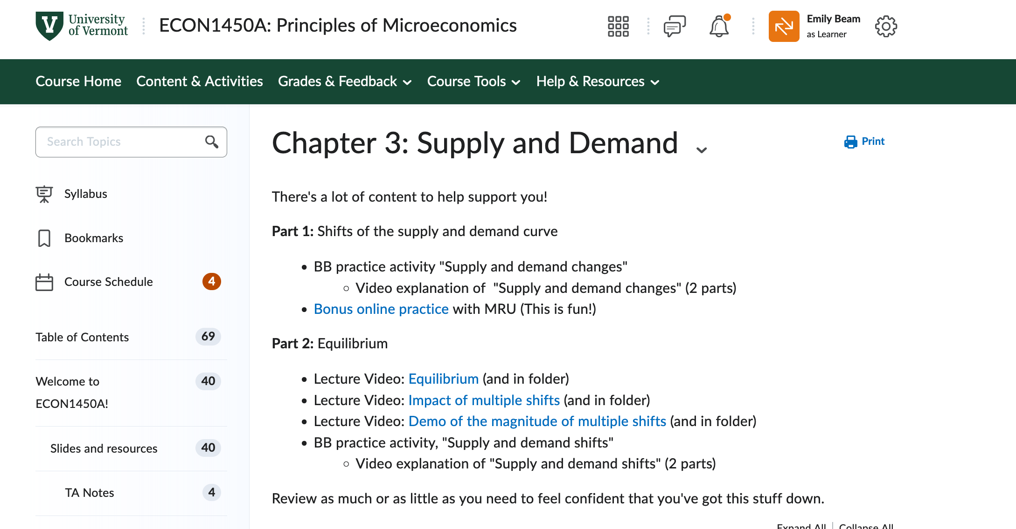
Exam Prep Resources
Brightspace / slides and resources
Recorded lectures/micro lectures
Practice examples and worksheets (CH3)
TA notes

Slide 4
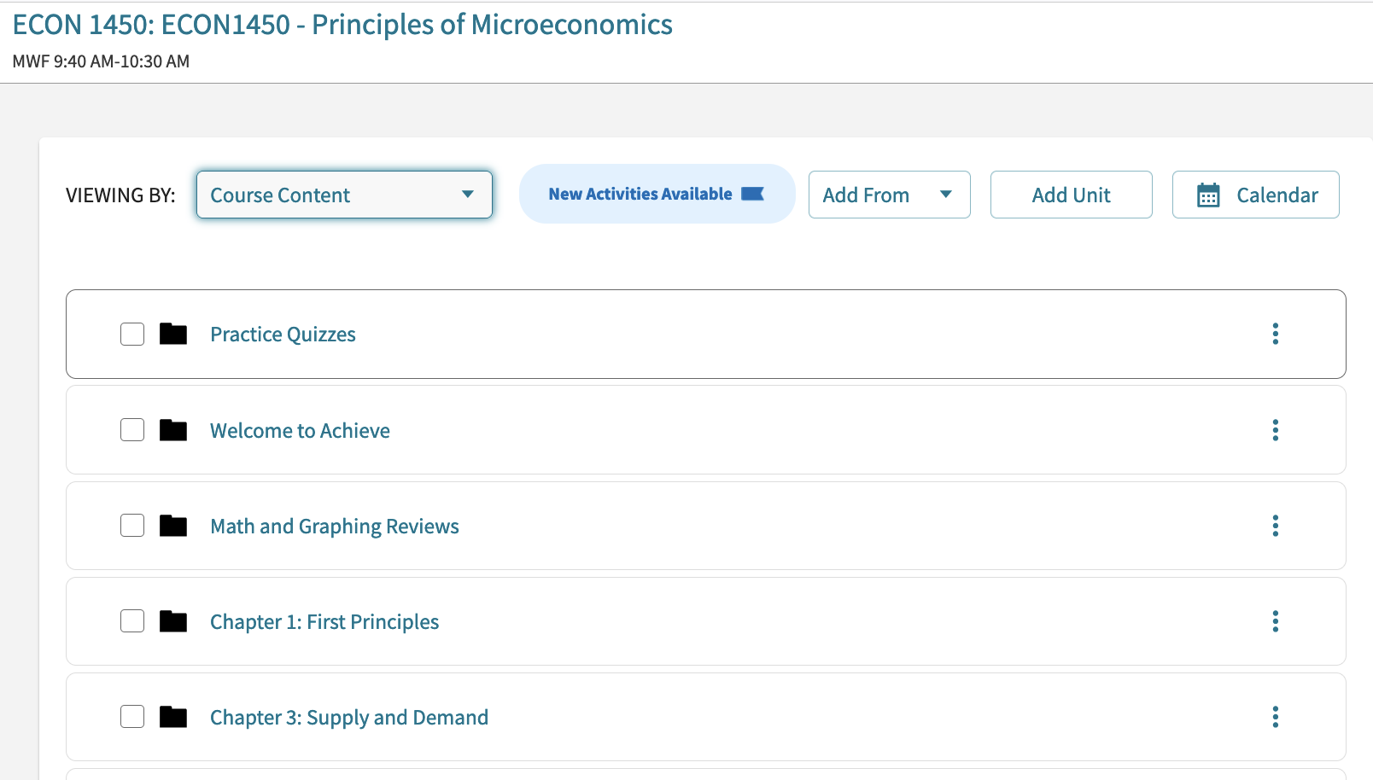
Exam Prep Resources
Achieve
Practice Quizzes (20 questions/chapter)
Review old HW/LC
TA assistance!
Review sessions today 11–12 in Lafayette L205
Exam review session TBD

Slide 5
Two worlds
You have been on it – reading textbook, attending class, doing homeworks. But, you want to make sure everything is fresh and you have no gaps
Most of us are probably somewhere in between
You’ve “brute force”-ed your way through assignments, have not opened e-book, attend lecture and feel like you mostly get it

Slide 6
One approach for Group 1
Make yourself a “cheatsheet” w/ formulas, labelled pictures
Work through chapter-specific practice quizzes in Achieve
Anything that takes you multiple tries, make a note and review that topic in textbook/etc
Sit down and take the “practice quiz” on BB (note that only CH 1, 3–5)
One sitting, check answers only at end, time yourself
Circle any question you’re not sure of
Check answers and list topics to review
Review content where you have holes, take notes
Repeat as necessary, review additional practice problems from HW/LC

Slide 7
One approach for Group 2
Practice problems are a good approach, but you will need to make sure you review/read content as well. Additional suggestions:
Watch microlectures and additional bonus videos (see BB)
If you missed class, review recorded lectures
Read textbook + notes = good way to get vocabulary and concepts.
Read lectures slides and write on them (posted on BB)
Use the learning objectives at beginning of each section lecture notes to make sure you’ve covered everything

Slide 8
Additional suggestions assuming infinite time
Good things to do
Make your studying ACTIVE
Trick yourself to figure out what you secretly don’t know
(metacognition: know what you know)

Slide 9
Active studying
When reading/watching, take notes
Watch lecture for 5 minutes. Pause. Write down a summary. Repeat
Talk yourself through problems/concepts out loud
When working through problems, use your hands
Draw and label diagrams
Make things
Cheat sheets Labelled diagrams
Lists of terms Types of example problems

Slide 10
Tricking yourself
Anything you can do to make yourself aware of gaps. Then you can fill them!
Take practice quiz start to finish w/o looking at answers or resources. Time yourself.
Work through Achieve practice quizzes in entirety before checking answers
Start with a blank piece of paper. Write down all the formulas/vocab you can remember
Try to make a cheat sheet w/o looking at resources

