Slide 1
DATA ANALYTICS:
THE VALUE OF DATA

Slide 2
HELLO!
ebernstein.GA@gmail.com
generalassemb.ly
facebook.com/gnrlassembly
Cell 617.606.1078

Slide 3
Course Goals
Input, transform, and format data for more productive use.
Analyze data to improve decision making.
Organize and package data for external consumption.
Learn how to easily manipulate datasets using pivot tables and other functions.
Find out how to leverage the onboard data analysis tools to make effective conclusions on data.
Master the art of shortcuts to streamline the process of analysis in Excel.

Slide 4
Today’s Objectives
Describe the value of data and how it can lead to informed decisions that have positive impact on many facets of an organization
Identify the steps and goals of the analytics workflow
Explore Excel both as software (basic layout, navigation, keyboard shortcuts, worksheet organization) and as a data analysis platform (basic math formulas, visualization)
Practice basic summary tactics used to familiarize yourself with a dataset

Slide 5
What is Data Analytics?
Learn to make sense of data; tell a story; defend your proposal
We can store data points, but learning from them is an entirely different skill.

Slide 6
Value of Data
What is the value of Data in the Modern World?

Slide 7
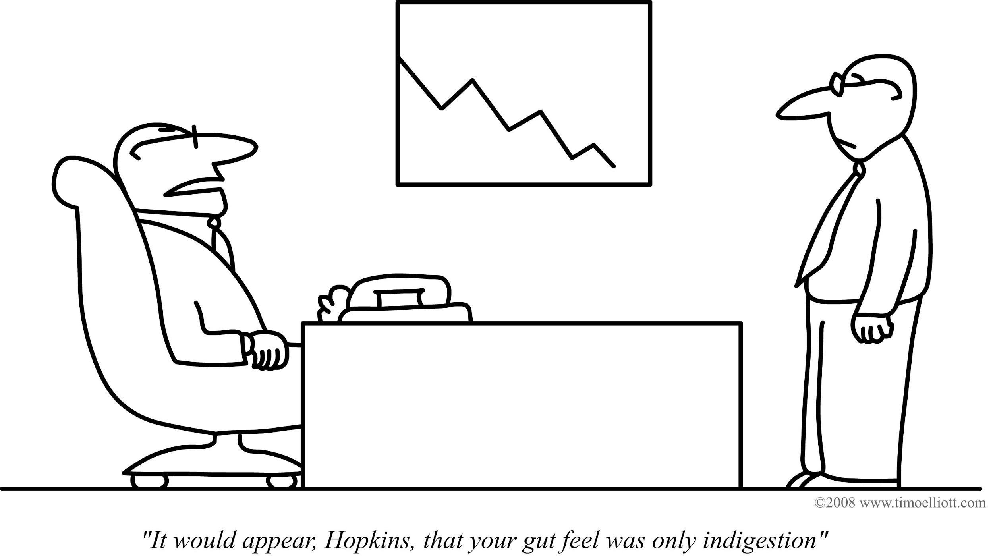

Slide 8

LIGO Collaboration

Slide 9

Gravitational Waves Detected 100 Years After Einstein's Prediction

Slide 10

LIGO -- Laser Interferometer Gravitational Wave Observatory

Slide 11
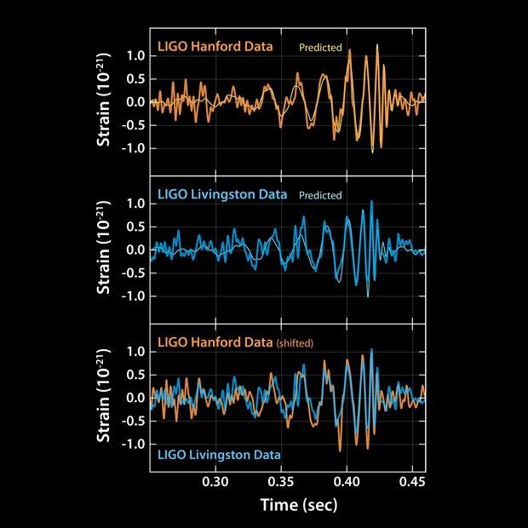
LIGO data

Slide 12
Class Exercise
With the 1 or 2 people sitting next to you, brainstorm the steps you would include in an analytical workflow. Think about the process from start to finish.

Slide 13
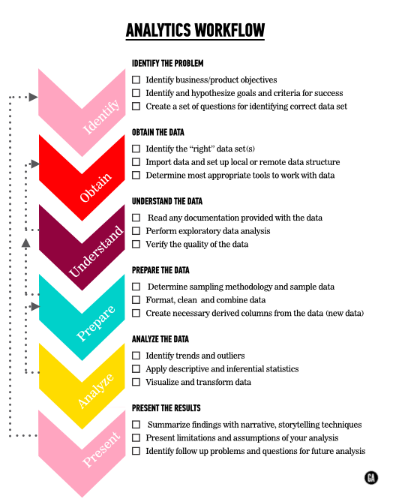
Data Analytics Workflow

Slide 14
Why is having a workflow framework important?
Guidance for you
Computers need help!
Prevent over-analysis
Defined feedback loops
Planning ahead => saving time
Defining goals, business context prevents irrelevant decision making

Slide 15
When should you reference the workflow?
From the beginning to the end of any analytical project
NOTE: It won’t give you specific details about each step but it guides you through higher-level tasks

Slide 16
Here’s the situation...
Congratulations! You’ve just started a new role as a product analyst at Kickstarter, a site for crowdsourcing fundraising. Your manager would like to gain a better understanding of the site’s projects, and what factors contribute to a project’s success.
Let’s start by accessing the data and navigating around it in Excel
If you haven’t already, download the Kickstarter data collected about projects and backers.

Slide 17
Intro to New Material

Slide 18
Data Types
Categorical (also Qualitative)
Categorical variables represent types of data which may be divided into groups
Ex: race, sex, age group, and educational level
Numerical (also Quantitative)
Values of a quantitative variable can be ordered and measured
Ex: age, height, sales, volume
Numbers are not always numerical data.
Ex: Gender (0=Male, 1=Female)

Slide 19
Conditional Formatting
Visualizing data helps us understand the relationship between different data points.
Conditional formatting is a great way to add quick and easy visual queues to our raw data.

Slide 20
Key Metrics
Numerical data can be evaluated using a few summary metrics. Here are four very useful ones with which to start:
Count( )
Min( )
Max( )
Average( )

Slide 21
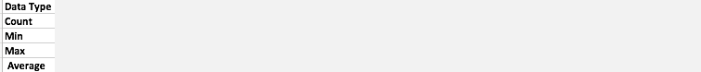
Getting to know your data
Populate the summary box at the top with formulas to fill them in and think about the following questions:
Why did we arrange our dataset this way?
What are some observations you had while examining the data?

Slide 22
Defining Business Problems
To do this, we must know: What does Kickstarter do?
Kickstarter is a site for crowdsourcing fundraising
Let’s assume this is Kickstarter’s only source of revenue
Kickstarter has a strong incentive to ensure projects make it over this threshold, and the further the better

Slide 23
Exploratory Analysis / Surface Analysis
Answers to exploratory analysis questions are critical in helping us understand the structure and shape of our data.
Example exploratory analysis questions:
What is the highest Goal amount in this dataset?
What project generated the highest Pledged amount?
What funded years are represented here?

Slide 24
Independent Practice - Surface Analysis of Kickstarter data
Take clean data - from Kickstarter - use shortcuts and functions to do a surface analysis and describe the data contained in each column, specifically answering these questions and creating these deliverables:
What data types are there?
Create documentation in a new worksheet (like a readme) with information around each unique, important column for each table.
Organize your workbook in structured fashion that is easy to understand
Identify the count, min, max, mean and median for number data-type columns
Identify the problem statement / business needs and relevant questions to be answered on a provided prompt.
Answer the relevant questions using aggregate Excel functions (feel free to ask other questions you feel are important):
How many projects are contained in the Kickstarter dataset?
What % of all projects were successful?
What was the average amount raised per project?
What was the most common duration for projects?

Slide 25
Today’s Objectives
Describe the relationship between functions and parameters
Use nested functions
Find, replace, and change text
Remove duplicate records
Remove spaces from text
Use barcharts

Slide 26
Examples of “Dirty” data
Example: Let’s look at our Kickstarter data? Take a look at column D or E. If we examine the unique values in these columns we see a few permutations:
Film & Video
Film &amp; Video
Country & Folk
Country &amp; Folk

Slide 27
So, why Prepare data?
We need clean data in order to perform a legitimate analysis and find information that would otherwise be hidden in the data.
Data, especially when taken from the web, has a ton of missing values and problems to tackle before any meaningful analysis can take place.

Slide 28
Why is Preparing, Cleaning your data Difficult?
There is no simple algorithm that deals with cleaning data; you only get good with practice and flexible rules.
We will give you tips; you will begin to create your own processes for cleaning

Slide 29
Types of Dirty Data
Duplicate rows
Your job is to determine what data is considered duplicate

Slide 30
Types of Dirty Data
Case text inconsistencies
User input makes this really difficult!
Spaces
Non-print characters
Numbers and number signs
Dates, times, and custom formats

Slide 31
Types of Dirty Data
Irrelevant columns
Up to you to decide which columns will provide substance to an analysis.
NEVER delete a column entirely, keep it in an original copy of the data.

Slide 32
Functions vs. Parameters vs. Output
How do functions relate to parameters?
How do functions and parameters lead to output?
A function can take parameters which are just values you supply to the function so that the function can do something utilizing those values.
COUNT(cell_range)
FIND(substring, string)

Slide 33
String Manipulation
Let’s try this together
Open the AN_lesson2_kickstarterscrape_student.xlsx
We’ll do the following:
Use FIND() and REPLACE() to remove ‘amp’ strings
Remove duplicates
Separate location into city and state
Create TRIM() column
Create LEN() column
Create conditionals

Slide 34
More String Manipulation
Remember, a lot of data is in text form
If we can get it standard, great! But it’s rare
Strings are simply pieces of text that can be manipulated, queried, moved, and edited using additional standard Excel functions
CONCATENATE()
LEFT()
RIGHT()
MID()

Slide 35
Text Manipulation
Use AN_lesson_2_student_kickstarter_model_practice.xlsx to practice combining text and selecting parts of strings.
Use CONCATENATE or “&” to create formulas that correctly populate the “Full Name with prefix” and “Full Address” columns:
combine columns D, E, and F to produce full name in column M
An example “Full Name with prefix” is “Ms Jane Smith”
combine columns G, H, I, and J to produce full address in column N
An example “Full Address” is “5 Gardeners Square, Evesham, Worcestershire WR11 1DZ, UK”
Extract the “Segment number” from column B to fill the “Segment” column
Hint: You can use conditional logic functions such as IF,AND and OR

Slide 36
Logic Operators
A lot of work in Excel involves comparing data in different cells.
To make this easy, Excel provides “Boolean” or “Logical” operators
Return either one of two possibilities
True or False
Used to determine what to display in the cell or do next in your formula

Slide 37
Boolean Operators
=, !=, <, <=, =,>=, >

Slide 38
Logical Operators
IF - checks whether a condition is met, returns one value if True and another value if False; often use boolean operators within the IF condition
AND - a functional operator you can use to chain comparisons or other boolean operators
OR - a functional operator you can use to chain comparisons or other boolean
ISBLANK() - checks whether or not a cell is blank

Slide 39
Nested Functions and Operators
=IF(OR(AND(A1>300,B1="Blue"),AND(A1<300,C1="Monday")),
"Correct","Wrong")
Let’s walk through this nice and slow

Slide 40
Nested Functions and Operators
=IF(OR(AND(A1>300,B1="Blue"),AND(A1<300,C1="Monday")),
"Correct","Wrong")
AND(A1>300,B1="Blue")
“If A1 is over 300 and B1 is “Blue”, return ‘Correct’

Slide 41
Nested Functions and Operators
=IF(OR(AND(A1>300,B1="Blue"),AND(A1<300,C1="Monday")),
"Correct","Wrong")
AND(A1<300,C1="Monday")
if A1 is less than 300 and C1 is “Monday”, return ‘Correct’.

Slide 42
Nested Functions and Operators
=IF(OR(AND(A1>300,B1="Blue"),AND(A1<300,C1="Monday")),
"Correct","Wrong")
So all together:
“If A1 is over 300 and B1 is “Blue”, return ‘Correct’ | OR | if A1 is less than 300 and C1 is “Monday”, return ‘Correct’ | Otherwise, it’s ‘Wrong’!”

Slide 43
Why visualizations?
For the remainder of unit 1, we’ll be looking at visualizations each class
They’re imperative to analysis because with them, we can uncover patterns not visible in an Excel table

Slide 44
Bar Charts
Best for comparing discrete values in a dataset
Discrete data is countable, ex: number of successful projects
Continuous data can take any value, ex: project backing total
Translation: “A bar chart encodes two pieces of information: categories and quantities for each category”

Slide 45
Common Issues with Bar Charts
To many categories
To many stacks in stacked bar charts
Inappropriate axis interval
Coloring, 3D

Slide 46
Creating Different Bar Charts
Kickstarter is thinking about providing a consulting service to project founders help its customers create more successful crowdfunding campaigns. You have been asked elaborate on your initial exploratory analysis. To do this, you’ll need to do some data transformation, preparation, and cleaning, just like you learned today.
In your “Summary” tab - of the AN_lesson2_kickstarterscrape_student.xlsx workbook - fill in the two summary tables: one with two columns - number of projects and successful projects for each different categories; then one with the same two columns but for different countries. Be sure to constructor two bar charts from each of your summary tables. Use the technical requirements below...

Slide 47
CLOSING DISCUSSION

