Slide 1
Figure 1: Map of the Santa Catalina Mts. and sampling sites.

Slide 2
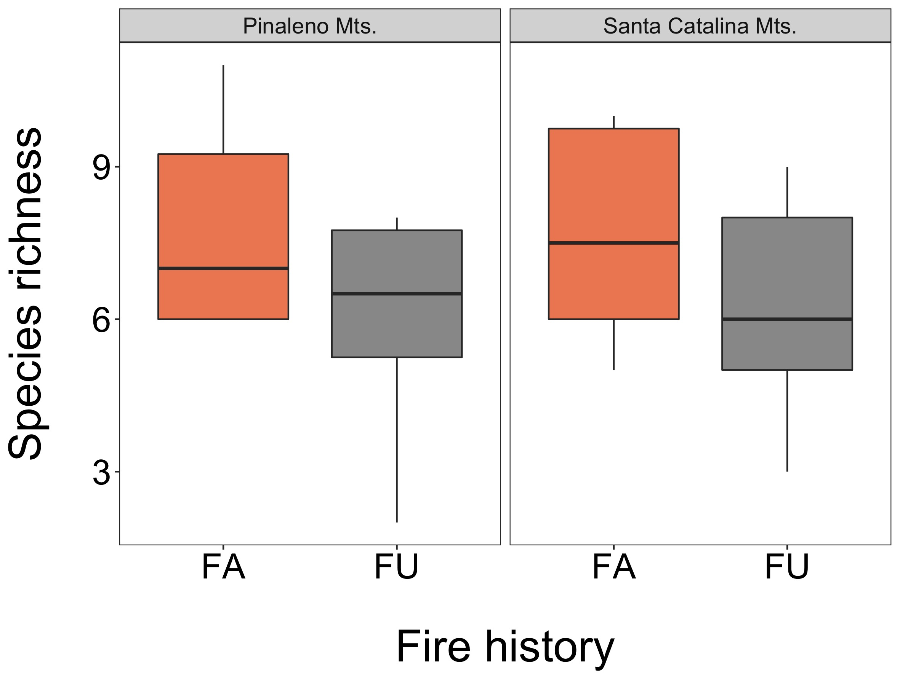
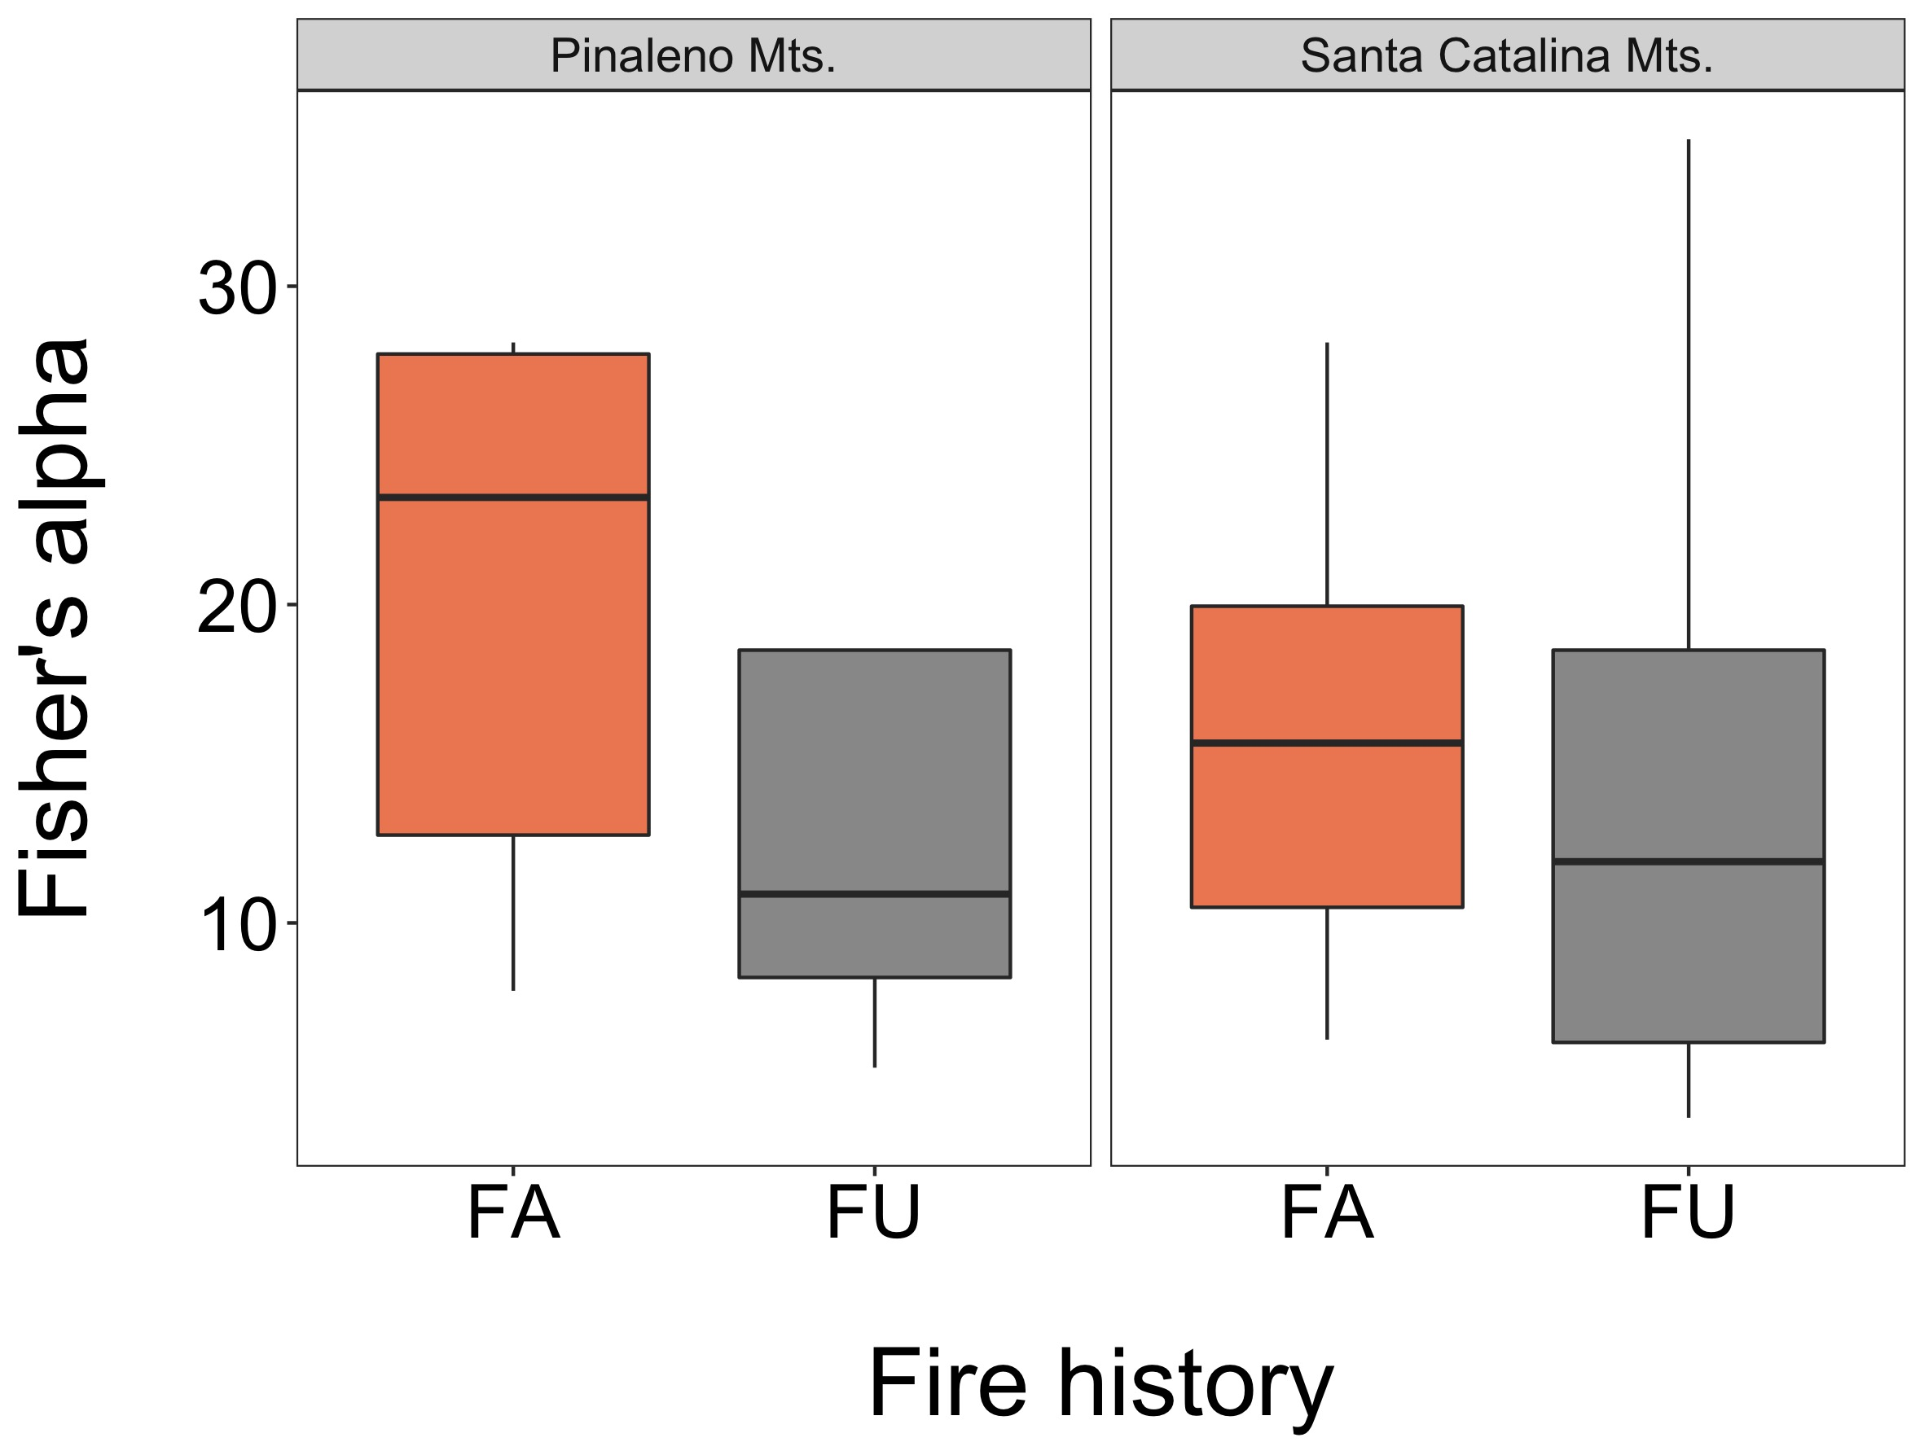
Figure 2: Species richness (A) and Fisher’s alpha diversity (B) as a function of both fire history and range. A. T-test, PM: T_{17.90}=1.76, p-value=0.10; SCM: T_{18.68}=1.81, p-value=0.09. B. T-test, PM: T_{7.09}=1.87, p-value=0.10; SCM: T_{16.44}=0.39, p-value=0.70. FA = fire affected, FU = fire unaffected.
A
B

Slide 3
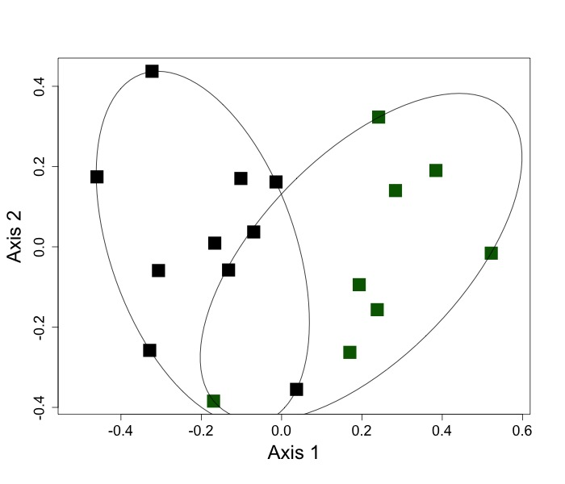
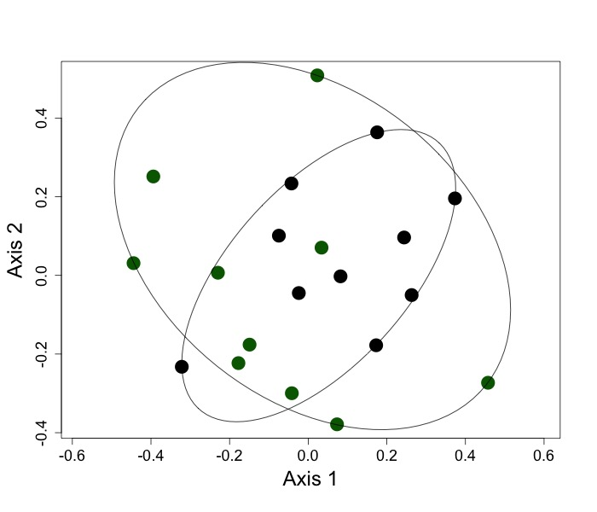
Figure 3: NMDS of EM community across fire unaffected (FA) and fire unaffected (FU) sites in the Pinaleno Mts. (A) and Santa Catalina Mts (B) based on Morisita Horn similarity index. A. PM, stress=0.16, ANOSIM: R=0.54, p=value=0.001; B. SCM, stress=0.20, PERMANOVA: F=1.96, R²=0.09, p-value=0.02. Green = FU, black = FA; circles = SCM, squares = PM.
A
B

Slide 4
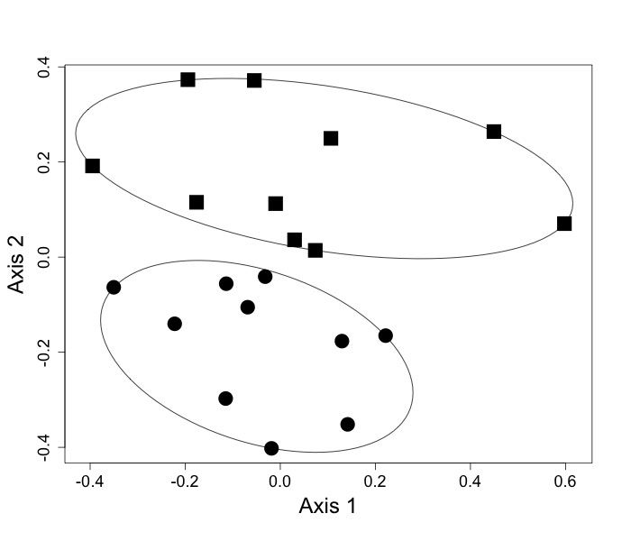
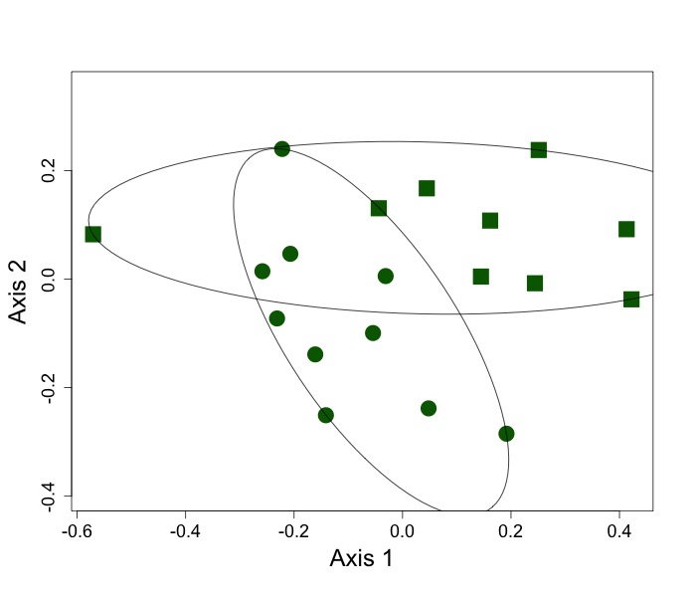
Figure 4: NMDS of EM community across fire affected (FA; A) and fire unaffected (FU; B) based on Morisita Horn similarity index . A. FA, stress=0.19, ANOSIM: R=0.33, p-value=0.001; B. FU, stress=0.15, PERMANOVA: F=3.23, R²=0.16, p=value=0.001. Green = FU, black = FA; circles = SCM, squares = PM.
A
B

Slide 5
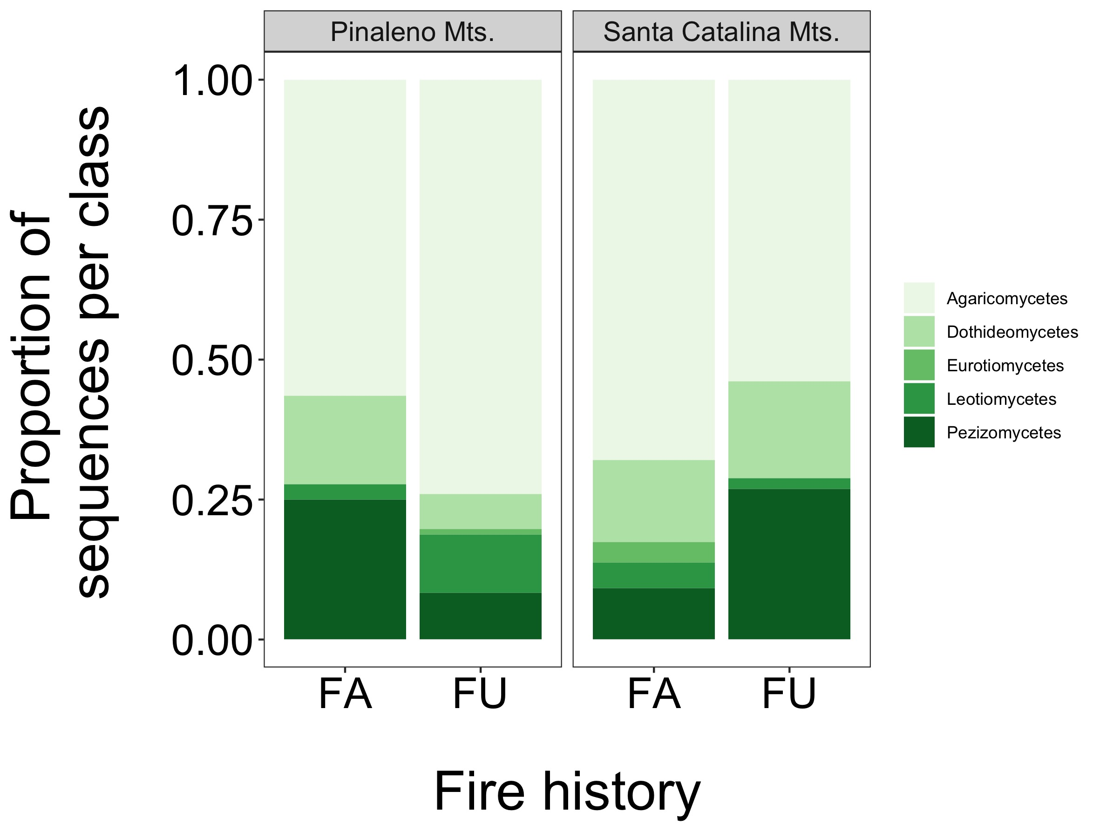
Figure 5: Class level taxonomy of EM communities as a function of fire history. Each range assessed individually. PM, X²₆=22.48, p-value<0.001; SCM, X²₆=16.314, p-value=0.003. FU = fire unaffected, FA = fire affected.

Slide 6
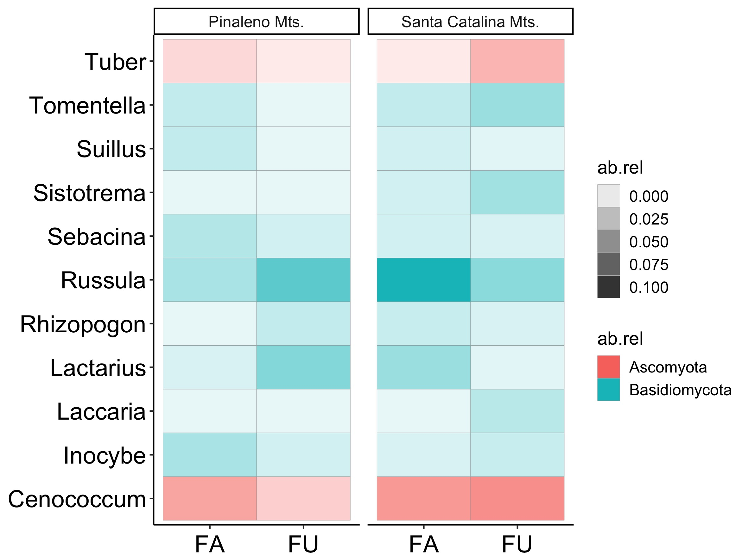
Figure 6: Genus level taxonomy of EM communities as a function of fire history. Each range assessed individually. A. PM, X²₉=37.62, p-value<0.001; B. SCM, X²₁₃=34.61, p-value=0.001. FU = fire unaffected, FA = fire affected.
Relative abundance
Phyla

