Slide 1
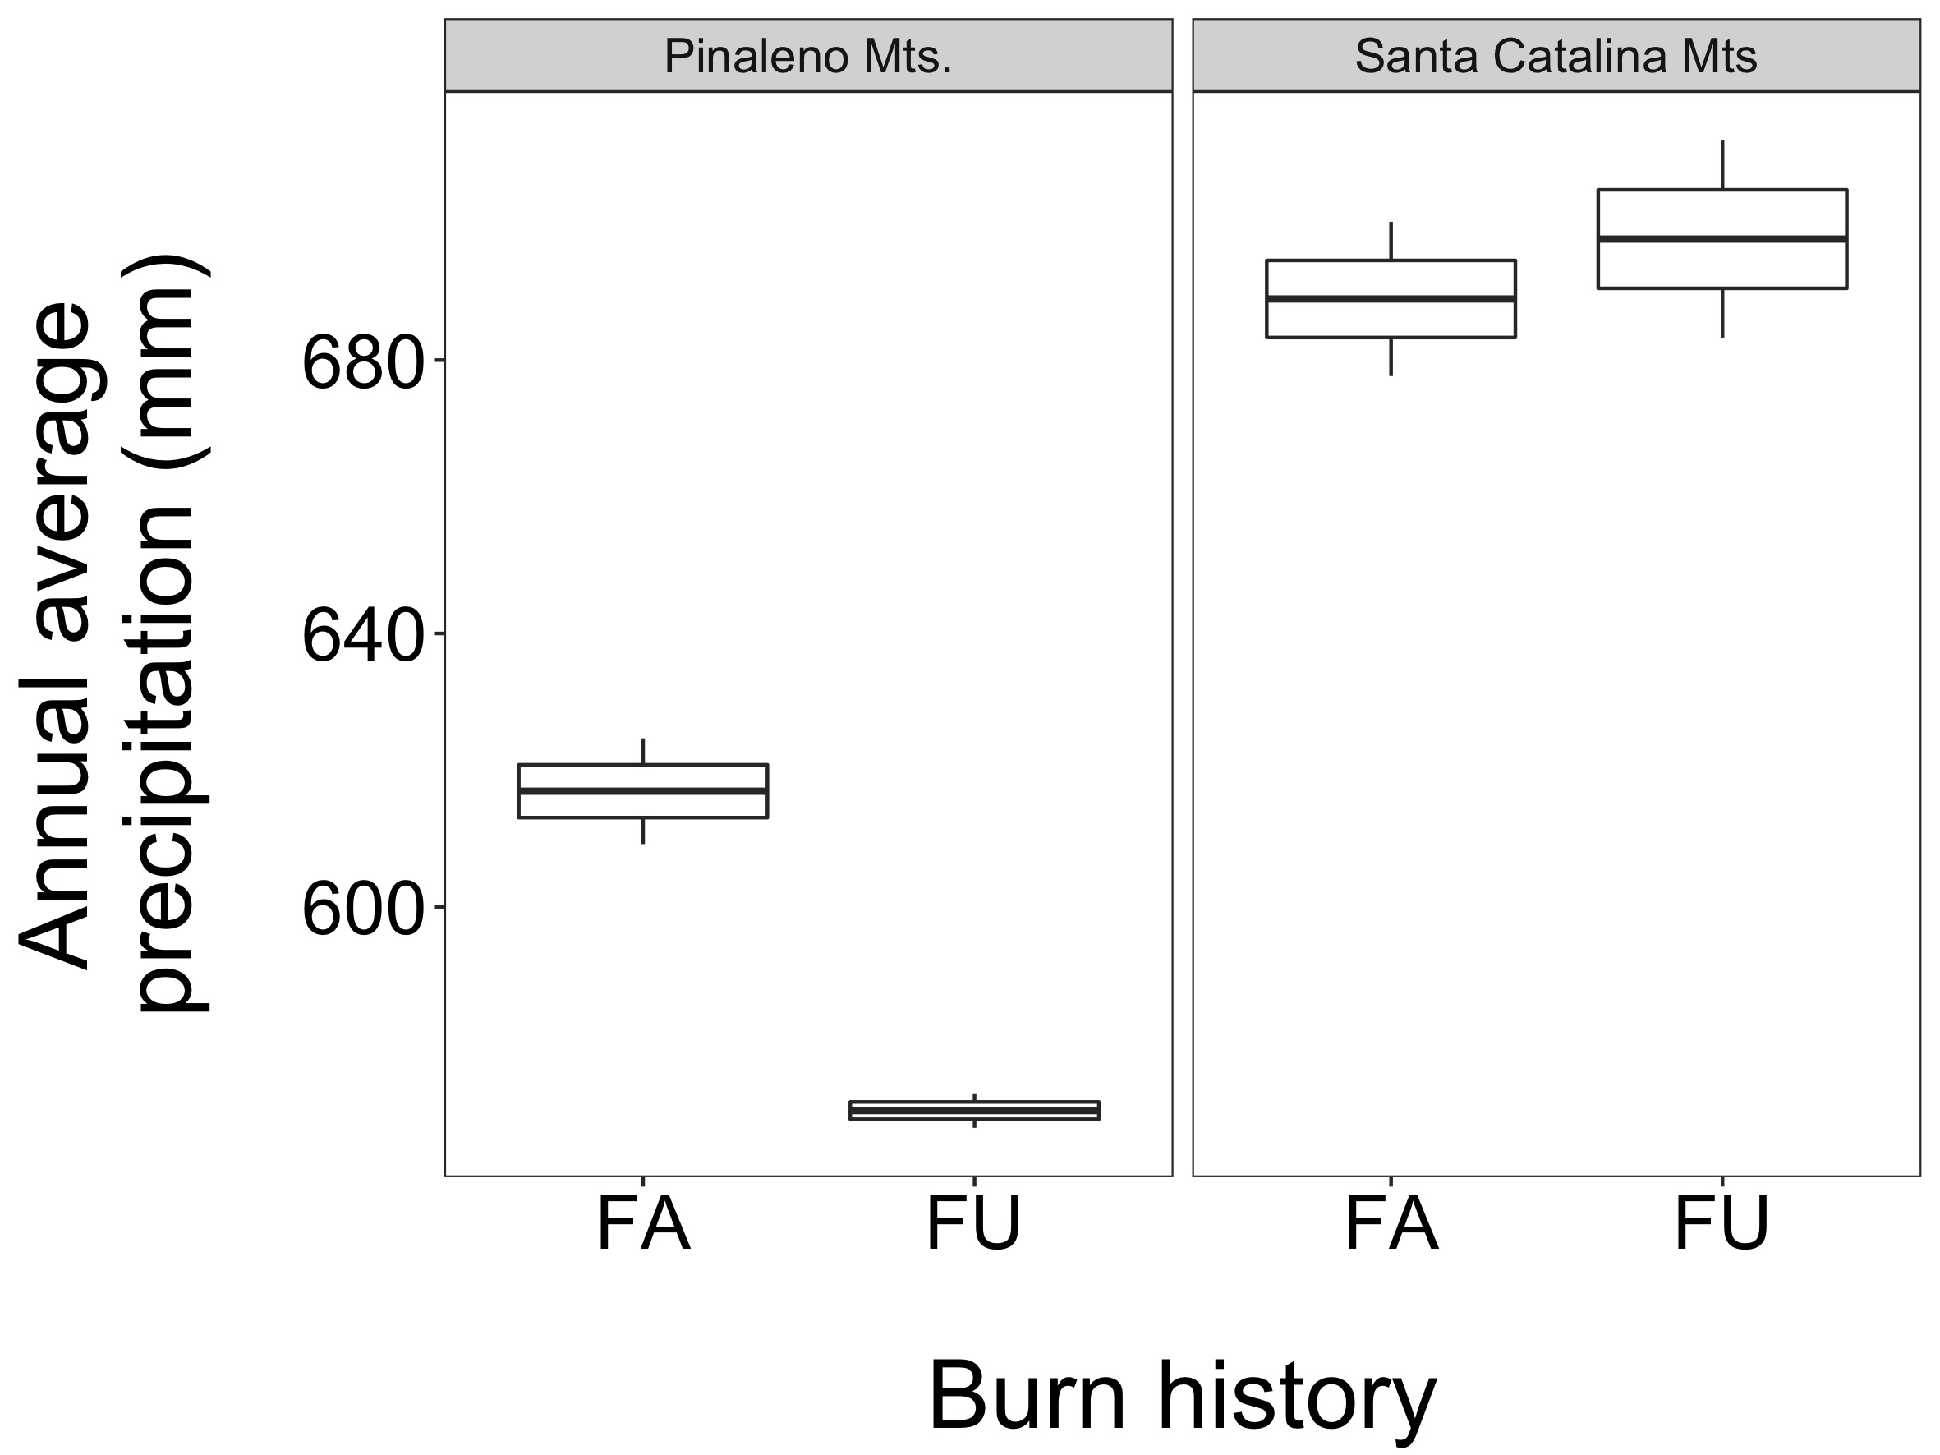
Figure S1: Average annual precipitation (mm) as a function of both range and fire history. ANOVA with site as a random factor, range: F_{1,4} = 99.21, p-value = 0.001; burn history: F_{1,4} = 3.59, p-value = 0.13; range:burn history: F_{1,4} = 7.67, p-value = 0.05. FA = fire affected; FU = fire unaffected.

Slide 2
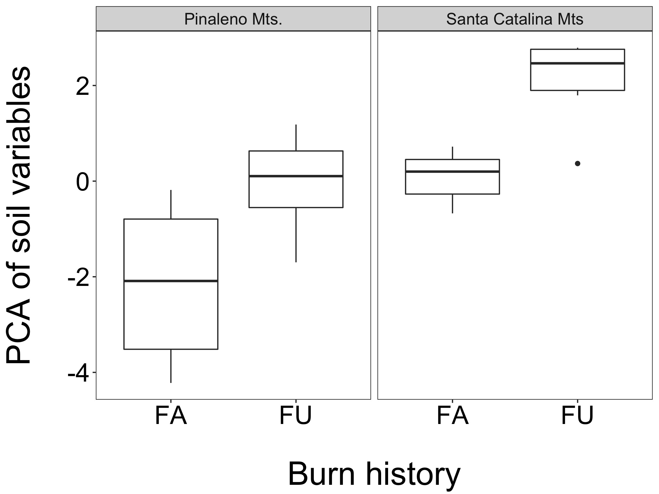
Figure S2: PCA of soil characteristics as a function of both range and fire history. ANOVA with site as a random factor, range: F_{1,4} = 7.20, p-value = 0.06; burn history: F_{1,4} = 6.32, p-value = 0.07; range:burn history: F_{1,4} = 0.003, p-value = 0.96. FA = fire affected; FU = fire unaffected.

Slide 3
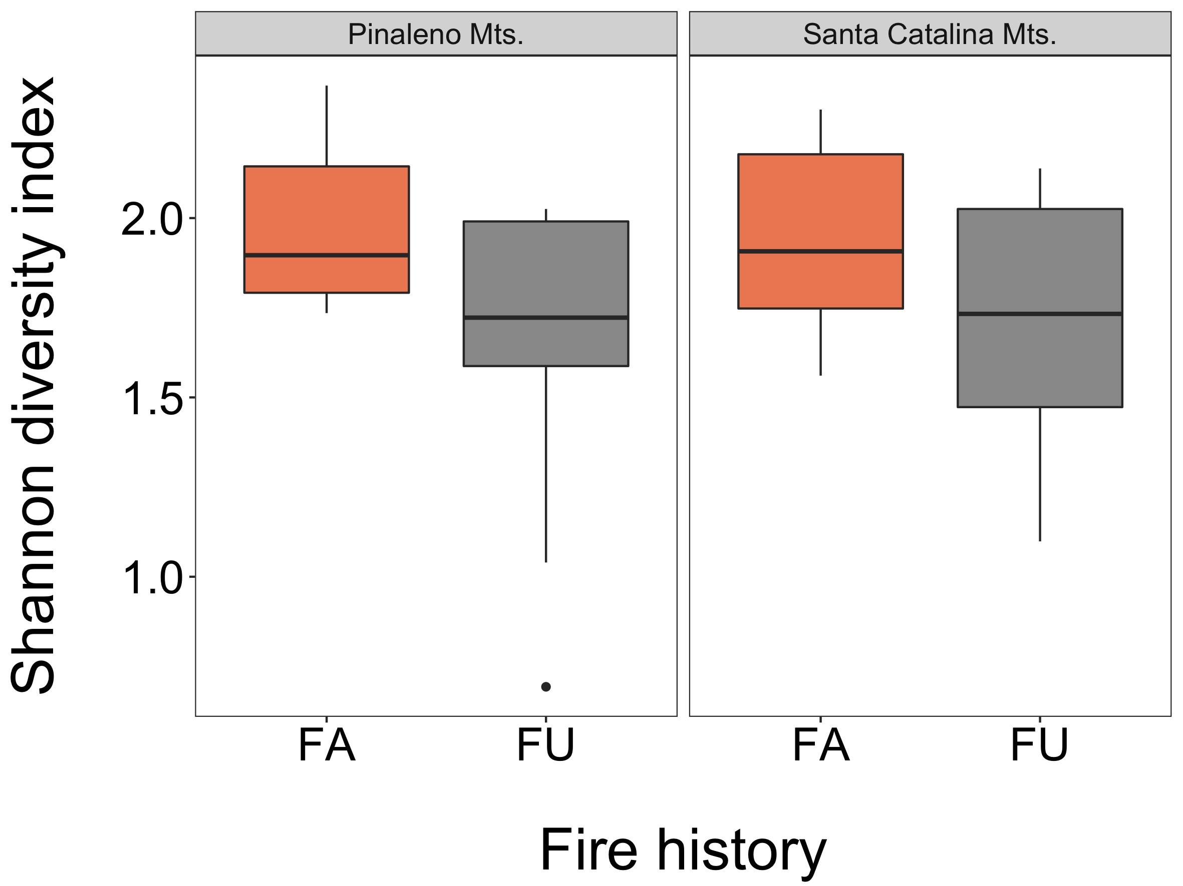
Figure S3: Shannon’s diversity as a function of fire history and range. T-test, PM.: T_{18.41}=1.83, p-value = 0.08; SCM: T_{13.48}=2.06, p-value =0.06.

Slide 4
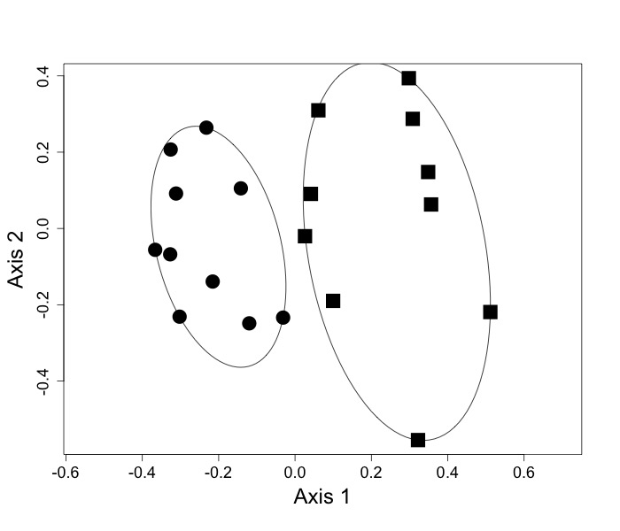
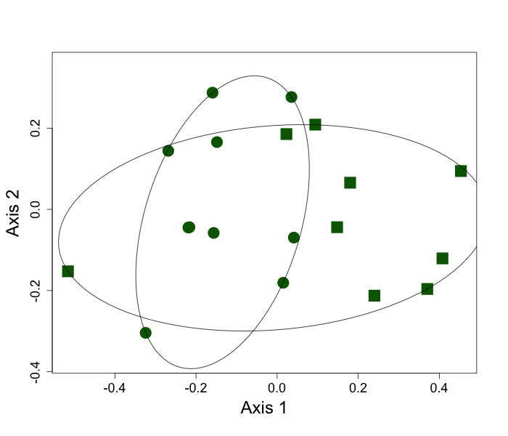
Figure S4: NMDS of EM community across fire affected (FA; A) and fire unaffected (FU; B) based on Jaccard similarity index. A. FA, stress=0.19, PERMANOVA: F=2.92, R²=0.14, p-value=0.001; B. FU, stress=0.13, PERMANOVA: F=2.41, R²=0.12, p=value=0.002. Black = FA, Green = FU; circles = SCM, squares = PM.
A
B

Slide 5
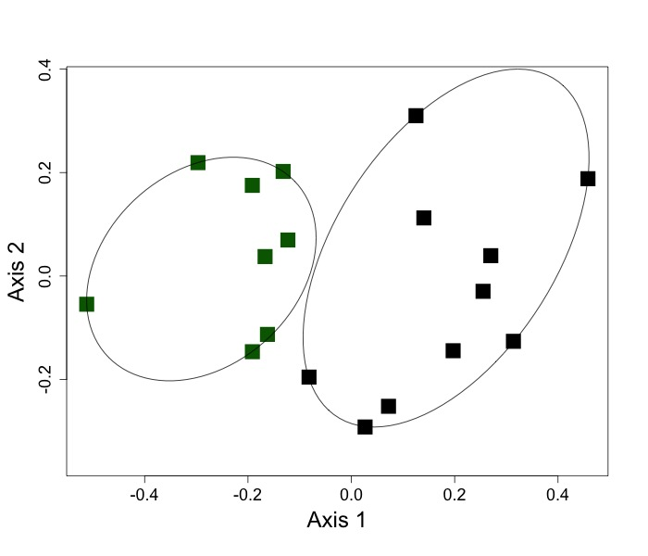
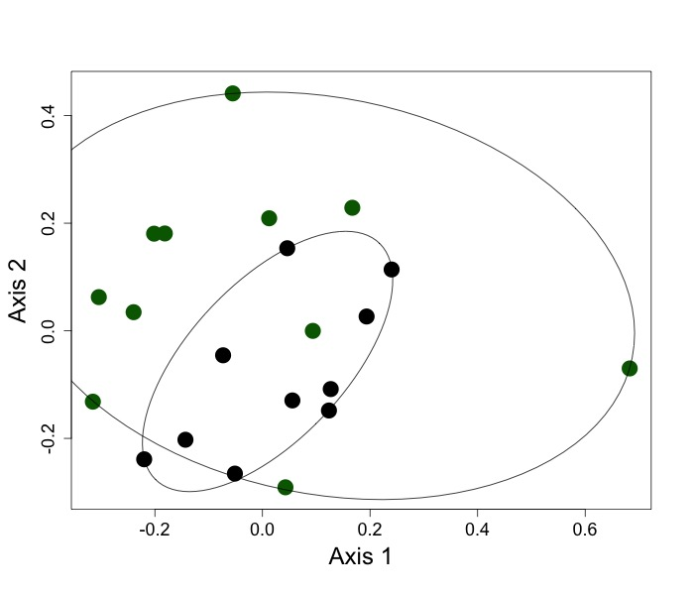
Figure S5: NMDS of EM community across FA and FU sites in the PM (A) and SCM (B) based on Jaccard similarity index. A. PM, stress=0.15, ANOSIM: R=0.53, p=value=0.001; B. SCM, stress=0.21, ANOSIM: R=0.11, p-value=0.06. Black = FA, green = FU; circles = SCM, squares = PM.
A
B

