Slide 1

Individual Project: Personal Recipe Management System
Lizzie Colwell
1 | Copyright © 2019 BAE Systems. All Rights Reserved. BAE SYSTEMS is a trade mark of BAE Systems plc. (See final slide for restrictions on use.)
Notes:
Hello Everyone, My name is Lizzie. First I would like to thank you all for being here; its really brilliant to have this opportunity to present to you all.
I recognise a couple of faces from the Christmas dinner.
It seems appropriate that I’m going to present my recipe application today as it’s almost lunch time so I hope you’re not too hungry.
So I’m going to talk to you about the project I’ve been working on over the past few weeks and I know it’s almost lunchtime so it seems appropriate that this is a recipe application
1

Slide 2
Overview
Project Journey
Demo
Self-Reflection
1 | Copyright © 2019 BAE Systems. All Rights Reserved. BAE SYSTEMS is a trade mark of BAE Systems plc. (See final slide for restrictions on use.)
Notes:
Today I’m going to tell you the story of my training journey from starting with very little programming experience. and reflect back on my time at the academy.
1

Slide 3

Background and the challenge
OOP-based application
Range of technologies
CRUD functionality
1 | Copyright © 2019 BAE Systems. All Rights Reserved. BAE SYSTEMS is a trade mark of BAE Systems plc. (See final slide for restrictions on use.)
Notes:
I arrived at the academy with very little programming experience but have managed to achieve a functional recipe application.
So at the start of the academy we were tasked with the challenge of producing an OOP-based application using a range of technologies we have learnt at QA. The application should allow the user to manipulate two tables with the ability to create, read, update and delete objects within those tables.
So how did I get there?
1

Slide 4

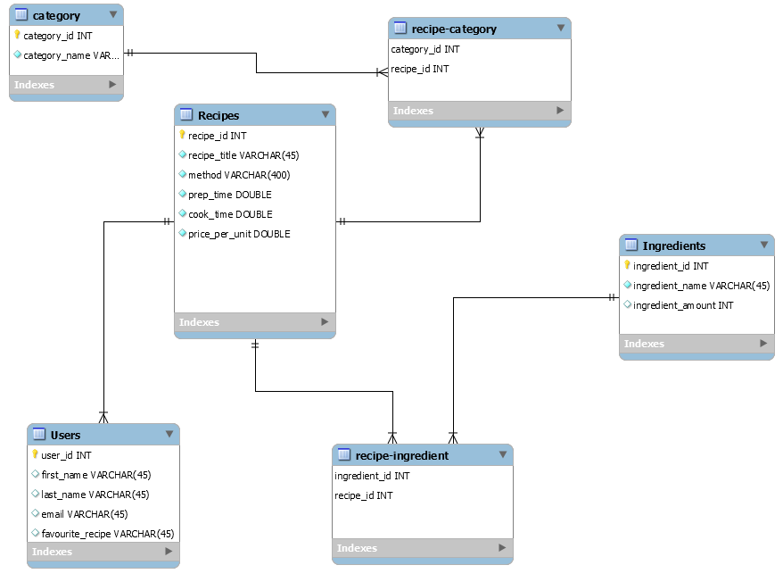

The idea
1 | Copyright © 2019 BAE Systems. All Rights Reserved. BAE SYSTEMS is a trade mark of BAE Systems plc. (See final slide for restrictions on use.)
Notes:
First I picked a project idea. To create a personal recipe application that would allow the user to create recipes and categories, as well as add and remove recipes from each category. This is my initial Entity relationship diagram. My Initial idea involved multiple related tables of data so I decided to scale it down to just the necessary components of a recipe. The recipe method, title, and ingredients.
1

Slide 5
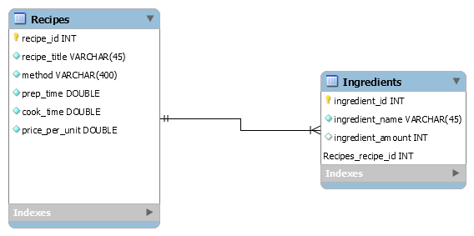
The solution
1 | Copyright © 2019 BAE Systems. All Rights Reserved. BAE SYSTEMS is a trade mark of BAE Systems plc. (See final slide for restrictions on use.)
Notes:
Plan of attack is to start with one to many relationships between recipes and ingredients. In the end I managed to build this initial phase. When we started desining these wireframes we had only just begun learning java so didn’t have any idea of how it might all come together.
1

Slide 6
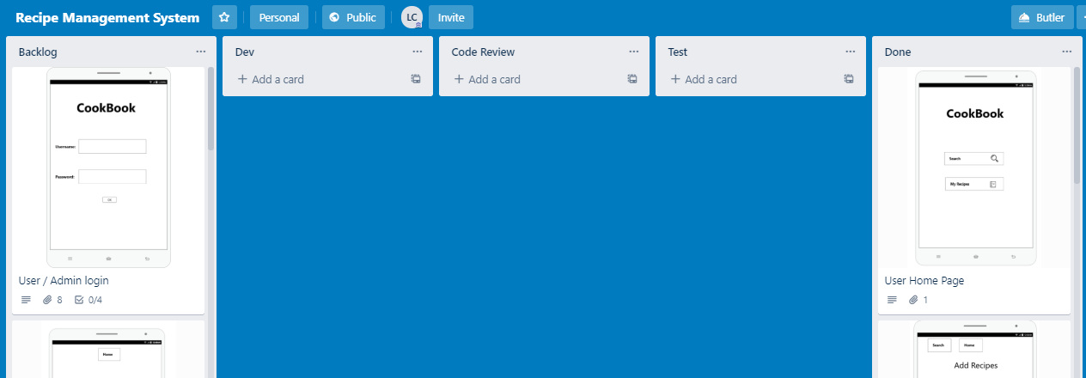
Agile Project Management
1 | Copyright © 2019 BAE Systems. All Rights Reserved. BAE SYSTEMS is a trade mark of BAE Systems plc. (See final slide for restrictions on use.)
Notes:
To start off the Agile process we were introduced to the software dev life cycle and project management systems. were introduced to Trello – a project management system used throughout the project to keep track of and plan out our work. We created user stories for each feature we wanted to create for instance; as a user I want to be able to add a recipe in order to view my recipes. We also created accepetance criteria for each story that would shape the users experience. We used this to keep a track of our work throughout the project and move it through each stage of the software dev process to hold us accountable.
1

Slide 7
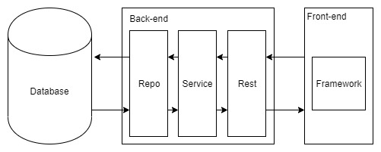
API development
Notes:
User will make a request (we have been mocking this via postman but will use Axios. User makes a request via http protocol which calls the controller, which calls the service layer, which calls repo which gets data from database and converts data into java objects , applies the business logic in the service layer and then java objects are turned into JSON at the front end.
I really enjoyed this part of our leaning journey as it was cool to see all of the components of our project coming together
1

Slide 8
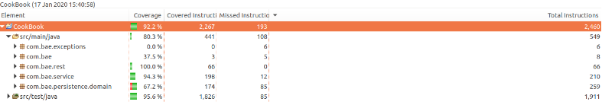
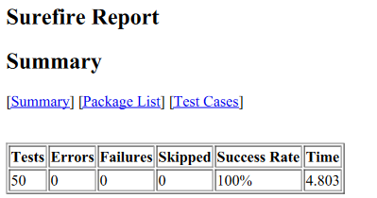
Testing: Unit
1 | Copyright © 2019 BAE Systems. All Rights Reserved. BAE SYSTEMS is a trade mark of BAE Systems plc. (See final slide for restrictions on use.)
Notes:
tbrief asked for 80 test coverage which I achieved.
The surefire report looks at all the tests written and gives feedback based on this
I would have liked to get some selenium tests done to cover the front end; however I was having some issues over the weekend configuring it on my laptop.
1

Slide 9
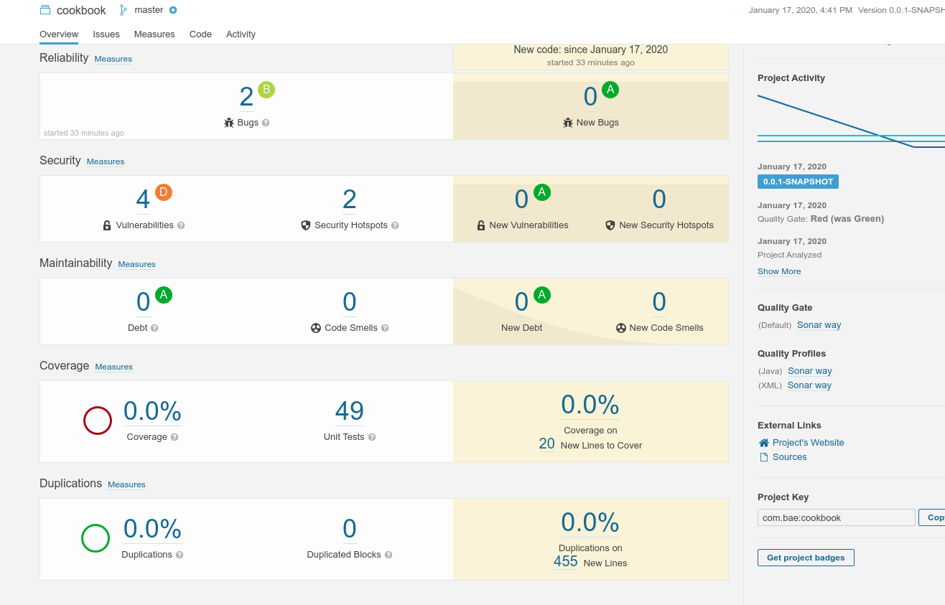
Testing: Static
1 | Copyright © 2019 BAE Systems. All Rights Reserved. BAE SYSTEMS is a trade mark of BAE Systems plc. (See final slide for restrictions on use.)
Notes:
Security - @origin annotation
The two errors were due to missing hashcodes
An the vulnerabilities were down to using entity dao’s(data access objects) in the controller layer- these really shouldn’t be used about service layer.
1

Slide 10
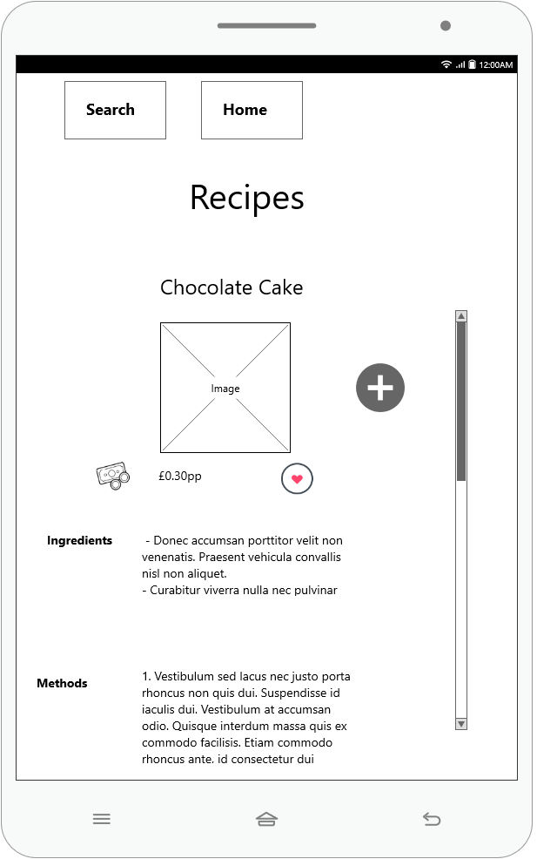
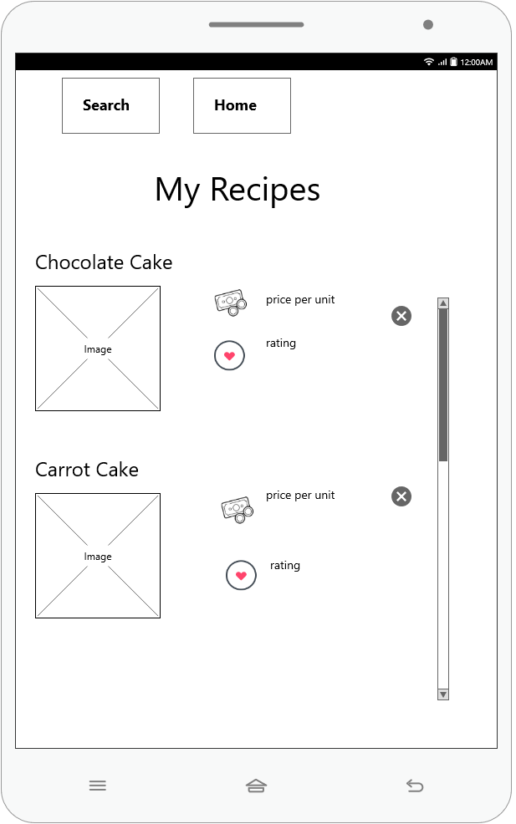
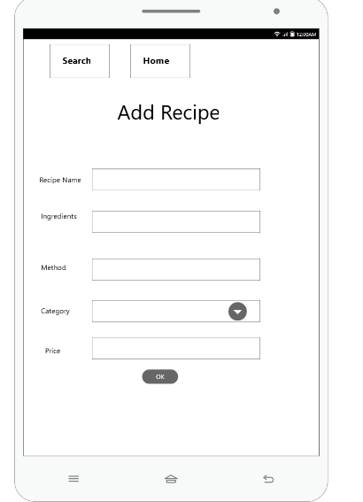
Front End: Wireframes
Notes:
Jenkins builds project from Maven War file
Jenkins- 1 / two points – not too much
TomCat/
CI pipeline, - Jenkins
1

Slide 11
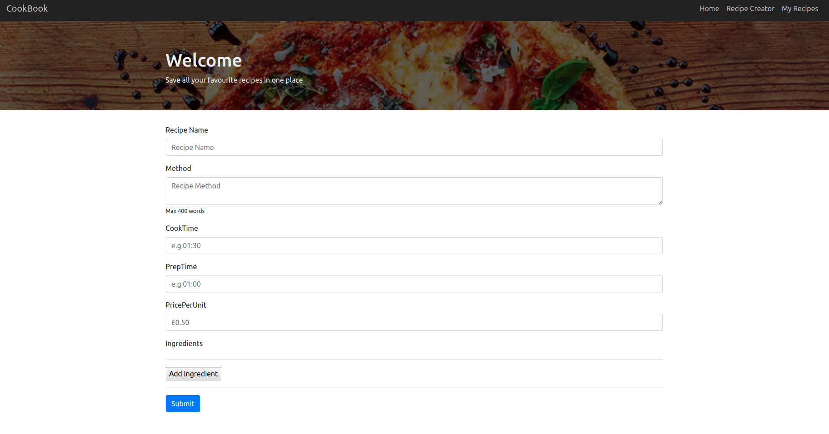
Front End: React Bootstrap
1 | Copyright © 2019 BAE Systems. All Rights Reserved. BAE SYSTEMS is a trade mark of BAE Systems plc. (See final slide for restrictions on use.)
Notes:
React
Styled Components
Node, Yarn
How react works – read up but don’t go into too much depth
1

Slide 12
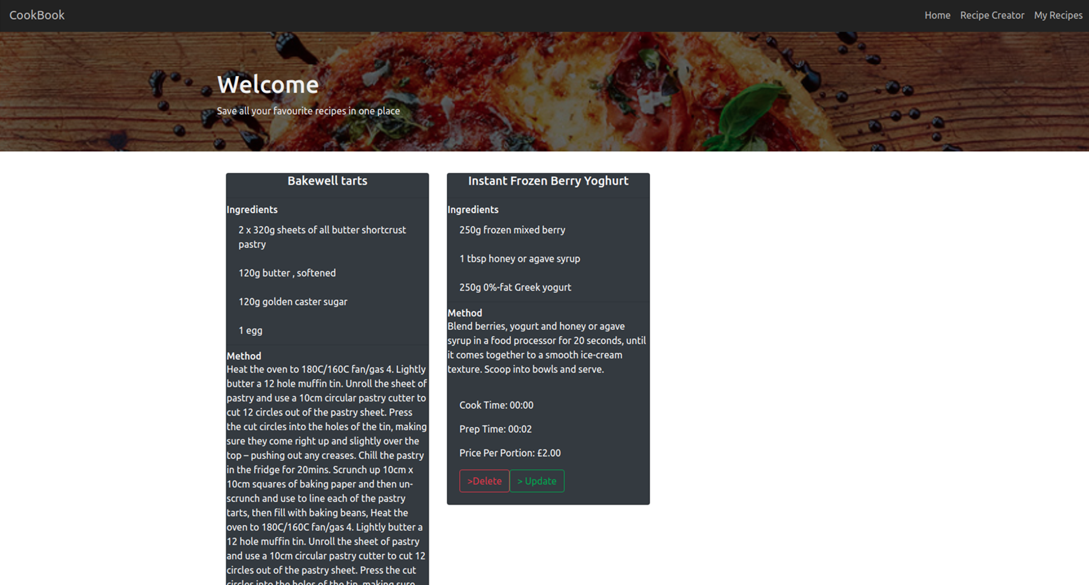
Front End: React Bootstrap
1 | Copyright © 2019 BAE Systems. All Rights Reserved. BAE SYSTEMS is a trade mark of BAE Systems plc. (See final slide for restrictions on use.)
Notes:
When you press the ‘more details’ button, it triggers a Modal box to appear, and there’s a bootstrap card which I learned to make during front end week – the idea for the modal box was definitely inspired by one of the group presentations that week that had a table appear as a popup like that→ I probably wouldn’t have found out about modal boxes otherwise
1

Slide 13
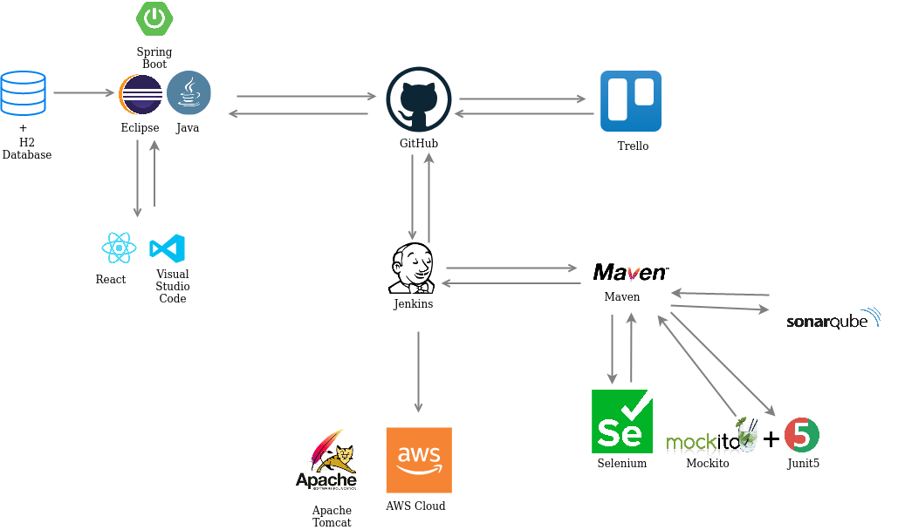
DevOps : Continuous Integration
1 | Copyright © 2019 BAE Systems. All Rights Reserved. BAE SYSTEMS is a trade mark of BAE Systems plc. (See final slide for restrictions on use.)
Notes:
1

Slide 14
Demonstration
1 | Copyright © 2019 BAE Systems. All Rights Reserved. BAE SYSTEMS is a trade mark of BAE Systems plc. (See final slide for restrictions on use.)

Slide 15





Future Aims
Search and filter feature
Category integration
User can add photos
Admin and user logins
Review
Notes:
1

Slide 16
Self Reflection
What went well
Overall journey
React
Test coverage and static testing
Regex
Improvements for the future
Many to many relationship
Use of VSC and project tracking
Front end testing (Selenium)
User experience
What didn’t go well
Time estimates
React
1 | Copyright © 2019 BAE Systems. All Rights Reserved. BAE SYSTEMS is a trade mark of BAE Systems plc. (See final slide for restrictions on use.)

Slide 17
Thank you! Any questions?
1 | Copyright © 2019 BAE Systems. All Rights Reserved. BAE SYSTEMS is a trade mark of BAE Systems plc. (See final slide for restrictions on use.)

Slide 18
BAE SYSTEMS
Surrey Research Park Guildford
Surrey GU2 7YP
United Kingdom
T: +44 (0)1483 816000
F: +44 (0)1483 816144
Copyright © 2017 BAE Systems. All Rights Reserved.
BAE SYSTEMS, the BAE SYSTEMS Logo and the product names referenced herein are trademarks of BAE Systems plc.
No part of this document may be copied, reproduced, adapted or redistributed in any form or by any means without the express prior written consent of BAE Systems.
BAE Systems Applied Intelligence Limited registered in England and Wales Company No. 1337451 with its registered office at Surrey Research Park, Guildford, England, GU2 7YP.
1 | Copyright © 2017 BAE Systems. All Rights Reserved. BAE SYSTEMS is a trade mark of BAE Systems plc. (See final slide for restrictions on use.)

