Slide 1
ANALYSING SHAMPOO SALES USING TIME SERIES
-ERANKI ADITYA CHARAN

Slide 2
OBJECTIVE:
This dataset describes the monthly number of sales of shampoo over a 3 year period. The units are a sales count and there are 36 observations.
To determine next 12 months of Sales using the 36 months, MAPE and AIC.
DATASET INFORMATION:
No. of Instances: 36
No. of Attributes: 2 (Month and Sales)

Slide 3
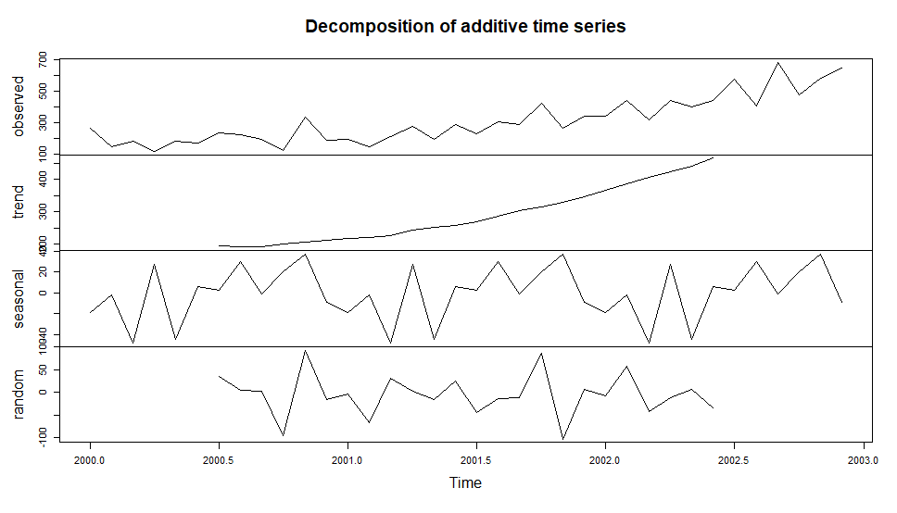
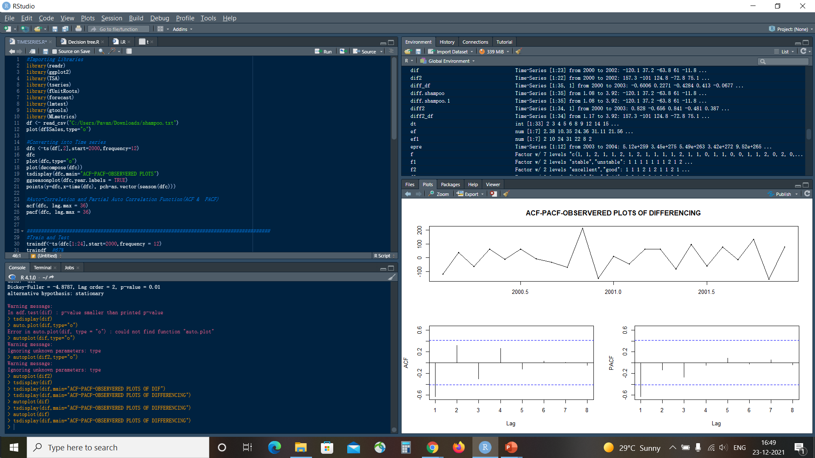
Exploratory Data Analysis
DECOMPOSITON PLOT

Slide 4
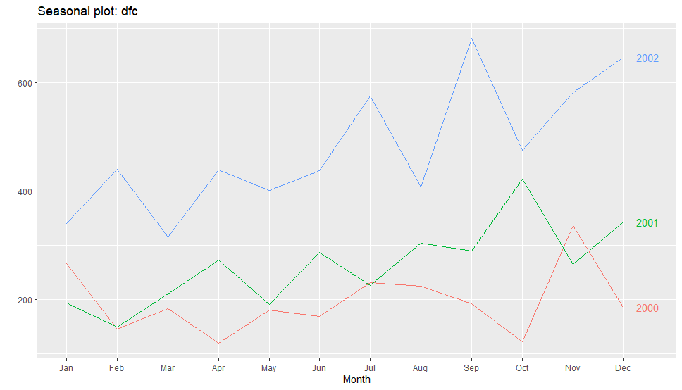
SEASONAL PLOT

Slide 5
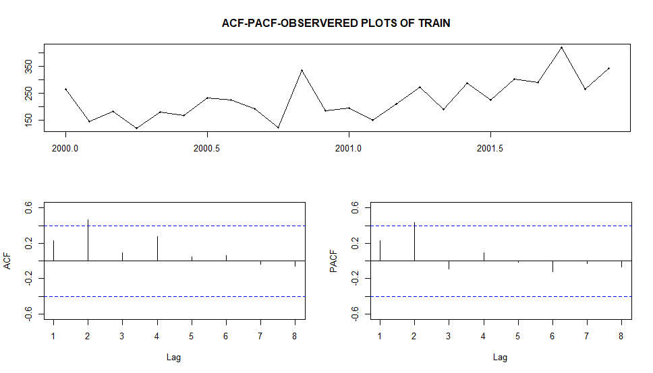
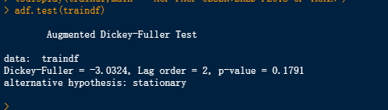
TRAIN DATA AND IT’S ADF TEST
ACF,PACF,OBSERVED PLOTS OF TRAIN DATA
ADF TEST FOR TRAIN DATA

Slide 6
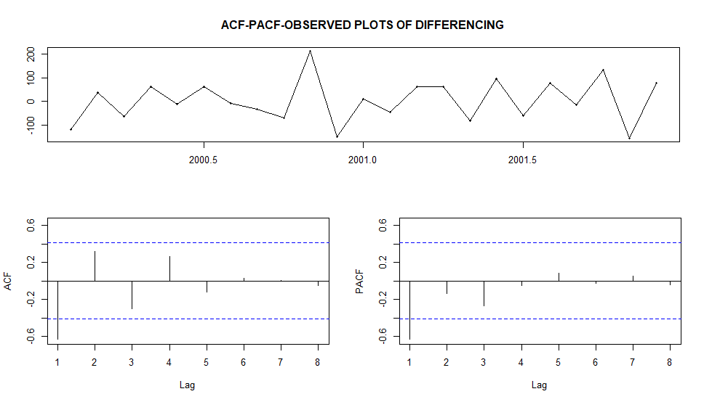
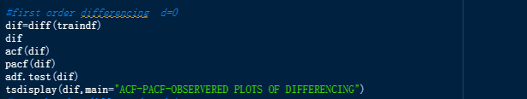
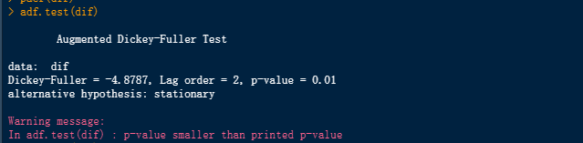
DIFFERENCING AND TRANFORMATION
ACF,PACF,OBSERVED PLOTS FOR DIFFERENCED DATA

Slide 7
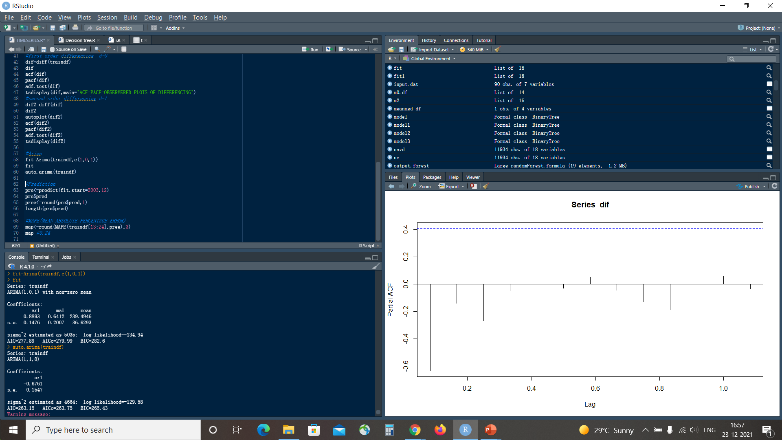
ARIMA
Arima From ACF and PACF
Auto Arima
Arima is calculated depending on the order of (p, d, q).
From the PACF and ACF the (p, q) values are (1,1) and as the differencing value is 0 to get the series as stationary (d=0). So, the ARIMA is (1, 0, 1)

Slide 8
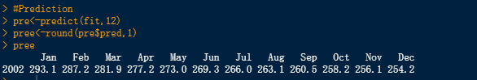
PREDICTION AND CONCLUSION
The Prediction Values
The attributes used for the prediction are Time and Sales of the Previous 36 Months.
The train : test ratio is 67:33.
MAPE(Mean Absolute Percentage Error) = 0.24

Slide 9
THANK YOU

