Slide 1
John P. Lalor, Pedro Rodriguez, João Sedoc, Jose Hernandez-Orallo https://eacl2024irt.github.io/
Item Response Theory for NLP
EACL2024 Tutorial, 21st March 2024
,
Notes:
Item Response Theory for NLP: From IRT to Measurement Layouts
With the advent of general-purpose systems in AI, such as large language models, their evaluation is finally transitioning from the reporting of aggregate performance on some benchmarks to the extraction of capabilities in more well-thought measurement experiments, in a way that should resemble the theory and practice of psychological measurement. I will illustrate some examples where Factor Analysis and Item Response Theory have been applied to AI evaluation in the past. In these psychometric approaches, estimating capabilities excels over measuring performance in that capabilities aim to be independent from the task distribution. However, the parameters and factors in these models are still highly dependent on the underlying population of AI systems, which are more arbitrary and changing than human or animal populations. To address this issue, we need a more cognitive, intrinsic approach, identifying task demands and mapping the capabilities that can meet these demands. Under this perspective, I will present a new approach referred to as 'measurement layouts', generalised (non-linear) Hierarchical Bayesian Networks that can infer the latent capabilities of a single AI system from observed performance and task demands, and then predict performance for new tasks. Measurement layouts provide understanding of what makes an individual AI system fail and anticipation of performance for future tasks. At the end of the talk, I'll invite attendees to an open discussion on how measurement layouts compare to other novel approaches such as Assessors (performance models trained on test data) and more traditional approaches such as Structural Equation Modelling (if used for individuals).

Slide 2
João Sedoc¹ ¹ New York University https://joaosedoc.com
Item Response Theory for NLP
EACL2024 Tutorial, 21st March 2024
Part 1. Evaluation for NLP
Notes:
Item Response Theory for NLP: From IRT to Measurement Layouts
With the advent of general-purpose systems in AI, such as large language models, their evaluation is finally transitioning from the reporting of aggregate performance on some benchmarks to the extraction of capabilities in more well-thought measurement experiments, in a way that should resemble the theory and practice of psychological measurement. I will illustrate some examples where Factor Analysis and Item Response Theory have been applied to AI evaluation in the past. In these psychometric approaches, estimating capabilities excels over measuring performance in that capabilities aim to be independent from the task distribution. However, the parameters and factors in these models are still highly dependent on the underlying population of AI systems, which are more arbitrary and changing than human or animal populations. To address this issue, we need a more cognitive, intrinsic approach, identifying task demands and mapping the capabilities that can meet these demands. Under this perspective, I will present a new approach referred to as 'measurement layouts', generalised (non-linear) Hierarchical Bayesian Networks that can infer the latent capabilities of a single AI system from observed performance and task demands, and then predict performance for new tasks. Measurement layouts provide understanding of what makes an individual AI system fail and anticipation of performance for future tasks. At the end of the talk, I'll invite attendees to an open discussion on how measurement layouts compare to other novel approaches such as Assessors (performance models trained on test data) and more traditional approaches such as Structural Equation Modelling (if used for individuals).

Slide 3
What Do We Evaluate in NLP?

Slide 4
Evaluations Are at Several Levels
1) System-level evaluations
This is probably the most common evaluation type (MT, Dialog, NLI, etc…)
2) Machine learning method evaluations
E.g., LSTM vs Transformer
3) Metrics
E.g., BLEU, BERTScore, etc
4) Annotations
Annotation error estimates
5) Data
Quality, domain similarity, toxicity

Slide 5
System Evaluations
Extrinsic task based evaluation
Intrinsic evaluation
Human evaluation
Automatic metric evaluation
A/B testing
Error analysis

Slide 6
Challenges for DIALOG SYSTEMS
Content
/
Context
Personality &
Persona
Emotion
&
Sentiment
Behavior
&
Strategy
Key Factors
Key Issues
Semantics
Consistency
Interactiveness
Named Entity Recognition
Domain/Topic
Intent Detection
Sentiment/ EmotionDetection
Knowledge & Reasoning
Key
Technologies
Entity Linking
Natural Language Generation
Personalization
Dialog Planning & Context Modelling
From Huang et al., 2019, “Challenges in Building Intelligent Open-Domain Systems”
Notes:
chatbot to process key issues
this framework show here allows us to evaluate key technologies

Slide 7
Common Task Framework & Leaderboards
There is general agreement that these competitive evaluations had a striking and beneficial effect on the performance of various systems tested over the years. However, it is also recognized (albeit less generally) that these evaluation experiments also had the, less beneficial, effect that the participating systems focused increasingly more narrowly on those few parameters that were measured in the evaluation, to the detriment of more general properties.
- Schwitter et al. 2000
Focusing on headline state-of-the-art numbers “provide(s) limited value for scientific progress absent insight into what drives them” and where they fail.
- Lipton and Steinhardt, 2019

Slide 8
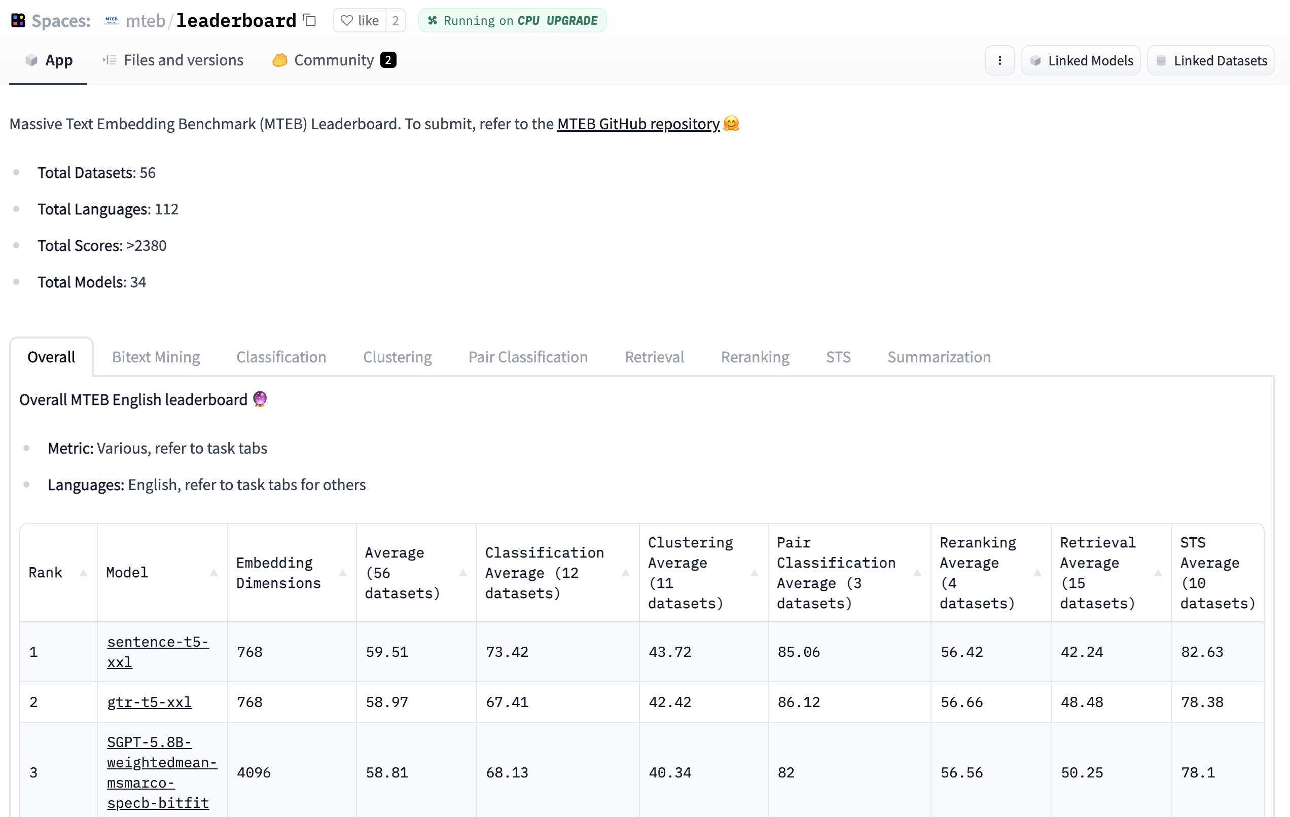
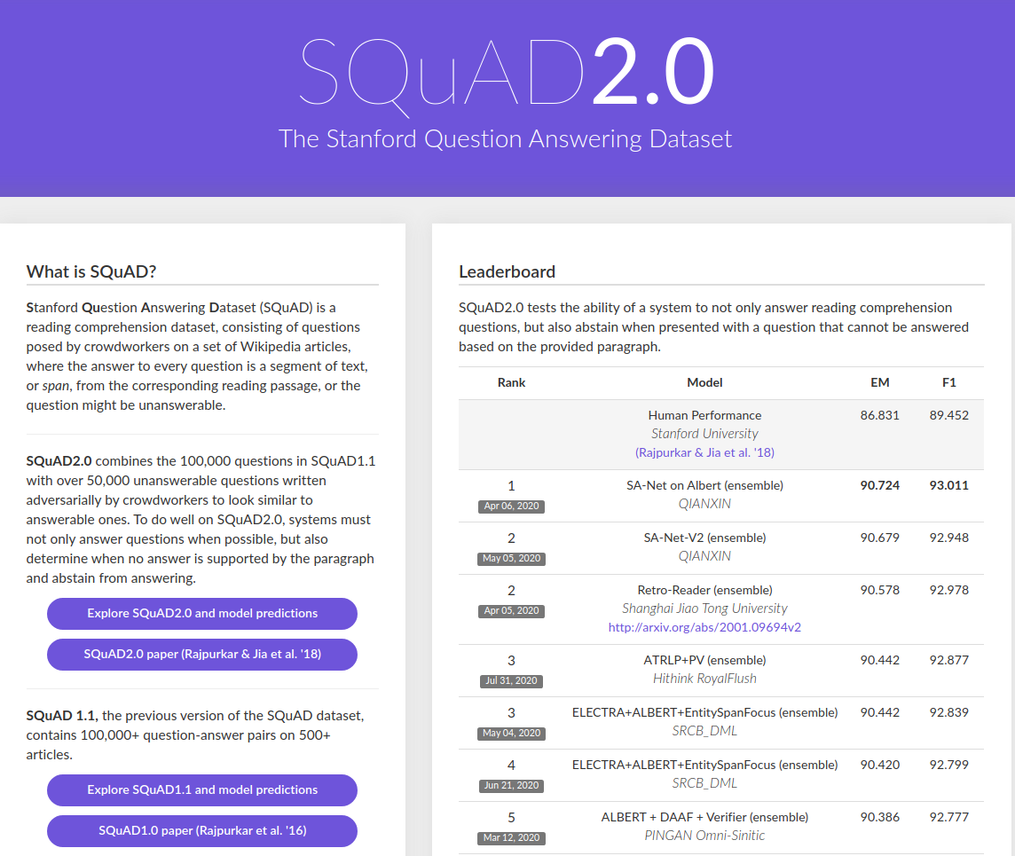
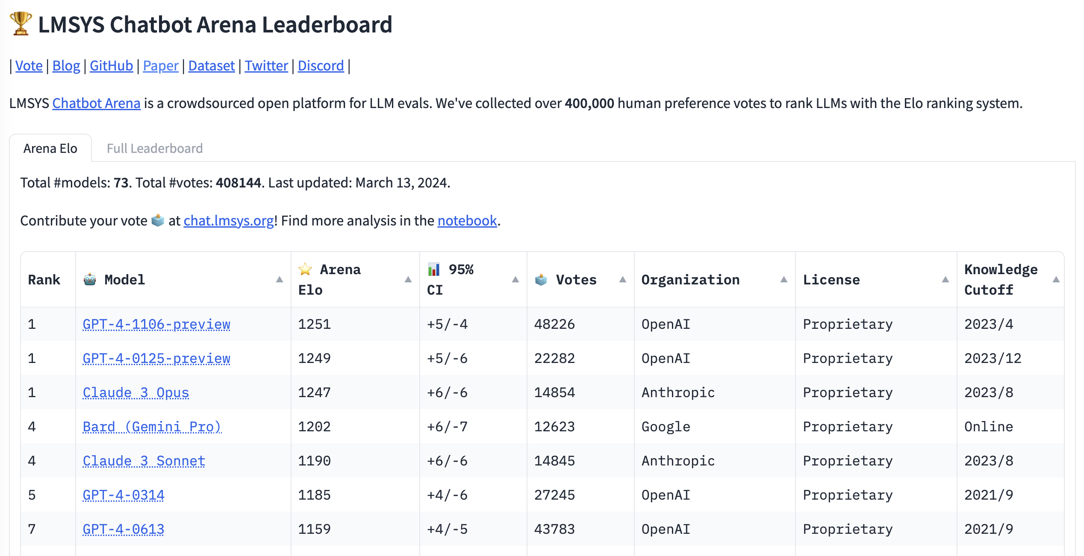
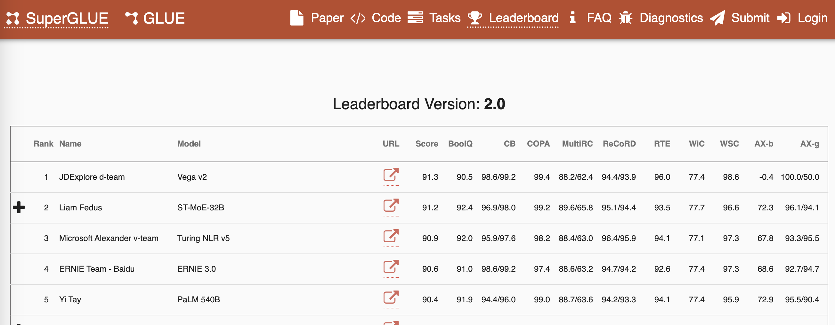
Lots of Leaderboards
Notes:
LMSYS leaderboard <> CTF – no fixed items

Slide 9
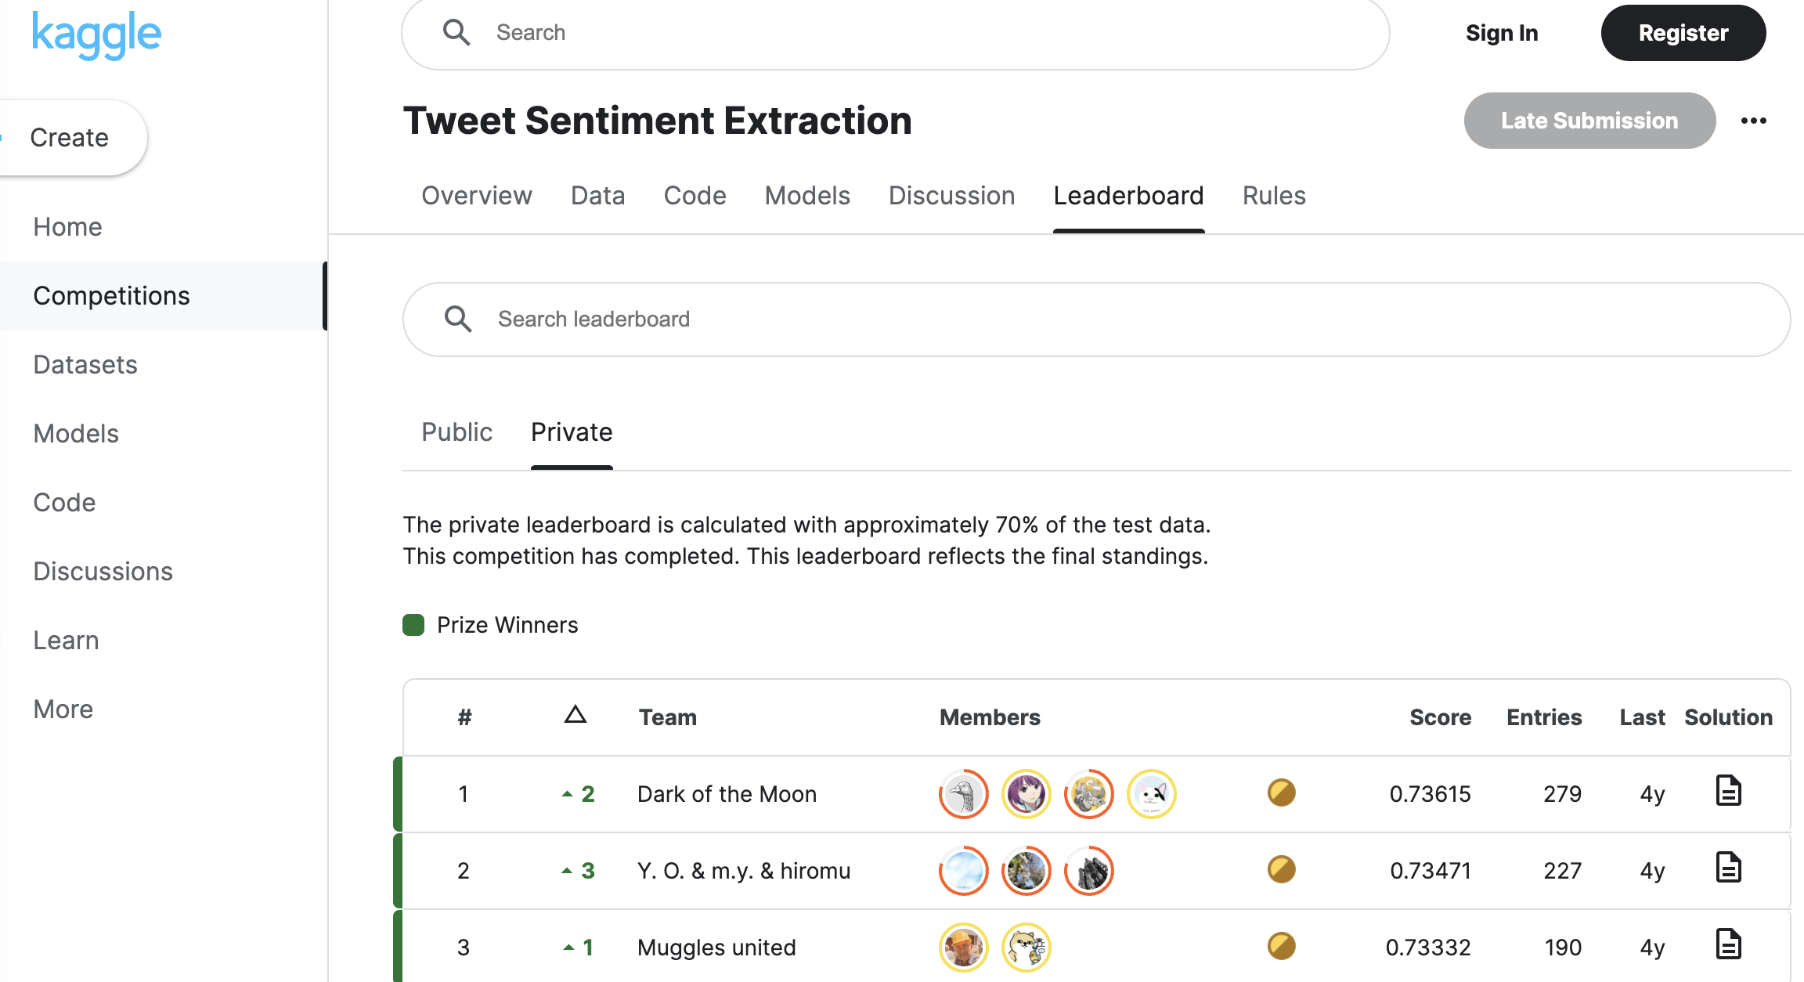
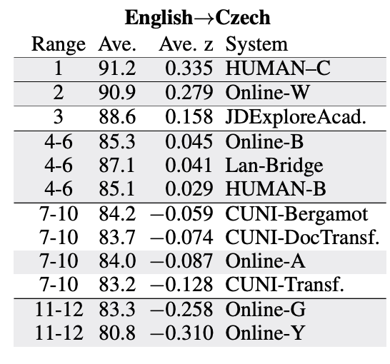
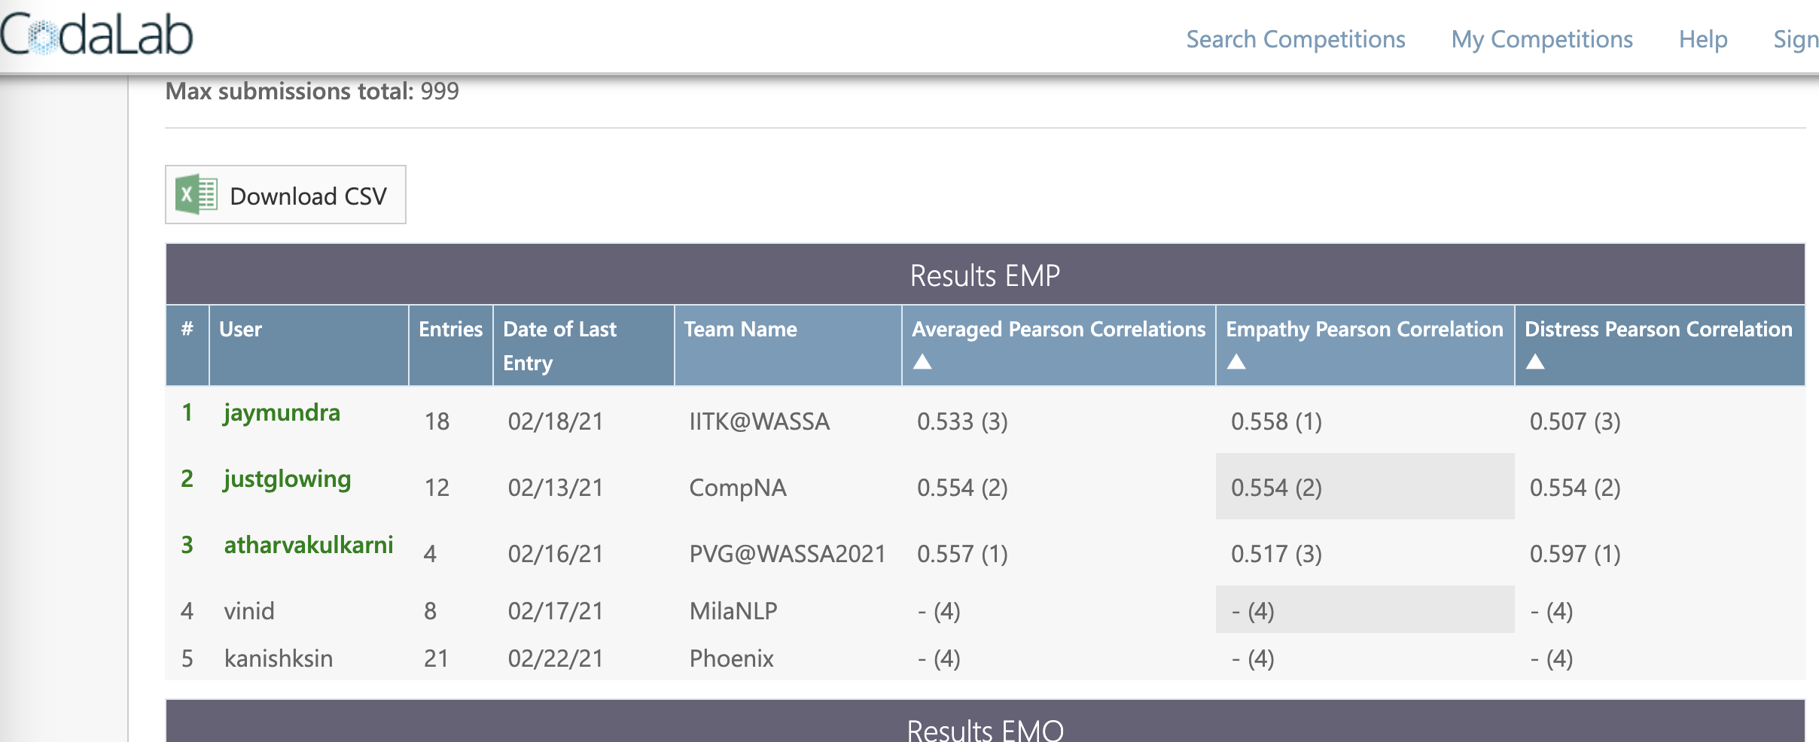
Shared Tasks

Slide 10
Leaderboards Can Improve
Questions with the Right Difficulty
Discriminative Questions
Minimize Ambiguity, Maximize Fairness
Don’t be Overly Definitive
Be Flexible and Introspective

Slide 11
Methods For Ranking
Average score
Z-scored ratings
Preference ranking
Bradley-Terry-Leech
Elo rating system
Trueskill
Item Response Theory

Slide 12
Human / Automatic metrics
Human evaluation
Expert judges (WOCHAT, Alexa)
Crowd-sourced (non-expert) judgments (DBDC)
Automated evaluation
Proxy metrics (e.g., G-Eval, BLEU, Perplexity)
Auto [wrt reference(s)]
S₁
U₁
S_{i-1}
U_{i-1}
S_{i}
U_{i}
U_{j}
U_{j}
Human [turn by turn]
U_{j}
U_{j}
H_{j}
Human [holistic]

Slide 13
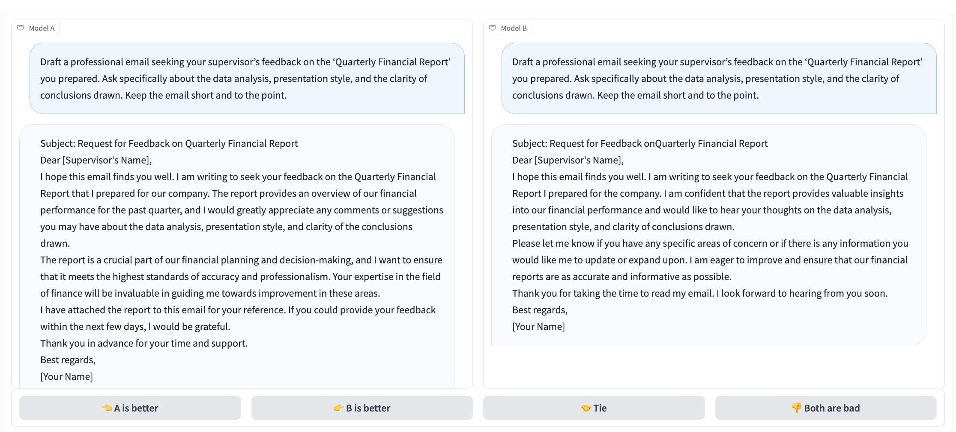
A / B testing

Slide 14
Error analysis
Categorize error types
Investigate sources
Identify possible explanations

Slide 15
Annotations

Slide 16
Evaluation of annotations
Inter-annotator agreement (IAA)
Cohen’s Kappa
Krippendorff’s alpha
Fleiss’ Kappa
Accuracy, Precision/Recall/F-score
Consistency checks
Error Analysis

Slide 17
Data

Slide 18
Underlying Data Analysis
Quality of the examples
Difficulty of data
Usefulness for evaluation
Error Analysis

Slide 19
THANK YOU!
JOAO SEDOC
http://joaosedoc.com/
jsedoc@nyu.edu

