Slide 1
Final project: Burial Records Classification and Text Extraction
Northeastern University
EAI6020: AI System Technologies
Daya Rudhramoorthi
July 3, 2021
Group 1
Xinyi Luo

Slide 2
Main Contents
Project Abstract
Introduction
Methodology
Conclusion
Data Description

Slide 3
Project Introduction
Burial records:
important evidences for tomb management. They often contain the name of the deceased and the detailed location and date of the burial.
Project goals:
Digitalization of these records helps maintain them as well as analysis on historical populations.

Slide 4
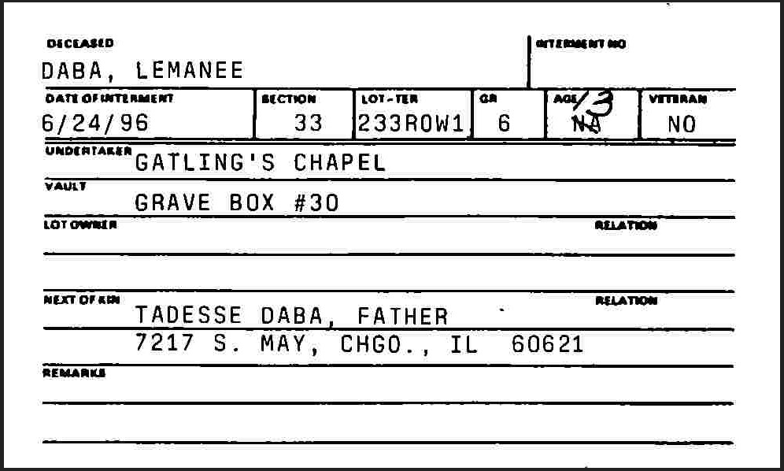
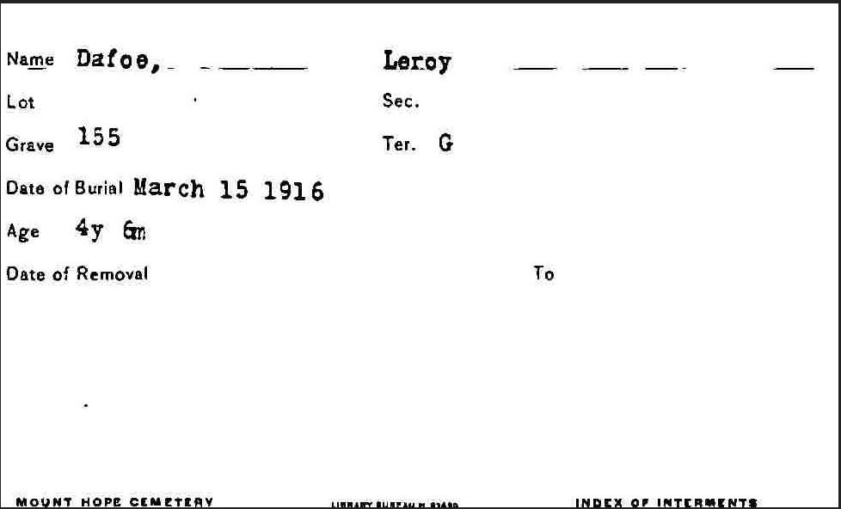
Data Description
The data set consists of 120 scanned images in type ‘.jpg’. Each image is one burial record. There are two kinds of formats distinct from each other:
Organized form with detailed information (Type 1)
Former form with only essential information (Type 2)
Essential variables:
“Decedent” -Decedent name
“Date” -Date of burial
“Section” -Section of cemetery
“Lot” -Lot of cemetery
“GR” -Grave spot

Slide 5
Main Contents
CNN Classifier
Introduction
Methodology
Conclusion
Image Process
Py-tesseract-OCR
Text Extraction
Azure FormRecognizer
Other OCR alternatives

Slide 6
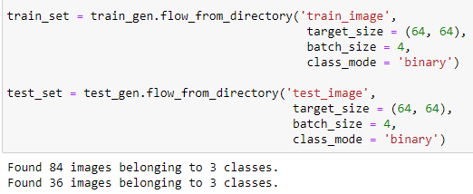

CNN Model Training
Classifications: 3 in total
Manually assign images to folders with labels. “form1”/”form2”/”form3”
Train set/Test set = 0.7/0.3 ratio

Slide 7
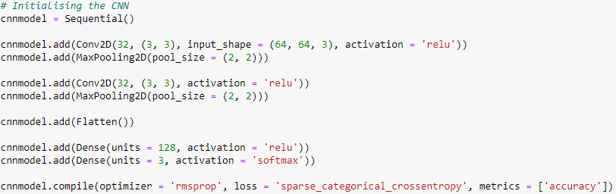
CNN Model Structure
Two convolutional layers with activation function and followed by two pooling layers to feed forward the image data.
One flatten() layer to connect all nodes.
One dense layer with ‘relu’ function to generate the result of parameter weights.
One Softmax() layer with ‘softmax’ function to sparse the result into one of the 3 classifications set before.
Compile with ‘RmsProp’ optimization function.

Slide 8
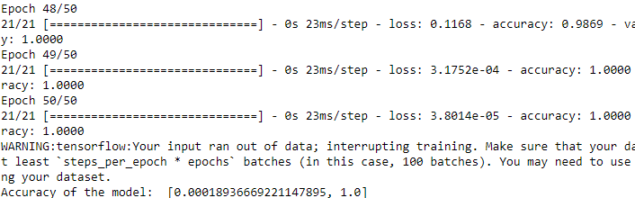
Classifier Performance
Training parameters: {train_set, steps_per_epoch = 21, epochs = 50, validation_data = test_set, validation_steps = 3}
With a validation dataset with 3*batch_size = 12 images, the model reaches 1.0 accuracy on the test set. The performance seems satisfying. Further image improvement will be based on the classification result.

Slide 9
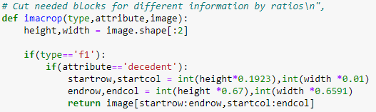
Image Process & Information Blocks Crop
Resize all images to a shape (900, 500). Crop all images with only ‘essential variables’ area.
Process all images through grayscale, denoise and filtering of OpenCV.
Cut blocks for different variables for extract the specific information
To cut small fields of a single variable, we need to cut with ratio.
(For example: How much percentage does the ‘Decedent’ block covering the processed Form 1 image)

Slide 10
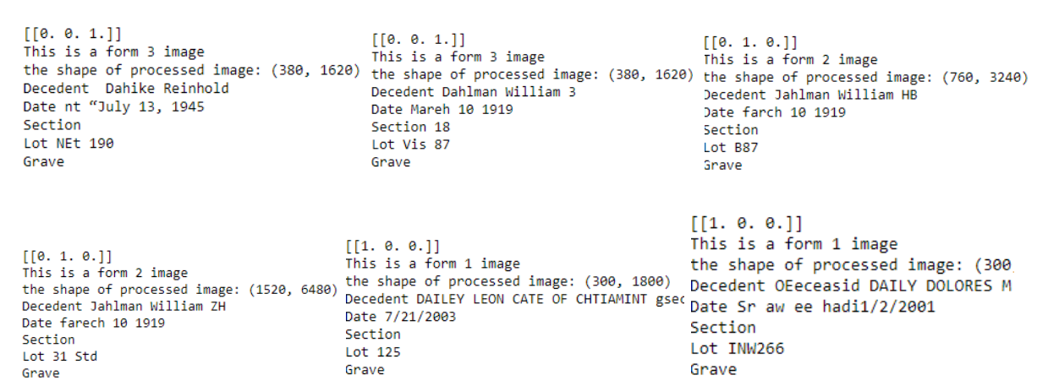
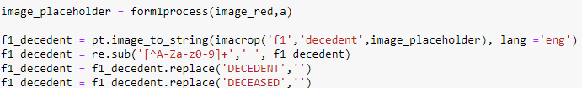
Text Extraction -Pytesseract
Performance:
The results obviously need much more tuning and improvement. I was trying to include as much information as possible to adapt the most images. That causes there is much noises text involved and extracted with needed information, as shown below:
Install the tesseract in system and direct to the commander:
For a single variable, extract the string from the cropped block and tune slightly with re.sub().

Slide 11
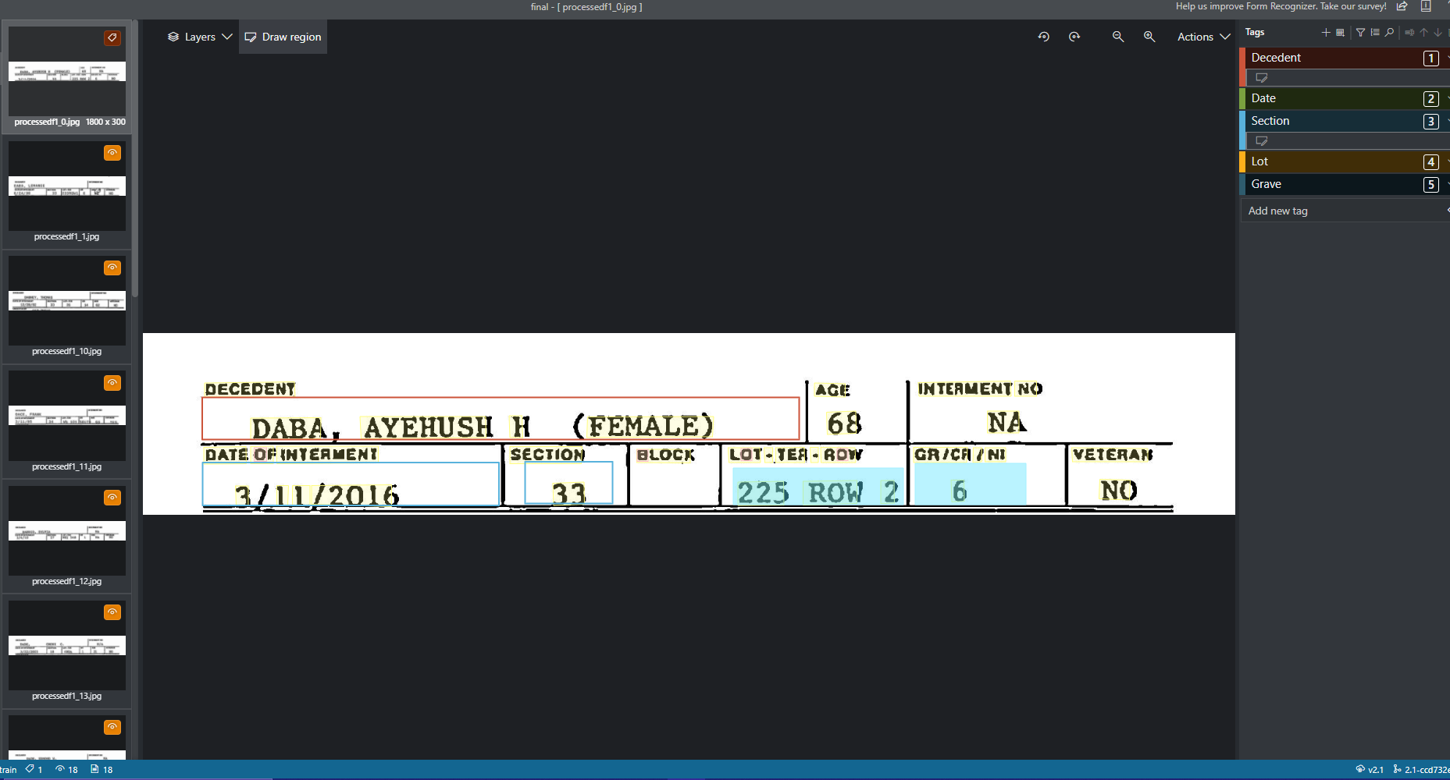
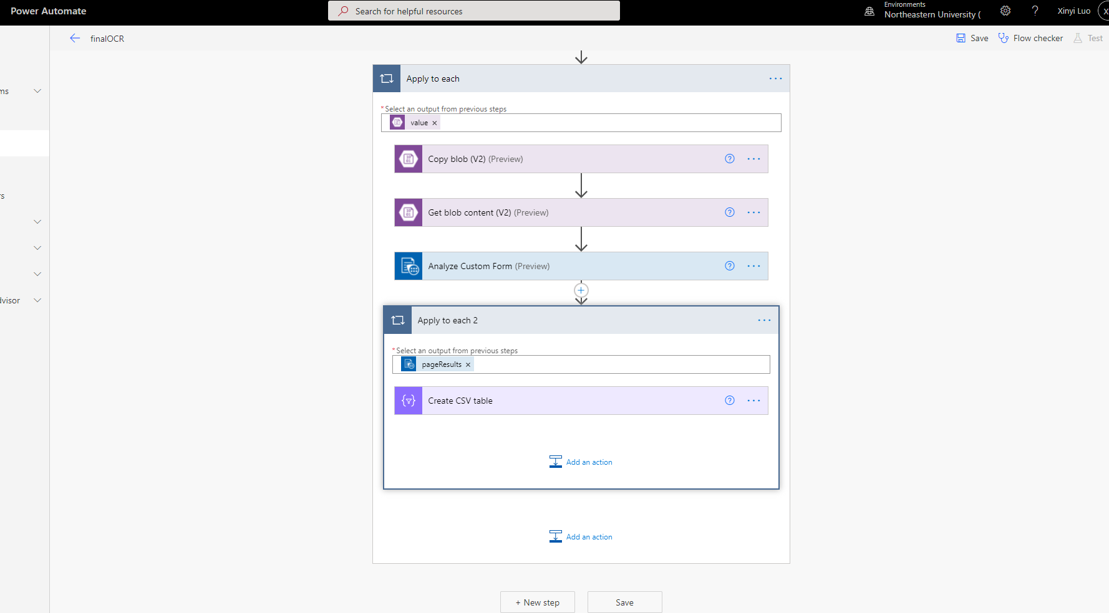
Text Extraction -Azure FormRecognizer
FormRecognizer(FR):
is an AI-powered text extractor deployed by Microsoft on their cloud platform, Azure.
Progress:
Train a custom FR model in portal with manually assign desired blocks for variables.
Conduct a workflow on Power Automate site to input images to excel.

Slide 12
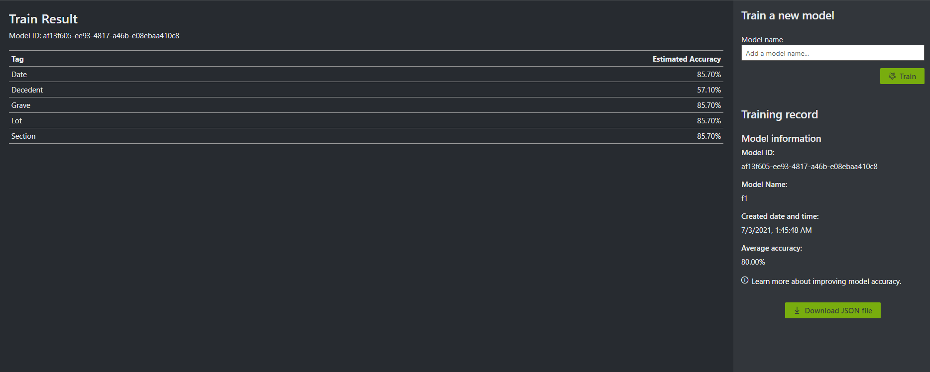
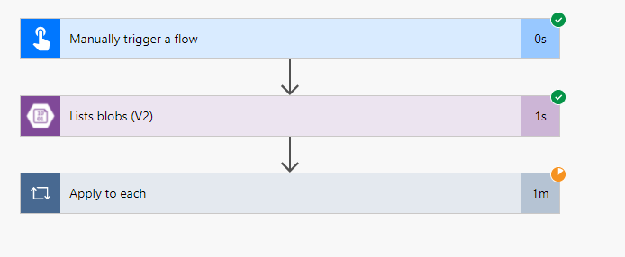
Trained Model
Complete WorkFlow

Slide 13
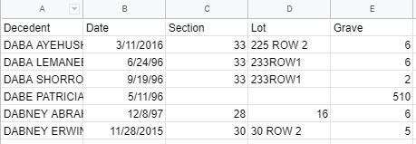
Text Extraction -FR Performance
FR works better than the original tesseract. Results come in a well-organized format with clean format.
And this dataset is chosen as the final submission.

Slide 14
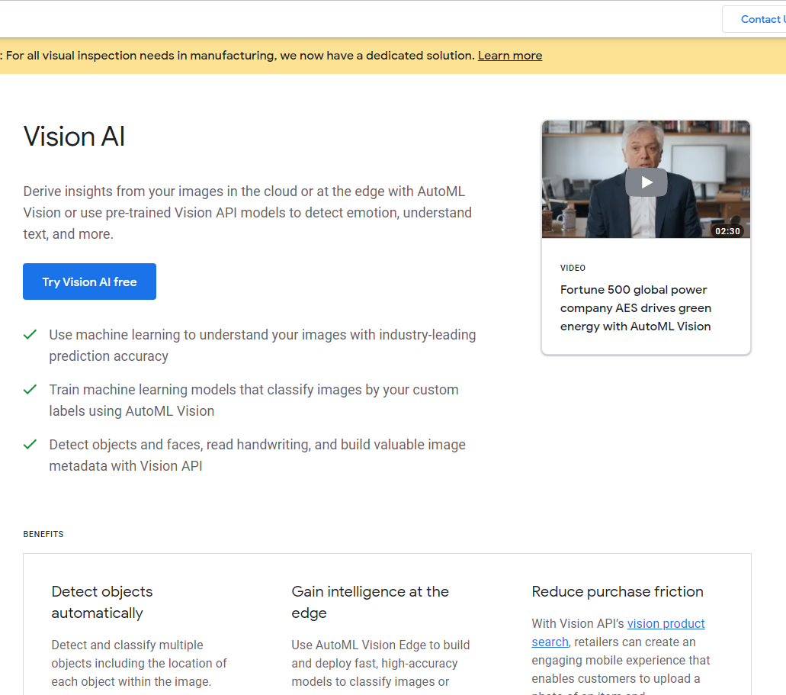
Google Vision AI
It is also a trendy tool for computer vision tasks.
To apply the Google Vision, the most simple way is to deploy a script with access to Google Cloud Platform.
With a GCP account, users could apply the API directly to the data and generate text from results.

Slide 15
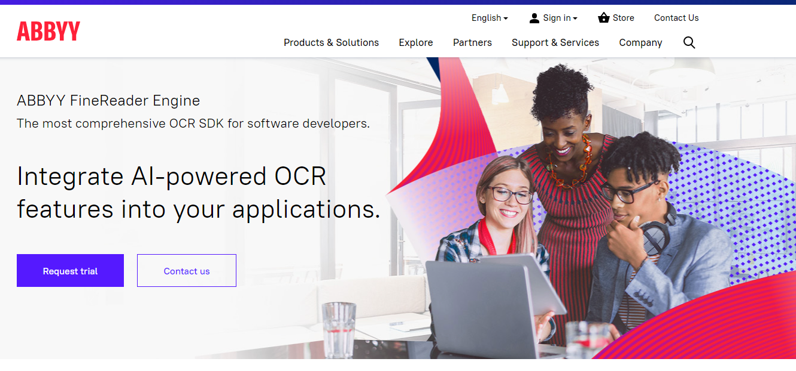
ABBYY Reader Engine
The engine provides an integrated end-to-end text extraction service. But it cost a little much to purchase an engine like that. It is more suitable for business.

Slide 16
Main Contents
Introduction
Methodology
Conclusion

Slide 17
Conclusion:
Compared to Pytesseract, Azure Form Recognizer is more functional and simple to use, even without any codes.
Moreover, accomplishing the whole task on a cloud platform could saves total time consumed to build and tune a machine learning model from scratch.
Cloud platform also provides Storage service for directly uploading the results to. That could be a huge addition on projects with large datasets.

Slide 18
Thanks!
References:
Microsoft Azure. (). Form Recognizer – Automated Data Processing Systems https://azure.microsoft.com/en-us/services/form-recognizer/
Microsoft Docs. (2021). IDs - Form Recognizer - Azure Applied AI Services https://docs.microsoft.com/en-us/azure/cognitive-services/form-recognizer/concept-identification-cards
Microsoft Power Platform. (2021). Microsoft Power Automate Portal https://us.flow.microsoft.com/en-us/
Issagha BA. (2020). How to automate form processing with Azure Form Recognizer - Microsoft Industry Blogs - United Kingdom. https://cloudblogs.microsoft.com/industry-blog/en-gb/technetuk/2020/10/22/how-to-automate-forms-processing-with-azure-form-recognizer/
Lee, M (2021). Pytesseract · PyPI. https://pypi.org/project/pytesseract/
Microsoft Azure. (2021). Home - Form OCR Testing Tool (fott-2-1.azurewebsites.net) https://fott-2-1.azurewebsites.net/
Google. (2021). Vision AI | Derive Image Insights via ML | Cloud Vision API (google.com) https://cloud.google.com/vision/
ABBYY. (2021). The Digital Intelligence Company https://www.abbyy.com/
Questions?

