Slide 1
Computational Genomics WS
Instructor: Liz Cooper
Email: ecoope4@clemson.edu
Office: BRC #300D (Bioinfo. Suite)
Notes:
* No pre-specified office hours; just set mtg time via email

Slide 2
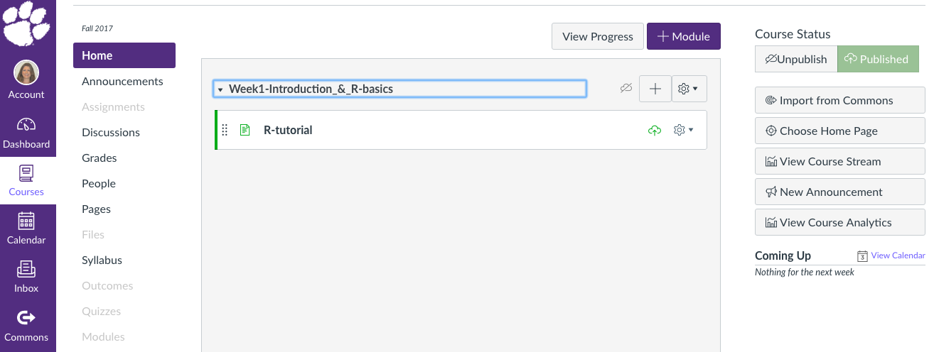
Course Materials on Canvas
I will add 1 Module per Week:
Before each class: Lecture Notes
Exercises
Sample Data Files
After each class: Exercise Solutions
Helpful code & functions
Syllabus & Final Project Guidelines available
Notes:
Also, don’t forget to check the Announcements page (or change settings to receive emails)

Slide 3
Course Structure Each Week
Today:
LECTURE
TUTORIAL/CODING DEMO
Next Week:
LECTURE
DEMO
CODING EXERCISE
Later Weeks:
LECTURE
CODING
LECTURE
CODING
Notes:
Next to last week (before final project work): also will be mostly coding demo for cluster use

Slide 4
Grading
In-class exercises will NOT ever be graded
Code/scripts will NEVER need to be handed in or graded
Class attendance
Using class time to work on the exercises
Asking for help when needed
Final Project:
10 min. presentation on the last day of class
Perform and present analysis of your choice on a real data set (your own if you have one, or a public or simulated data set).
Notes:
Min. requirement for project = run an analysis already covered in class on a real data set (your own, publicly available, or private)
If you have your own data and a different analysis that you want to do (that fits better with your real research) – go for it!

Slide 5
Learning R
R is hard at first, but worth it in the long run!
Used Frequently in Bioinformatics
Many pre-existing packages for bio applications (e.g. GWAS, Phylogenetics, RNAseq)
Learning R programming means you can do pretty much any analysis you can think of
Notes:
Also, check out online tutorials in my earlier email (such as the Pirate’s guide or Code School) for additional R instruction

Slide 6
Focusing on SNP (Genotype) Data
RNA
CHiP-Seq
GFF3
FPKM
Raw Sequencing Reads
Bioinformatics Pipelines:
De novo Assembly
Read Mapping
Abundance Estimation
De-multiplexing
GIANT FINAL DATA SET
Whole Genome
GBS
BAM
VCF
Microbiome
?
Often workshops and online tutorials cover how to get from raw data to a final data set,
But what do you do with that data once you have it?!
Population genetics has been around since the 1930s, and is based on the idea of testing evolutionary theory with nothing more than SNP genotypes.
Textbooks provide equations, but the examples are usually old and use just a handful of loci;
This class: we re-visit those equations and apply them to next-gen scale data!
ANSWER TO A BIOLOGICAL QUESTION
Notes:
Understanding how to get from raw data to a data set is important, but it is more of a technical problem than a biology one
There is a lot less guidance on what to do once you’ve got a big data set, so they is why we focus on this in this class
We will talk next week about the steps to get to a VCF file, but we won’t actually run the steps
Also, no time to cover RNA-seq analysis (unfortunately), but know R in general will still be helpful for reading RNA-seq vignettes and tutorials.

Slide 7
Why Write Your Own Scripts?
Many pre-existing R packages can analyze SNP files; are we re-inventing the wheel?

Slide 8
Why Write Your Own Scripts?
Writing code helps you understand other people’s code, so you can:
Troubleshoot errors or strange results
Ensure a program can accommodate YOUR data (formats, assumptions, etc.)
You will get a much better understanding of the statistics
You’re not stuck with what is out there (if you read about a new test, you can implement it!)

Slide 9

Today’s R Tutorial
Basic intro. plus some things specifically useful for genetic data sets
Focus on variables, data structures, sub-setting, and looping
On the test data sets, the looping structure may seem inefficient and unnecessary, but:
Writing programs this way can make it easier to understand what process is happening
When we scale up to real-size data sets, iterating functions on “bite-size” chunks will become essential!
Today we will go through things quickly, but in later weeks you will get lots of in class practice with some applied problems

