Slide 1
The Variant Call Format

Slide 2
Outline of Today’s Class
Next-Gen (Illumina) Library Construction and Sequencing
Overview of a typical data processing pipeline
How to call variants to generate VCF files
Understanding the information within a VCF
Exercises: 1) Read a VCF file into R, 2) count the genotypes, 3) calculate % heterozygosity and 4) convert to an alternate format

Slide 3

Constructing an Illumina Library
Start with genomic DNA:
Randomly fragment DNA:
(usually with sonication)
Flowcell Binding Site
Add Forward and Reverse Adapters:
Forward Primer Site
Overhang
Overhang
Reverse Primer Site
PCR amplification:
Size Selection:
~500 bp
Final Library:

Slide 4
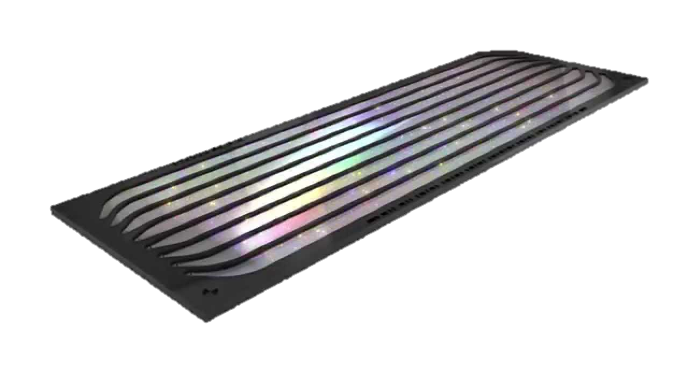
Sequencing-By-Synthesis
Library:
Illumina Flow Cell w/ 8 lanes
Flow cell is pre-coated with small DNA oligos
Fragments in the library are bound to the oligos on the flow cell (via the recognition seq. on the ends of the adapters)
A
Add labeled nucleotides
G
G
G
G
C
T
Base | Prob. Wrong
T | <1%
T
T
T
C
G
C
G
G
C
T
A
T
T
A
T
T
T
A
A
T
A
<1%
A
T
A
A
T
A
T
A
A
T
T
A
T
A
T
T
T
<1%
G
30%
In situ amplification creates clusters of identical copies of each fragment
Cross section of one cluster (notice there is a mutation/PCR error at one position)
Overhead view of the same cluster
Output

Slide 5
Illumina Output: Fastq Format
Base | Prob. | Phred Score | Code
T | 0.01% | 40 | H
A | 0.1% | 30 | ?
T | 0.05% | 33 | B
G | 30% | 5 | &
A | 1% | 20 | 4
C | 5% | 13 | .
Phred Score (Q) =
-log₁₀(Prob. of Error)
Code comes from a subset of ASCII characters
**Note that different versions of Illumina use slightly different sets of codes
Single Cluster
Sequencing-By-Synthesis
@Seqname:Flowcell:Lane:X1:Y1
TATGAC
+Seqname:Flowcell:Lane:X1:Y1
H?B&4.
@Seqname:Flowcell:Lane:X2:Y2
AAAGGG
+Seqname:Flowcell:Lane:X2:Y2
HH??AB
Fastq format (.fq or .fastq):
A text file with 4 lines per sequence

Slide 6
Data Processing Pipeline
Quality Check
Trimming
Remove leftover adapters
RawData.fq
CleanData.fq
FASTQ
FASTQ
FastQC
BWA
NAST
Trimmomatic
Bowtie2
soap2
Gmap
Map to a Reference
GATK
Samtools varFilter
freeBayes
Find Variant Sites b/t individual aligned files:
Single Nucleotide Polymorphism (SNPs)
Insertion/Deletions (InDels)
AlignedReads.sam
VCF
SAM/BAM
.msa, .bed, .psl

Slide 7
SNP Calling
SNP 1
SNP
2
SNP
3
SNP
4
SNP
5
Reference Genome:
Map. Rds
Sample 1:
Map. Rds
Sample 2:
Map. Rds
Sample 3:
SNP Position | Sample 1 | Sample 2 | Sample 3
1 | 0/0 | 0/0 | 1/1
2 | 1/1 | 0/1 | 0/0
3 | 0/0 | 0/1 | 0/0
4 | ./. | 0/0 | 1/1
5 | 1/1 | 1/1 | 0/0

Slide 8
VCF Files
At its core, a VCF file is just a tab-delimited text file
##fileformat=VCFv4.2
##FORMAT=<ID=GT,Number=1,Type=Integer,Description="Genotype">
##FORMAT=<ID=GP,Number=G,Type=Float,Description="Genotype Probabilities">
##FORMAT=<ID=PL,Number=G,Type=Float,Description="Phred-scaled Genotype Likelihoods">
#CHROM POS ID REF ALT QUAL FILTER INFO FORMAT SAMP001 SAMP002
20 1291018 rs11449 G A 20 PASS . GT 0/0 0/1
20 2300608 rs84825 C T 30 PASS . GT:GP 0/1:. 0/1:0.03,0.97,0
20 2301308 rs84823 T G 30 PASS . GT:PL 1/1:26,3,0 1/1:10,5,0
## Denotes a Meta-information Line. These lines can define the FILTER, INFO, and FORMAT terms, depending on what program created the vcf file (so not all vcf files are exactly the same!). The first line will always specify which VCF version a file is.
# Denotes the Header line. The first NINE columns should always be the same for every VCF (unless you have a really old version). Then, there will be one column for every individual in your sample (i.e. these columns will change for each data set). The names for these columns are usually taken from your input file names.
The remaining rows have the information about each SNP position, with 1 row per VARIANT site (i.e. sites with data, but no observed differences, are NOT in the VCF file by default!)
Notes:
Meta-information typically gives you things like the definition of each term in the “Format” field, and will do the same for the “info” field if it is used
Filter information will tell you what filters (if any) were applied to the vcf (for instance using a tool like GatK or VCFtools)
Can also open a (small) vcf in Excel-give this a try to look at the data set for today

Slide 9
VCF Files
##fileformat=VCFv4.2
##FORMAT=<ID=GT,Number=1,Type=Integer,Description="Genotype">
##FORMAT=<ID=GP,Number=G,Type=Float,Description="Genotype Probabilities">
##FORMAT=<ID=PL,Number=G,Type=Float,Description="Phred-scaled Genotype Likelihoods">
#CHROM POS ID REF ALT QUAL FILTER INFO FORMAT SAMP001 SAMP002
20 1291018 rs11449 G A 20 PASS . GT 0/0 0/1
20 2300608 rs84825 C T 30 PASS . GT:GP 0/1:. 0/1:0.03,0.97,0
20 2301308 rs84823 T G 30 PASS . GT:PL 1/1:26,3,0 1/1:10,5,0
CHROM: The chromosome (or scaffold) where the SNP is located. Comes from the names within your .fasta reference genome file
POS: The position within the chromosome of the SNP (positions start at 1).
ID: A database ID for each SNP (if there is one). Often this may be blank: “.”
REF: The allele for the Reference Genome at the SNP position. If the position has an InDel mutation, the REF may be a string instead of a single letter.
ALT: The allele for alternate/SNP allele found at the position. If there are more than 2 alleles at a site, ALT will have a comma delimited list of all possible alleles.
QUAL: The quality or likelihood score given to the site by the program used to call variants. Often a phred-scaled score, but sometimes a –ln(likelihood) or other score in a very different range.
FILTER: If you run a filter on the vcf after calling the SNPs, this will say whether each SNP passed or failed (rather than deleting SNPs that fail the filter).
INFO: Often this field is blank (“.”), unless you have run some additional analysis, such as annotation prediction.
Notes:
Meta-information typically gives you things like the definition of each term in the “Format” field, and will do the same for the “info” field if it is used
Filter information will tell you what filters (if any) were applied to the vcf (for instance using a tool like GatK or VCFtools)
Can also open a (small) vcf in Excel-give this a try to look at the data set for today

Slide 10
VCF Files
##fileformat=VCFv4.2
##FORMAT=<ID=GT,Number=1,Type=Integer,Description="Genotype">
##FORMAT=<ID=GP,Number=G,Type=Float,Description="Genotype Probabilities">
##FORMAT=<ID=PL,Number=G,Type=Float,Description="Phred-scaled Genotype Likelihoods">
#CHROM POS ID REF ALT QUAL FILTER INFO FORMAT SAMP001 SAMP002
20 1291018 rs11449 G A 20 PASS . GT 0/0 0/1
20 2300608 rs84825 C T 30 PASS . GT:GP 0/1:. 0/1:0.03,0.97,0
20 2301308 rs84823 T G 30 PASS . GT:PL 1/1:26,3,0 1/1:10,5,0
The FORMAT column tells us exactly what “fields” we can expect in each of our sample columns. Each field is separated by a “:” and the fields are typically defined in the meta information. Different programs can return different info., but the piece we are most interested in is the “GT” field, which is the actual genotype.
Individual Genotypes are always given in the form: allele1/allele2
0 = reference allele
1 = alternate allele
0/0 = homozygous ref; 0/1 = heterozygous; 1/1 = homozygous alt
A “./.” means that the genotype is missing for that individual.
If a site is multi-allelic, then there will be additional encodings (e.g. 0/2, 2/2, etc.)
If a sample is polyploid, the genotype will give all of the alleles: 0/0/1/1 (tetraploid)
If a sample is “phased” (a term we will discuss during linkage), there is a | between alleles instead of a /
Notes:
Meta-information typically gives you things like the definition of each term in the “Format” field, and will do the same for the “info” field if it is used
Filter information will tell you what filters (if any) were applied to the vcf (for instance using a tool like GatK or VCFtools)
Can also open a (small) vcf in Excel-give this a try to look at the data set for today

Slide 11
VCF Files and R
Since the VCF format is essentially a text file, it is easily readable by R
The things to watch out for are the special characters:
VCF files have ## and # headers, which is NOT commonly differentiated by most computing languages
The use of “.” as a missing data character can trip up some regular expression searches
The use of “|” in phased VCF files can also mess up regular expression searches.
It is also important to keep in mind that it is almost impossible to write a script that will work correctly with every version of the VCF format; early versions in particular might cause problems.
This is also true of software with dedicated teams of programmers (like GATK), a change in version can break certain package functions!
So, don’t feel bad – just be aware of the issue!
A very detailed guide to VCF files can be found here: https://samtools.github.io/hts-specs/VCFv4.1.pdf
Notes:
Meta-information typically gives you things like the definition of each term in the “Format” field, and will do the same for the “info” field if it is used
Filter information will tell you what filters (if any) were applied to the vcf (for instance using a tool like GatK or VCFtools)
Can also open a (small) vcf in Excel-give this a try to look at the data set for today

