Slide 1
Computational Genomics WS
Week 3: Hardy-Weinberg Equilibrium

Slide 2
Review: Variant Call Format
VCF files are a standard file type produced by Next-Gen pipelines
1 row per Variant/SNP locus
1 column per Individual/Sample (after 9 columns of other info.)
Solutions for Week 2 exercises can be found at:
https://clemson.instructure.com/courses/34867/pages/week-2-solutions
(self-contained R code and/or step-by-step explanations)
Source code with useful R functions can be found thru this page:
https://clemson.instructure.com/courses/34867/pages/r-functions

Slide 3
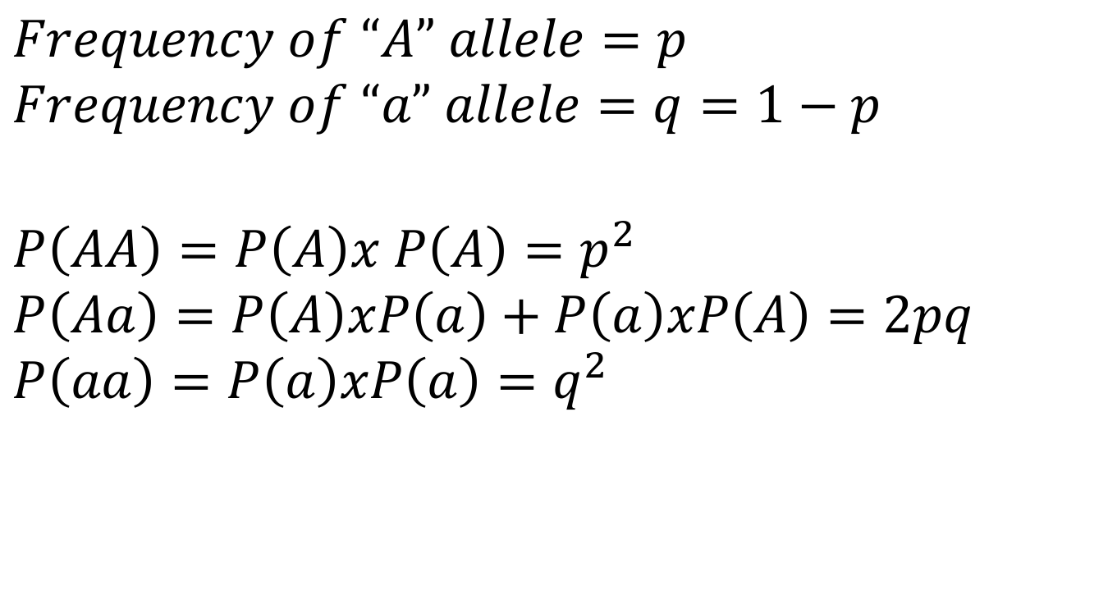
Hardy–Weinberg Equilibrium
$$Frequency of “A” allele=p$$
$$Frequency of “a” allele=q=1−p$$
$$P\left(AA\right)=P\left(A\right)x P\left(A\right)=p^{2}$$
$$P\left(Aa\right)=P\left(A\right)xP\left(a\right)+P\left(a\right)xP\left(A\right)=2pq$$
$$P\left(aa\right)=P\left(a\right)xP\left(a\right)=q^{2}$$
At equilibrium, allele frequencies will NOT change over time, and genotype frequencies can be predicted by allele frequencies following Mendel’s law of segregation.

Slide 4
What is “Equilibrium”?
No selection.
No mutation (refers to repeated mutations at the same site).
No migration.
No genetic drift (loss of alleles or genotypes in a finite population due to random chance).
Random mating (No selfing, no population structure).
Basically, EQUILIBRIUM = NO EVOLUTION.
So, a site that “fails” the HWE test might be said to show evidence for some kind of evolutionary process. But is this really a useful test?
Notes:
Only testing the immediately preceding generation-not looking at historic evidence of selection like the better tests we will look at later.
Also only looking at a single site at a time.

Slide 5
HWE as a Diagnostic Tool
Use the Hardy-Weinberg equation to calculate EXPECTED genotype counts
Test the deviation of OBSERVED genotypes from the EXPECTED value*
Deviations from HWE can be indicative of possible errors during sequencing, alignment, or SNP calling**
*If you are familiar with the Chi-squared test in statistics, then this should ring a bell. Fisher’s Exact test is very similar to Chi-square tests.
** They can be real biological phenomena as well, but systematic deviations in a genome-wide data set is usually indicative of a problem
Notes:
With the very large SNP data sets that are generated in Next-Gen sequencing, HWE has actually regained some utility. With 100K SNPs, it is reasonable to expect MOST of them to be in HWE within a population!

Slide 6
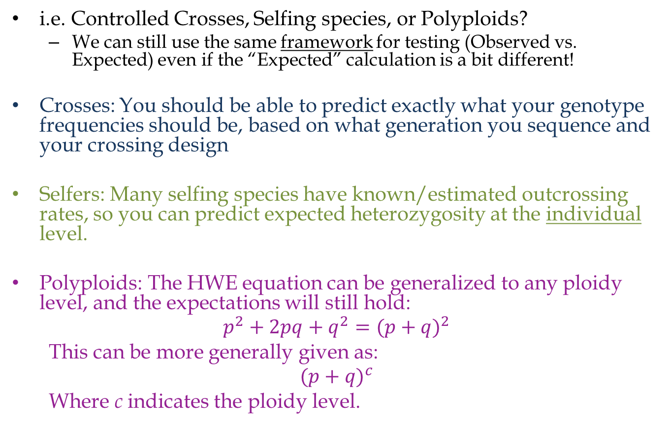
HWE as a Diagnostic Tool: What about Samples that Violate Assumptions?
i.e. Controlled Crosses, Selfing species, or Polyploids?
We can still use the same framework for testing (Observed vs. Expected) even if the “Expected” calculation is a bit different!
Crosses: You should be able to predict exactly what your genotype frequencies should be, based on what generation you sequence and your crossing design
Selfers: Many selfing species have known/estimated outcrossing rates, so you can predict expected heterozygosity at the individual level.
Polyploids: The HWE equation can be generalized to any ploidy level, and the expectations will still hold:
$$p^{2}+{2pq+q}^{2}={(p+q)}^{2}$$
This can be more generally given as:
$${(p+q)}^{c}$$
Where c indicates the ploidy level.

Slide 7
Significance of HWE Deviation:
Fisher’s Exact Test
Similar in set-up to Chi-squared Test (2x2 contingency table), BUT underlying math is different
Fisher’s test is more robust when sample sizes are small or unbalanced
Not the only test for HWE: also can use G-Test, or HWE Exact Test (NOT the same as Fisher’s exact!)
In R, there is a built-in function for Fisher’s Exact
The matrix object that R requires holds the 2x2 table to test. For HWE, your table should be set up like this:
fisher.test(matrix)
 | A₂ | a₂
A₁ | #AA genotypes | (1/2) #Aa
a₁ | (1/2) #Aa | # aa
Tip: you can extract just the p-value from the results like this: fisher.test(matrix)$p.value
Notes:
Could use chi-square with observed and expected values, but Fisher’s works with large and small samples, so I typically use it
Trade off: Fisher’s is difficult/impossible to compute by hand, but R has a built in function
Refer to R intro docs to remember how to create a matrix

Slide 8
Next-Gen Pipelines: Where can Problems Occur?
Sample contamination
Ind 1
Ind 2
Result: Excess heterozygosity at the Individual level

Slide 9
Next-Gen Pipelines: Where can Problems Occur?
Incorrect Read Mapping

Slide 10
Next-Gen Pipelines: Where can Problems Occur?
Incorrect Read Mapping

Slide 11
Next-Gen Pipelines: Where can Problems Occur?
Incorrect Read Mapping
Result: Paralogous/Duplicated Loci Can Lead to Excess Polymorphism and excess heterozygosity in a particular region
Stringent mapping thresholds, and filtering SNPs based on mapping quality can help with this, but is not always perfect

Slide 12
Next-Gen Pipelines: Where can Problems Occur?
Low Coverage
Result: Without enough coverage to detect both alleles, heterozygotes will be missed (bias towards excess homozygosity).
Standard threshold for SNP callers: alternate allele must be in at least 20% of reads to be kept, so 5X is MINIMUM to call hets!

Slide 13
Next-Gen Pipelines: Where can Problems Occur?
Too much missing data
Result: Too many missing individuals could skew the frequencies of observed genotypes at a particular site.

Slide 14
Handling Outlier Loci
If you find sites that significantly deviate from HWE...
Is the H_{obs} too...
Are the outlier sites clustered in one region?
High?
Yes
Low?
Run samtools rmdup, then re-test SNPs
This could be a paralog.
Is the read depth too low (<5X)?
Yes
No
No
Did you check for PCR duplicates?
Manually BLAST some reads to ref.
No
Yes
Is the read depth too high?
Does BLAST return multiple hits?
No
Are there a lot of missing samples?
No
Yes
Yes
Yes
No
Filter data more stringently and remove sites.
Might be a real pattern of selection. Keep or discard based on downstream analyses.
Probably paralogous. Remove from data set.
Notes:
# Take an opportunity here to look at the helpful commands file and the new functions in “LC_functions”
People should still save their code on their own (don’t completely rely on me)

Slide 15
Exercises
Week 3 Sample VCF: ~1,000 SNP sites and ~100 individuals
Calculate the OBSERVED and EXPECTED counts of each Genotype (AA, Aa, aa) at every site.
Uses Fisher’s Exact test to see which sites deviate significantly from HWE
Look at outlier sites and try to see what might cause deviation.

Slide 16
my.data = read in the sample VCF file
my.results = Set up empty table to hold results
Get the table of Genotype Counts and save in my.results
Add 3 new empty columns to my.results: N, p, q
Use the Genotype Counts to calculate N, p, q:
N = AA + Aa + aa
p = [2(AA) + Aa]/2N
q = 1 –p
Make a new column in my.results to hold P-values
Run Fisher’s Exact Test on EACH site to get the p-value:
for (i in 1:nrow(my.data)) {
x = get matrix of counts for my.data[i,]
test = fisher.test(x)
my.results$Pvalue[i] = test$p.value
}
Count sites with significant deviation from HWE
Look at read depth for sites where obs(Aa) is too low
Look at positions for sites where obs(Aa) is too high
We did this last week, so we can re-use code!
Just use basic math functions for this part
Code to get x is given w/ the exercise details
Practice using subset and which; otherwise code is given

