Slide 1
Computational Genomics WS
McDonald-Kreitman Test
Changes in Protein Coding Sequence
11-14-2017

Slide 2
Outline for Today
Review of Tajima’s D
Skews in the Allele Frequency Spectrum
Solutions to Last Week’s Exercises
McDonald-Kreitman Test
Related Tests
HKA test
Ka/Ks Ratio
R Exercise
Using R package VariantAnnotation
Testing for Selection w/ MK test

Slide 3
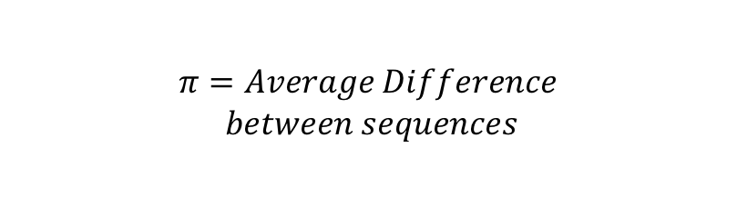

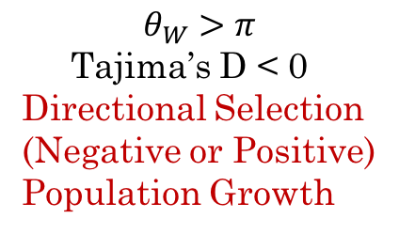
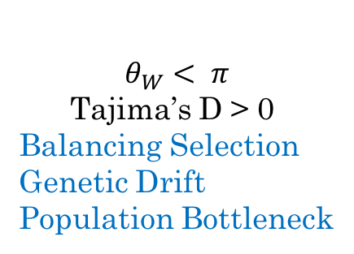
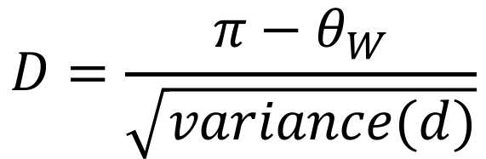
Review: Tajima’s D
$$D=\frac{{π−θ}_{W}}{\sqrt{variance(d)}}$$
$$π=Average Difference$$
$$between sequences$$
$$θ_{W}=\frac{Number of SNPs}{\sum_{i=1}^{2N−1}{1/i}}$$
$$θ_{W}>π$$
Tajima’s D < 0
Directional Selection
(Negative or Positive)
Population Growth
$$θ_{W}< π$$
Tajima’s D > 0
Balancing Selection
Genetic Drift
Population Bottleneck

Slide 4
Solutions for Last Week’s Exercise:
Gene appears to be under
directional (probably positive) selection
in domesticated sorghum
Notes:
Trickiest part: calculating Pi

Slide 5
Genetic Drift
Each new mutation can have a different trajectory
1.0
0.8
0.6
Allele Frequency
0.4
0.2
0.0
5
10
15
20
25
30
35
40
45
50
Time (generations)

Slide 6
Genetic Drift
Mutation trajectories proceed independently in non-mating sub-populations
Allele Frequency
Time (generations)
Allele Frequency
Time (generations)

Slide 7
Genetic Drift
Smaller populations have more randomness
N=10
N=100
Notes:
Important to remember that drift isn’t necessarily predictable

Slide 8
Natural Selection
Local Adaption: Different selective pressures in different environments
Notes:
Now, imagine 2 populations start with the exact same levels of variation,
But then they experience different environments (i.e. different selective pressures)

Slide 9
Natural Selection
Local Adaption: Different selective pressures in different environments: Different alleles driven to fixation
Notes:
Selection will drive fixation of alleles advantageous in each environment, which driver differentiation

Slide 10
Natural Selection
Sexual selection:
In animals: new color mutation + different preferences
In plants: new color mutation + different pollinators
Any other type of mutation that lets an individual occupy a new niche
Notes:
Occupying a new niche (i.e. there doesn’t necessarily have to be physical separation to drive differentiation)

Slide 11
Natural Selection
Eventually, non-random mating leads to an accumulation of differences at other sites
Sympatric speciation can occur this way.
Notes:
If they are not randomly mating, eventually they will also accumulate mutations at other sites, and can become different enough to be different species
i.e. differentiation that is initiated/driven by a selective process can lead to more differentiation through non-selective processes

Slide 12

Population Differentiation
Migration will decrease Differentiation
$$F_{ST}≈\frac{1}{4N_{m}+1}$$
Notes:
Lastly, another process that is important when thinking about differentiation is Migration, which decreases/counteracts it (i.e. lowers Fst)
Mathematical relationship with migration (Nm is number of migrants) is another reason to potentially be interested in calculating Fst

Slide 13
Population Differentiation
Migration, Selection, Mutation, and Drift are NOT mutually exclusive
Typically, a combination of some or all of these forces is occurring in natural populations
At the Gene scale, you could not distinguish them, but at the Genome-wide scale, you may be able to:
Selection
Notes:
i.e., selection, or a shift to a new niche, is probably only involving a few loci, and not the entire genome (as long as you haven’t allowed time for a lot of other differences to accumulate)
Whereas drift and random mutation should be actiing all across the genome indiscriminantly
Migration is hypothetically acting at a genome-wide scale too, but this is more complex to look at

Slide 14
Population Differentiation
Migration, Selection, Mutation, and Drift are NOT mutually exclusive
Typically, a combination of some or all of these forces is occurring in natural populations
At the Gene scale, you could not distinguish them, but at the Genome-wide scale, you may be able to:
Neutral Forces
Notes:
i.e., selection, or a shift to a new niche, is probably only involving a few loci, and not the entire genome (as long as you haven’t allowed time for a lot of other differences to accumulate)
Whereas drift and random mutation should be acting all across the genome indiscriminately
Migration is hypothetically acting at a genome-wide scale too, but this is more complex to look at
So, I will see different things by looking at the genome-wide averages versus looking at a single site or a single gene; we will get an idea of this with the plots we do in the exercise today

Slide 15
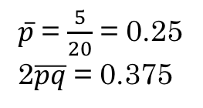
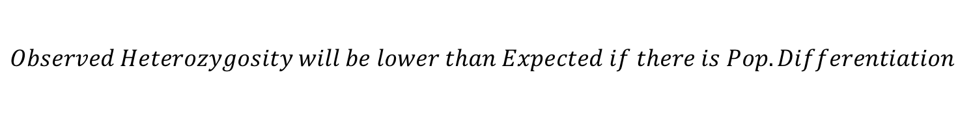
F_{ST}: Measuring Pop Differentiation
The Wahlund Effect
p₁ = 0.1
2pq = 0.18
p₂ = 0.4
2pq = 0.48
$\overline{p}$ = $\frac{5}{20}$ = 0.25
2$\overline{pq}$ = 0.375
$$Observed Heterozygosity will be lower than Expected if there is Pop. Differentiation$$
Notes:
Get notes from Ch. 5 lectures

Slide 16
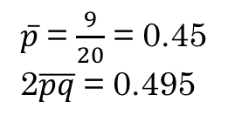
F_{ST}: Measuring Pop Differentiation
The Wahlund Effect
p₁ = 0.1
2pq = 0.18
p₂ = 0.8
2pq = 0.32
$\overline{p}$ = $\frac{9}{20}$ = 0.45
2$\overline{pq}$ = 0.495
Notes:
The more differentiated the populations are, the more extreme this effect will be.

Slide 17
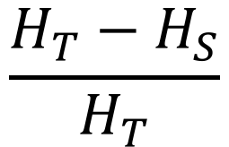
Estimating F_{ST}:
Wright’s Fixation Index (F_{ST}):
$$\frac{H_{T}−H_{S}}{H_{T}}$$
H_{T} : Total Heterozygosity
H_{S} : Average Subpopulation Heterozygosity
Sewall Wright
In other words:
What proportion of the variation observed among the individuals can be explained by differences between the groups?
If F_{ST} = 1; All of the variation comes from differences between groups (i.e., individuals within each group are identical, but the groups are completely different.)
If F_{ST} = 0; Individuals vary just as much within a group as they do between groups (i.e., the groups are identical)
Notes:
Wright = one of the fathers of population genetics (along with Fisher and Haldane); key figure in the modern synthesis
Came up with several F-statistics

Slide 18
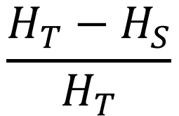



Estimating F_{ST}:
$$\frac{H_{T}−H_{S}}{H_{T}}$$
H_{T} : Total Heterozygosity
H_{S} : Average Subpopulation Heterozygosity
In Wright’s original formulation (1951), Heterozygosity is defined as the Expected Heterozygosity (based on HWE equation).
$H_{T}=2\overline{p}\overline{q}$
$\overline{p}$ = frequency of allele “A” in the total sample
$\overline{q}$ = 1- $\overline{p}$
k = the number of subpopulations
$$H_{S}=\sum_{i=1}^{k}{c_{i}}2p_{i}q_{i}$$
c_{i} = the relative size of the i^{th} subpopulation
= n_{i}/N
p_{i} = the frequency of allele “A” in the i^{th} subpop.
q_{i} = 1 - p_{i}
Notes:
How do you define “heterozygosity”?
Wright’s definition (with expected het., back to Wahlund effect)
Hs is a weighted average (you won’t necessarily always see it formulated this way; sometimes it is just a regular average; i.e. in Nei)
All equations also in exercise handout

Slide 19
Estimating F_{ST}:
Alternative Equations:
e.g. Weir and Cockerham’s
Nei’s G_{ST}
- Different methods for calculating “heterozygosity” when considering multiple sites together (i.e. estimating F_{ST} for a gene or gene region instead of at a single SNP site)
- Corrections for sampling bias or population size differences
𝛳
See also: Bhatia et al. (2013). Estimating and interpreting F_{ST}: The impact of rare variants. Genome Research 23:1514
Notes:
Despite differences, interpretations should be the same
Cited paper does a nice job of giving an overview of how different estimators relate to each other

Slide 20
Cryptic Population Structure
Observe the Wahlund Effect (low heterozygosity), but you don’t know what the groups are
1. Principal Components Analysis
2. STRUCTURE (https://web.stanford.edu/group/pritchardlab/structure.html)
Salmela E, Lappalainen T, Fransson I, Andersen PM, Dahlman-Wright K, Fiebig A, et al. (2008) Genome-Wide Analysis of Single Nucleotide Polymorphisms Uncovers Population Structure in Northern Europe. PLoS ONE 3(10): e3519. https://doi.org/10.1371/journal.pone.0003519
Notes:
STRUCTURE: K-means clustering

Slide 21
Today’s Data Set: from Darwin’s Finches
Notes:
Slide taken from https://www.slideshare.net/scottstevens/ap-biology-charles-darwin

Slide 22
Today’s Data Set: from Darwin’s Finches
What about differentiation within group?
Are these 2 different species?
Or are differences the result of developmental plasticity?
VCF file: ~40 total samples; ~1000 SNPs from chr. 5
Notes:
Slide taken from https://www.slideshare.net/scottstevens/ap-biology-charles-darwin

Slide 23
In-Class Exercises
Calculate F_{ST} at every site (row) in a VCF file using Wright’s estimator (equations given)
Look at the distribution of all F_{ST} values to get a sense of how overall differentiated the 2 groups are (histogram function is given)
Plot F_{ST} along the chromosome to find sites that might be under selection (plotting function is given)
Bonus: Run PCA and plot to see Pop. Structure
Notes:
Sample file details should be on the board

Slide 24
Read in the VCF file
Set up empty Results Table
3. Get Expected Heterozygosity for All Samples (H_{T})
4. Figure out how to extract only columns relating to each sub-pop
5. Get Expected Heterozygosity for Sub- Population 1
6. Get Expected Heterozygosity for Sub- Population 2
7. Calculate H_{S} (weighted mean of H_{exp} for the 2 sub-pops)
Calculate F_{ST} (all you need for this is H_{T} and H_{S}
Create Plots
Same as last week!
Sample name patterns given for each sub-pop
Once you get the right subset, you can follow the same steps as for #3
Use R’s math functions
Instructions given

