Slide 1
Computational Genomics WS
Week 5: Linkage Disequilibrium
Part 1: Definition, Data, and Statistics

Slide 2


F_{ST} Results:

Slide 3
Previous Weeks:
Single Site Tests
Hardy-Weinberg
F_{ST}
R code uses a loop to process 1 line of a file at a time.
This Week (and next week):
Linkage Disequilibrium
PAIRWISE test: 2 sites at a time
Code for calculating single site allele freq. can be re-used
TODAY: New code for Haplotype Frequencies!
Notes:
LD will entail a different way to think about the loop structure
Can re-use some calculations from the first few weeks, but will need some new code as well
Today: not worrying about the loop structure, but will want the code for the new calculations
Also: today will be focused on basic definition of LD and statistics for measuring it (very text book);
Next week: talk about causes and implications of LD and how to use and interpret genomewide patterns

Slide 4
What is Linkage Disequilibrium (LD)?
LD occurs when there is a non-random association between the alleles at two loci in a population.
A
B
2 chromosomes in a diploid organism
a
b
2 Loci with 2 alleles Each: Locus #1 (with alleles A and a) and Locus #2 (with alleles B and b)
2 Genotypes: Gen. #1 = Aa; Gen #2 = Bb
2 Haplotypes:
Haplotype = Haploid Genotype = The multilocus genotype of a single chromosome or gamete
In this case: Haplotype #1 = AB, and Haplotype #2 = ab
Notes:
Haplotypes are important because they represent sets of alleles that can be inherited together (i.e. passed on from one parent)
Also important to consider: we usually don’t measure LD between chromosomes, because during meiosis they are not kept together, don’t really get inherited together)

Slide 5
What is LD?
Review: Meiosis, Crossing Over, and the Formation of Gametes
Notes:
Diploid cell
DNA replication = 2 sets homologous chromosome pairs
Can have crossing over after homologous pairing (but not necessarily); closer loci are together, less likely crossing over event between them
When have crossing over, get new combinations of alleles
Cell division 1: 2 new diploid cells with the new chromosome pairs
Cell division 2: 4 haploid gamete cells
Within the population, if crossing over is happening randomly in all individuals, and the gametes from each parent are coming back together “randomly”, then haplotypes will be pretty mixed up; if not, then you will have LD

Slide 6
What is Linkage Disequilibrium (LD)?
LD occurs when there is a non-random association between the alleles at two loci in a population.
A
B
At Locus #1:
1/2 alleles are A
1/2 alleles are a
At Locus #2:
1/2 alleles are B
1/2 alleles are b
If there is an A at Locus 1, there is still a 50% chance of a B at Locus 2. Therefore, they are randomly associated; i.e. in linkage equilibrium.
A
b
a
B
a
b
A
b
a
b
A
B
a
B
Notes:
In this case, there is no LD. Knowing the allele at Locus 1 doesn’t give you any information about the allele at Locus 2.

Slide 7
What is Linkage Disequilibrium (LD)?
LD occurs when there is a non-random association between the alleles at two loci in a population.
A
B
At Locus #1:
1/2 alleles are A
1/2 alleles are a
At Locus #2:
1/2 alleles are B
1/2 alleles are b
If there is an A at Locus 1, there is now a 100% chance of a B at Locus 2. Therefore, they are Non-randomly Associated; i.e. they are in LD.
A
B
A
B
a
b
a
b
a
b
A
B
a
b
Notes:
In this case, they are in complete LD
Notice that it doesn’t matter how they are combined into genotypes. The LD here is still the same as the previous slide.
Note that no crossing over happened

Slide 8




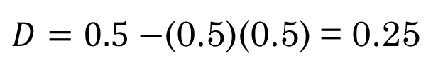
LD statistics:
1. D: The coefficient of LD
$$D=p_{AB}−p_{A}p_{B}$$
A
B
$$p_{A}=\frac{4}{8}=0.5$$
A
B
A
B
$$p_{B}=\frac{4}{8}=0.5$$
a
b
a
b
$$p_{AB}=\frac{4}{8}=0.5$$
a
b
A
B
$D=0.5−$(0.5)(0.5) = 0.25
a
b
Notes:
We know this population is in complete (maximum LD), and the value for D we compute is 0.25, which doesn’t seem to immediately reflect complete linkage

Slide 9

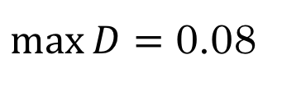


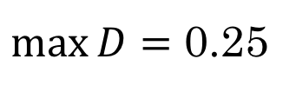


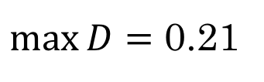

LD statistics:
1. D: The coefficient of LD
$$D=p_{AB}−p_{A}p_{B}$$
$p_{A}=0.$5
$\max{D}=$ 0.25
$p_{B}=0.$5
Calculations of D are hard to compare. The underlying range depends on the allele frequencies.
$p_{A}=0.$3
$\max{D}=$ 0.21
$p_{B}=0.$3
$p_{A}=0.$2
$\max{D}=$ 0.08
$p_{B}=0.$1
Notes:
We know this population is in complete (maximum LD), and the value for D we compute is 0.25, which doesn’t seem to immediately reflect complete linkage

Slide 10
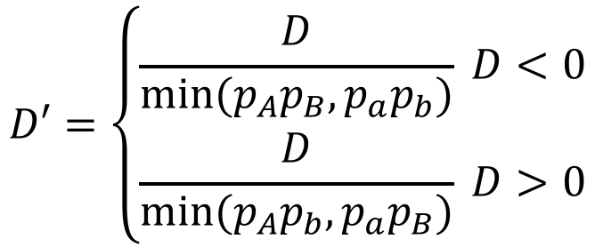



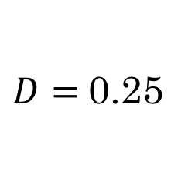
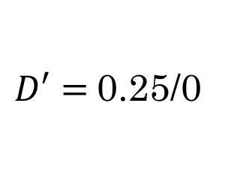
LD statistics:
2. D’: A scaled version of D
$$D′=\left\{\begin{aligned}\frac{D}{min⁡(p_{A}p_{B},p_{a}p_{b})} D<0 \\ \frac{D}{min⁡(p_{A}p_{b},p_{a}p_{B})} D>0\end{aligned}\right.$$
A
B
A
B
A
B
a
b
$$p_{A}=0.5$$
$$p_{B}=0.5$$
$$p_{AB}=0.5$$
a
b
$D=$0.25
$D′=$0.25/0
a
b
Normally, range for D’ is between -1 and 1, where 0 is equilibrium and 1 or -1 are complete LD.
BUT, if one or more haplotypes is not observed, D’ will be problematic
A
B
a
b
Notes:
We know this population is in complete (maximum LD), and the value for D we compute is 0.25, which doesn’t seem to immediately reflect complete linkage

Slide 11
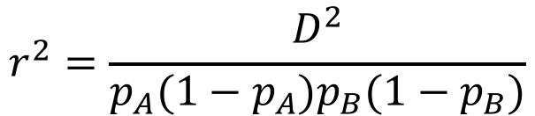



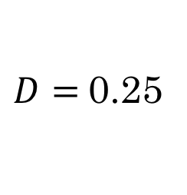
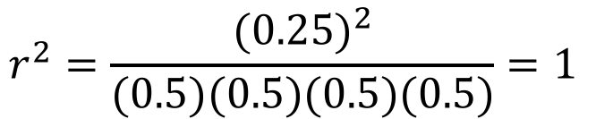
LD statistics:
3. r²: Correlation coefficient between alleles
$$r^{2}=\frac{D^{2}}{p_{A}(1−p_{A})p_{B}(1−p_{B})}$$
A
B
$$p_{A}=0.5$$
$$p_{B}=0.5$$
$$p_{AB}=0.5$$
A
B
A
B
$D=$0.25
a
b
a
b
$$r^{2}=\frac{{(0.25)}^{2}}{(0.5)(0.5)(0.5)(0.5)}=1$$
a
b
A
B
a
b
r² will have a range between 0 and 1,
Where 1 is complete LD and 0 is equilibrium
Notes:
R-squared is the most useful measure for plotting and interpreting, and the one we will focus on next week.

Slide 12
LD: Genotypes vs. Haplotypes
Knowing the Genotype does NOT mean you can always tell the Haplotype!
G/A
C/G
G
C
OR
G
G
A
G
A
C
Notes:
If heterozygous at 2 loci, with no other information, I don’t know which pair of gametes/haplotypes created this genotype pattern

Slide 13
LD: Genotypes vs. Haplotypes
Almost ALL sequencing data will contain Genotypes.
So how do we get haplotype data?
Several programs exist to infer/predict haplotypes from genotype data based on information in the whole sample. This is called Phasing.
G
C
G
G
G/A
C/G
G/G
C/C
A
G
A
C
A/A
G/G
A/A
G/G
G/G
C/C
Notes:
In this case, I pick which haplotypes are most likely based on the homozygous genotypes that I observe in the sample
Note, that this problem could be hard if I observed all possible haplotypes in the homozygous data as well

Slide 14
Common Programs for Phasing:
1. BEAGLE (https://faculty.washington.edu/browning/beagle/beagle.html)
Uses the unambiguous haplotypes already observed in a sample to predict most likely phase of heterozygotes
Fast, but biased against detecting rare haplotypes and recombination events
fastPHASE (http://stephenslab.uchicago.edu/software.html)
Expectation-Maximization (EM) algorithm
Iterative approach to find optimum value
Can be sensitive to starting point if there are local optima
ShapeIT (also uses iterative likelihood approach, but faster) (https://mathgen.stats.ox.ac.uk/genetics_software/shapeit/shapeit.html)
IF a program takes Genotype data as input and calculates LD, it must be running some kind of haplotype inference in the background!
e.g. R “genetics” package
Notes:
Caution: not all phased results are equal
Best to use a program that will actually return likelihoods or probs for each inferred hap
Note: there are molecular methods, and methods using family data to predict haplotypes more directly

Slide 15
VCF format for Haplotypes:
“0/1”, “0/0”, “1/1” : VCF format for Un-phased Genotype Data
“0|1”, “0|0”, “1|1”, “1|0” : VCF format for Phased Genotype Data
Order matters!
Alleles given before “|” should be on the same chromosome; same with alleles after “|”
Sample data set for the next 2 weeks is already Phased using the program Beagle version 4.1
- Data comes from Sorghum, which is a selfing crop species (i.e. very few heterozygotes to start with)

Slide 16
Allele Frequency vs. Haplotype Frequency:
VCF Row 1:
CHROM POS REF ALT FILTER FORMAT Ind1 Ind2 Ind3 Ind4 Ind5 Ind6
"1" "203" "G" "A" "PASS" "GT" "0|0" "0|0" "0|0" "0|0" "0|1" "1|1"
VCF Row 2:
CHROM POS REF ALT FILTER FORMAT Ind1 Ind2 Ind3 Ind4 Ind5 Ind6
"1" "1629" "A" "C" "PASS" "GT" "0|0" "0|0" "0|0" "0|1" "1|0" "0|0"
pA = | # REF (“0”) row1 ÷ | # alleles Row1 =
pB = | # REF row 2 ÷ | # alleles Row2 =
pAB = | # “00” haplotypes ÷ | # haplotypes =
D = | pAB - | pA * pB =

Slide 17
Allele Frequency vs. Haplotype Frequency:
VCF Row 1:
CHROM POS REF ALT FILTER FORMAT Ind1 Ind2 Ind3 Ind4 Ind5 Ind6
"1" "203" "G" "A" "PASS" "GT" "0|0" "0|0" "0|0" "0|0" "0|1" "1|1"
VCF Row 2:
CHROM POS REF ALT FILTER FORMAT Ind1 Ind2 Ind3 Ind4 Ind5 Ind6
"1" "1629" "A" "C" "PASS" "GT" "0|0" "0|0" "0|0" "0|1" "1|0" "0|0"
pA = | 9 ÷ | 12 = | 0.75
pB = | # REF row 2 ÷ | # alleles Row2 =
pAB = | # “00” haplotypes ÷ | # haplotypes =
D = | pAB - | pA * pB =

Slide 18
Allele Frequency vs. Haplotype Frequency:
VCF Row 1:
CHROM POS REF ALT FILTER FORMAT Ind1 Ind2 Ind3 Ind4 Ind5 Ind6
"1" "203" "G" "A" "PASS" "GT" "0|0" "0|0" "0|0" "0|0" "0|1" "1|1"
VCF Row 2:
CHROM POS REF ALT FILTER FORMAT Ind1 Ind2 Ind3 Ind4 Ind5 Ind6
"1" "1629" "A" "C" "PASS" "GT" "0|0" "0|0" "0|0" "0|1" "1|0" "0|0"
pA = | 9 ÷ | 12 = | 0.75
pB = | 10 ÷ | 12 = | 0.833
pAB = | # “00” haplotypes ÷ | # haplotypes =
D = | pAB - | pA * pB =

Slide 19
Allele Frequency vs. Haplotype Frequency:
VCF Row 1:
CHROM POS REF ALT FILTER FORMAT Ind1 Ind2 Ind3 Ind4 Ind5 Ind6
"1" "203" "G" "A" "PASS" "GT" "0|0" "0|0" "0|0" "0|0" "0|1" "1|1"
VCF Row 2:
CHROM POS REF ALT FILTER FORMAT Ind1 Ind2 Ind3 Ind4 Ind5 Ind6
"1" "1629" "A" "C" "PASS" "GT" "0|0" "0|0" "0|0" "0|1" "1|0" "0|0"
pA = | 9 ÷ | 12 = | 0.75
pB = | 10 ÷ | 12 = | 0.833
pAB = | 7 ÷ | 12 = | 0.583
D = | pAB - | pA * pB =

Slide 20
Allele Frequency vs. Haplotype Frequency:
VCF Row 1:
CHROM POS REF ALT FILTER FORMAT Ind1 Ind2 Ind3 Ind4 Ind5 Ind6
"1" "203" "G" "A" "PASS" "GT" "0|0" "0|0" "0|0" "0|0" "0|1" "1|1"
VCF Row 2:
CHROM POS REF ALT FILTER FORMAT Ind1 Ind2 Ind3 Ind4 Ind5 Ind6
"1" "1629" "A" "C" "PASS" "GT" "0|0" "0|0" "0|0" "0|1" "1|0" "0|0"
pA = | 9 ÷ | 12 = | 0.75
pB = | 10 ÷ | 12 = | 0.833
pAB = | 7 ÷ | 12 = | 0.583
D = | 0.583 - | .75 * .833 = | -0.0395

Slide 21
Exercise for Today:
Create code to calculate:
Physical distance between sites (Pos1 – Pos2)
D = p_{AB} – p_{A}p_{B}
r² = D²/[p_{A}(1-p_{A})p_{B}(1-p_{B})]
Focus on a Single Pair of Positions
No need to write loop (yet) unless you want to!
BUT: Save your code for Next Week!!!!
Sample VCF: 33 individuals with only 5 rows of data (positions)
Notes:
5 rows are if people want to try loop, but file should be small enough that people can also try some calculations by hand if they need to.

Slide 22
read in the sample VCF
Extract Row #1:
row1 = as.vector(my.data[1,], mode=“character”)
Extract Row #2:
row2 = as.vector(my.data[2,], mode=“character”)
Calculate distance between sites:
(row2 POS – row1 POS)
You can use your code from previous weeks to calculate allele frequency (p)
2) Calculate allele frequency (p_{A}) at Site/Row #1
3) Calculate allele frequency (p_{B}) at Site/Row #2
You will need new code for this!
4) Calculate HAPLOTYPE frequency (p_{AB}) for the Row Pair
5) Calculate D using values from 2,3, and 4
Perform calculations with R’s math functions
6) Calculate r-squared using values from 2,3, and 5
Optional: repeat calculations on all row pairs
in the mini sample file:
(1,3), (1,4), (1,5),
(2,3), (2,4), (2,5),
(3,4), (3,5)
(4,5)

