Slide 1
Computational Genomics WS
McDonald-Kreitman Test
Changes in Protein Coding Sequence
11-14-2017

Slide 2
Outline for Today
Review of Tajima’s D
Skews in the Allele Frequency Spectrum
Solutions to Last Week’s Exercises
McDonald-Kreitman Test
Related Tests
HKA test
Ka/Ks Ratio
R Exercise
Using R package VariantAnnotation
Testing for Selection w/ MK test

Slide 3
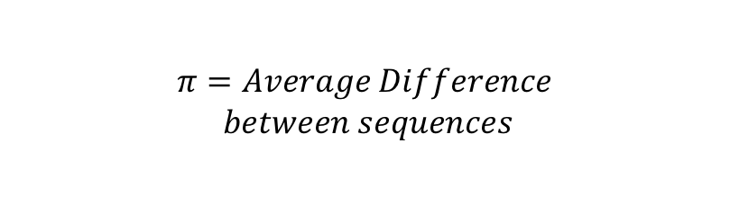

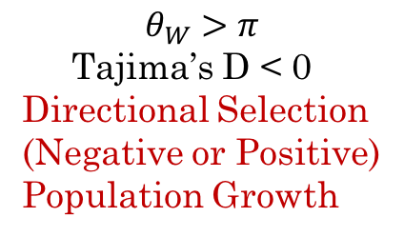
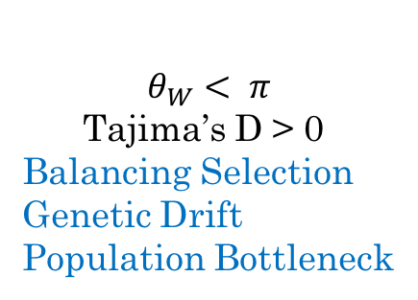
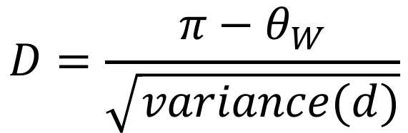
Review: Tajima’s D
$$D=\frac{{π−θ}_{W}}{\sqrt{variance(d)}}$$
$$π=Average Difference$$
$$between sequences$$
$$θ_{W}=\frac{Number of SNPs}{\sum_{i=1}^{2N−1}{1/i}}$$
$$θ_{W}>π$$
Tajima’s D < 0
Directional Selection
(Negative or Positive)
Population Growth
$$θ_{W}< π$$
Tajima’s D > 0
Balancing Selection
Genetic Drift
Population Bottleneck

Slide 4
Solutions for Last Week’s Exercise:
Gene appears to be under
directional (probably positive) selection
in domesticated sorghum
Notes:
Trickiest part: calculating Pi

Slide 5
Genome-wide Scans: A Note about Scale in Different Studies
Size of Entire Region = 30 kb
Each point = calculation for 600 bp (~20 SNPs)

Slide 6
Genome-wide Scans: A Note about Scale in Different Studies
Zoom Out to ~ 1 Mb:
Zoom Out to ~ 10 Mb
Zoom Out to ~ 30 Mb (size of original QTL region)
Zoom out to original QTL plot (that little dash is the whole 30Mb region):

Slide 7
McDonald-Kreitman Test: Underlying Theory/Assumptions
Selection acts Nonsynonymous changes (mutations that change the protein sequence)
Synonymous (silent) mutations should be neutral
Advantageous mutations will fix more rapidly than neutral ones.
Deleterious mutations will be removed more rapidly than neutral ones.
Nonsynonymous mutations that are adaptive for a particular species will become fixed differences between species (more quickly than you would expect by chance)!
Notes:
Very simplified assumptions re: which sites are neutral or not
Makes this a very conservative test

Slide 8
McDonald-Kreitman Test: Fixed vs. Polymorphic Sites
Species 1
Species 2

Slide 9
McDonald-Kreitman Test: Fixed vs. Polymorphic Sites
A mutation here
will show up as shared b/t the 2 species
Species 1
Species 2
Outgroup
Pos. 1: Monomorphic
G
T
G
T
T
G
G
C
G
T
T
G
G
T
G
T
T
G
G
C
G
T
T
G
A
C
G
T
T
G

Slide 10
McDonald-Kreitman Test: Fixed vs. Polymorphic Sites
Mutations here will be
fixed differences between the species
Species 1
Species 2
Outgroup
Pos. 1: Monomorphic
G
T
G
T
T
G
G
T
G
T
T
G
G
C
C
T
T
G
G
C
C
T
T
G
A
C
G
T
T
G
Pos. 2: Fixed
Pos. 3: Fixed

Slide 11
McDonald-Kreitman Test: Fixed vs. Polymorphic Sites
Mutations here will be
Polymorphic within species
Species 1
Species 2
Outgroup
Pos. 1: Monomorphic
G
T
G
A
T
G
G
T
G
T
T
A
G
C
C
T
T
A
G
C
C
T
G
G
A
C
G
T
T
G
Pos. 2: Fixed
Pos. 3: Fixed
Pos. 4: Polymorphic
Pos. 5: Polymorphic

Slide 12
McDonald-Kreitman Test: Fixed vs. Polymorphic Sites
Migration, incomplete lineage sorting, or parallel mutation events can also result in polymorphic sites
Species 1
Species 2
Outgroup
Pos. 1: Monomorphic
G
T
G
A
T
G
G
T
G
T
T
A
G
C
C
T
T
A
G
C
C
T
G
G
A
C
G
T
T
G
Pos. 2: Fixed
Pos. 3: Fixed
Pos. 4: Polymorphic
Pos. 5: Polymorphic
Pos. 6: Polymorphic

Slide 13
McDonald-Kreitman Test: Fixed vs. Polymorphic Sites
1. If synonymous mutations are neutral, then they should happen with equal probability on any of the branches of the tree.
1 Monomorphic SNP
2 SNPs fixed in Species 1
2 SNPs fixed in Species 2
1 SNP polymorphic in Species 1
2 SNPs polymorphic in Species 2
Species 1
Species 2

Slide 14
McDonald-Kreitman Test: Synonymous vs. Nonsynonymous
1. If synonymous mutations are neutral, then they should happen with equal probability on any of the branches of the tree.
2. If nonsynonymous mutations are under the same selective pressure in each species, then they should also be equally likely (or unlikely) to appear on any given branch.
Synonymous
1 Monomorphic SNP
2 SNPs fixed in Species 1
2 SNPs fixed in Species 2
2 SNPs polymorphic in Species 1
2 SNPs polymorphic in Species 2
Nonynonymous
1 SNPs fixed in Species 1
1 SNP fixed in Species 2
1 SNP polymorphic in Species 1
1 SNP polymorphic in Species 2
Even though #Nonsyn < #Syn,
The relative frequency of them (1/2) is the same both within and between species
Species 1
Species 2

Slide 15
M-K Test: Synonymous vs. Nonsynonymous
1. If synonymous mutations are neutral, then they should happen with equal probability on any of the branches of the tree.
2. If nonsynonymous mutations are under the same selective pressure in each species, then they should also be equally likely (or unlikely) to appear on any given branch.
3. If a gene has been selected to have a novel functions in 1 of the 2 species, then nonsynonymous mutations are disproportionately likely to appear on only one of the branches since the species split.
Synonymous
1 Monomorphic SNP
2 SNPs fixed in Species 1
2 SNPs fixed in Species 2
2 SNPs polymorphic in Species 1
2 SNPs polymorphic in Species 2
Nonynonymous
3 SNPs fixed in Species 1
0 SNPs fixed in Species 2
0 SNPs polymorphic in Species 1
1 SNP polymorphic in Species 2
Species 1
Species 2
Notes:
Should hold true even if mutation rate is different among different genes (because silent substitution rate is essentially a control)
Also if different demographic histories affect species differently, hypothetically the synon substitution rate controls for that as well

Slide 16
McDonald-Kreitman Test
 | Nonsynonymous | Synonymous
Fixed | F_{N} | F_{S}
Polymorphic | P_{N} | P_{S}
Under Neutrality:
F_{N}/F_{S} = P_{N}/P_{S}
But, if selection is acting to fix advantageous nonsynonymous changes:
F_{N}/F_{S} > P_{N}/P_{S}
Or, if selection is working to remove deleterious nonsyn. changes:
F_{N}/F_{S} < P_{N}/P_{S}
Notes:
i.e., if rates are equal along the tree branches, then even if there are fewer (or more) nonsynonmous mutations vs. synonymous, the proportion should be equal no matter where on the tree I look

Slide 17
McDonald-Kreitman Test
 | Nonsynonymous | Synonymous
Fixed | F_{N} | F_{S}
Polymorphic | P_{N} | P_{S}
Under Neutrality:
F_{N}/F_{S} = P_{N}/P_{S} ** We test this with Chi-Square or Fisher’s Exact
Neutrality Index:
(P_{N}/P_{S})
(F_{N}/F_{S}) * If this is < 1; Nonsynonymous changes are being Fixed at a higher rate than expected by chance
* If this is >1; nonsyn changes are being removed at a higher rate than expected by chance
Notes:
In other words, under neutrality things happen at the same rate higher up the tree as they do lower down

Slide 18
Related Tests
Hudson-Kreitman-Aguade (HKA) Test:
Originally a precursor to the MK Test, but also very useful on its own
Also looks at the rate of divergence between species vs. the rate of polymorphism within species
Does not distinguish b/t Nonsynonymous and Synonymous Sites
Main Theory:
Different loci in the genome can have different mutation rates, but under neutrality these rates should have been constant over time.
Therefore, a locus with high divergence between species should also have high polymorphism within species (and vice versa), unless selection is acting on one of them.

Slide 19
HKA Test
Neutral Evolution:
Purifying Selection:
Loc 1 has high divergence b/t species
Loc 2 has low divergence b/t species
Loc 1 has high polymorphism w/in species B
Loc 2 has low polymorphism w/in species B
Conclusion: Locus 1 has a higher mutation rate than Locus 2, but their differences can be explained with a neutral model
Loc 1 has high divergence b/t species
Loc 2 has high divergence b/t species
Loc 1 has high polymorphism w/in species B
Loc 2 has low polymorphism w/in species B
Conclusion: If we explain the similar divergence rates between Locus 1 and Locus 2 by assuming their mutation rates are equal, then there must be some kind of selection against variation in order to explain the low polymorphism in species B
Notes:
Test of significance (i.e. can we really not explain pattern 2 without the neutral model) takes some model fitting

Slide 20
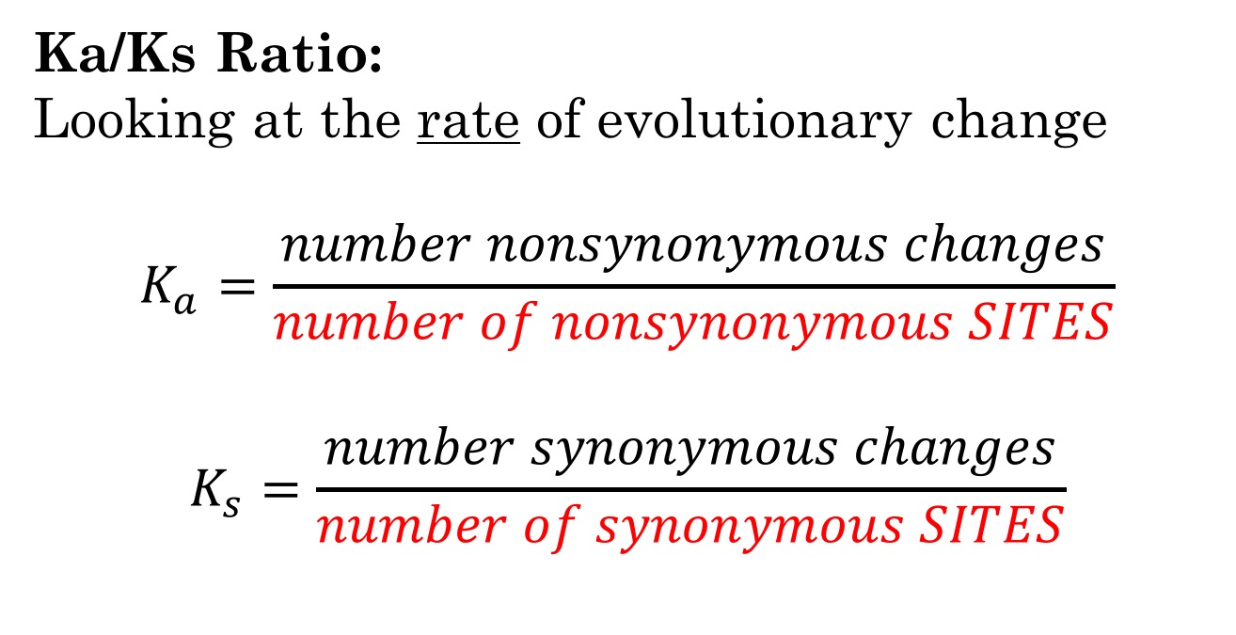
Related Tests
Ka/Ks Ratio:
Looking at the rate of evolutionary change
$$K_{a}=\frac{number nonsynonymous changes}{number of nonsynonymous SITES}$$
$$K_{s}=\frac{number synonymous changes}{number of synonymous SITES}$$
Ka/Ks is widely used; you don’t necessarily need out group information (for instance you can compare duplicate copies of the same gene), AND it is the most informative for inferring the direction of selection
BUT: calculating the denominator (in red) is non-trivial – programs like PAML can do this, though

Slide 21
Comparison of Tests
 | Outgroup (?) | Annotation (?) | Max. Likelihood Models (?)
HKA | Y | N | Y
MK | Y | Y | N
Ka/Ks | N | Y | Y
Software for HKA:
https://github.com/rossibarra/MLHKA
Also not too hard to write your own code in R, and use a package like lme4 for model fitting
For Ka/Ks:
R package “seqinr” has a kaks function
*some work req to get vcf to fasta, but not too bad
PAML (http://abacus.gene.ucl.ac.uk/software/paml.html)

Slide 22
Other ways to look at Site Classes
Separate SNPs based on their Predicted Effects, and look at the frequency spectrum for each category:
Example from Ramu et al. (2017) Nat. Gen.: Cassava evolution

Slide 23
Today’s R Exercise
Vs.
Use the MK test on some candidate genes involved in the evolution of Polar Bears

Slide 24
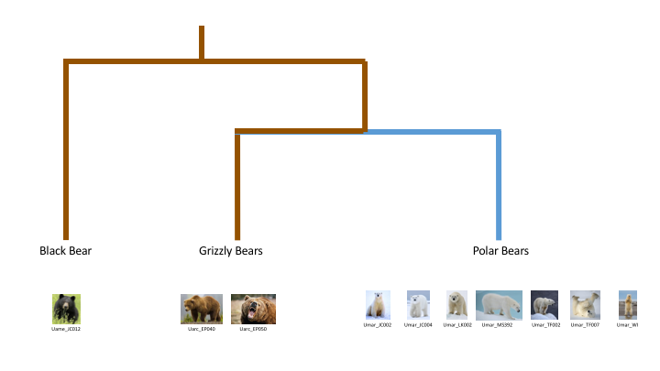
Today’s R Exercise
Group 1
Group 2
Note that this specifically tests selection for (or against) protein coding changes unique to polar bears! It won’t detect genes important in the split from Black Bears.
Notes:
MK test depends on outgroup in general.

Slide 25
Today’s R Exercise
SNP annotation workflow to find nonsynonymous changes (using R package “variantAnnotation”)
Other programs: snpEff (java), ensembleVEP (web), ANNOVAR
MK Test to see if F_{N}/F_{S} = P_{N}/P_{S}
A A A A A A G G G G G G G G G G G G G G
T T T T G G G G T T G G G G T G T T G G
A A C C C C A A A A A A A A A A A A A A
G G . . G G C C C C C C C C . . C C C C
Treat the Black Bear and the 2 Grizzlies as 1 group;
Treat all 7 polar bears as the other group

