Slide 1
Data Mining and Machine Learning
Clustering III
Dr. Edgar Acuna
Department of Mathematics
University of Puerto Rico - Mayaguez academic.uprm.edu/eacuna

Slide 2
Cluster Validation
Internal Indexes. Do not require knowing a previous assignment of classes. Mainly these indexes are Statistics based on sums of squares between clusters and within clusters. The number of K clusters is the one that maximizes or minimizes one of these indices (Milligan, G.W. & Cooper,M.C., 1985). Among the main ones are the Dunn index, the Davies-Bouldin Index, the Calanski-Harabaz index and the average silhouette width.
Determining the number of components of a mixture of distributions is the same as
determine the number of clusters. So, one can use the AIC criteria (Akaike Information Criterion) and BIC (Bayesian Information Criterion) to find out the number of clusters.

Slide 3
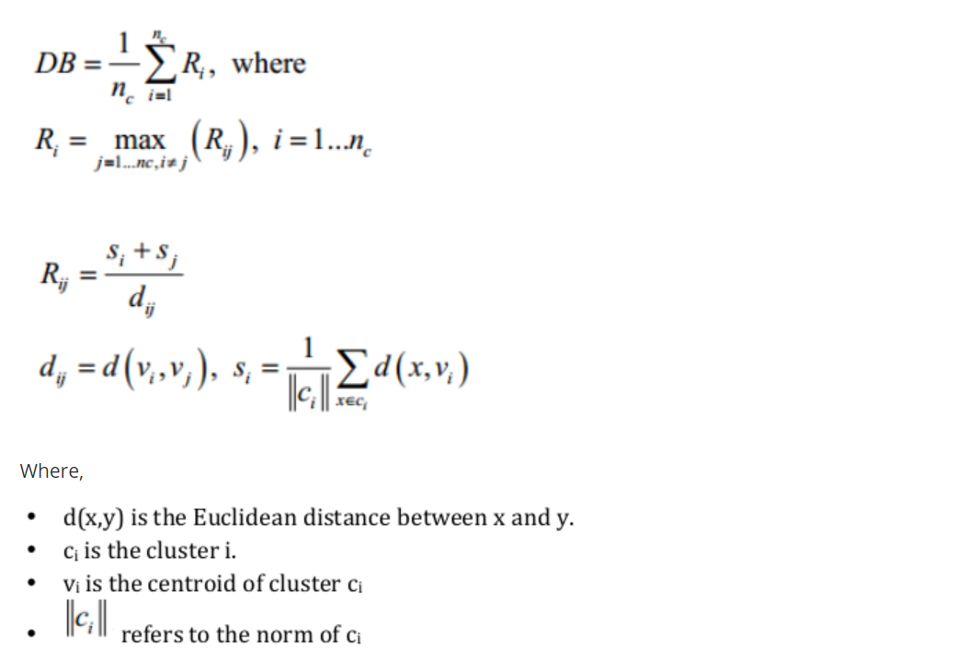
Davies-Bouldin’s Index (1979)
The best number of clusters nc would be the one with the lowest Davies-Bouldin’ index.

Slide 4
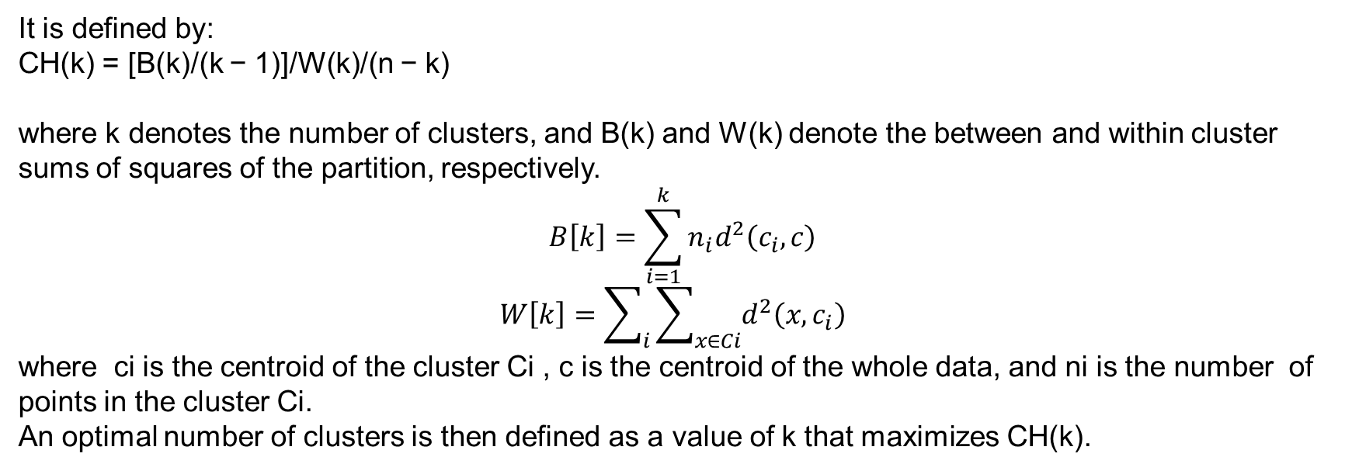
.
Calanski-Harabasz index (1974)
It is defined by:
CH(k) = [B(k)/(k − 1)]/W(k)/(n − k)
where k denotes the number of clusters, and B(k) and W(k) denote the between and within cluster sums of squares of the partition, respectively.
$$B\left[k\right]=\sum_{i=1}^{k}{n_{i}d^{2}\left(c_{i},c\right)}$$
$$W\left[k\right]=\sum_{i}{\sum_{x∈Ci}{d^{2}\left(x,c_{i}\right) }}$$
where ci is the centroid of the cluster Ci , c is the centroid of the whole data, and ni is the number of points in the cluster Ci. An optimal number of clusters is then defined as a value of k that maximizes CH(k).
.

Slide 5
Silhouette plots
Silhouette plots, (Rousseeuw 1987) could be used for:
Determining the number of clusters.
Evaluate how good the observations were assigned into the clusters.
The silhouette width if the i-th observation is defined by:
sil_{i} = (b_{i} - a_{i})/ max(a_{i}, b_{i})
Where, a_{i} is the average distance between i and all the other observations that belong to same cluster as i and b_{i} denotes the smallest average distance between i and the observations that belong to other clusters
.
The silhouette value goes from -1 to +1.

Slide 6
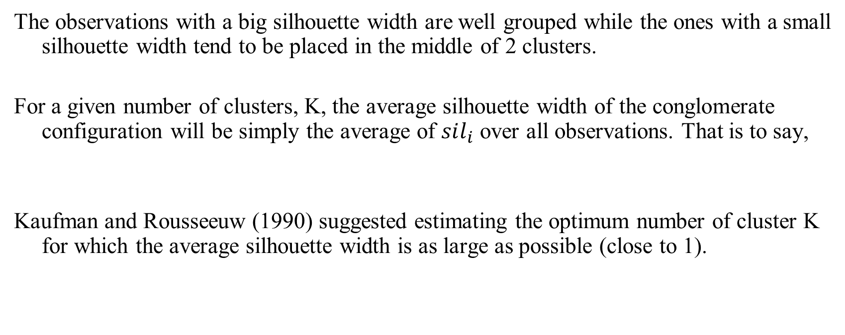
Silhouette plots (cont.)
The observations with a big silhouette width are well grouped while the ones with a small silhouette width tend to be placed in the middle of 2 clusters.
For a given number of clusters, K, the average silhouette width of the conglomerate configuration will be simply the average of $sil_{i}$ over all observations. That is to say,
Kaufman and Rousseeuw (1990) suggested estimating the optimum number of cluster K for which the average silhouette width is as large as possible (close to 1).

Slide 7
Computing Internal measures in Python
The module scikit-learn includes a submodule metrics that contains functions to compute Davies-Bouldin, Calinski-Harabasz, and Silhouette indexes.

Slide 8
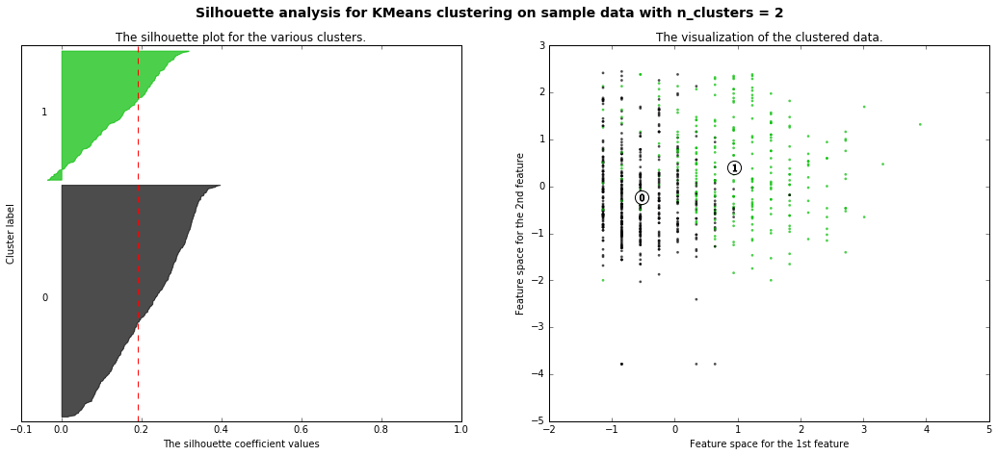
Silhouette plots for clustering Diabetes (k=2)
'For n_clusters =', 2, 'The average silhouette_score is :', 0.19214441257334328

Slide 9
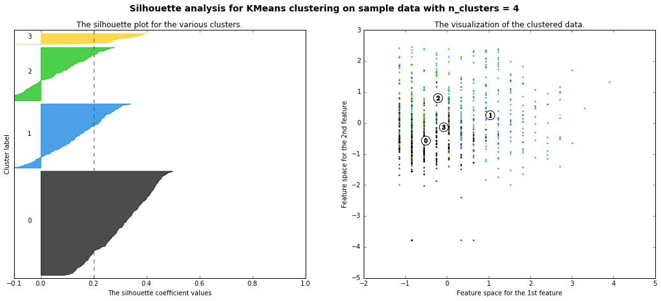
Silhouette plots for clustering Diabetes (k=4)
For n_clusters =', 4, 'The average silhouette_score is :', 0.20174890536020607

Slide 10
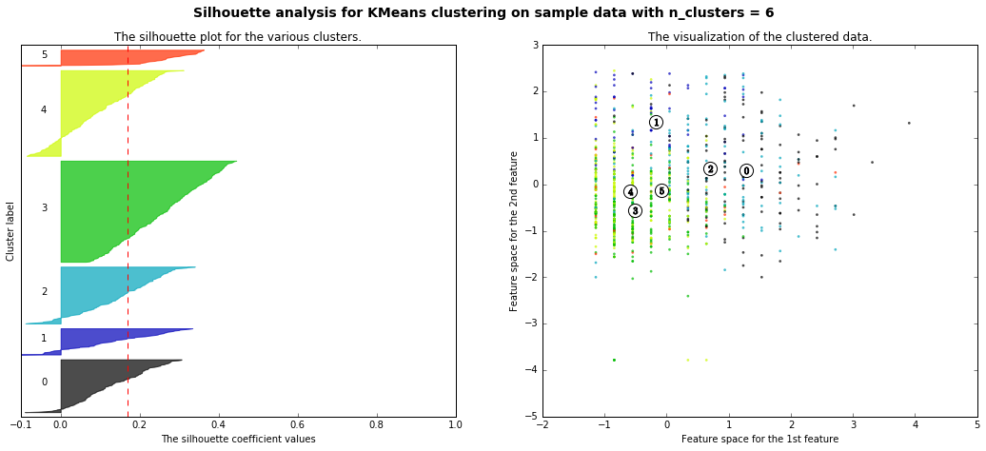
Silhouette plots for clustering Diabetes (k=6)
For n_clusters =', 6, 'The average silhouette_score is :', 0.16913445400402236

Slide 11
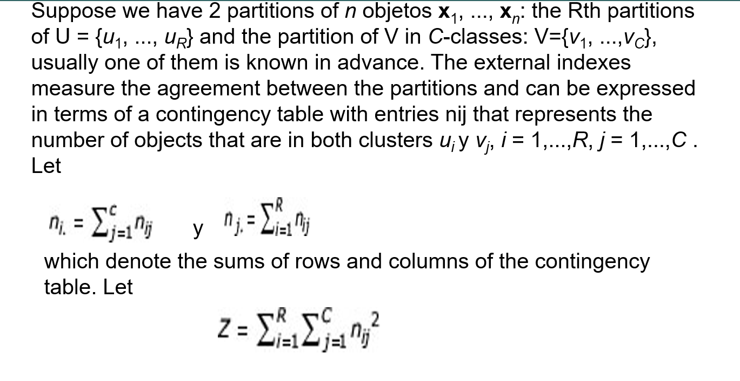
External measures

Slide 12
External Measures (cont)
Given the U and V partitions
a: number of pairs of objects that are in the same cluster in both U and V.
c: number of pairs of objects that are in the same cluster in V but not in U.
b: number of pairs of objects that are in the same cluster in U but not in V.
d: number of pairs of objects that are in different clusters in both U and V.
m₁=a+b = number of pairs of objects in the same cluster in U.
m₂=a+c = number of pairs of objects in the same cluster in V.

Slide 13
Example
a= 4, b =2, c=3, d=6, m₁=6, m₂=7, Z=16+4+9+36=65
1
4
5
1
4
5
2
2
3
6
3
6
U
V
Note that M=a+b+c+d=
=15

Slide 14
Rand(1971)
Jaccard
Fowlkes and Mallows
A Rand, Jaccard and FM value close to 1 indicates a good grouping.

Slide 15
Hubert’s and Arabie(1985) proposed an adjusted rand Index Γ.
Γ= (rand index-expected index)/(max index- expected index)

Slide 16
External measures in Python
The module scikit-learn includes a submodule metrics that contains functions to compute Adjusted Rank Index and Fowlkes-Mallows.

Slide 17
Other Measures
Purity
Entropy
Medida F
FOM=Figure of Merit (Yeung and Ruzzo,2001)
The Gap Statistics (Tibshirani,2000).
Clest (Dudoit & Fridlyand, 2002)

