Slide 1
Analytes classification using Machine Learning
Dr. Edgar Acuna
Summer Faculty Fellow at NRL
Created: August 3, 2021
Reviewed: June 9, 2023

Slide 2
Comparing the two synthetic Datasets
40 Analytes Dataset (2020)
55 Analytes Dataset (2021)
40 analytes to be classified
9 substrates
Each analyte-substrate combination contains 50 spectra with mass loadings from 5 to 50 µg/cm².
Added noise level: 0%, 0.1%, 0.25%, 0.5% and 1%. Approx. 3600 spectra for each level.
18,000 spectra with 1701 spectral points
Only 14 analytes appear in both datasets. Lactose is one of them.
55 Analytes to be classified
9 substrates
Each analyte-substrate combination contains 100 spectra with mass loadings from 1 to 100 µg/cm².
Added noise level: 0%, 0.1%, 0.25%, 0.5% and 1% . Approx. 9900 spectra for each level.
49,500 spectra with 1701 spectral points

Slide 3
Comparing the noise generated by Mass Loading in the two datasets
SNR(signal to Noise ratio)=mean/std. dev=1/CV
40 Analytes
55 Analytes
SNR for Mass Loadings goes from 1.86 (analyte #34) up to 2.51 ( analyte #21). High values of SNR implies less noise.
Mean of SNR for the 40 analytes
Is 2.13.
SNR for Mass Loadings goes from 1.55 (analyte #4) up to 2.13( analyte #21). Low values of SNR implies more noise.
Mean of SNR for the 55 analytes
Is 1.79.

Slide 4
Data preparation:
Substrate effect, Normalization,
Visualization
Main constraint: The substrates must be known
Training, of classifiers:
KNN, Logistic, 1D-CNN, MLP, CNN-LSTM,SVM, Transformers
Improving the performance of classifiers:
Validation of classifiers on new data, with similar distributional properties of the trained data

Slide 5
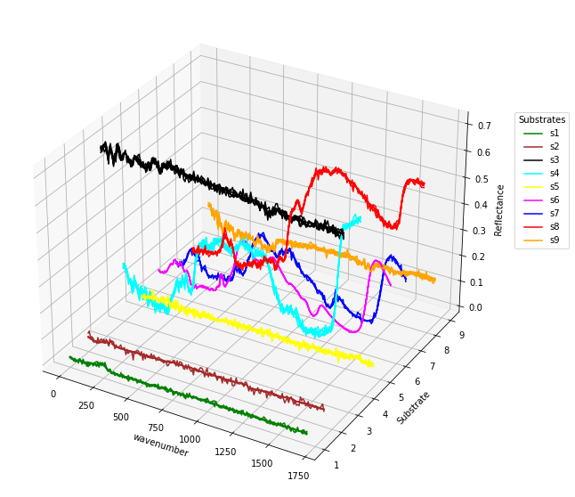
3D plot of 90 spectra.

Slide 6
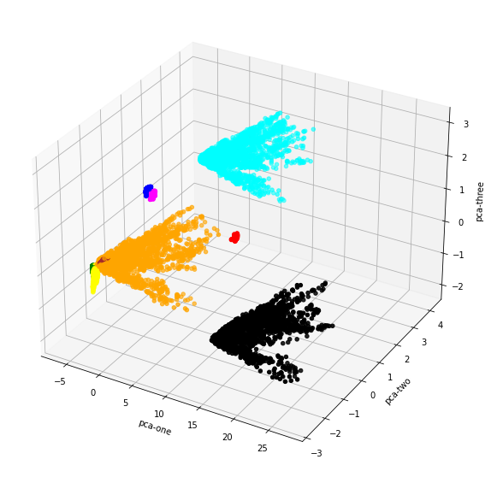
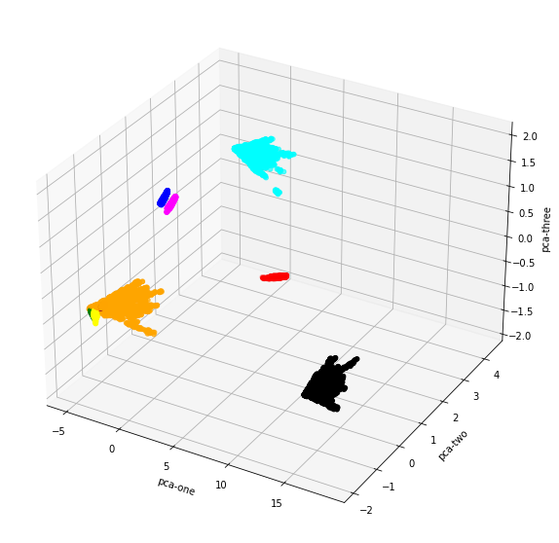
PCA visualization of the raw spectra in the nine substrates
40 Analytes
55 Analytes

Slide 7
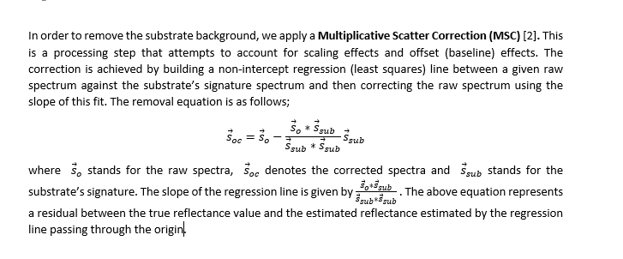
Data Preprocessing

Slide 8
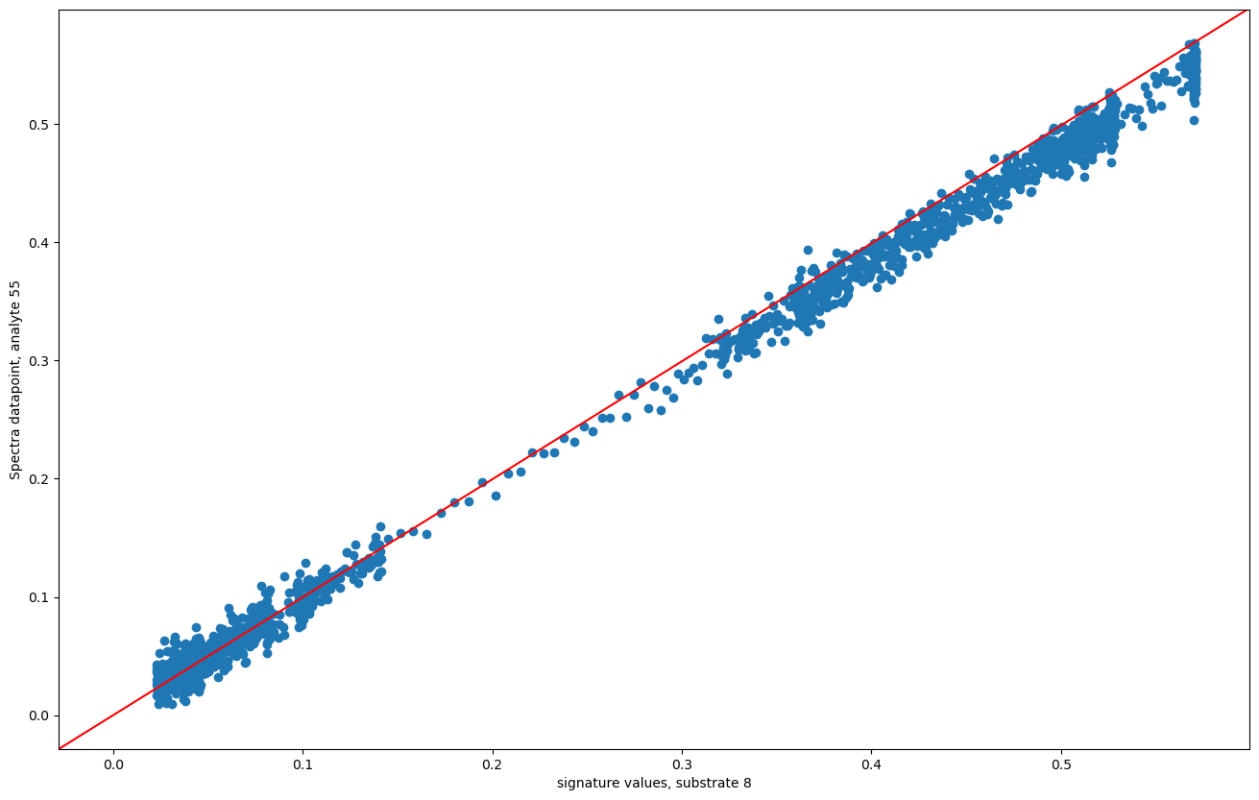

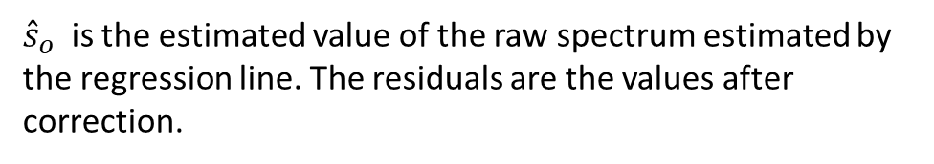
Visualization of the substrate correction
Residual=s_{o}-${\hat{s}}_{o}$
The values in the y-axis are the datapoints for a spectrum (s_{o}) corresponding to a sample of analyte 55.
The values in the x-axis are the datapoints for the signature of the substrate #8 where the chosen analyte lies on.
Regression Line passing through the origin.
${\hat{s}}_{o}$ is the estimated value of the raw spectrum estimated by the regression line. The residuals are the values after correction.

Slide 9
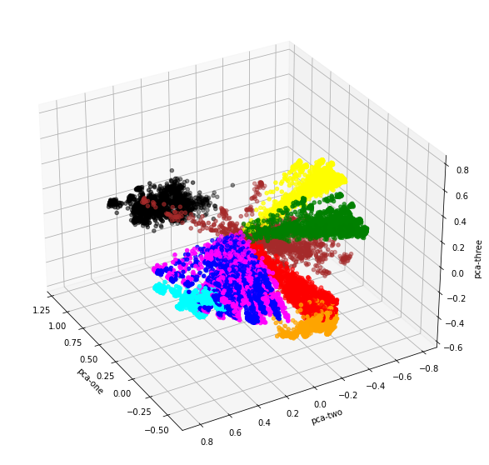
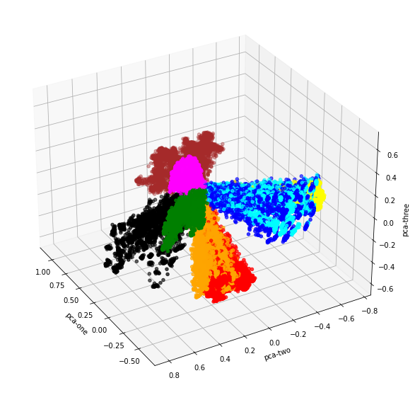
PCA visualization after removing the substrate background
40 analytes
55 analytes

Slide 10
PCA data visualization in 3D after centering and normalization, colored by substrate.

Slide 11
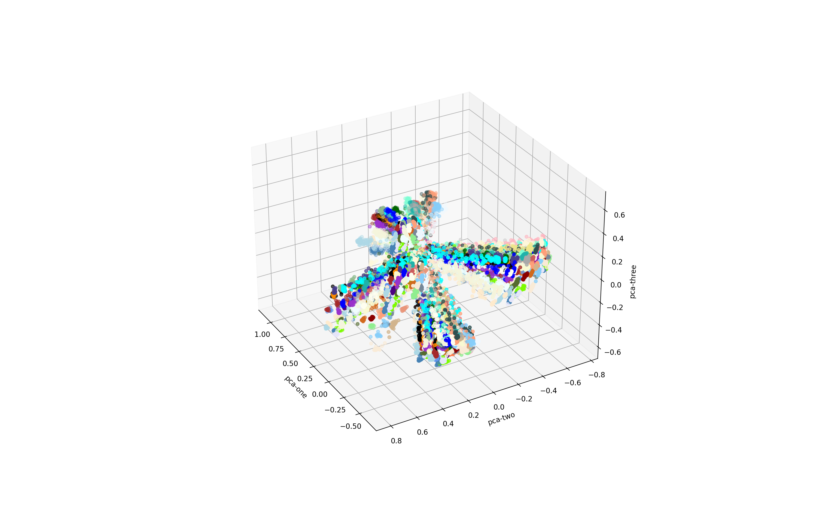
PCA data visualization in 3D after centering and normalization, colored by analyte.

Slide 12
Table 1. Accuracy for Multiclass classification (Testing set: 9,900 spectra)
Classifier | 40 analytes | 55 analytes | Training time in secs (55 Analytes)
Knn* | .9822 | .8696 | 20.4
Logistic Regression | .9636 | .8316 | 148.2
1D-CNN | .9677 | .8080 | 2420.1
MLP | .9553 | .7987 | 120.4
CNN-LSTM | .9447 | .7988 | 6375.0
SVM | .9277 | .7877 | 1285.4
^Optimal values of neighbors: k=9 for 40-analytes and k=13 for 55-analytes.
Using MLP to classify 55 analytes, it is found that 1,980 out of 9,900 spectra are incorrectly classified. Furthermore, when MLP is used the analyte #45 is classified incorrectly in 18 out 180 spectra, whereas the analyte #55 is incorrectly classified in 63 spectra out of 180.

Slide 13
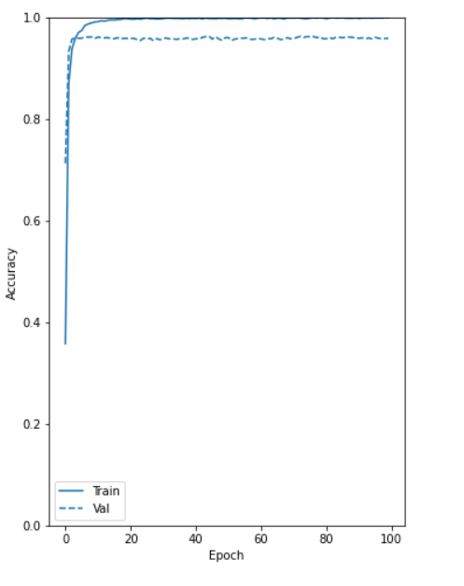
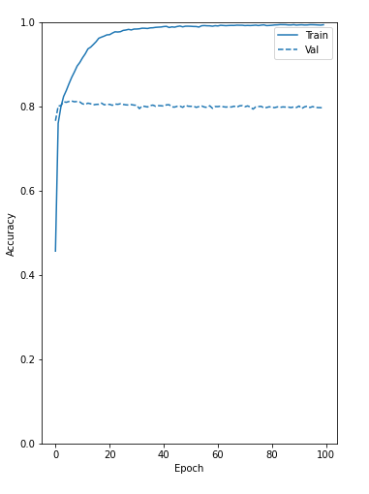
Learning curves for MLP
40 analytes
55 analytes
The algorithm learns fast

Slide 14
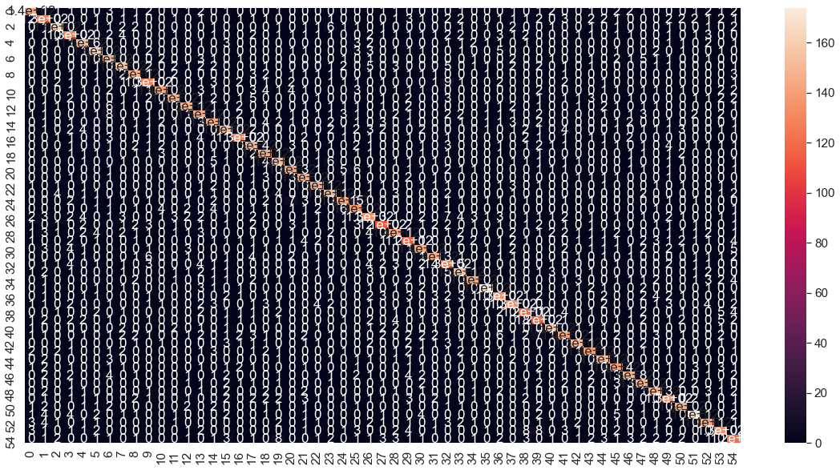
Confusion Matrix plot for MLP (55-analytes dataset)

Slide 15
Percentage of correct classification for each analyte (MLP)
[0.80446927 0.75 0.85051546 0.77011494 0.81420765 0.87301587
0.8255814 0.79591837 0.83333333 0.81595092 0.76216216 0.81420765
0.78918919 0.77202073 0.78142077 0.7628866 0.82911392 0.78835979
0.82954545 0.82162162 0.83707865 0.84848485 0.8045977 0.84916201
0.75935829 0.81325301 0.67164179 0.7133758 0.70408163 0.70731707
0.79781421 0.81111111 0.7816092 0.81052632 0.83146067 0.91282051
0.76136364 0.79190751 0.70731707 0.73913043 0.90449438 0.72222222
0.81111111 0.82386364 0.89940828 0.78531073 0.76142132 0.78453039
0.80446927 0.78947368 0.84659091 0.82524272 0.80662983 0.74175824
0.6519337 ]
Analytes with low correct classification rate: #55 (HMX), #27(Sodium chlorate) , #29 Guanidine nitrate ), #30 (RDX), #39 (lactose)

Slide 16
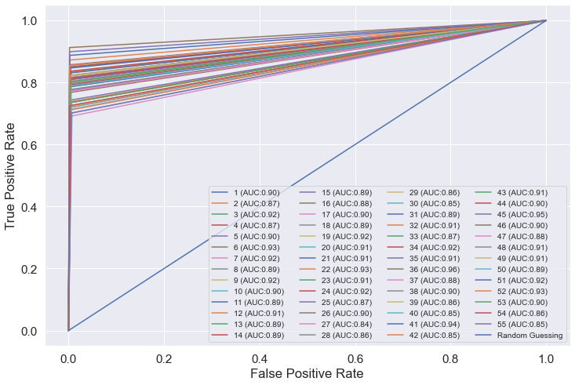
ROC curves for analytes classification using MLP

Slide 17
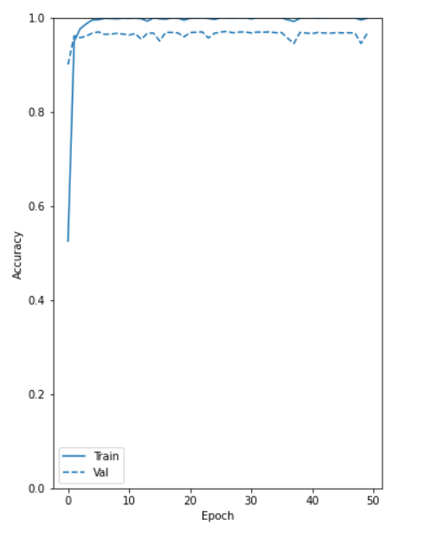
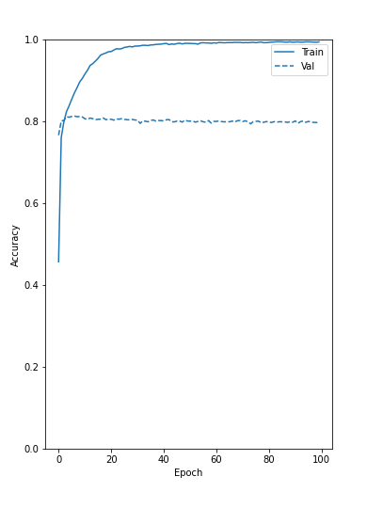
Learning curves for 1D-CNN
40 analytes
55 analytes

Slide 18
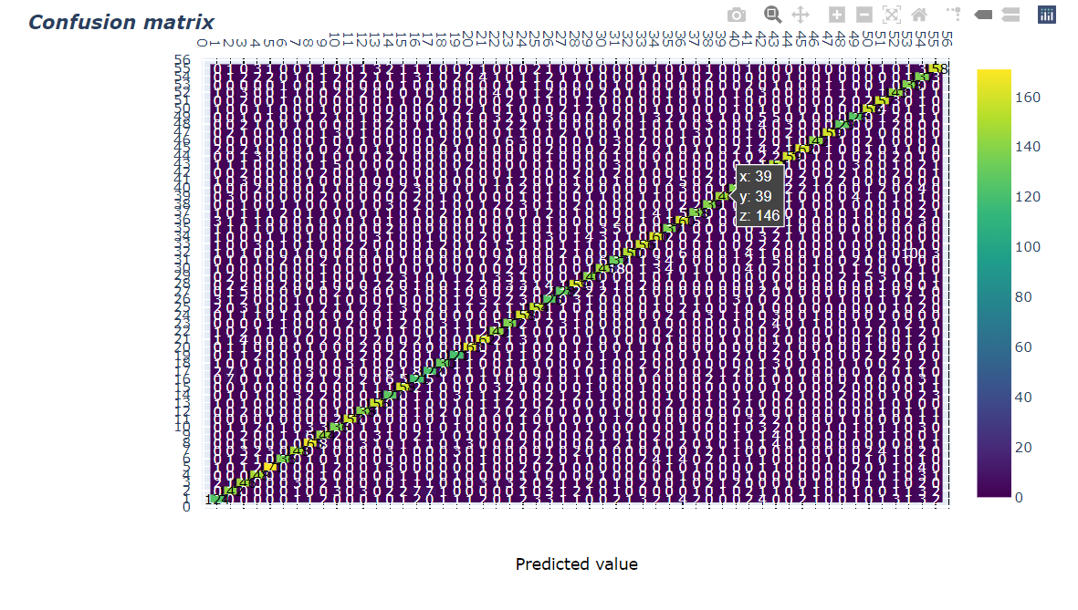
Confusion Matrix plot for 1D-CNN (using Plotly)

Slide 19
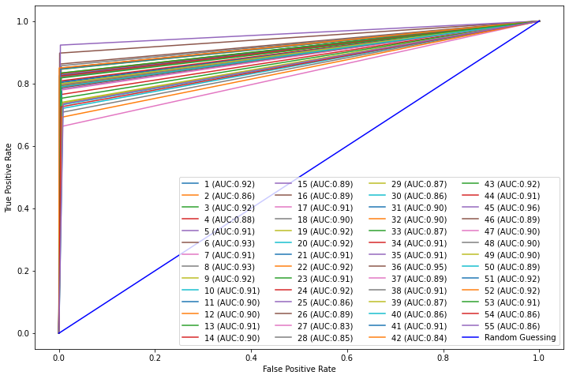
ROC curves for analytes classification using 1D-CNN

Slide 20
Percentage of correct classification for each analyte (1D-CNN)
[0.84042553 0.75690608 0.91390728 0.79444444 0.86263736 0.85245902
0.7283237 0.7962963 0.85483871 0.81142857 0.81818182 0.85945946
0.84831461 0.83428571 0.80681818 0.7752809 0.83908046 0.79428571
0.77094972 0.82051282 0.85625 0.79207921 0.82105263 0.81081081
0.75862069 0.74358974 0.76086957 0.81122449 0.76646707 0.73684211
0.78974359 0.86813187 0.74456522 0.83040936 0.80597015 0.89071038
0.76100629 0.8125 0.70930233 0.69942197 0.88268156 0.74269006
0.87640449 0.8625 0.83957219 0.79069767 0.76595745 0.80882353
0.80874317 0.8 0.855 0.90797546 0.76439791 0.7357513
0.67759563]
Analytes with low correct classification rate: #55 (HMX), #40 (sucralose), #39 (lactose).

Slide 21
Table 2. Percentage of Classification Probability exceeding a given threshold
Classifier | Threshold | Accuracy
 | 0.5 | 0.8 | 0.9
K-nn | 0.9056 | 0.8536 | 0.8329
1D-CNN | 0.9830 | 0.9049 | 0.8698
MLP* | 0.9674 | 0.8767 | 0.8531
CNN-LSTM | 0.8740 | 0.7947 | 0.7527
Logistic Regression | 0.5668 | 0.2854 | 0.1875
A classifier assigns an analyte j* to a spectrum s*, such that
j*=argmax_{i=1,…,55}P(label i/s*)
An entry in Table 2 represents the percentage of spectra that are assigned to a given analyte with a probability greater than a given threshold.
For instance, 98.03% spectra are assigned by the 1D-CNN to an analyte con probability greater than .5.
This table suggests that classification performed by deep learning algorithms are less risky.

Slide 22
Ways to improve the analytes classification
We have tried the following approaches:
Removing analytes that are difficult to classify
PCA
Data Augmentation
Shuffling
Use other algorithms: Transformers (better than RNN and LSTM).
Zenghui Wang, Jun Zhang, Xiaochu Zhang, Peng Chen, Bing Wang
Transformer Model for Functional Near-Infrared Spectroscopy Classification. IEEE Journal of Biomedical and Health Informatics ( Volume: 26, Issue: 6, June 2022)
D. Hong et al., "SpectralFormer: Rethinking Hyperspectral Image Classification With Transformers," in IEEE Transactions on Geoscience and Remote Sensing, vol. 60, pp. 1-15, 2022, Art no. 5518615, doi: 10.1109/TGRS.2021.3130716.

Slide 23
Identifying the analytes that are difficult to classify
F1-score = 2 * (PRE * REC) / (PRE + REC)
where PRE=Precision=TP/(TP+FP) and REC=Recall=TP/(TP+FN).
A high value for F1-score means that you have low false positives and low false negatives.The optimal value of the F1-Score is 1.
According to the average F1-score with six classifiers, we have identified these analytes as the most difficult to classify correctly.
#55: 0.590 (HMX)
#40: 0.673 (Sucralose)
#30: 0.695 (RDX)
#27: 0.711 (Sodium chlorate)
------------------------
#39: 0.727 (Lactose)
#2: 0.745
#4: 0.747

Slide 24
Table 3. Metrics for classification of 55 analytes after removing the top four analytes that are most difficult to classify
Classifier | Before | After
Knn * | .8696 | .8852
Logistic Regression | .8316 | .8513
CNN | .8080 | .8119
MLP | .8010 | .8198
SVM | .7877 | .8156
CNN-LSTM | .7988 | .7991
We can see only a small improvement
*k=13

Slide 25
Table 4. Comparing both datasets by the Cumulative explained variation of their PCAs
40 Analytes 55 Analytes
10Pcs 66.03% 47.82%
20Pcs 70.52% 50.84%
30 Pcs 71.94% 52.09%
50 Pcs 73.07% 53.40%
100 Pcs 77.77% 55.47%
Robust PCA: PCA resistant to outliers

Slide 26
Table 4. Accuracy of the Multiclass classification based on 50 PCs
Classifier | Accuracy
 | 40 -analytes | 55 analytes
K-nn | 0.9400 | 0.7920
Logistic Regression | 0.9647 | 0.8139
CNN | 0.9572 | 0.8204
MLP* | 0.9469 | 0.8097
SVM | 0.9322 | 0.8370
CNN-LSTM | 0.9529 | 0.8174

Slide 27
Data augmentation using Autoencoders
Autoencoders are feed Forward Neural Network models for unsupervised tasks (No Labels).
Applies backpropagation, setting the target values to be equal to the inputs.

Slide 28
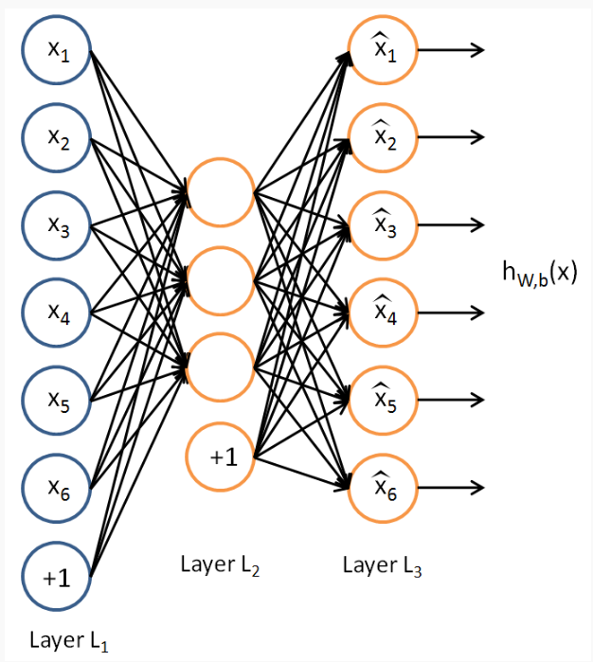
Example of autoencoder

Slide 29
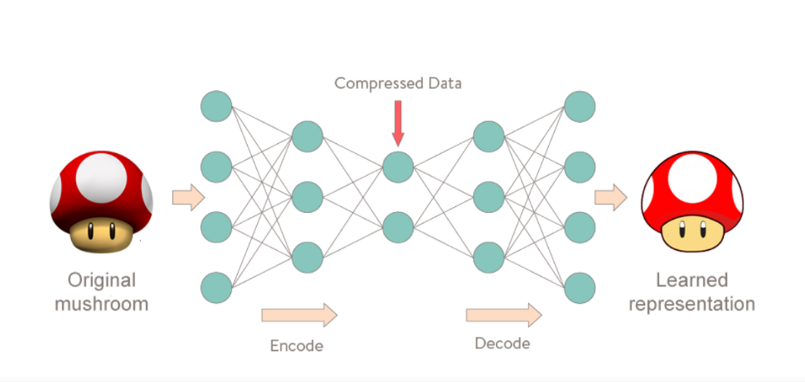
Autoencoder with 5 layers
256 units
1,700 spectral points
1,700 spectral points
128 units

Slide 30

The autoencoder model tries to minimize the reconstruction error (RE), which is the mean squared distance between input and output.
Reconstruction Error

Slide 31
The model will train on the original dataset by minimizing the RE. It is expected that the RE to be relatively high when it is tested on a new abnormal datapoint (outlier)
However, one needs to do tuning on the RE’s threshold to detect outliers

Slide 32
Table 5. Effect of data augmentation on the classifier accuracy
Classifier | Original Data | Original Data + Reconstructed Data | Running Time
Knn* | 0.8696 | 0.8534 | 72.9
CNN | 0.8080 | 0.7957 | 5138.6
MLP | 0.8010 | 0.7877 | 488.1
Logistic Regression | 0.8316 | 0.7910 | 3562.7
SVM | 0.7877 | 0.7973 | 5661.0
CNN-LSTM | 0.7988 | 0.7978 | 13000
The augmented dataset has 2*49,500=99,000 instances.
We have used an autoencoder network with three encoder layers y three decoder layers
A new version called Variational Autoencoder also can be considered

Slide 33
Effect of “Mass Loadings” and “Added noise percent” in the classification task

Slide 34
Table 6. Effect of Mass Loadings on the accuracy of the classifiers
Classifier | Amount of Mass Loading
 | No Filtering | mass>5 | mass>20 | Mass>30 | mass>50
K-nn | 0.8696 | 0.8871 | 0.9248 | 0.9396 | 0.9628
Logistic Regression | 0.8316 | 0.8468 | 0.8883 | 0.9064 | 0.9334
CNN | 0.8080 | 0.8073 | 0.8598 | 0.8919 | 0.9252
MLP* | 0.8010 | 0.8176 | 0.8572 | 0.8825 | 0.9107
CNN-LSTM | 0.7988 | 0.8067 | 0.8358 | 0.8502 | 0.8817
SVM | 0.7877 | 0.8024 | 0.8335 | 0.8559 | 0.8750
Filtering | Number of spectra | SNR
None | 49,500 | 1.79
mass>5 | 47,350 | 1.95
mass>20 | 40,150 | 2.65
mass>30 | 35,330 | 3.26
mass>50 | 25,320 | 5.19

Slide 35
Table 7. Effect of Mass Loading on the accuracy of the classifiers (increasing ordering)
Classifier | Amount of Mass Loading
 | No Filtering | Mass<5 | Mass<10 | Mass<30 | Mass<50
K-nn | 0.8696 | 0.3864 | 0.4651 | 0.6690 | 0.7568
Logistic Regression | 0.8316 | 0.2209 | 0.3144 | 0.5959 | 0.7053
CNN | 0.8080 | 0.3488 | 0.4181 | 0.5726 | 0.6625
MLP* | 0.8010 | 0.3372 | 0.3864 | 0.5783 | 0.6701
SVM | 0.7877 | 0.1907 | 0.2696 | 0.5420 | 0.6459
CNN-LSTM | 0.7915 | 0.2628 | 0.3057 | 0.5572 | 0.6427
Filtering | Number of spectra | SNR
None | 49,500 | 1.79
<5 | 2,150 | *
<10 | 4,580 | 2.36
<30 | 14,170 | 1.83
<50 | 24,180 | 1.80

Slide 36
Table 8. Effect of the added noise percent on the accuracy of the classifiers
Classifier |  | Noise Level
 | No Filtering | NoisePerc<5 | NoisePerc>=5
K-nn | 0.8696 | 0.9620 | 0.4230
CNN | 0.8080 | 0.9342 | 0.5682
MLP* | 0.8010 | 0.9298 | 0.5612
SVM | 0.7877 | 0.9028 | 0.5375
Logistic Regression | 0.8316 | 0.9430 | 0.5915
CNN-LSTM | 0.7915 | 0.9051 | 0.5545
Filtering | Number of spectra
None | 49,500
NPc<5 | 29,501
NPc>=.5 | 19,999

Slide 37
Using the 40-analytes dataset as the testing dataset
The procedure used was the following:
1-The 55-analytes dataset is filtered to consider only spectra with mass loading between 5 and 50 µg/cm². The number of spectra is reduced from 49,500 to 22,030. After that the substrate’s effect is removed and data normalization is applied.
2-A classifier is trained using the filtered dataset obtained in step 1. The accuracy’s results in the testing dataset randomly generated from the whole data are in the 70’s%.
3-Since only 14 analytes from the 40-analytes dataset appear in the 55-analytes dataset, it is necessary to filter the latter considering only those analytes. Furthermore, the corresponding labels of these analytes are mapped to the 55-analytes dataset labels.
4- For some of the fourteen analytes the classifiers reach more than 90 percent of accuracy and some (for example: #33, #39) reach very low accuracy. Both results are inconsistent.

