Slide 1
Machine Algorithms for analytes classification
Edgar Acuna
Mathemaical Sciences Department
University of Puerto Rico-Mayaguez
Github.com/eacunafer

Slide 2
Summary
In this work, we have applied five algorithms to classify 40 analytes placed into 9 substrates. The simulated data consists of 18,000 spectra taken at 1701 points. Two of these algorithms are coming from the statistical field; k-nn and Logistic regression. The Support Vector Machine classifier is from the Machine Learning area whereas Multiplayer Perceptron (MLP) and Convolutional Neural Networks are considered Deep Learning Algorithms. Our experimental results lead us to the conclusion that in the multiclass classification k-nn as well as CNN have the best metrics. After PCA all the classifiers had similar performance in both accuracy and F1-score. The CNN algorithm has a very good performance when one given analyte needs to be classified (binary classification). Its main disadvantage is that it has long running time. But this can be decreased by reducing the dimensionality through PCA.

Slide 3
I-Data Preparation

Slide 4
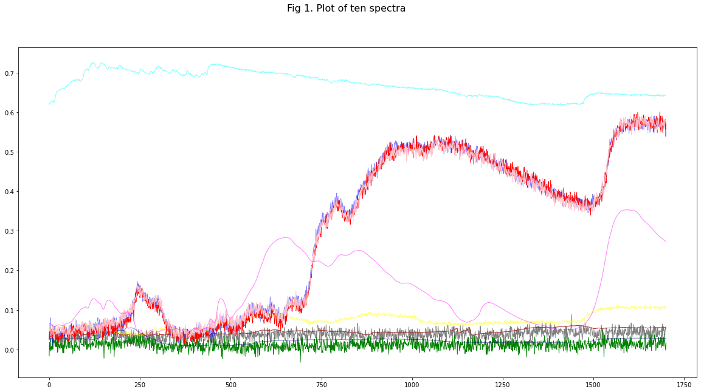

Slide 5
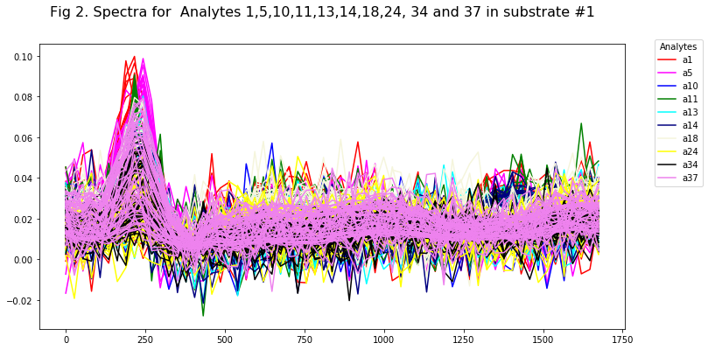

Slide 6
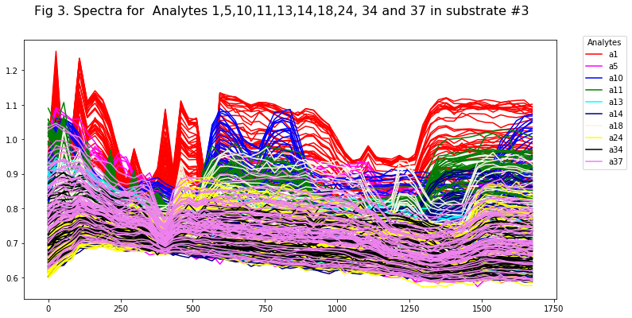

Slide 7
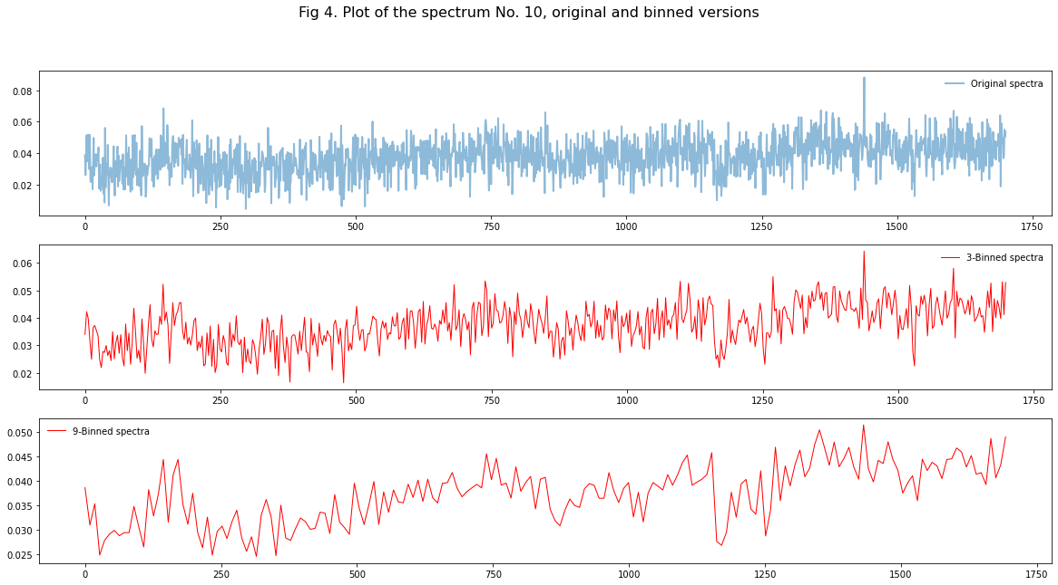

Slide 8
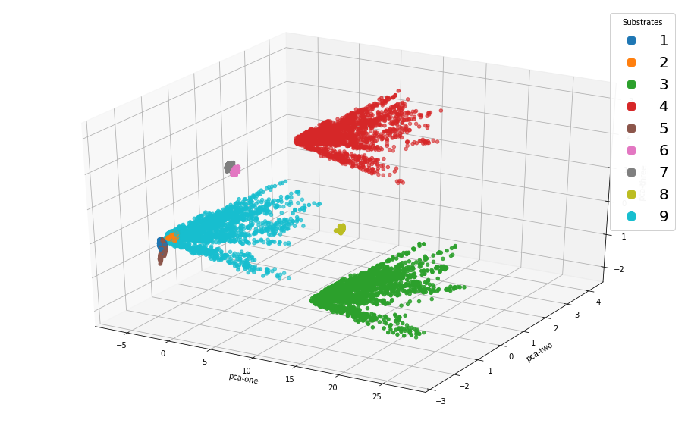
Fig 5. Principal Components 3D visualization of the raw data, colored by Substrate

Slide 9
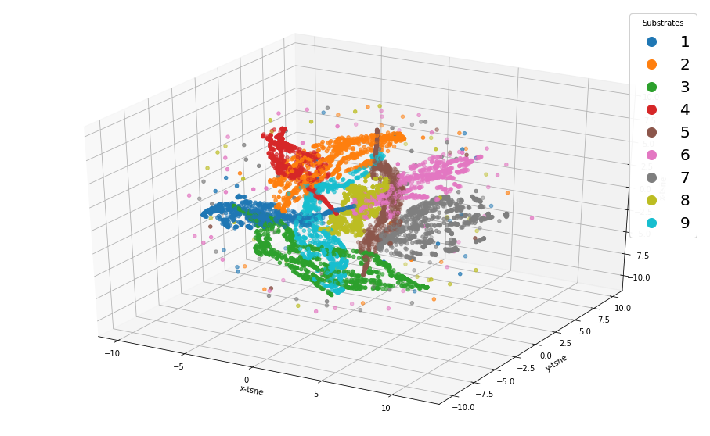
Fig 6. t- distributed Stochastic Neighbor Embedding (t-SNE) 3D visualization of the raw data, colored by substrate

Slide 10
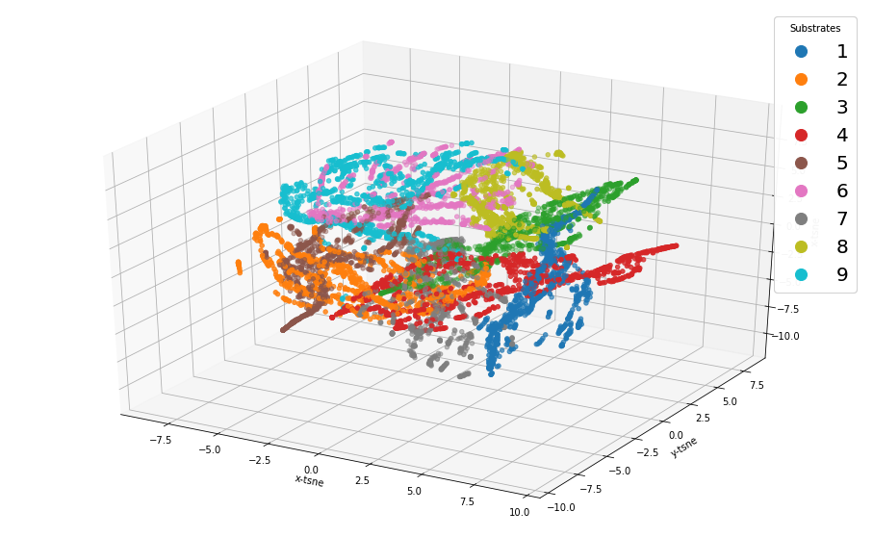
Fig 7. t- distributed Stochastic Neighbor Embedding (t-SNE) 3D visualization of 100 PCs

Slide 11
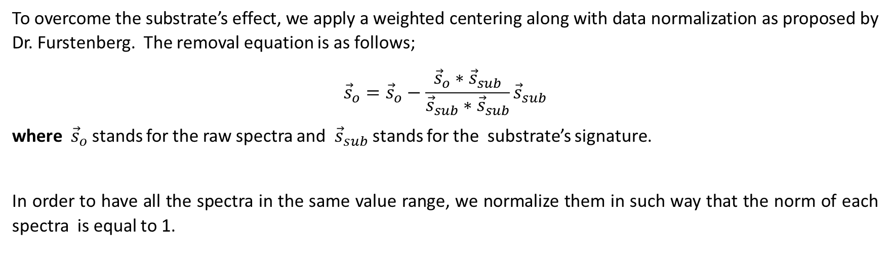
Data Preprocessing
To overcome the substrate’s effect, we apply a weighted centering along with data normalization as proposed by Dr. Furstenberg. The removal equation is as follows;
$${\vec{s}}_{o}={\vec{s}}_{o}−\frac{{\vec{s}}_{o}{∗\vec{s}}_{sub}}{{\vec{s}}_{sub}{∗\vec{s}}_{sub}}{\vec{s}}_{sub}$$
where ${\vec{s}}_{o}$ stands for the raw spectra and ${\vec{s}}_{sub}$ stands for the substrate’s signature.
In order to have all the spectra in the same value range, we normalize them in such way that the norm of each spectra is equal to 1.

Slide 12
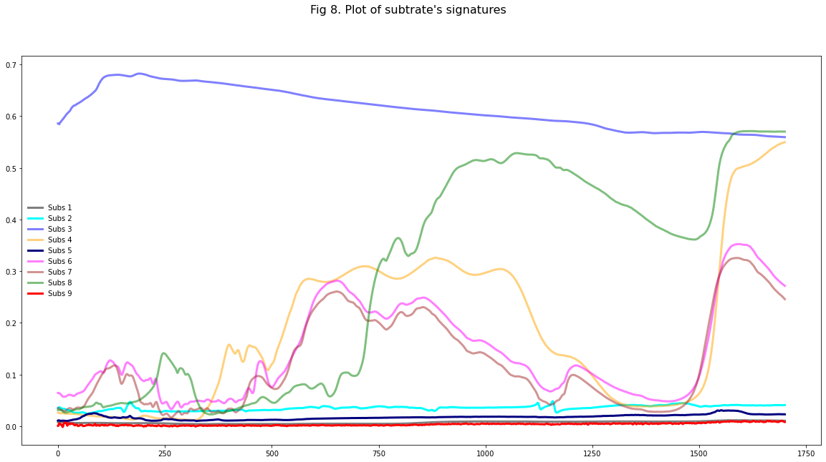

Slide 13
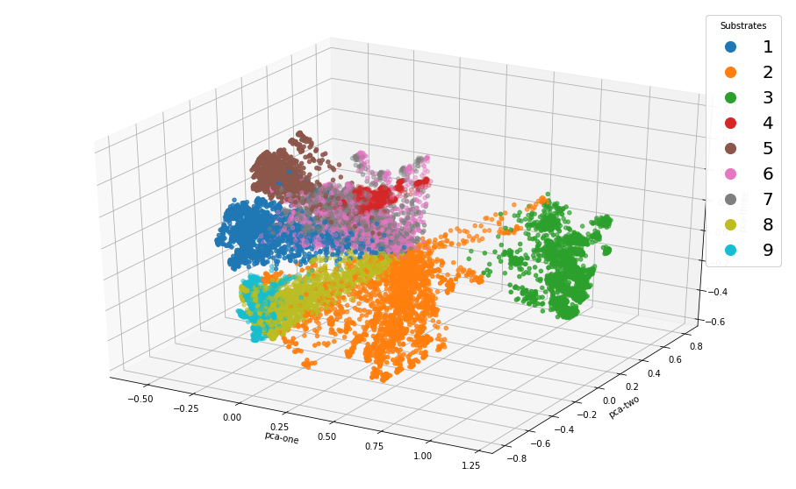
Fig 9. Principal Components data visualization in 3D after centering and normalization colored by Substrate

Slide 14
Hardware and software specifications
Dell Lattitude with 32 GB of RAM and 12 processors intel i7
Python 3.8.8
Scikit-learn 0.24.1
Keras 2.4.3
Tensorflow 2.3.0

Slide 15
2. Analytes Classification

Slide 16
K-nearest neighbors
In this case, the classification of an instance x is carried out as it follows:
i) Find the k instances in the training dataset that are closer in distance (Euclidean distance is the most used) to the instance x, k usually is and odd number: 1, 3 etc. to avoid ties.
ii) If the majority of these k instances belong to class C_{i}, then instance x is assigned to that class.
In case of a neighbors’s tie, the class is assigned randomly (or by ordering)
In this study, we have used k=9 for multiclass classification and k=3 for the binary classification.
The time complexity of the algorithm is O(ndk), where n=number of instances, d=dimension and k=number of neighbors.

Slide 17
Multilayer Perceptron MLP
In this work, we have applied a sequential model MLP which is a linear stack of layer. This is a deep learning algorithm which is an extension of the basic neural network. The MLP’s architecture used in this work consists of:
a) An input layer containing units equal to the number of predictors (i.e. 1,701 units).
b) A Dropout layer, where a fraction of inputs is set up to zero in an effort to reduce overfitting. A .30 dropout was applied to the input layer meaning that in each epoch a 30% of features was discarded at random from the parameter estimation.
c) Two Dense connected layers. In the multiclass classification task, the first layer has 300 neurons and the second layer has100 neurons.
d) Epochs: is the number of times that the model is exposed to the training dataset. In this work we have used 100 epochs.
e) Batch Size: is the number of training instances shown to the model before a weight update is performed. A batch size of size 150 was used in this work.

Slide 18
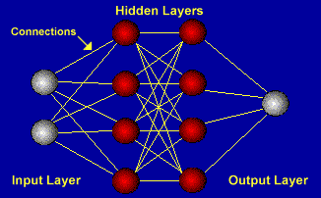
300 neurons
100 neurons
40 Analytes
1,701 features

Slide 19
Convolutional Neural networks (CNN)
There are plenty of CNN architectures: LeNet, AlexNet, GoogleNet[4]. Here, we have used a sequential model for CNN. The first layer considered was a one-dimensional convolutional layer, Conv1D. 1D convolutional layers are efficient for analyzing time series data as well spectral data. In this work, since each row of the data frame is converted in a vector of shape (1701,1), this is going to be the input shape parameter of the Conv1D layer. Then, we added Dense, MaxPooling1D, and Flatten layers into the model. The output layer contains the number of output classes, 40, and the 'softmax' activation function. As in the MLP algorithm, we used 100 epochs. The batch size used was 64.

Slide 20
Non-linear Support vector Machine (SVM)
The classification is based on the instances closest to the boundary (hyperplane) between classes. These instances are called support vectors. The goal is to maximize the Margin, which is the distance between support vectors belonging to opposite classes .
The general Idea is the original feature space can always be mapped to some higher-dimensional feature space where the training set is separable, using a function called the Kernel. In our study, we have used a Gaussian kernel ( also called Radial basis Function).
SVMs are inherently two-class classifiers. The traditional way to do multiclass classification with SVMs is to build C one-versus-rest classifiers (commonly referred to as ``one-versus-rest' or OVR classification), and to choose the class which classifies the test datum with greatest margin.
The time complexity of the SVM is given by O(n²).

Slide 21
Logistic Regression
For binary classification in class C₁=1 and class C₂=0, It is assumed that the ratio of distribution of the predictors in each of the classes holds this condition,
where x is a p-dimensional vector of predictor variables, α is a constant and β is a vector of p parameters. The estimation of the parameters is done iteratively. In here, we have used the Newton-conjugate gradient method with 10,000 iterations.
Let p=P(Y=1/x) be the posterior probability that an instance with observed measurements x belong to class Y=1. The classification is based on the estimated value of p.
When there are K classes then the odds ratios are taken with respect to one class, say the last class.

Slide 22
Table 1. Metrics for Multiclass classification
Classifier | F1-score | Accuracy | Running time(secs)
Knn (k=9)* | .9822 | .9822 | 3.7
CNN | .9634 | .9633 | 377
MLP | .9503 | .9502 | 331.6
SVM | .9370 | .9277 | 207
Logistic Regression | .9644 | .9636 | 7.8
F1 = 2 * (PRE * REC) / (PRE + REC)
PRE = TP / (TP + FP)
REC = TP / (TP + FN)
A validation set of 20 percent was used for MLP and CNN. This fact decreases the training size from 18,000 to 11,520 instances, since 3,600 (20 percent) are already in the test dataset and from the remaining 14,400 instances 2880 are assigned to the validation set.
*k=9 gives the highest accuracy on the test set, k was varied from 1 up to 40.

Slide 23
Table 2. Metrics for Multiclass classification after PCA
Classifier | F1-score |  | Accuracy |  | Running time(secs)
 | 30 PCs | 50 PCS | 30 Pcs | 50 PCs | 30 PCs | 50 PCs
K-nn | 0.9484 | 0.9405 | 0.9480 | 0.9400 | 0.36 | 1.39
CNN | 0.9588 | 0.9562 | 0.9588 | 0.9572 | 11.43 | 15.14
MLP* | 0.9492 | 0.9494 | 0.9492 | 0.9491 | 403.8 | 223.01
SVM | 0.9557 | 0.9343 | 0.9552 | 0.9322 | 6.52 | 8.86
Logistic Regression | 0.9530 | 0.9654 | 0.9525 | 0.9647 | 2.50 | 2.10
*MLP with two layers each of them having 30 neurons

Slide 24
Classifiers to be added
LSTM: Long short-term memory
CNN-LSTM
Functional data analysis (??)

