Slide 1
AI SPACE
Weekly Intelligence Report
Week of Jun 29 - Jul 05, 2026
Generated June 29, 2026 · @eitanadar.ai · AI & Automation Intelligence

Slide 2
Executive Summary
Top insights from the AI & automation space — week of Jun 29 - Jul 05, 2026
1
The market is clearly segmenting: 'agentic AI' is the new power term replacing 'generative AI' — creators who use this framing are pulling more technical, higher-intent audiences
2
Claude Code is the dominant tool being featured this week across builders, designers, and automation creators — positioning around it is still wide open in the real estate niche
3
Income-specific hooks massively outperform generic AI content — exact numbers ($90K, $0 cost, 30 days) drive clicks and watch time
4
WhatsApp automation is exploding as a business use case, especially for sales workflows — real estate is an obvious fit and underserved in this content space
5
Agent infrastructure (how to run agents reliably at scale) is becoming its own content category, signaling the audience is maturing past 'what is AI' into 'how do I actually deploy this'

Slide 3
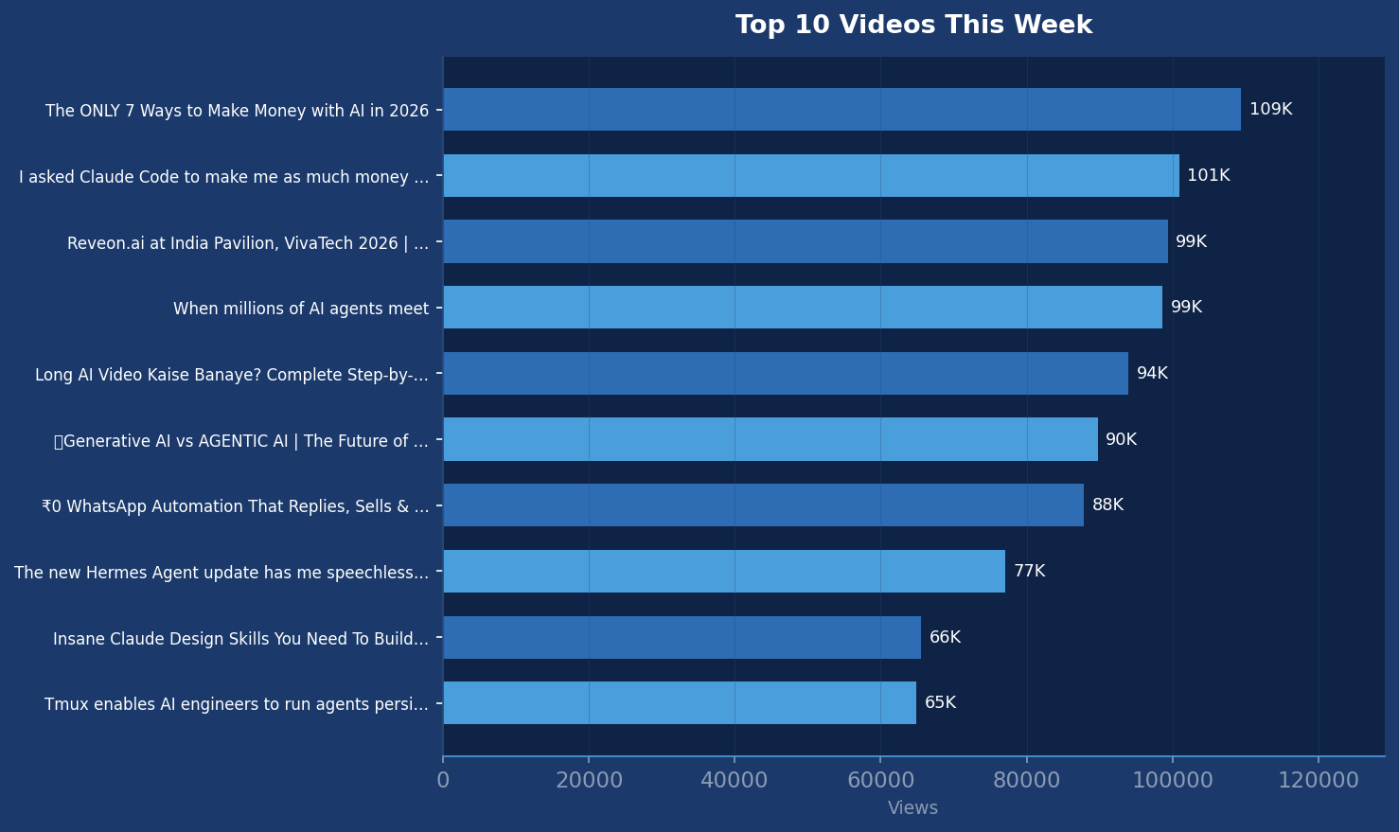
Top 10 Videos This Week
Ranked by view count — past 7 days

Slide 4
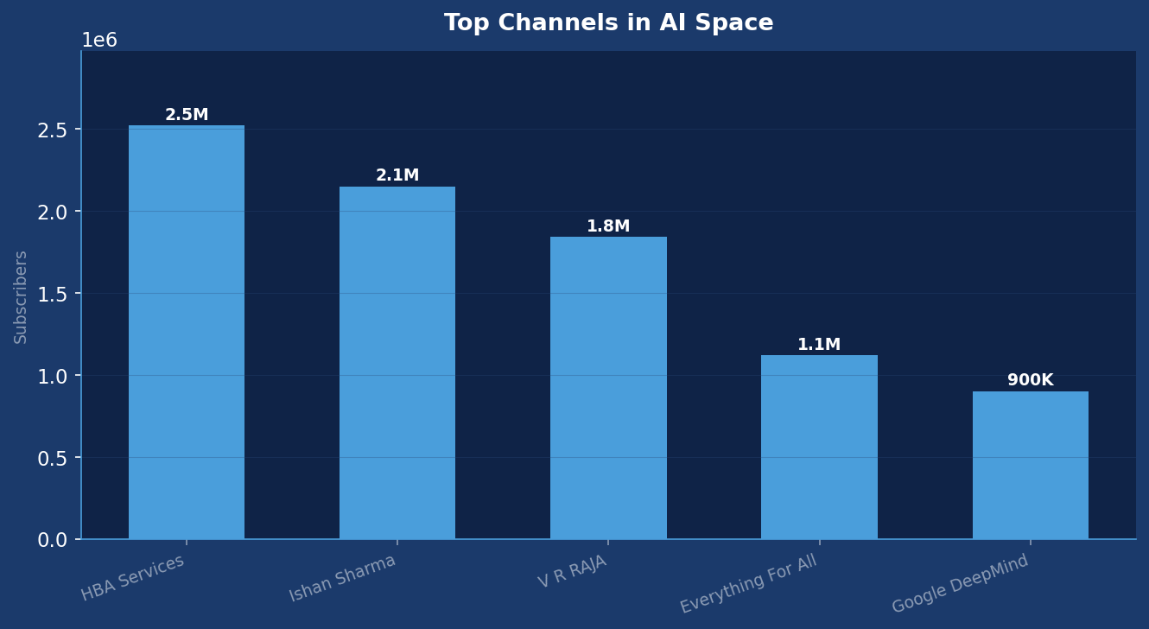
Top Channels in the AI Space
Ranked by subscriber count

Slide 5
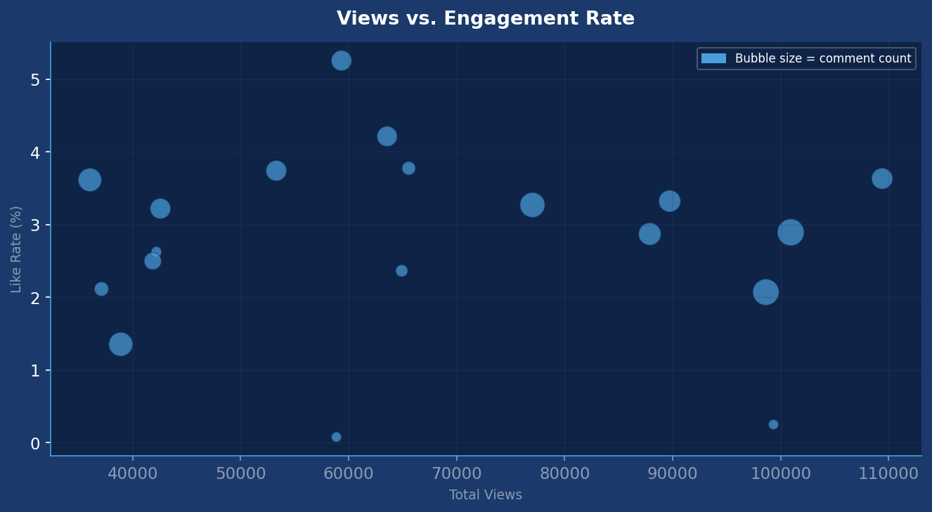
Engagement Analysis
Views vs. like rate — bubble size = comment volume
High-right = high views + high engagement. Ideal quadrant for content inspiration.

Slide 6
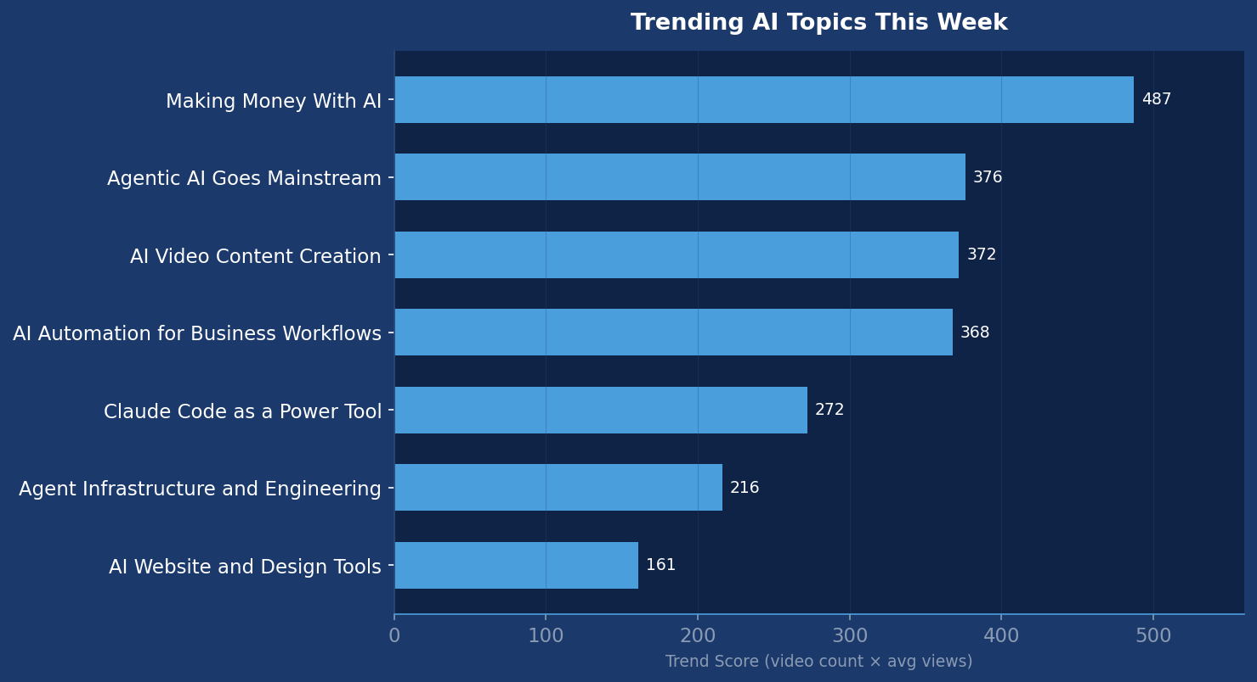
Trending Topics
Trend score = video count × avg views (thousands)

Slide 7
Posting Patterns
Title hooks and content formats driving clicks this week
Exact dollar amounts in the title ('$90K', '$0 cost') paired with 'steal it' or 'copy this' CTAs — signals free, actionable value
Challenge/experiment framing: 'I let an AI agent run X for 30 days' or 'I asked Claude to make me as much money as possible' — builds narrative tension and curiosity
Warning/urgency pattern: 'The ONLY 7 ways', 'Anthropic just replaced', 'YouTube's big crackdown' — creates FOMO around missing a shift
Skill-to-income pipeline: 'Fresh grad makes $90K with these AI skills' — aspirational outcome with a clear implied path the viewer can follow

Slide 8
Content Recommendations
For @eitanadar.ai — based on gaps and trending themes this week
→
'The WhatsApp Automation Real Estate Agents Are Using to Follow Up 24/7 (Steal This)' — show a full n8n or Make scenario that handles new lead intake, follow-up sequences, and appointment booking via WhatsApp, framed specifically for real estate
→
'I Asked Claude Code to Build Me a Real Estate Lead Machine — Here's What Happened' — document an experiment where you use Claude Code to build a functional lead capture or CRM tool from scratch, riding the Claude Code wave with a real estate-specific spin
→
'The Only 5 AI Automations Real Estate Agents Actually Need in 2026' — mirror the '7 ways to make money with AI' format but niche it down hard; cover lead follow-up, listing descriptions, comp reports, appointment scheduling, and client nurture
→
'How I Built a Full AI Team for My Real Estate Business (and Fired the VA)' — mirror the 'full AI content creation team' format but apply it to real estate ops: prospecting, follow-up, content, admin — one agent per function, zero human overhead

Slide 9
Thank You
Stay curious. Stay ahead.
This report analysed 10 videos · 7 themes identified · 5 channels tracked
Watch next week:
Hermes Agent adoption — if Alex Finn's video sparks a wave of tutorials, this model may challenge Claude Code's builder mindshare and is worth covering early · YouTube AI video policy enforcement — the Hindi-language creator coverage suggests a policy update is either live or imminent; if it affects AI-generated content at scale it will hit automation creators hard · Multi-agent orchestration frameworks — the 'millions of agents' and 'stop prompting one task at a time' signals suggest orchestration tools (CrewAI, LangGraph, Claude multi-agent) are about to get a content wave
Generated June 29, 2026 · @eitanadar.ai · Adar Realty Studio AI Intelligence

