Slide 1
A Demo of Cloud Analytics

Slide 2
What's in the talk
(Brief) analytics overview
Why cloud? Trade-offs.
Managed clusters – AWS EMR demo
SQL style batch queries – Google Big Query demo
Google DataFlow demo

Slide 3
What do we mean by analytics?
"The systematic computational analysis of data or statistics"
"The discovery, interpretation, and communication of meaningful patterns in data"

Slide 4


Big Data
Distributed computing power

Slide 5
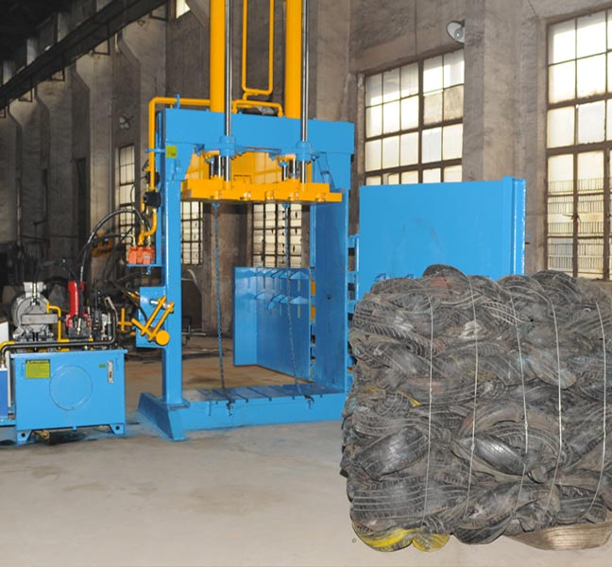

Batch
Streaming
Notes:
Batch
* Run on bulk data – persisted somewhere
* High latency
* Use cases – aggregation (eg sales data), transformation
Streaming
* Run on event streams (IoT, click streams)
* One event at a time or short windows
* Low latency
* Use cases – fraud detection, process monitoring

Slide 6




DIY Tech Stacks
Hadoop - Batch (Map/Reduce)
Spark - Batch and Streaming
Apache Storm – Event stream topologies
Hive – SQL style queries over structured and semi-structured data
And so on...
Notes:
Map Reduce – input data divided amongst mappers, each mapper emits key value pairs, kvps grouped by key, divided amongst reducers, each reducer combines values for the same key. Canonical example is word count.
Spark – define operations (maps, filters, joins) over RDDs (bit like lists) or DataFrames (columnar data)
Storm - Spouts/Bolts

Slide 7
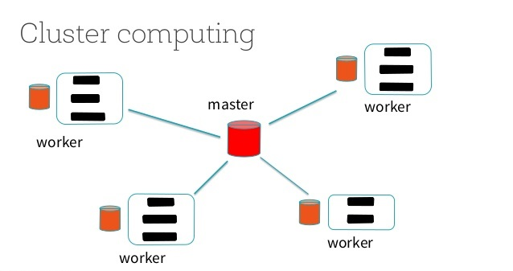
DIY Tech Stacks
Requires running a cluster of nodes:
A master node (or nodes) for receiving job requests/managing resources.
A set of worker nodes doing the actual work.
Some form of distributed storage – HDFS
Notes:
Multiple masters for HA
Storage – also Cassandra, HBase (built on HDFS)
Storage for inputs/outputs/JARs
Actual data lives on hard drives of the nodes
Eg data is partitioned and each worker processes a single partition

Slide 8
Why Cloud?
Reduces pain of creating and managing a cluster
  Easy to provision (and tear down) infrastructure – managed clusters
  Or there might not be any – 'serverless'
Pay as you go
Can rescale easily, or even automatically
Integration with cloud storage offerings
  Read/write data directly from/to storage – no need to copy to cluster's own HDFS
  Data is permanent even if cluster is not
Integration with cloud event/message streams
SLAs guarantee availability
APIs and CLIs allow for easy integration
Notes:
Avoid networking/installation issues

Slide 9
Trade-offs
Ease of setup
Everything needs to be configured
Little to set up
DIY
Managed Clusters
'Serverless'
Full control
Flexible
Limited control
Specific functionality
Control
Notes:
For the sliding scale:
* DIY – have tools like Ambari to help
* Managed clusters – still have to choose machine sizes, maybe still some tweaking of configs (eg scheduler queues, etc), but easy script provisioning through CLI
* 'Serverless' offerings – abstracts away from VMs completely – usually just a concept of defining your inputs, outputs and the code you want to run in between.

Slide 10



Cloud Managed Clusters
Used to provision a (potentially transient) cluster – pick the applications you want
Pick how big your cluster needs to be and off you go – rescale as necessary
Implementation of application logic independent of cloud provider – you are just writing, e.g., a Spark job.
Examples
AWS Elastic MapReduce
Google Cloud DataProc
Azure HDInsight

Slide 11
DEMO
AWS EMR
Managed cluster
Notes:
Things to point out:
Setup can also be done via command line or via Java SDK
Additional apps are: Flink (stream processing), Hue (Analytics Workbench), Zeppelin (Data Science notebook), Ganglia (cluster monitoring), Sqoop (bulk data transfer), Phoenix (SQL queries over HBase), HCatalog (schema management for Hive), Tez (workflow graph creation), Presto (like Hive), Oozie (workflow scheduler)
Jobs submitted as steps which execute sequentially – can also set up the cluster as auto terminating
Worker nodes distinguished as Core (also an HDFS data node) or Task nodes.
Can use Spot instances (including for manual scaling) – bid for spare capacity
Supports autoscaling
Can write to bucket storage with s3:// protocol

Slide 12
Managed Cluster Price Comparison
Google Data Proc
Compute Engine costs - 30GB RAM 8 core n1-standard8 is ~$0.49 per hour
Plus ~$0.01 per hour per vCPU
AWS EMR
EC2 costs – 32GB RAM 8 core m4.2xlarge is ~$0.40 per hour
Discounts for spot instances
Billed to full hour, not per minute
Azure HDInsight
VM costs – 14GB 8 Core A4 instance is ~$0.64 per hour
Notes:
Azure HDInsight – Also offers 'Premium' level for an additional $0.02 per core per hour, for which you get Hadoop security based on Apache Ranger.

Slide 13
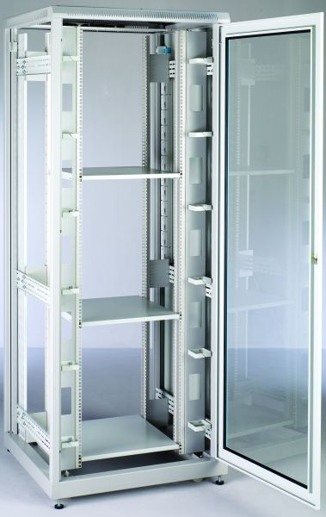
'Serverless' Offerings
SQL Style Batch Queries
Google BigQuery
AWS Athena
Azure Data Lake Analytics with U-SQL
Streaming Analytics
AWS Kinesis Analytics
Azure Stream Analytics
Google Cloud DataFlow
Notes:
All different – side by side comparison difficult

Slide 14

DEMO
Google BigQuery
Data Warehouse supporting SQL queries

Slide 15

Google Cloud DataFlow
Serverless batch and stream processing akin to Spark
Developer defines a pipeline of operations over a distributed collection (PCollection).
Programming model is Apache Beam – unified programming model for batch/stream processing.
  Local runner available, e.g. for testing
Each job is automatically assigned an 'appropriate' number of workers – auto-scales as necessary
  ~$0.083/hour for batch worker, ~$0.352/hour for streaming worker with default CPU/memory/disk
Integrates with:
  Google data stores (BigQuery, BigTable, DataStore)
  Distributed databases, e.g. HBase, Cassandra
  Various message queues (e.g. Google Pub/Sub, Kafka, AMQP, JMS, AWS Kinesis)
  Many other I/O transforms under development (e.g. Neo4J, Solr)
Notes:
* Apache Beam – intended to separate implementation from runtime - also works with Spark, Flink and Apex (latter two batch/stream analytics)
* Apache Beam - Java/Python
* Little control over number of workers – can fix it but then won't autoscale. Can cap maximum number
* Built in I/O here: https://beam.apache.org/documentation/io/built-in/
* Pricing - $0.056 (Batch)/$0.069 (Streaming) per vCPU/hour, $0.0036 GB mem/hour, $0.000054 GB disk/hour, where batch worker defaults to 1 vCPU/3.75GB mem/250GB disk, streaming worker to 4 vCPUs/15GB mem/420 GB disk
* Pricing – compared to AWS streaming is actually similar (slightly cheaper) price for same memory/vCPUs.

Slide 16
DEMO
Google Cloud DataFlow
Serverless Batch and Stream processing

Slide 17



DataFlow Streaming Analytics
PubSub
DataFlow
BigQuery
Extract Hashtags
Window over 1 minute
Count per Hashtag
Top 10 Hashtags

Slide 18
In Conclusion
Few reasons not to use a managed cluster
Consider serverless if it's the right tool for the job

Slide 19
Any Questions?

Slide 20
References
DIY Stacks
Hadoop http://hadoop.apache.org/
Spark http://spark.apache.org/
Storm http://storm.apache.org/
Hive https://hive.apache.org/
Managed Clusters
AWS EMR https://aws.amazon.com/emr/
Google DataProc https://cloud.google.com/dataproc/
Azure HDInsight https://azure.microsoft.com/en-gb/services/hdinsight/

Slide 21
References cont.
Serverless
AWS Athena https://aws.amazon.com/athena/
Google BigQuery https://cloud.google.com/bigquery/
Azure Data Lake Analytics https://azure.microsoft.com/en-gb/services/data-lake-analytics/
AWS Kinesis Analytics https://aws.amazon.com/kinesis/analytics/
Azure Stream Analytics https://azure.microsoft.com/en-gb/services/stream-analytics/
Google DataFlow https://cloud.google.com/dataflow/
SDKs and APIs
Beam https://beam.apache.org/
Beam IO https://beam.apache.org/documentation/io/built-in/
Tweepy Twitter client API http://www.tweepy.org/
Google Python client APIs https://cloud.google.com/python/apis

Slide 22
Thank you

