Slide 1
Rheology of the Lithosphere: Yield Strength Envelope
The Byerlee Pasticity law is :
σ = σ₀ + μP
Then, for the creep the constitutive law is:
Which in the stress explicit form reads:
Knowing that temperature increases with depth, different strength curves can be plot corresponding to different strain rate values.
σ
σ
Creep
.
.
ε = ε₀
ε = ε₁
ε = ε₂
Byerlee
.
.
.
.
Depth
Depth

Slide 2
Rheology of the Lithosphere: Yield Strength Envelope
How the Yield Strength Envelope (YSE) is built
Boundary Conditions - Parameters
The stress is the Pressure (P=ρgy)
Temperature (Heat flow, dT/dy)
Fix a background strain rate (10⁻¹⁵ s⁻¹)
Rheologies
4) Byerlee’s Frictional Sliding
(Red Line)
5) Creep Law for the Olivine (Blue)
6) Creep Law for the Crust (Green)
Rheological Model:
7) Find the minimum (Dashed black line)
σ
Crust
Moho
ε = ε₁
.
.
Lithospheric Mantle
(Olivine)
Depth

Slide 3
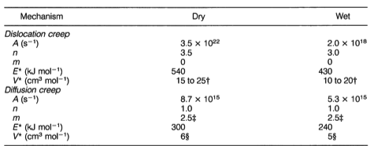
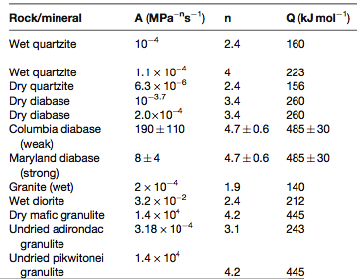
Rheology of the Lithosphere: Yield Strength Envelope

