Slide 1
DDCA · DIGITAL LOGIC PROJECT
Design of a 4-Bit Binary-to-Decimal Conversion & Display System Using Logic Gates
A combinational-logic system that reads a 4-bit binary value and displays its decimal — and, above 9, hexadecimal — equivalent on a digit display, designed and verified in Logisim.
COURSE
FACULTY
INSTITUTION
Digital Design & Computer Architecture
L R Rahul
KLH
Guntaka Rishika
Eaga Bhavyansh
Keta Pravalika
Kadiyam Jai Siva Sai Sri
2620030103
2620030142
2620030144
2620030145
01 / 11

Slide 2
01
01 PROBLEM STATEMENT
What the system needs to do
The core design problem this project solves.
Design and implement a 4-bit binary-to-decimal conversion and display system using digital logic gates.
EXAMPLE
0
1
0
1
01
Accept a 4-bit binary input.
02
Process the input using combinational logic.
↓
03
Convert the binary input into its corresponding decimal representation.
5
04
Display the result on a digit display.
05
Correctly handle all 16 possible 4-bit input combinations.
BINARY 0101 → DECIMAL 5
02 / 11

Slide 3
02
02 OBJECTIVES
What this project sets out to learn
Six learning goals guiding the design and build.
1
Binary → decimal conversion
2
Combinational design
How digital logic maps binary to decimal.
Output depends only on current inputs.
3
Boolean → gates
4
Digit display decoding
Boolean expressions realised as logic gates.
How a 4-bit code drives a visible digit.
5
K-map simplification
6
Simulate & verify
Minimising decoding logic with K-maps.
Build and test the circuit in Logisim.
03 / 11

Slide 4
03
03 SYSTEM OVERVIEW
Theory, and what we actually built
2⁴ = 16 possible inputs, ranging from 0000 to 1111.
THEORY — HOW A DECODER IS DESIGNED
OUR BUILD — INSIDE LOGISIM
4-bit input A B C D
4 Input Pins A B C D
Truth table (16 rows)
Splitter (Fan Out 4, Width 4)
Boolean expression per segment
Combined 4-bit bus
K-map simplification
Hex Digit Display
AND / OR / NOT gates
Decimal (0–9) / Hex (A–F) shown
Display segments light up
Key point — the Hex Digit Display does this decoding internally. We use it as a verified, ready-made block instead of wiring ~20 gates by hand.
04 / 11

Slide 5
04
04 TRUTH TABLE
All 16 input combinations
4-bit binary input and its decimal / displayed value.
A | B | C | D | DECIMAL
0 | 0 | 0 | 0 | 0
0 | 0 | 0 | 1 | 1
0 | 0 | 1 | 0 | 2
0 | 0 | 1 | 1 | 3
0 | 1 | 0 | 0 | 4
0 | 1 | 0 | 1 | 5
0 | 1 | 1 | 0 | 6
0 | 1 | 1 | 1 | 7
1 | 0 | 0 | 0 | 8
1 | 0 | 0 | 1 | 9
1 | 0 | 1 | 0 | 10 → A
1 | 0 | 1 | 1 | 11 → B
1 | 1 | 0 | 0 | 12 → C
1 | 1 | 0 | 1 | 13 → D
1 | 1 | 1 | 0 | 14 → E
1 | 1 | 1 | 1 | 15 → F
Rows 0–9 map directly to the ten decimal digits.
Rows 10–15 show as hex A–F — we use a single Hex Digit Display, so two decimal digits aren't possible.
WORKED EXAMPLE
1010 → A (decimal 10)
05 / 11

Slide 6
05
05 DESIGN & METHODOLOGY
How the circuit was built, step by step
The exact procedure followed in Logisim.
COMPONENTS USED
PROCEDURE
× 4
Input Pin
Wiring
1
Open Logisim, create a new circuit.
2
Place 4 Input Pins vertically: A (MSB) at top, D (LSB) at bottom.
× 1
Splitter
Wiring
3
Add a Splitter; set Fan Out = 4, Bit Width In = 4.
4
Wire all 4 Input Pins to the Splitter's inputs.
× 1
Hex Digit Display
Input / Output
5
Place a Hex Digit Display.
6
Wire the Splitter's output to the display.
7
Save the circuit.
Only 3 components total — the Hex Digit Display does all the decoding work internally.
8
Use the Poke Tool to toggle each pin 0 / 1.
9
Observe: 0000–1001 → 0–9, 1010–1111 → A–F.
06 / 11

Slide 7
06
06 LOGIC GATE DESIGN
The logic inside the display
What the Hex Digit Display is doing on our behalf.
SEGMENT A
A digit display lights segments a–g based on A, B, C, D. Each segment is a Boolean function, found via a truth table and minimised with a K-map.
a = A + C + BD + B'D'
SEGMENT B
b = B' + C'D' + CD
Our Hex Digit Display performs exactly this internally — extended to A–F — so we use it directly instead of ~20 hand-wired gates.
SEGMENTS C–G
derived the same way, per segment
07 / 11

Slide 8
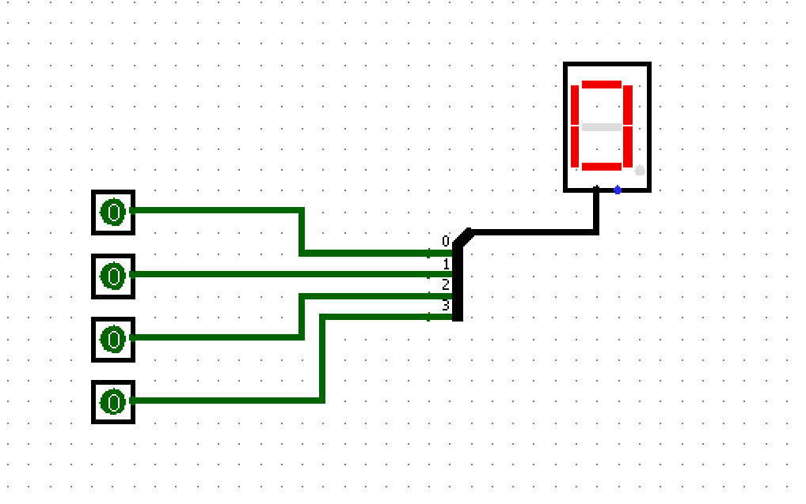
07
07 LOGISIM SIMULATION
The circuit, built and simulated
Live view of the circuit in Logisim, all inputs at 0.
CIRCUIT CONTAINS
4
Input Pins, each togglable 0 / 1
1
Splitter (Fan Out 4, Width 4) merging the bits into one bus
1
Hex Digit Display showing the live result
TEST CASES
INPUT | OUTPUT
0000 | 0
0011 | 3
0101 | 5
0111 | 7
1001 | 9
1010 | A
1111 | F
08 / 11

Slide 9
08
08 RESULTS & VERIFICATION
It works, across every input
Verified for all 16 combinations using the Poke Tool.
✓
Accepts a 4-bit input from 4 switches
0101
5
decimal, correct
✓
Combines the bits into one bus
1001
9
decimal, correct
✓
Display decodes and shows the result
✓
Shows 0–9 for inputs 0000–1001
1010
A
decimal 10, shown as hex
✓
Shows A–F for inputs 1010–1111
✓
Verified across all 16 combinations
1111
F
decimal 15, shown as hex
09 / 11

Slide 10
09
09 REPOSITORY
Project repository
Everything organised for submission and reuse.
README CONTAINS
4-bit-Binary-to-Decimal-Display/
├── README.md
├── Logisim/
│ └── binary_to_hex_display.circ
├── Documentation/
│ ├── Problem_Statement.pdf
│ ├── Methodology.pdf
│ └── Truth_Table.pdf
├── Images/
│ └── Logisim_Circuit.png
└── Demo/
└── Demo_Video_Link.txt
Project overview & problem statement
Objectives
Methodology
Circuit diagram & truth table
Logisim simulation & results
Team members
Demo video
GitHub Link: [Add your repository link here]
10 / 11

Slide 11
10
10 CONCLUSION
A 4-bit binary value, converted and displayed as its decimal — or hexadecimal — equivalent, using combinational logic verified end-to-end in Logisim.
1
2
3
4
Built with Input Pins, a Splitter, and a Hex Digit Display.
The display runs the same decoding logic studied in our objectives.
Covers the full workflow: problem → truth table → simulation.
Verified correct across all 16 possible inputs.
THANK YOU — GUNTAKA RISHIKA · EAGA BHAVYANSH · KETA PRAVALIKA · KADIYAM JAI SIVA SAI SRI
11 / 11

