Slide 1
Header
List of Companies
Company Information
Stock Data
View Charts
Filter:
Go
Clear
logo, symbol, name, sector, subindustry, address, website, exchange, description
Date
Open
Close
Low
High
Volume
Map
Use latitude and longitude
Average
Min
Max

Slide 2
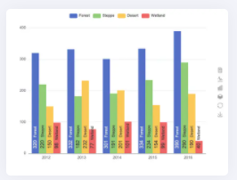
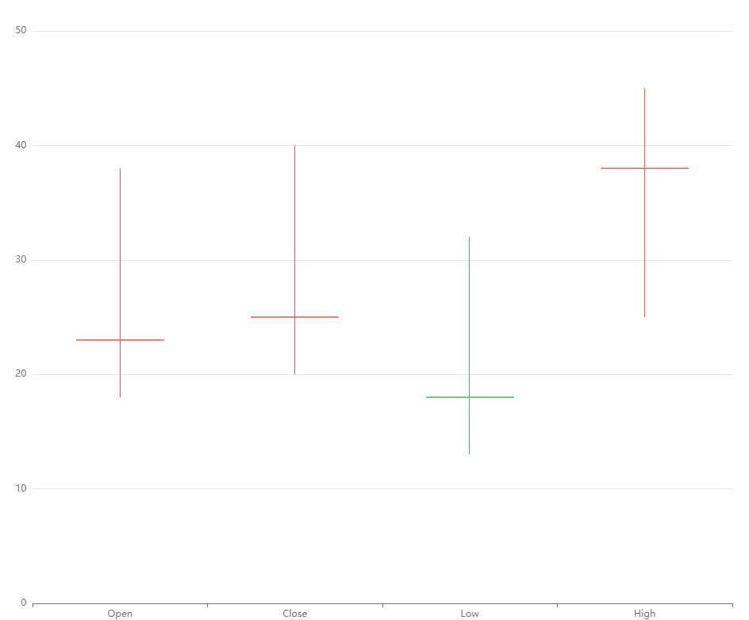
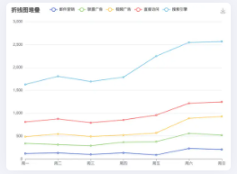
Header
Charts
Company Name + Symbol
Description
Speak
Close
Financials

