Slide 1
Quantum Computing
An overview of quantum computing and it’s possibilities
Eric C. Aghadiuno
Walden University, 2018

Slide 2





What is quantum computing?
Based on the principle of quantum mechanics, which deals with deals with studying objects that are really small, isolated and very, very cold
Involves building new breed of computers based on Quantum Mechanics
The have all the features of conventional computers but instead of “bits” they run “Qubits”
A quantum bit or quit is a unit of quantum information
Different objects can be used as qubits. These include atoms, photons and electrons.
Qubits exists a ‘0’, a ‘1’ or simultaneously as superposition of both ‘0’ and ‘1’

Slide 3
History of Quantum Computing
1973 - Alexander Holevo publishes paper showing that n qubits cannot carry more than n classical bits of information.
1976 - Polish mathematical physicist Roman Ingarden shows that Shannon information theory cannot directly be generalized to the quantum case.
1981 - Richard Feynman determines that it is impossible to efficiently simulate a evolution of a quantum system on a classical computer.
1985 - David Deutsch of the University of Oxford, describes the first universal quantum computer.
1993 - Dan Simon, at Universite de Montreal, invents an oracle problem for which quantum computer would be exponentially faster than conventional computer. This algorithm introduced the main ideas which were then developed in Peter Shor's factoring algorithm.
1994 - Peter Shor, at AT&T's Bell Labs discovers algorithm to allow quantum computers to factor large integers quickly. Shor's algorithm could theoretically break many of the cryptosystems in use today.
1995 - Shor proposs the first scheme for quantum error correction.
1996 - Lov Grover, at Bell Labs, invents quantum database search algorithm.
1997 - David Cory, A.F. Fahmy, Timothy Havel, Neil Gershenfeld and Isaac Chuang publish the first papers on quantum computers based on bulk spin resonance, or thermal ensembles. Computers are actually a single, small molecule, storing qubits in the spin of protons and neutrons. Trillions of trillions of these can float in a cup of water.
1998 - First working 2-qubit NMR computer demonstrated at University of California, Berkeley.
1999 - First working 3-qubit NMR computer demonstrated at IBM's Almaden Research Center. First execution of Grover's algorithm.
2000 - First working 5-qubit NMR computer demonstrated at IBM's Almaden Research Center.
2001 - First working 7-qubit NMR computer demonstrated at IBM's Almaden Research Center. First execution of Shor's algorithm. The number 15 was factored using 1018 identical molecules, each containing 7 atoms.

Slide 4
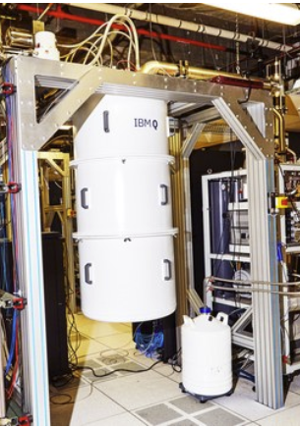
What’s a quantum computer?
A quantum computer is a machine that performs calculations based on the laws of quantum mechanics, which is the behavior of particles at the sub-atomic level.

Slide 5
Bit VS Qubit
Classical Bit Qubit
0 or 1 0 or 1 or 1 and 0
101
000 001 010 011 100 101 110 111

Slide 6
How Quantum Computers Work
Today’s Computers
Turing Machine- theoretical device that consists of tape of unlimited length that is divided into little squares. Each square can either hold a symbol (1 or 0) or be left blank.
Today's computers work by manipulating bits that exist in one of two states: a 0 or a 1.
1 and 0’s are carried and turned on by states of electrical current
Quantum Computers
Quantum computers aren't limited to two states like today’s computers. They encode information as quantum bits, or qubits, which can exist in superposition.
Superposition- quantum computers can represent both 0 and 1 as well as everything in between at the same time.
Qubits can be carried as atoms, ions, photons or electrons and their respective control devices that are working together to act as computer memory and a processor.
Basically, a quantum computer can work on a million computations at once, while your desktop PC works on one.

Slide 7
Overview of Quantum Computing
The importance of Quantum computing is the SPEED it processes information
Tt will take only days or hours to solve problems that would take billions of years using present-day computers.
Impossible for digital computers to factor large numbers which are the products of two primes of nearly equal size. Quantum Computer with 2n qubits can factor numbers with lengths of n bits (binary)
Example: To search the entire Library of Congress for one’s name given an unsorted database...
Classical Computer – 100 years
Quantum Computer – ½ second

Slide 8
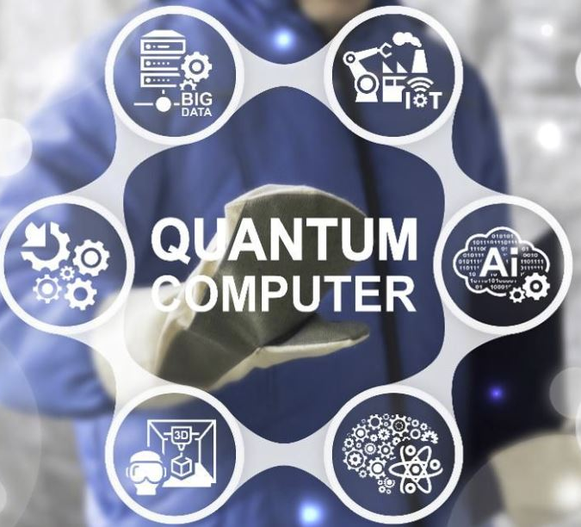
Implications of QC Technology
Artificial Intelligence
Molecular Modeling
Cryptography
Financial Modeling
Weather Forecasting
Particle Physics
3D Gaming
Big Data Processing
Information Technology
Encryption Technology

Slide 9
Risks
Not Available commercially
Unstable Technology
Current technology is ≈ 100 Qubit operating machine needed to rival current classical equivalents.
Decoherence - the tendency of a quantum computer to decay from a given quantum state into an incoherent state as it interacts with the environment.

Slide 10
Opportunities
Investors betting heavily on QC.
Banks, aerospace companies, and cybersecurity firms are among those taking advantage of the computational revolution.
Simulation of molecular structures of chemicals
Code-breaking and hacking
AI systems today by speeding up machine-learning algorithms
China, USA and European Union spending Billions of dollars in QC research

Slide 11
Conclusion
With recent development in Quantum computing technology, it will only continue to improve
Theory also continues to advance as it is applied to other applications

