Slide 1

Classification Genius Project
Eliyar Asgarieh, PhD
March 7, 2016

Slide 2
Outline
Objectives
Project/data description
Challenges of project
Initial structure of solution algorithm
Learning model:
Preprocessing available CG log data
Producing classification/ranking model
Prediction:
Processing new query and finding most relevant candidates
Project schedule
Notes:
change: log data: CG log data
remove practical/efficient
change: modeling: learning model
change: preprocessing: processing
change: probable:relavant

Slide 3

Objectives
Finding most probable candidates for an entered information/query by an agent.
Ranking candidates based on their relevance/similarity and importance.
Suggesting most relevant candidates to the agent.
ww.dreamtimes.com
Query:
no sim alert
Product | Component | Issue
iPhone 5s | Feature | iOS Setup
iPhone 6 | Bluetooth | Bluetooth
iCloud | iCloud account | storage
Notes:
probable: relevant

Slide 4
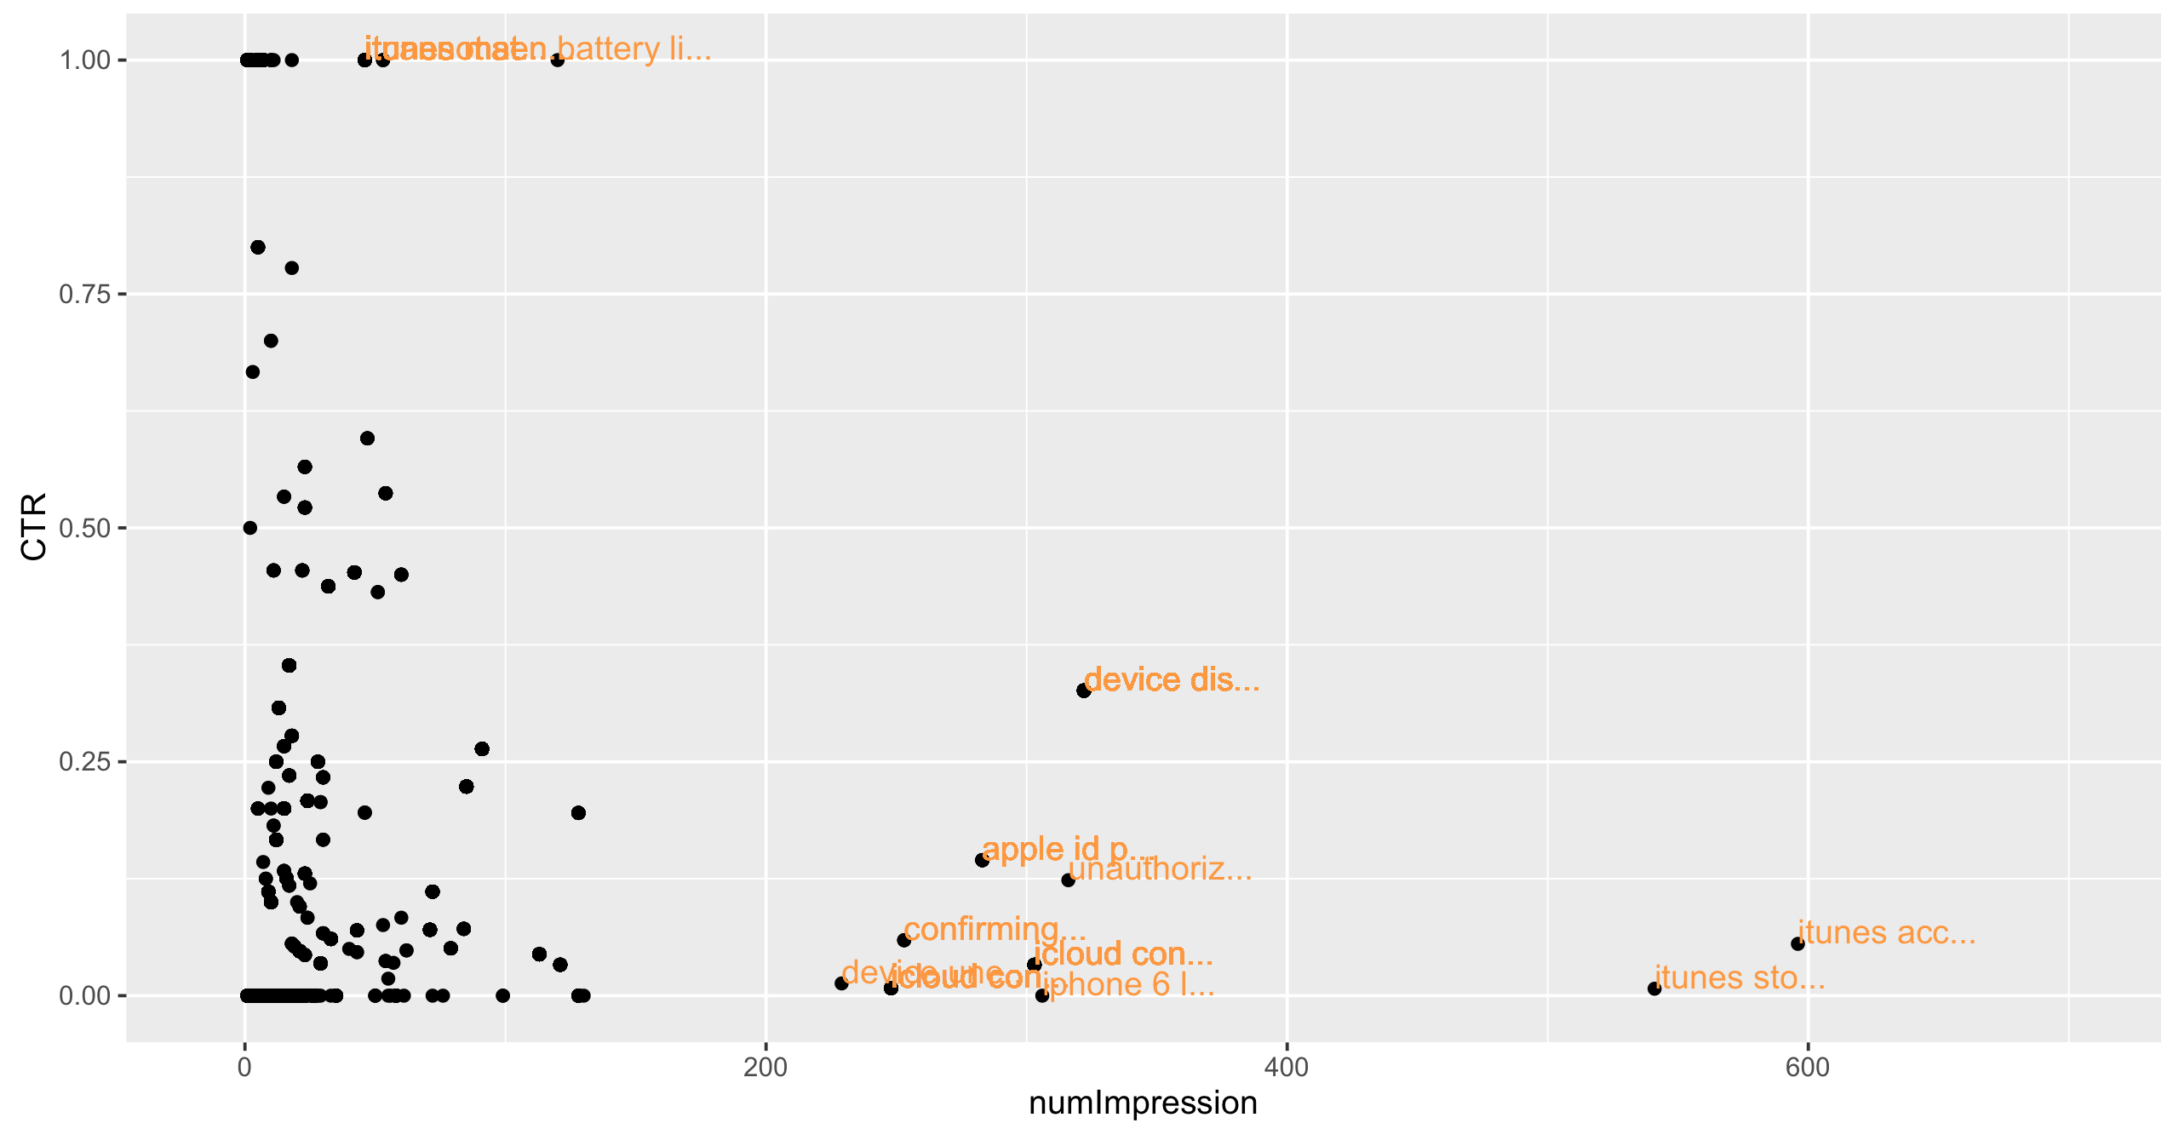
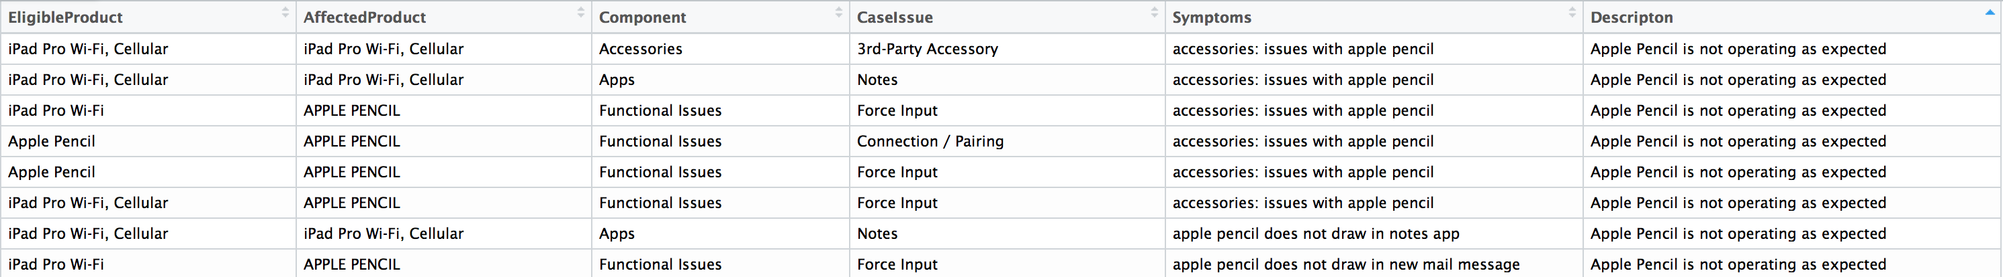
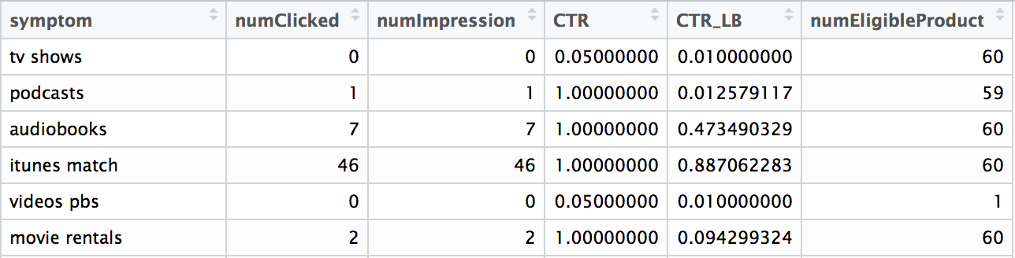
Project/Data description
Data:
Prepared product-component-issue (P-C-I) table:
Feedback and evaluation:
Query
Notes:
Query just arrow to symptom, and add "compare" label
Delete formula

Slide 5
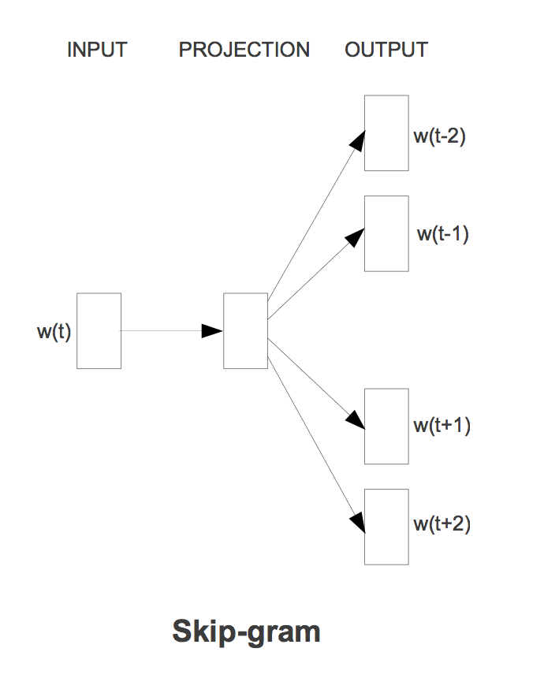
Project/Data description
Natural Language Processing (NLP) techniques are used for finding the most syntactically/semantically similar symptoms to new queries.
Semantic/syntactic similarities between words (e.g., word2vec: skip-gram and CBOW).
Sematic/syntactic similarities between sentences (e.g., LDA, LSA, Doc2Vec, WMD).
display blury pixalated
screen turned solid gray
Mikolov et al. 2013

Slide 6
Challenges
The size of vocabulary in the provided CG log (sparcity).
The numbers of P-C-I’s per symptom are very different (imbalance).
The feedback data e.g., Number of Impression and CTR are not available for all symptoms.
Numbers of variables as explicit features for use in the classification algorithm are very low.

Slide 7
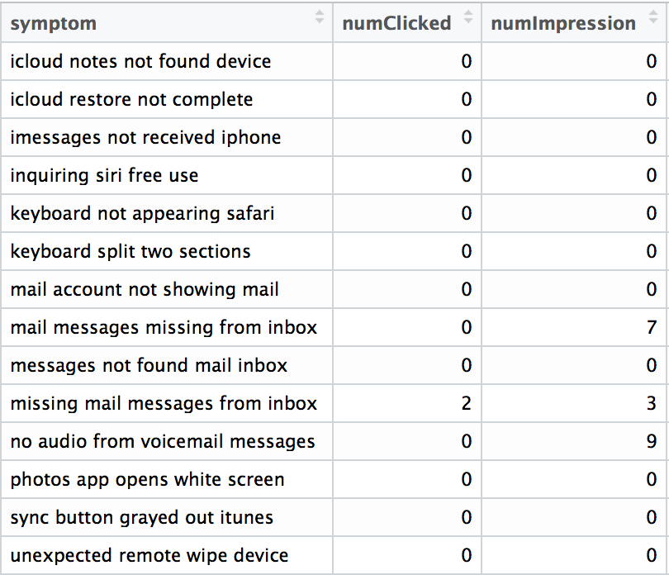
Structure of solution algorithm
Preprocessing/modeling using log data
Finding clusters of similar symptoms:
Defining document similarity metric.
Finding pairwise similarities (dissimilarities) between the symptoms in the log data.
Clustering similar symptoms at various levels (Hierarchical clustering).
Determining clusters of symptoms by assuming a proper clustering level.
labs.genetics.ucla.edu

Slide 8
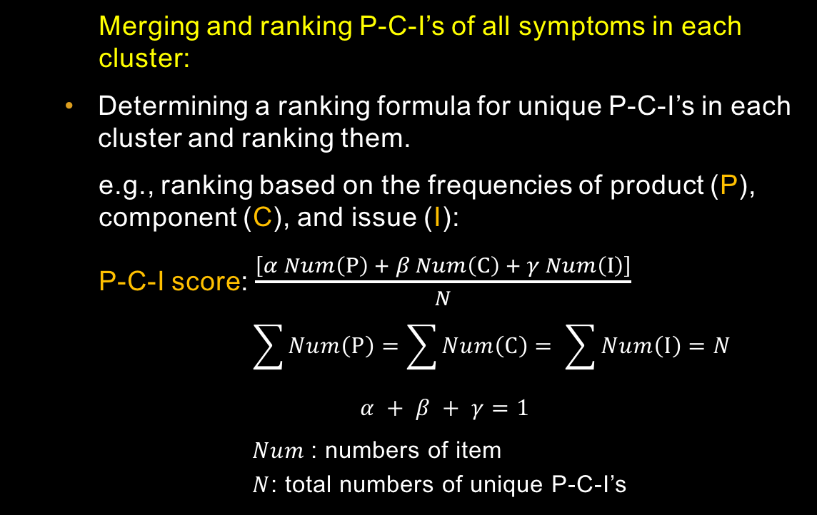
Structure of solution algorithm
Bag of symptoms
Merging and ranking P-C-I’s of all symptoms in each cluster:
Determining a ranking formula for unique P-C-I’s in each cluster and ranking them.
e.g., ranking based on the frequencies of product (P), component (C), and issue (I):
P-C-I score: $\frac{\left[α Num\left(P\right) + β Num\left(C\right) + γ Num\left(I\right)\right]}{N}$
$$\sum{Num\left(P\right)}=\sum{Num\left(C\right)}= \sum{Num\left(I\right)}=N$$
$$α + β + γ=1$$
$Num$: numbers of item
$N$: total numbers of unique P-C-I’s
Symptom 1
Symptom 1
Symptom 2
P-C-I 1
P-C-I 2
P-C-I 3
Symptom 2
P-C-I 1
P-C-I 5
P-C-I 2
P-C-I 3
P-C-I 3
P-C-I 4
P-C-I 5
P-C-I 2
P-C-I 7
P-C-I 2
P-C-I 6
P-C-I 4
P-C-I 4
P-C-I 5
P-C-I 1
P-C-I 6
P-C-I 7
P-C-I 7
P-C-I 6
Bag of P-C-I’s
Bag of P-C-I’s (ranked)

Slide 9
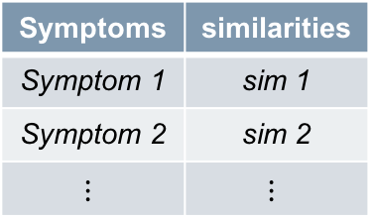
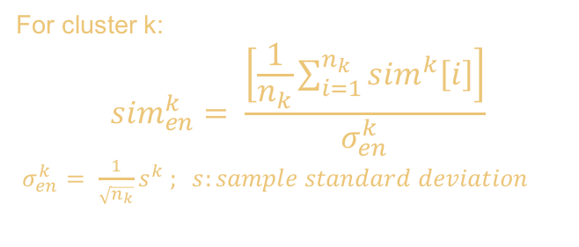
Structure of solution algorithm
Assessing similarity of the new query with bags (clusters) of symptoms:
Finding the similarity metric values between the new query and symptoms.
Calculating an ensemble metric for each cluster of symptoms (e.g., average of individual similarity metrics divided by uncertainty factor).
Selecting the most similar cluster of symptoms to the query.
Suggesting the highest ranked P-C-I’s from the trained model.
Query:
… … … … …
Cluster 1
Symptoms | similarities
Symptom 1 | sim 1
Symptom 2 | sim 2
$$⋮$$ | $$⋮$$
Cluster 10023
Cluster 2
Cluster 3
Cluster 56
For cluster k:
$${sim}_{en}^{k}= \frac{\left[\frac{1}{n_{k}}\sum_{i=1}^{n_{k}}{{sim}^{k}\left[i\right]}\right]}{σ_{en}^{k}}$$
$σ_{en}^{k}= \frac{1}{\sqrt{n_{k}}}s^{k} ; s:sample standard deviation$
P-C-I
Rank 1
Rank 2
Rank 3

Slide 10
Project Schedule
…

Slide 11
Thank You

Slide 12
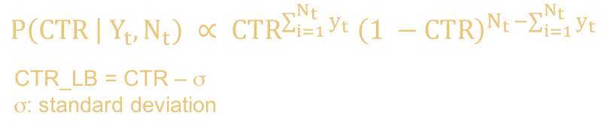
$$P\left(CTR \right| Y_{t}, N_{t}) ∝ {CTR}^{\sum_{i=1}^{N_{t}}{y_{t}}} {\left(1 −CTR\right)}^{N_{t }−\sum_{i=1}^{N_{t}}{y_{t}}}$$
CTR_LB = CTR – σ
σ: standard deviation

