Slide 1
Factorization Machine
Jingru Li
2019-3-20

Slide 2
Contents
Background
FM
SGD
ALS
MCMC
Code implementation: LIBFM
HOFM
Deep & Cross
DeepFM & xDeepFM
Code implementation: TFFM

Slide 3
Background
SVM can not learn reliable parameters (‘hyperplanes’) in complex (non-linear) kernel spaces under very sparse data.
Drawback of tensor factorization models is that
They are not applicable to standard prediction data
Specialized models are usually derived individually for a specific task requiring effort in modelling and design of a learning algorithm.

Slide 4
Introduction
FM = SVM+ Factorization
Advantages:
FMs allow parameter estimation under very sparse data where SVMs fails.
FMs have linear complexity, can be optimized in the primal and do not rely on support vectors like SVM.
FMs are a general predictor that can work with any real valued feature vector. In contrast to this, other state-of-the-art factorization models work only on very restricted input data.

Slide 5





Introduction
Target Function
Target Domain
$$T$$
Training Dataset
Non-zero numbers
$$m(x)$$
Model Equation

Slide 6
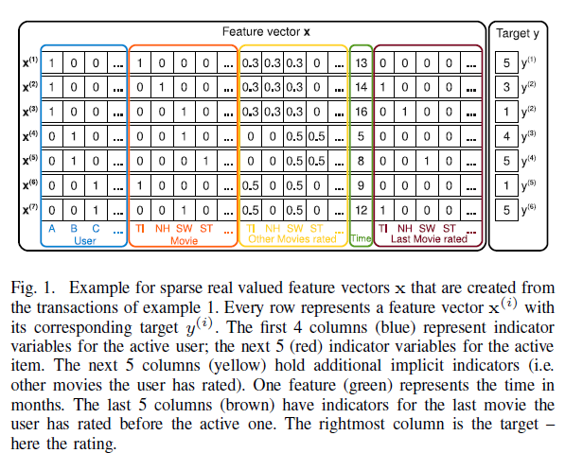
User | Movie | Time | Rating
A | TI | 2010-1 | 5
A | NH | 2010-2 | 3
A | SW | 2010-4 | 1
B | SW | 2009-5 | 4
B | ST | 2009-8 | 5
C | TI | 2009-9 | 1
C | SW | 2009-12 | 5

Slide 7
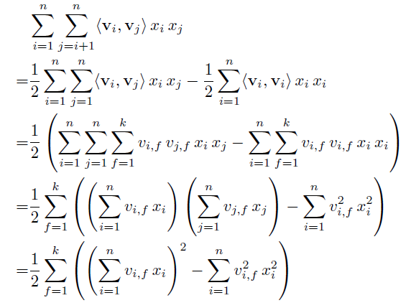

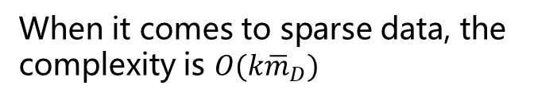
Linear Time
When it comes to sparse data, the complexity is $O(k{\overline{m}}_{D})$

Slide 8


Sparsity
User | Movie | Time | Rating
A | TI | 2010-1 | 5
A | NH | 2010-2 | 3
A | SW | 2010-4 | 1
B | SW | 2009-5 | 4
B | ST | 2009-8 | 5
C | TI | 2009-9 | 1
C | SW | 2009-12 | 5
Direct interaction
Factorized interaction

Slide 9

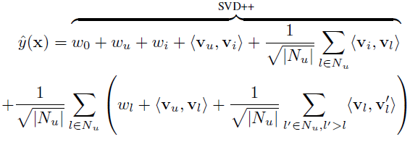
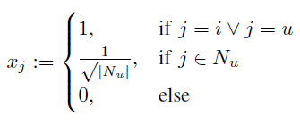
FM vs. Factorization Models
Matrix factorization:
SVD++:
$N_{u}$ is the set of all movies the user has ever rated

Slide 10
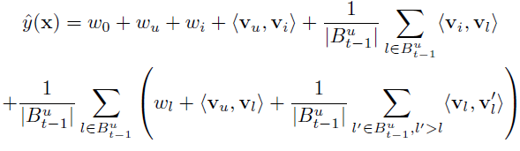
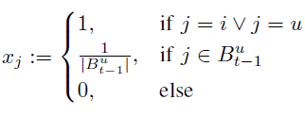
FM vs. Factorization Models
PITF for Tag Recommendation:
Factorized Personalized Markov Chains(FPMC):
Notes:
FPMC主要是加入了时序的考虑

Slide 11


Learning Methods
Loss Function - Regression
Gradients

Slide 12
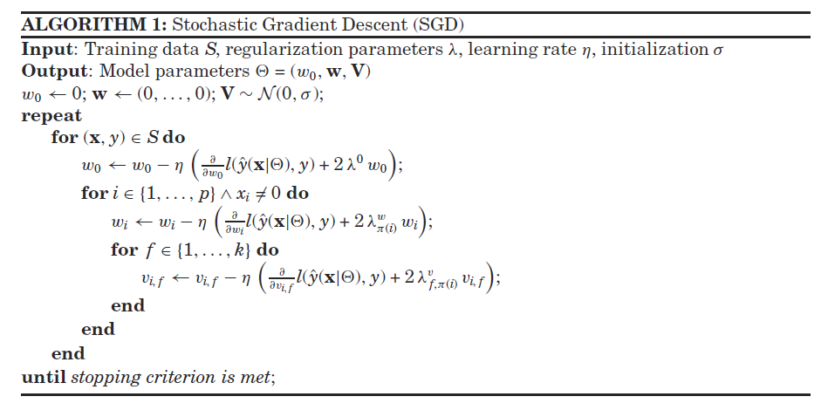
Learning Methods - SGD
0-order features
1-order features
2-order features

Slide 13
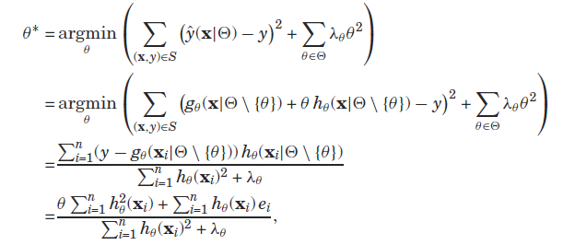


Learning Methods - ALS
Θ can be features of different orders.
Object function: Least square error

Slide 14
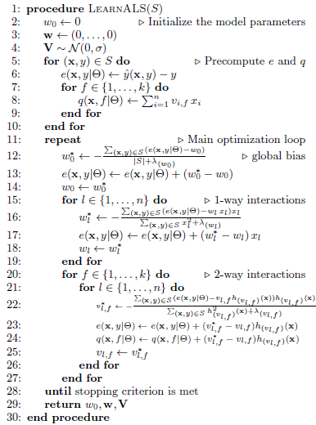

Learning Methods - ALS
Can find an analytic solution for the object function( due to multi-linearity)
Three improvements:
precomputing error terms
precomputing h-terms for 2-way interactions
using the sparsity in S
Notes:
这里的三点提升总结如下：
对于（1），误差结果可以预先计算，使得整个训练过程的时间复杂度从线性下降到常数。我们可以预先将误差存储并计算。（line 6）
对于（2），h-term表示的是预测函数对参数\theta的梯度。这里的q函数是根据h导出来的，与l无关，可以在每个训练集中进行预计算。与误差函数类似的可以实现q函数的更新。（line 8）
对于（3），总时间复杂度仅与特征中非0值的数量有关。

Slide 15
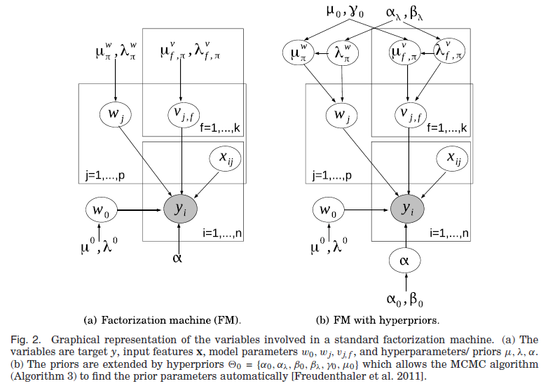
Learning Methods - MCMC
Inference: Efficient Gibbs Sampling
Integrate the regularization parameters θ_{H} into the model.
Avoid time-consuming search for hyperparameters

Slide 16
Code implementation -LibFM
LibFM code implementation:
https://github.com/srendle/libfm
Chinese explanation(My blog : )
https://blog.csdn.net/lijingru1/article/details/88641873

Slide 17
Next….
Background
FM
SGD
ALS
MCMC
Code implementation: LIBFM
HOFM
Deep & Cross
DeepFM & xDeepFM
Code implementation: TFFM

