Slide 1
Active Learning (A brief Introduction)
Liangcheng Li ZJU Eagle Lab

Slide 2
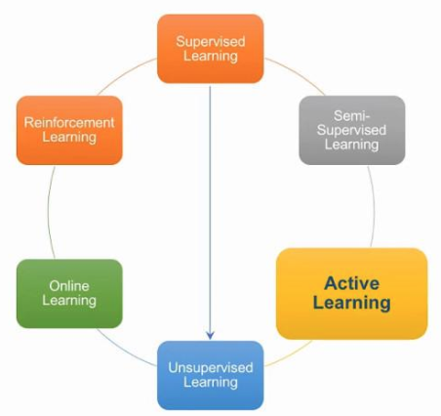
What is AL
Subfield of ML, AI
Hypothesis: Choose the data from which it learns and perform better with less training
AL: Overcome the labeling bottleneck by asking queries in the form of unlabeled instances to be labeled by an oracle
Achieve high accuracy with few labeled instances
Minimize the cost of obtaining labeled data
Eg: Speech recognition, Information Extraction, Classification & filtering

Slide 3
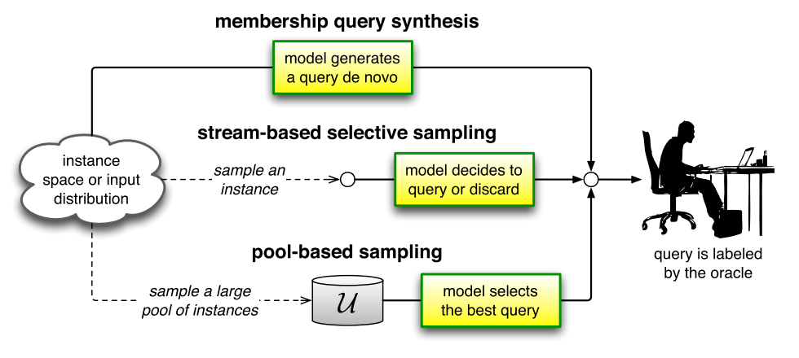
Scenarios
Membership query synthesis
Stream-based selective sampling
Pool-based sampling

Slide 4
Membership Query Synthesis
Membership query
Learner may request labels for any unlabeled instance in the input space
Including queries the learner generates de novo instead of those from some underlying natural distribution
If the oracle is a human annotator, arbitrary labeling can be awkward
NLP, handwritten characters classify
Notes:
membership query synthesis，是指模型可以生成新的样本，即模型可以操控样本的生成。这类似于人在学习的过程中进行举一反三，自己生成一些新的问题，然后通过更深入的研究新问题来提高自己的认知。

Slide 5
Stream-based Selective Sampling
Key assumption
Obtaining an unlabeled instance is free (or inexpensive)
Can first be sampled from the actual distribution, then the learner can decide whether or not to request its label
If the input distribution is uniform, selective sampling may well behave like membership query learning
Measurement for selecting an instance
Informative measure
Query strategy
Region of uncertainty
…
Notes:
stream-based selective sampling，是指样本不在池子中，而是按一定次序被模型看到，而模型需要决定是否对每个新看到的样本进行标记。这一过程类似于人每天都在接受新的概念和定义并从中选择出需要的内容进行专门学习，不需要的则抛弃或忘记。

Slide 6
Pool-based Sampling
A small set of labeled data L, a large pool of unlabeled data U
Queries are selectively drawn from the pool, usually assumed to be closed
With some informativeness measure to evaluate all instances in the pool
The most used method among the three methods
Notes:
pool-based sampling，顾名思义，即所有的数据均存在于一个池子中。我们的工作就是在该池子中选出一些样本进行标记。在这样的设定下，所有样本都提供给模型，模型来选择一部分样本进行标记。

Slide 7
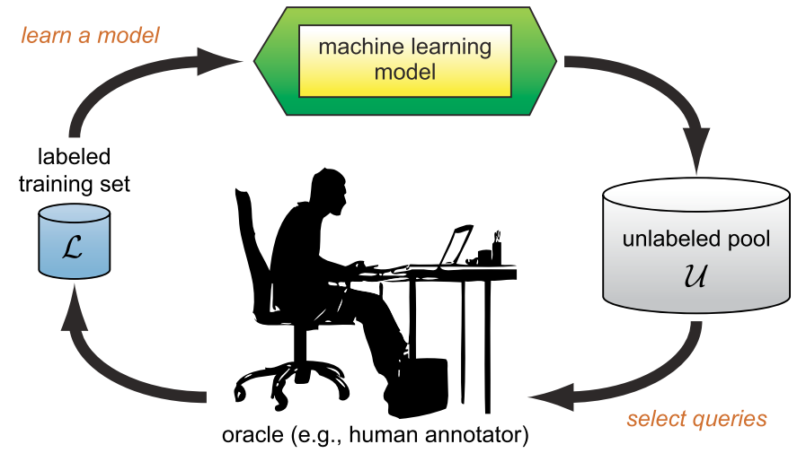
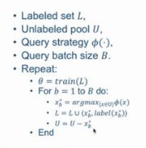
An Example

Slide 8
Query Strategy Framework
refer to the most informative instance (best query) according to query selection algorithm A

Slide 9
Uncertainty Sampling
The least confident
where
Margin sampling
Entropy

Slide 10
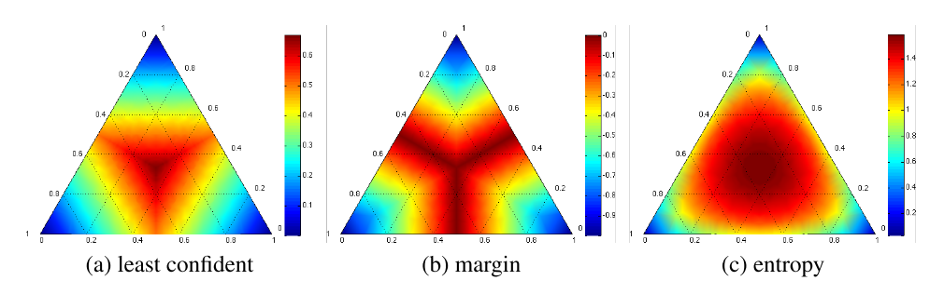
Comparison
Notes:
Simplex corners indicate where one label has very high probability, with the opposite edge showing the probability range for the other two classes when that label has very low probability.
Simplex centers represent a uniform posterior distribution. The most informative query region for each strategy is shown in dark red, radiating from the centers.
The entropy measure does not favor instances where only one of the labels is highly unlikely (i.e., along the outer side edges), because the model is fairly certain that it is not the true label.
The least confident and margin measures, on the other hand, consider such instances to be useful if the model cannot distinguish between the remaining two classes.

Slide 11
Query-by-committee
Maintaining a committee C = {θ⁽¹⁾, . . . , θ^{(C)}} of models which are all trained on the current labeled set L
Each committee member is then allowed to vote on the labelings of query candidates
The most informative query is considered to be the instance about which they most disagree

Slide 12
Query-by-committee
Vote entropy
Average KL divergence
C represents the committee as a whole
Can be measured by other divergence

Slide 13

Expected Model Change
Selecting the instance that would impart the greatest change to the current model if we knew its label (decision-theoretic approach)
Useful in empirical studies, but fail in large feature space and labeled dataset
Leading astray when scaling improperly

Slide 14
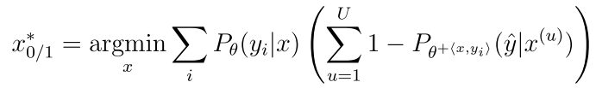
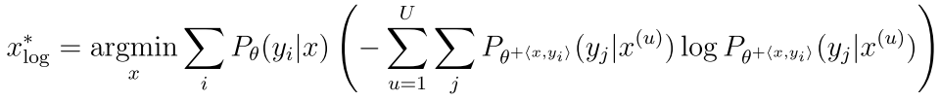
Expected Error Reduction
measure not how much the model is likely to change, but how much its generalization error is likely to be reduced
0/1 loss
Log-loss
High computational complexity

Slide 15
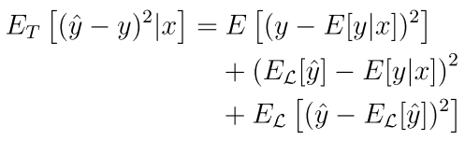


Variance Reduction
reduce generalization error indirectly by minimizing output variance

Slide 16


Fisher Information Ratio
Fisher Information
Minimize the variance = maximize the Fisher information
With K parameters, what should I optimize with FI covariance matrix
A-optimality: minimize the trace of the inverse information matrix
FIR
Notes:
This measure is convenient because its inverse sets a lower bound on the variance of the model’s parameter estimates
上面的等式为我们提供了两个矩阵的内积给出的比率，可以将其解释为模型在输入分布上的输出方差（由U近似），而不是由x计算

Slide 17
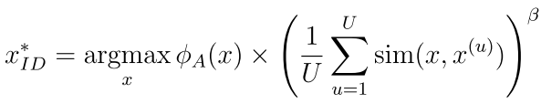
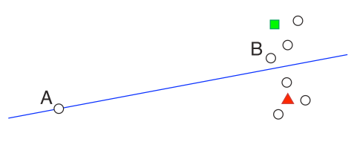
Density-weighted Methods
the estimated error and variance reduction frameworks focus on the entire input space, which are less prone to querying outliers
Informative instances should not only be those which are uncertain, but also those which are “representative” of the underlying distribution

Slide 18
Application fields
Structured Outputs
Feature Acquisition & Classification
Class selection
Clustering

Slide 19
Challenge
Batch-mode AL
Noisy Oracles
Variable labeling cost
Alternative query type
Multi-class AL
Stopping criteria

Slide 20
Related works
Semi-supervised learning
RL
Submodular optimization
Equivalence query learning
Model parroting and compression

Slide 21
Tools: ALipy
Support
Numpy, scipy, prettytable, matplotlib, scikit-learn
Cvxpy
Modules
Alipy.data_manipulate
Alipy.query_strategy
Alipy.index.IndexCollection
Alipy.metric
Alipy.experiment.state & experiment.state_io
Alipy.experiment.stopping_criteria
Alipy.oracle
Alipy.experiment.experiment_analyser
Alipy.utils.multi_thread

Slide 22
Tools: ALipy
Install
http://parnec.nuaa.edu.cn/huangsj/alipy/installation.html
Test
http://parnec.nuaa.edu.cn/huangsj/alipy/10_mins_to_alipy.html

