Slide 1
LSTM And Variants
马宁,2019.03.13

Slide 2
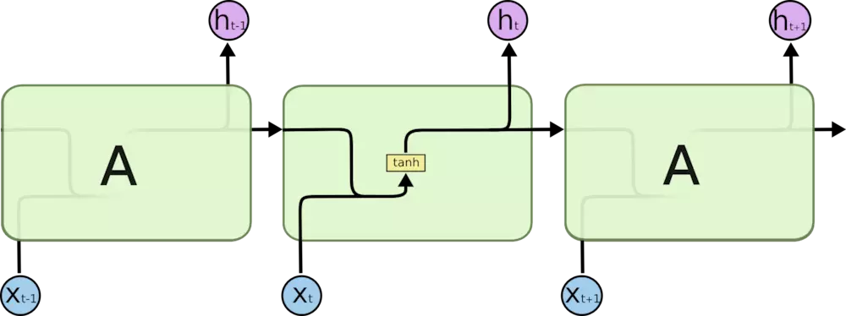
Vanilla RNN
Learning long-term dependencies with gradient descent is difficult![1]
[1]:Learning long-term dependencies with gradient descent is difficult,Yoshua Bengio

Slide 3
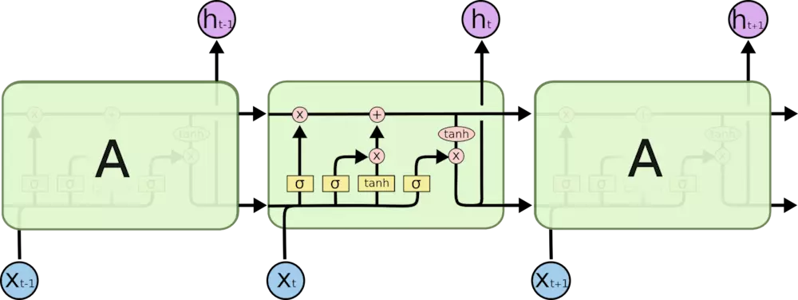
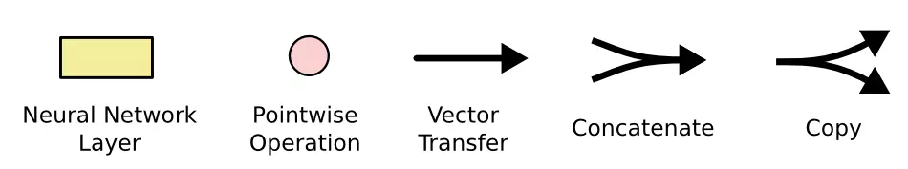
LSTM(Long Short-Term Memory)

Slide 4
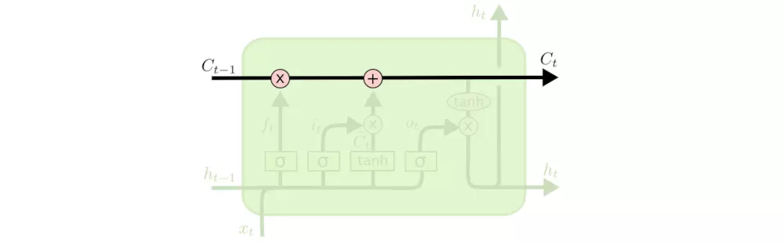
Cell State

Slide 5
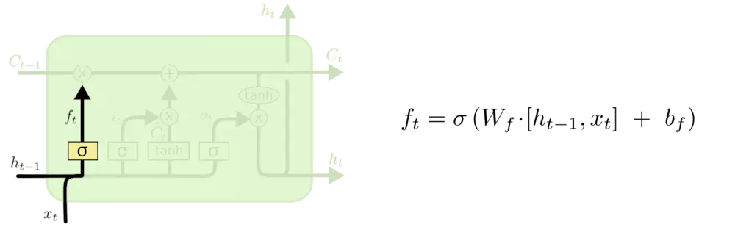
Forget Gate

Slide 6
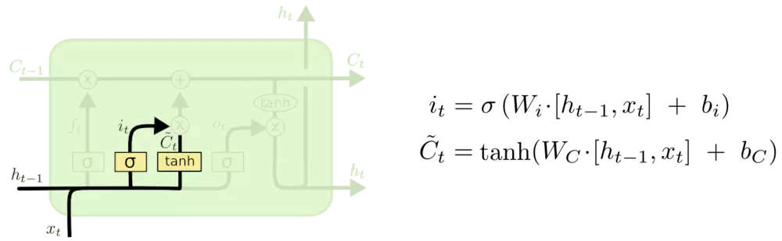
Input Gate

Slide 7
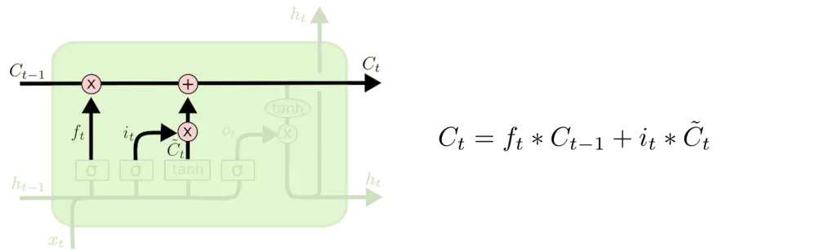
Cell State Update

Slide 8
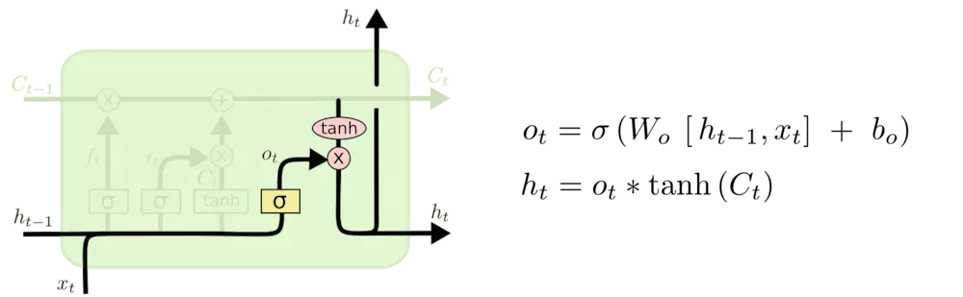
Output Gate

Slide 9
LSTM(Long Short-Term Memory)

Slide 10
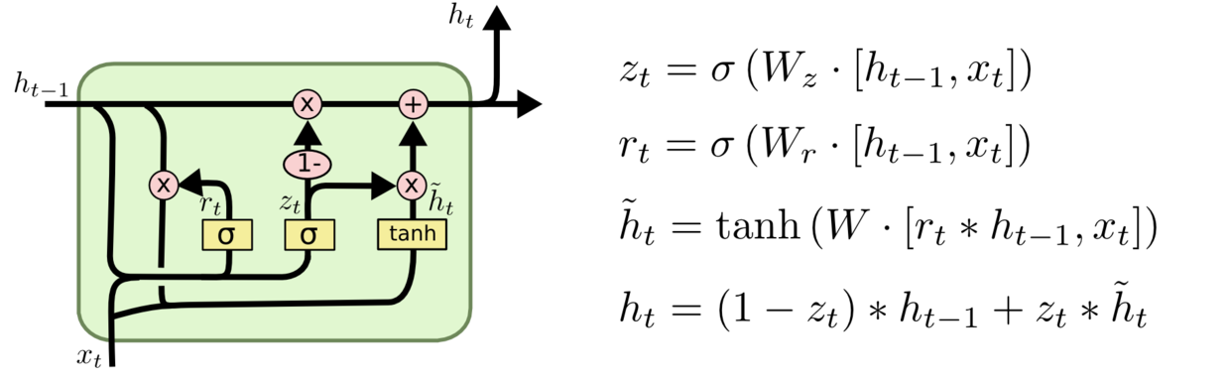
LSTM and Variant
LSTM vs GRU
Ref:LSTM: A Search Space Odyssey;Klaus Greff
Ref:An Empirical Exploration of Recurrent Network Architectures;Samuel Ritter,Jane X. Wang

Slide 11
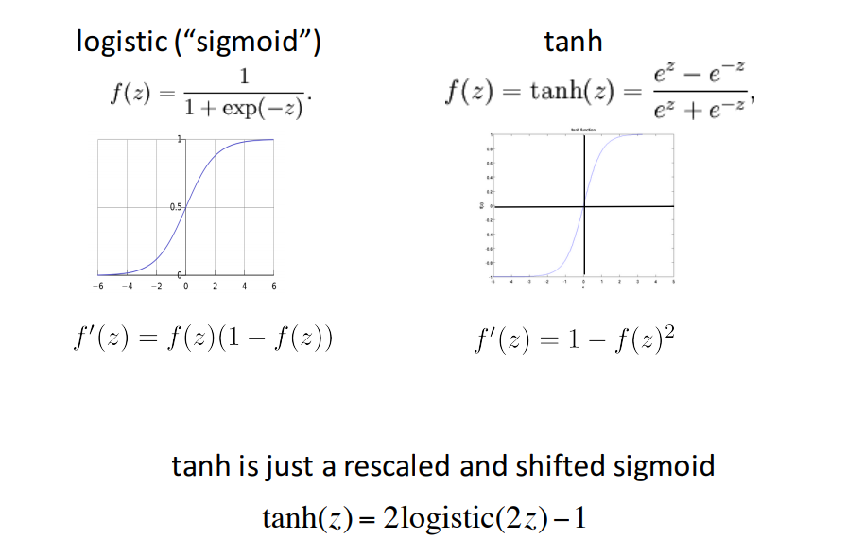
Why sigmoid and tanh?
Ref:https://cs224d.stanford.edu/lectures/CS224d-Lecture6.pdf

Slide 12
Why LSTM better than RNN?
Gradient Vanishing (or Long-Term Dependencies )
Vanilla RNN forward step:
LSTM cell state forward step:

Slide 13
More Than LSTM
LSTMs do not excel at Long-Term Dependencies
Latest improvement: Episodic LSTM^{[1]}
[1],Been There, Done That: Meta-Learning with Episodic Recall,Samuel Ritter

Slide 14
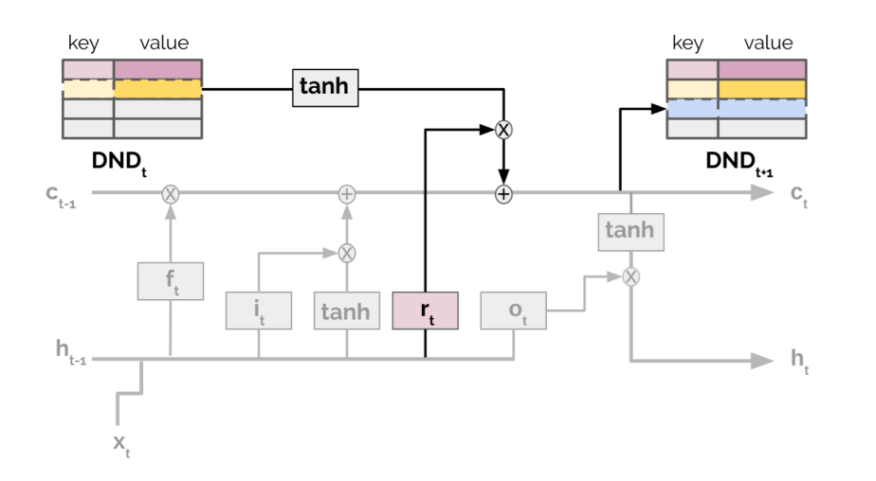
Episodic LSTM
Framework
DND: Differentiable Neural Dictionary^{[1]}
[1],Neural episodic control;Pritzel, Alexander

Slide 15
Thanks

