Slide 1


Netflow Data Analytics With ELK Stack & DDoS Attack Mitigation

Slide 2


Founded in 2016
Over 15 employees
Managing 700Gbit/s DDOS Mitigation capacity in MY, SG, HK, TW, US and EU on the way
Providing DDOS protection solution for more than 100 ISPs
Development on DDOS & Traffic monitoring system - INI
About
IPDC SOLUTIONS

Slide 3

Why do we need to develop our own
NetFlow tools?
As We need to resolve some operation difficulties, that required information that cannot be found from
MRTG

Slide 4
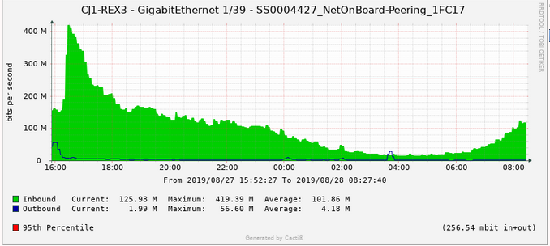
Example 1. When we see a spike like the following graph

Slide 5
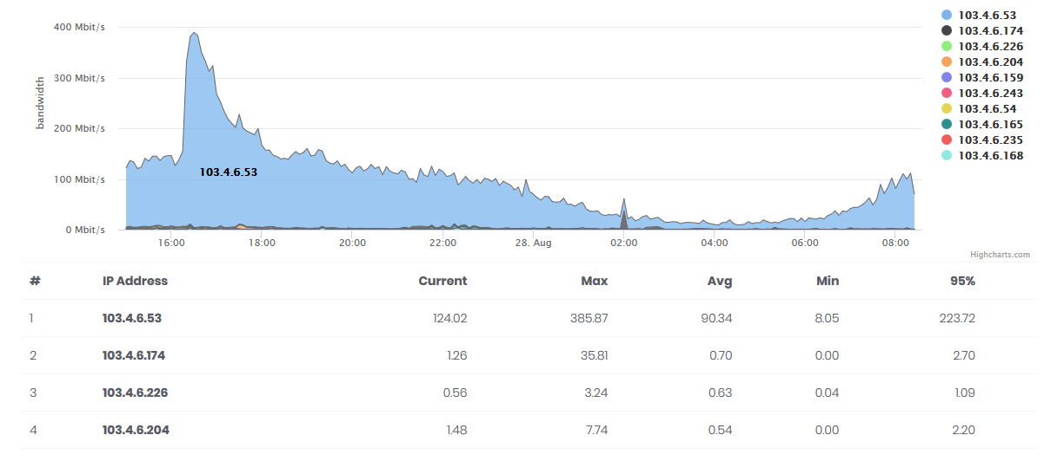
You probably may need to know where the majority of your traffic comes from?
Who uses the most
bandwidth here?
We found this from Netflow graph

Slide 6
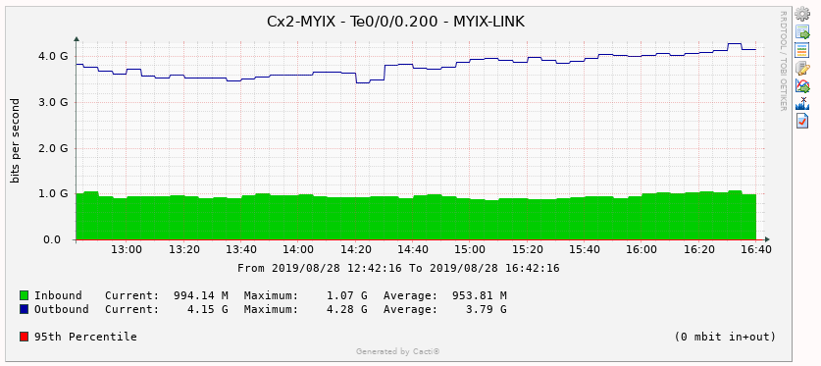
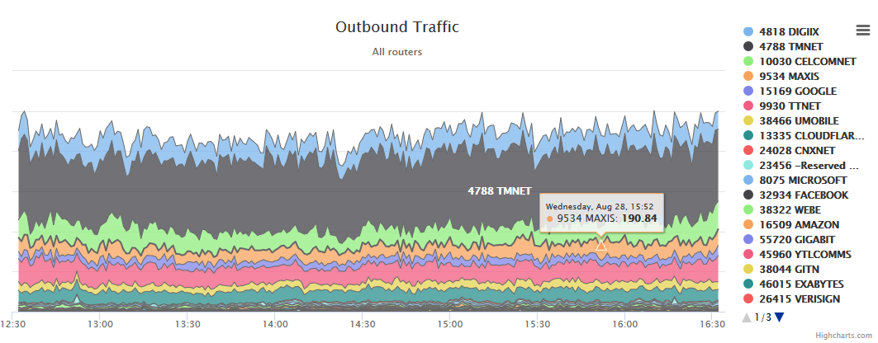
A NetFlow graph would be able to breakdown the usage
for your outbound / inbound traffic
When we almost hitting your committed bandwidth limit.
Netflow helps us on finding out which ASN that contributing this traffic

Slide 7
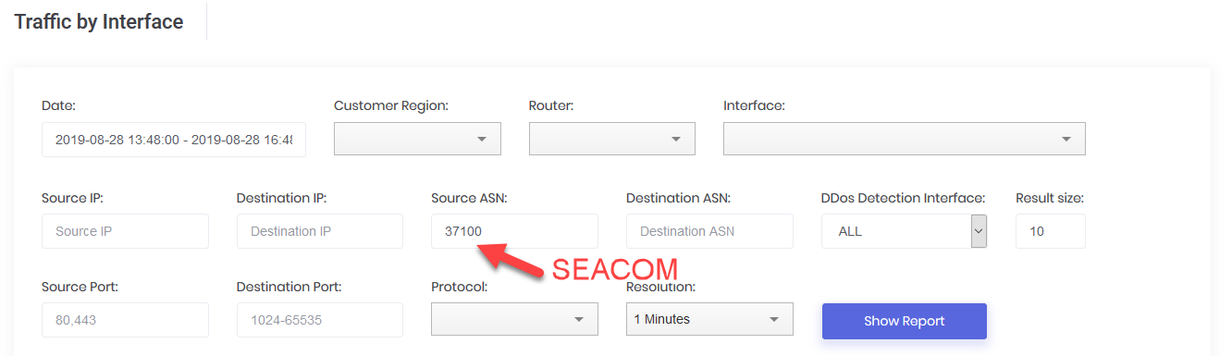
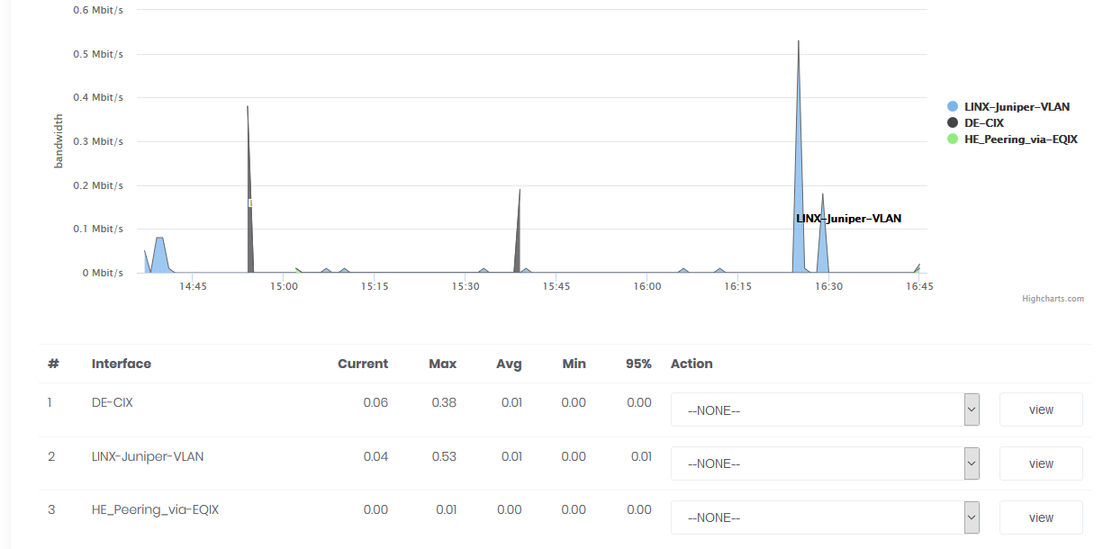
Netflow is not just for graphing purposes. It helps on how identify, which upstream / interface the traffic coming from
Coming from DE-CIX, LINX & HE

Slide 8
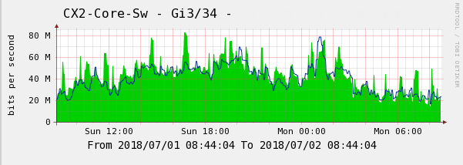
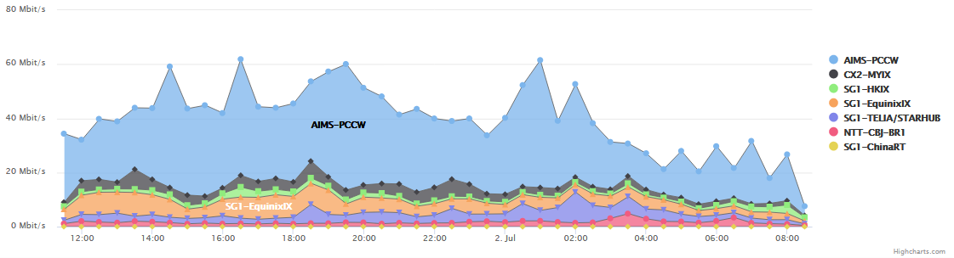
If you considering to enhance your MRTG with a NetFlow graph
Here is how we do…
MRTG GRAPH
NETFLOW
GRAPH

Slide 9
To get the graph plotted, we will need to store them into a database
ElasticSearch, Logstash,
And Kibana (ELK)?

Slide 10
Why ELK?
Before I get to know ELK stack, I was using MySQL to store all the NetFlow information.
I wrote a PHP application that converts NetFlow information into a MySQL statement.
That was too slow on the conversion performance and the data retrieval was a complete nightmare.
There is no function / feature to get traffic statistic in the histogram form.
It’s just too difficult to run this in MySQL

Slide 11
Why ELK?
Speed is the primary reason that I have chosen ELK
It has a lot of codec, which I can just plug and play
COST; it runs on commodity hardware and it works just fine with Nearline SAS Hard drives
Open Source
Support Clustering
It has SQL like syntax, so data searching is much more easier
It has a very high performance; we had a working environment of 100Kflows per second

Slide 12
Alternative to ELK
We did consider to use InfluxDB
The OpenSource edition doesn’t support clustering.
OpenTSDB
The setup is very time-consuming.
MongoDB.
This is a great DB; however, we still prefer to use ElasticSearch.
ClickHouse
ClickHouse is an open-source column-oriented DBMS for online analytical processing. ClickHouse was developed by the Russian IT company Yandex

Slide 13
How to record the
NetFlow Data?

Slide 14






The NetFlow is being collected with the following setup
NetFlow Source
Logstash
ElasticSearch
API
+ Custom App
ElasticSearch

Slide 15

Adding BGP table information into the ElasticSearch
BGP Routing Table
BGP routing table entry for 103.3.174.0/24, version 737937
Paths: (34 available, best #21, table default)
Not advertised to any peer
Refresh Epoch 1
3356 3491 45352
4.69.184.193 from 4.69.184.193 (4.69.184.193)
Origin IGP, metric 0, localpref 100, valid, external
Community: 3356:666 3356:2012 3491:400 3491:413
rx pathid: 0, tx pathid: 0
Refresh Epoch 1
3549 3356 2914 45352
208.51.134.254 from 208.51.134.254 (67.16.168.191)
Origin IGP, metric 0, localpref 100, valid, external
Community: 3356:3 3356:86 3356:575
3356:666 3356:2011 3356:11940 3549:2581 3549:30840
rx pathid: 0, tx pathid: 0
Refresh Epoch 1
20912 1267 45352
212.66.96.126 from 212.66.96.126 (212.66.96.126)
Origin incomplete, localpref 100, valid, external
Community: 1267:167 1267:200 20912:65001
rx pathid: 0, tx pathid: 0
Refresh Epoch 1
route-views>
NetFlow Source
ExaBGP
Logstash
ElasticSearch
PHP + Golang

Slide 16
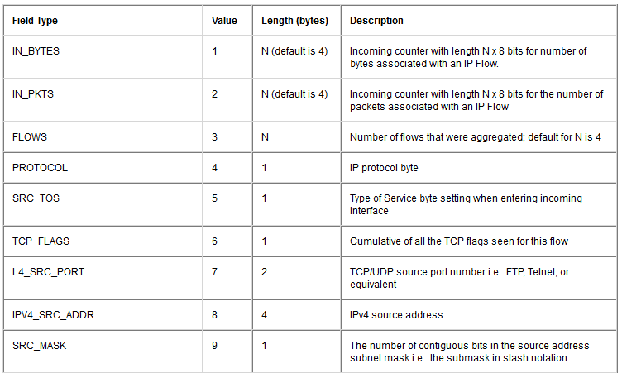
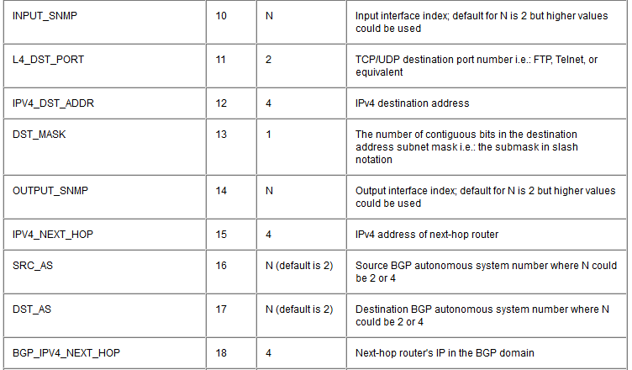
We use NetFlow v9 in our projects
Here is the field that we keep

Slide 17











Hardware vs Software
The NetFlow is being collected with the following setup
The hardware specification used for keeping our NetFlow
The software used to run our NetFlow
1 x Intel Xeon 8 cores 2.1Ghz Processor
CentOS 7
64bit Operating System
Java
4 x 2TB HDD
MySQL
32GB RAM
PHP
ElasticSearch, Logstash
1 x Gigabit Network Card

Slide 18

How to put up the software?
CentOS Installation
You can follow the way you do normally; but please remember to keep most of the free space into /var.

Slide 19
Quick intro about ElasticSearch
ElasticSearch is a search engine based on Lucene. It provides a distributed architecture, support multi-tenancy and full-text search engine with an HTTP web interface.
https://www.elastic.co/guide/en/elasticsearch/reference/current/rpm.html
Elasticsearch could support horizontal scaling
Where you cluster multiple server, and make it into 1 single cluster
To improve the processing capabilities, and also the speed to deliver your search result.

Slide 20
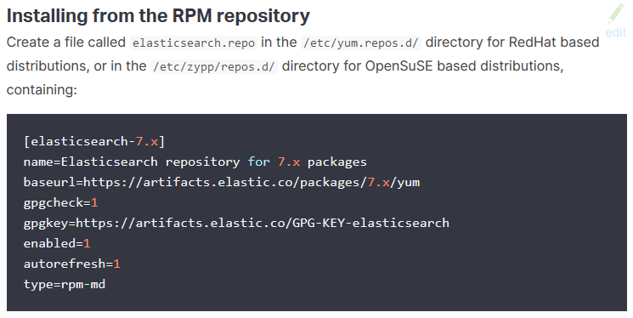
ElasticSearch Installation
rpm --import https://artifacts.elastic.co/GPG-KEY-elasticsearch
sudo yum install elasticsearch

Slide 21
Start ElasticSearch
[root@elk-stack ~]# systemctl daemon-reload
[root@elk-stack ~]# systemctl start elasticsearch
[root@elk-stack ~]# systemctl enable elasticsearch
To check what are the indexes available in the ElasticSearch:
[root@elk-stack ~]# curl -XGET ‘http://localhost:9200/_cat/indices?v’
health status index uuid pri rep docs.count docs.deleted store.size pri.store.size
yellow open stat-20180603 byH89tWFQSS_R9kS_QPGPw 5 1 54822544 0 6.9gb 6.9gb
yellow open stat-20180616 qZYSua4CQDa18GGMc8uiHQ 5 1 51830338 0 6.6gb 6.6gb
yellow open stat-20180604 PYdGUxX7SZ2aaFRV-ng4NQ 5 1 57828976 0 7.3gb 7.3gb
yellow open stat-20180630 FwrBuf6FQ-6SlyZhknATLQ 5 1 50014372 0 6.4gb 6.4gb
yellow open stat-20180618 _Nloca3jROCQ2vChWmDoGw 5 1 54976264 0 7gb 7gb
yellow open stat-20180526 ObGvcFbfTDuuk_MtZNlCQA 5 1 51836183 0 6.6gb 6.6gb
yellow open stat-20180615 t_CxQoauRUiVRTaJRPz2eQ 5 1 55490519 0 7gb 7gb

Slide 22
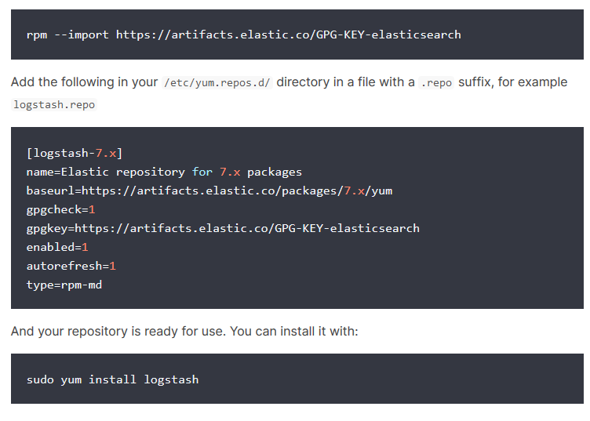
Logstash Installation
Logstash is one of the softwares inside the ELK stack. The main objective for this software is to convert NetFlow data into ElasticSearch acceptable format.

Slide 23
Configure Logstash to decode NetFlow
LS_HOME/bin/logstash-plugin install logstash-codec-sflow
LS_HOME/bin/logstash-plugin update logstash-codec-netflow
LS_HOME/bin/logstash-plugin update logstash-input-udp
LS_HOME/bin/logstash-plugin update logstash-filter-dns
Create a netflow.conf /etc/logstash/
input {
udp {
port => 2055
codec => netflow
}
}
output {
elasticsearch {
protocol => "http"
host => "127.0.0.1"
}
stdout { codec => rubydebug }
}
Complete instruction: https://www.elastic.co/guide/en/logstash/current/plugins-codecs-netflow.html

Slide 24
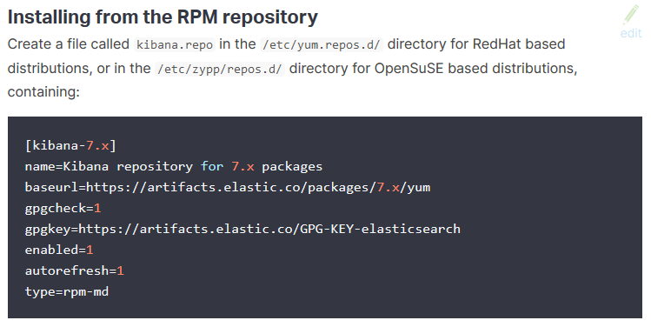
Kibana Installation
Kibana is one of the GUI tools that helps retrieve data from ElasticSearch. It can also come with the graphing capability to manipulate the Doc in ElasticSearch to be something more meaningful to system engineers.
sudo yum install kibana

Slide 25
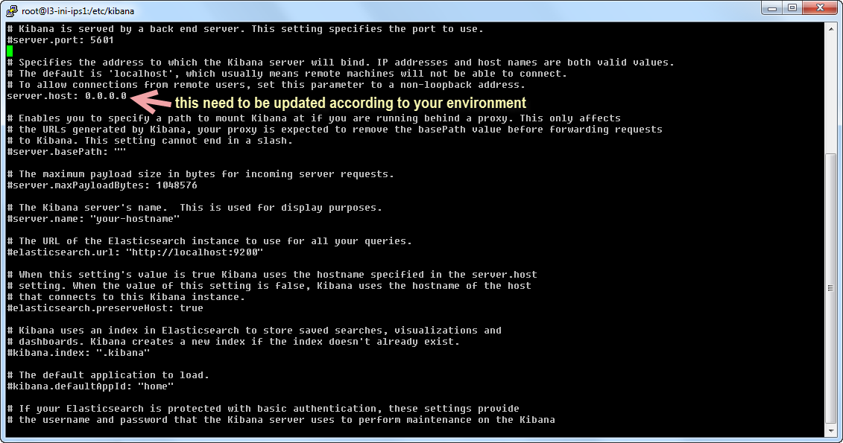
Kibana Configuration
Kibana does not listen to any IP besides 127.0.0.1;
you will need to update the configuration file to make the Kibana accessible from outside the host.
vi /etc/kibana/kibana.yml

Slide 26
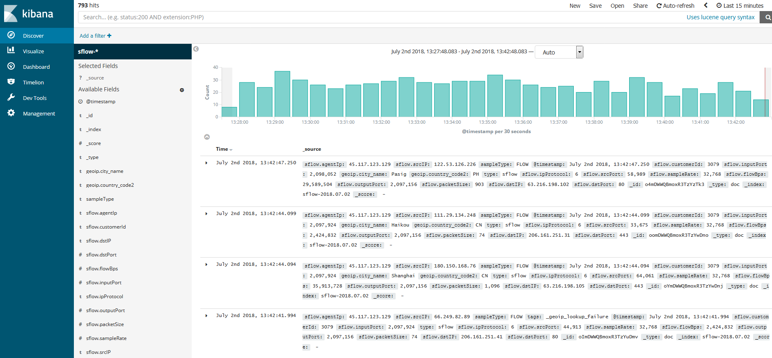
A quick look on the data stored in ElasticSearch
If the data is successfully collected by Logstash, this is what will be shown in Kibana:

Slide 27
How to query ElasticSearch
for top 10 IP talkers?

Slide 28
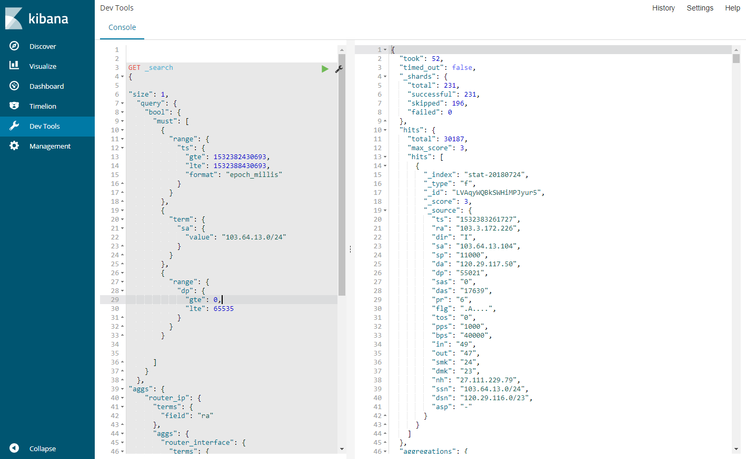
ElasticSearch has it’s own Query Language called Query DSL
Here is a sample query command for the IP range 103.64.13.0/24 at the specific time period. (formatted in epoch milliseconds)

Slide 29
Kibana is easy to use…
However, it’s still complicated for my NOC team
We make use of ElasticSearch Client API for PHP, to make a query interface so that they can do the job quicker and simplify the learning curve.

Slide 30
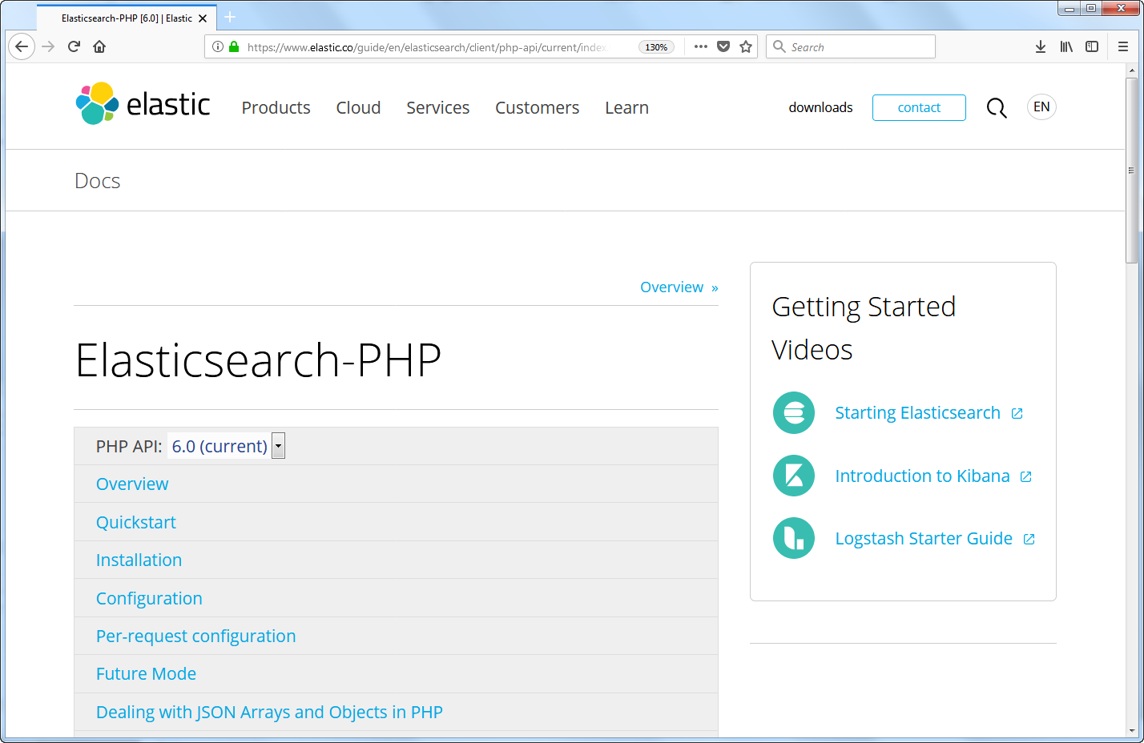
A PHP client to consume ElasticSearch

Slide 31
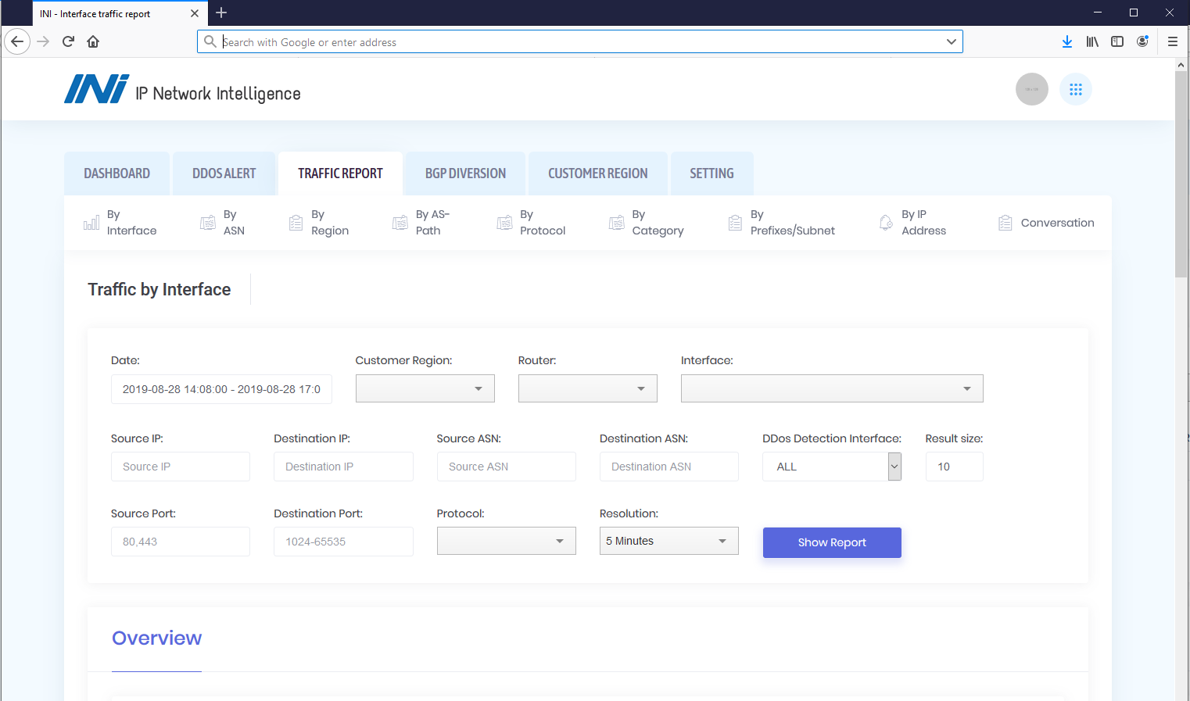
A Query screen for the NOC engineer

Slide 32
Samples
on how we use the NetFlow Data

Slide 33
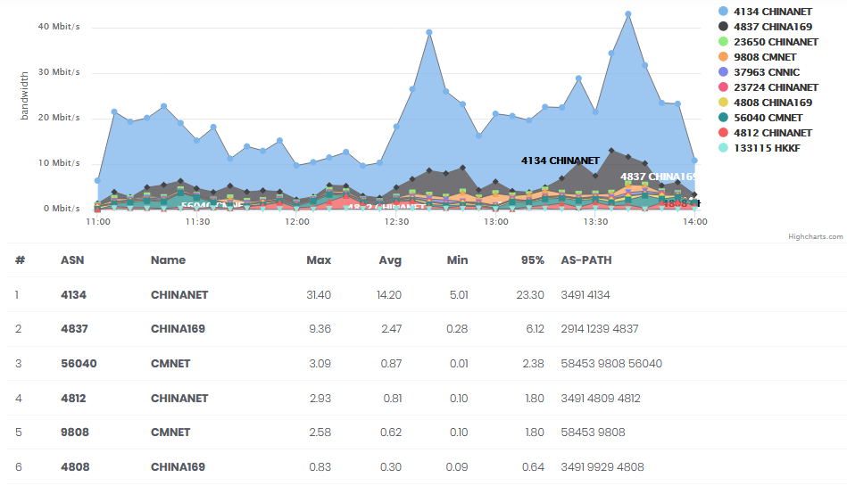
Outgoing traffic by ASN and it’s AS-PATH
This allows us to know which ASN the traffic flows; and helps us optimize the planning and traffic engineering according to AS Number.

Slide 34
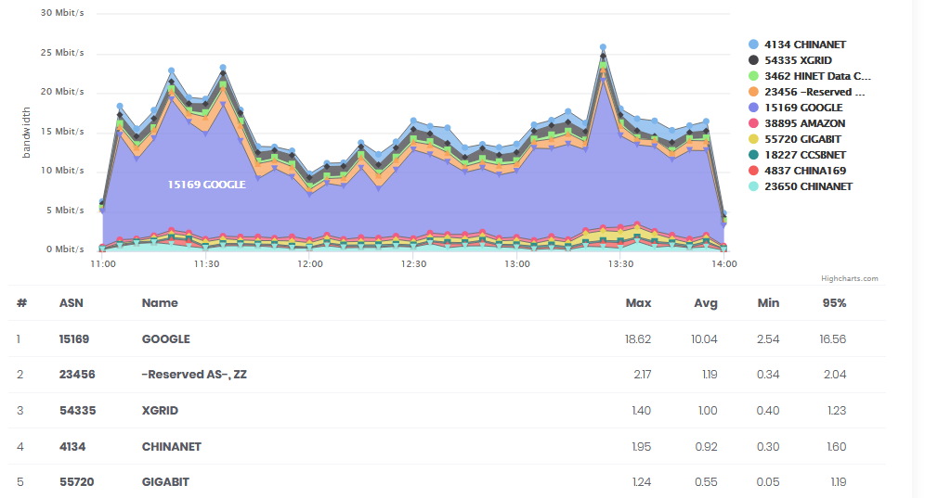
Incoming traffic by Source ASN
This is also helpful when it comes to traffic engineering

Slide 35
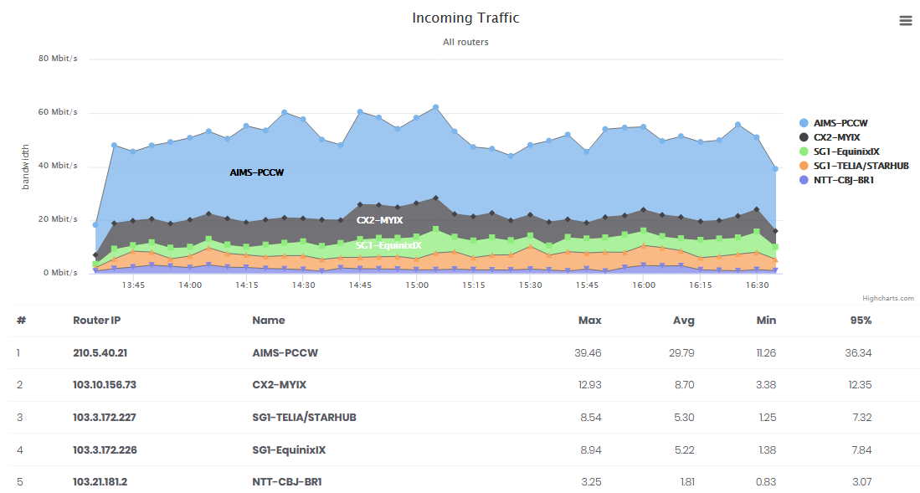
Identify customer traffic profile
Identify the estimated bandwidth cost for each customer.
See if the customer traffic utilization is more towards international or local bandwidth.

Slide 36
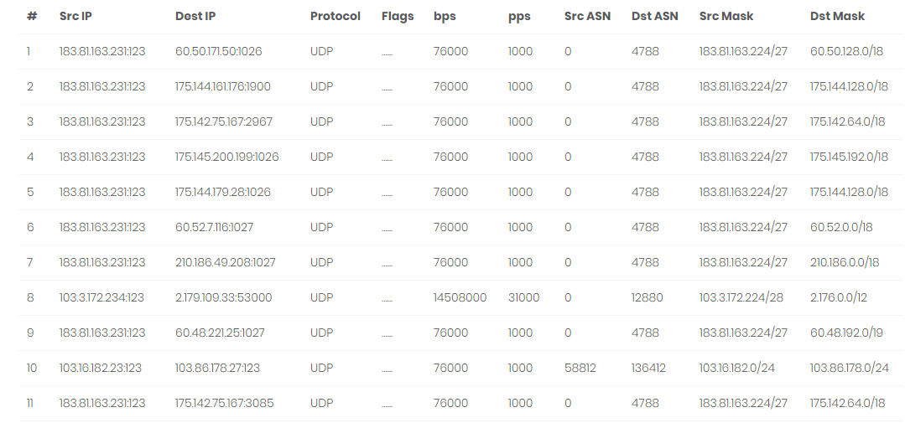
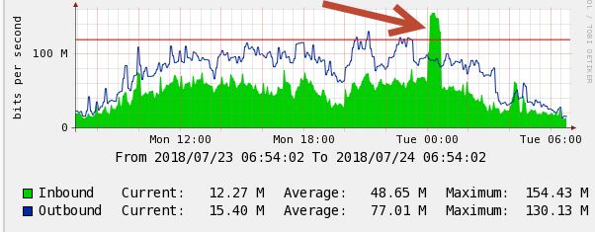
IP Conversation History
It’s something really useful for troubleshooting a network related issue, such as spamming activity, NTP attack within the network, and ability to identify the compromised host quickly.

Slide 37
We also use the Netflow information to do DDOS-Detection & Mitigation

Slide 38
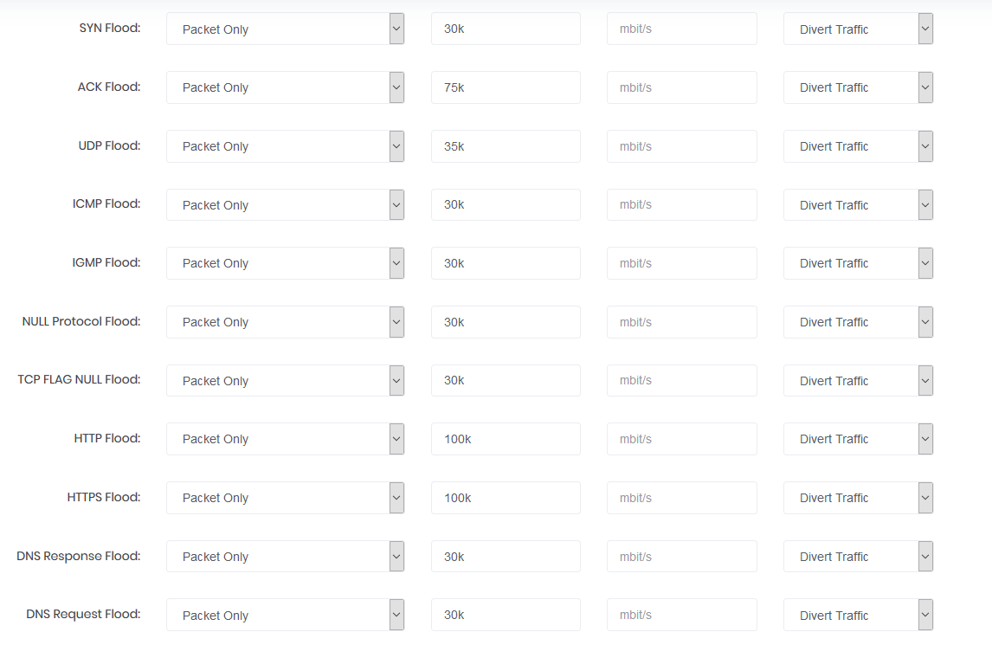
We wrote a utility (named INI) that analysize the netflow record; and when the threshold met, then the INI will trigger a BGP diversion

Slide 39


To mitigate the attack toward the victim IP.
We use BIRD routing daemon to communicate with our
Borders routers.
INI responsible for automating the script for
Bird to send BGP announcement go Router
BGP Route
advertisement
Scripted config
NetFlow Source
DDOS detection
BGP Route
advertisement

Slide 40
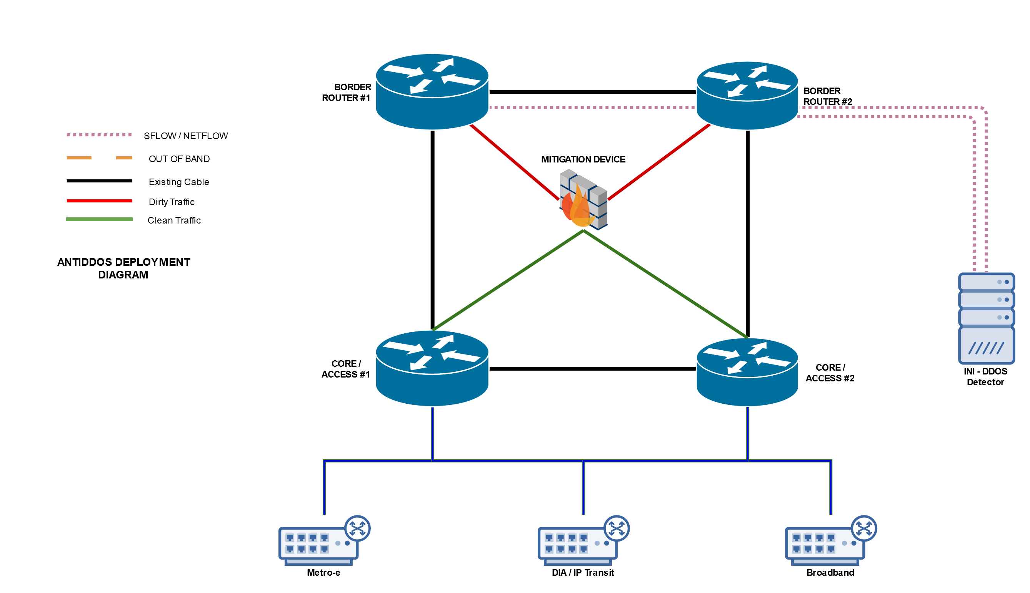
Mitigation Method #1,
Clean the DDOS attack locally on prem device
When Attack detected a /32 will be advertised, and next-hop to the mitigation device
DDOS detection

Slide 41
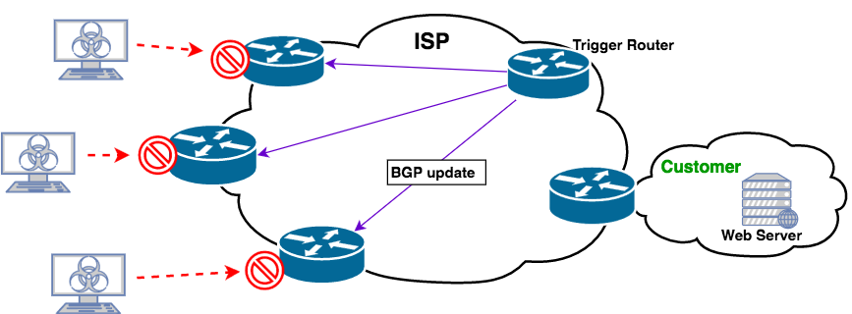
Mitigation Method #2,
Send a Remote Triggered Blackhole command
Or, it could trigger a remote blackhole
To the upstream provider
DDOS detection

Slide 42
2 of the trending pattern that we encountered.

Slide 43
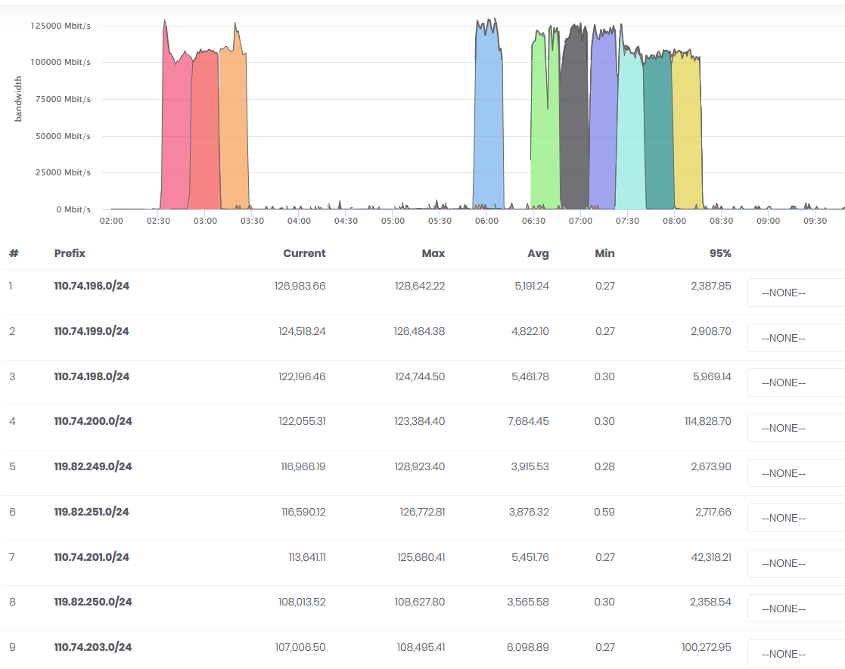
Trend #1: The attack is hitting all IPs in the subnet..
Every /24 is experience
> 120Gbit/s attack

Slide 44
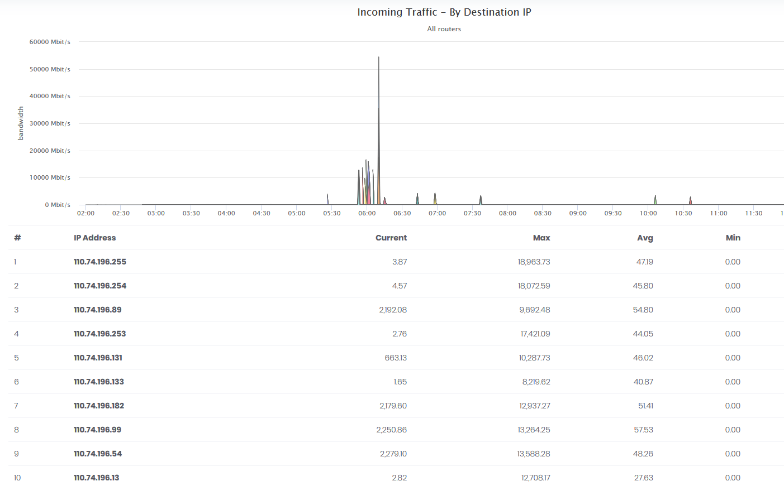
If we breakdown the usage by IP address by this subnet. We could see which IP is being hit between 8G – 19G

Slide 45
Trend #2: Carpet style attack
This attack method is crafted to send attack “below” the legitimate volume
Example:
If you allocate 1 fixed IP with 50Mbit/s for each customer
How the attack being done is.
They will attack
45Mbit/s to each of your IP address. The total attack traffic would be
256 IP x 45Mbit/s =11.5Gbi/s
In some cases, they will spread the attack over a /22

Slide 46
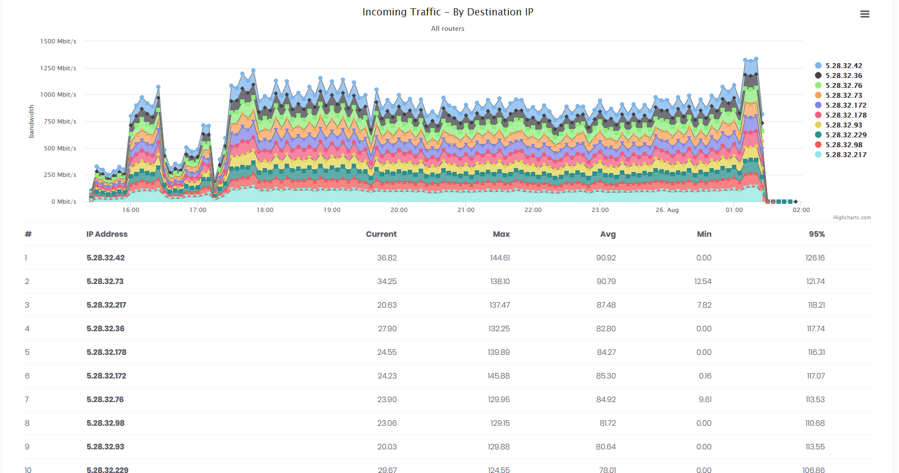
Carpet style attack

Slide 47
Summary
1) Netflow would be very useful for traffic engineering & Analysis.
2) Storing them into ELK stack for graph plotting Is not difficult, and it’s free with opensource tool

Slide 48

ANY
QUESTIONS?

Slide 49

Thank you
Your trusted cybersecurity partner
E-mail: cllee@ipdc.asia
www.ipdc.asia
ISO Certificate No:IS 651738

